Slide 1
DATA SCIENCE CAPSTONE · EDA & REGRESSION
Yes Bank Stock
Closing Price Prediction
A machine learning approach to forecasting monthly closing prices using historical OHLC data (2005-2020)
Prepared by: Harini S
M.Sc. Data Science · Individual Contribution

Slide 2

THE CHALLENGE
Problem Statement
Stock prices are volatile and shaped by many interacting market forces.
Yes Bank's price history spans a rally, a governance crisis, and a sharp collapse.
Manual trend-reading cannot reliably anticipate future closing prices.
A data-driven model is needed to quantify the Open-High-Low-Close relationship.
Goal: Analyze historical Yes Bank stock prices and build a regression model that accurately predicts the monthly closing price from Open, High, and Low.
Yes Bank Stock Closing Price Prediction
2

Slide 3




WHAT WE SET OUT TO DO
Project Objectives
Explore the Data
Engineer Leak-Free Features
Model & Compare
Deliver a Reliable Predictor
Understand trends, distributions and volatility in Yes Bank's OHLC history.
Build predictive signals without letting the target leak into inputs.
Train Linear Regression, Random Forest, and XGBoost regressors.
Select the model with the best accuracy and generalization for deployment.
Yes Bank Stock Closing Price Prediction
3

Slide 4
DATA FOUNDATION
Dataset Overview
185
5
Monthly Yes Bank stock prices from July 2005 to November 2020.
Columns: Date, Open, High, Low, and Close (all numerical, well-structured).
Data verified clean at the outset - no imputation or deduplication needed.
Date parsed to datetime and sorted chronologically for time-series integrity.
Monthly Records
Columns
0
0
Missing Values
Duplicates
Yes Bank Stock Closing Price Prediction
4

Slide 5



GETTING MODEL-READY
Data Preprocessing
Missing Values
Outliers
Categorical Encoding
Scaling
None found - no imputation required.
Detected via IQR/box plots; retained as genuine market volatility.
Not needed - all features are purely numerical.
StandardScaler applied (mean = 0, std = 1) for stable model training.
80:20 chronological train-test split - trains on early history, tests on unseen later months.
Dataset is a continuous regression target (Close price) - not a classification task, so class imbalance does not apply.
Yes Bank Stock Closing Price Prediction
5

Slide 6
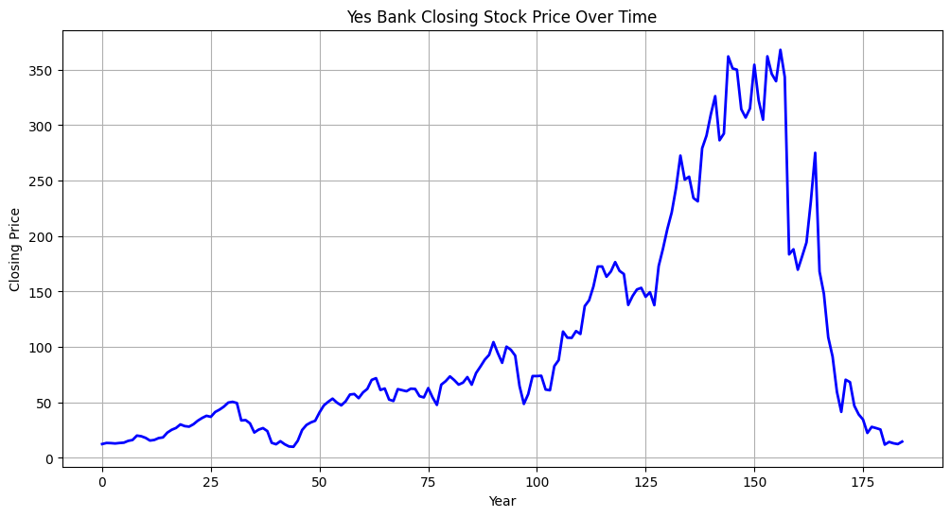
EXPLORATORY DATA ANALYSIS
Price Trends Over Time
Price climbs from ₹13 (Jul 2005) to an all-time high of ₹367.90 (Jul 2018).
Historic low of ₹9.98 hit in Mar 2009 during the global financial crisis.
From late 2018, price collapses sharply amid governance and asset-quality issues.
Three distinct regimes: early volatility, a 2009-2018 rally, and a post-2018 correction.
Yes Bank Stock Closing Price Prediction
6

Slide 7
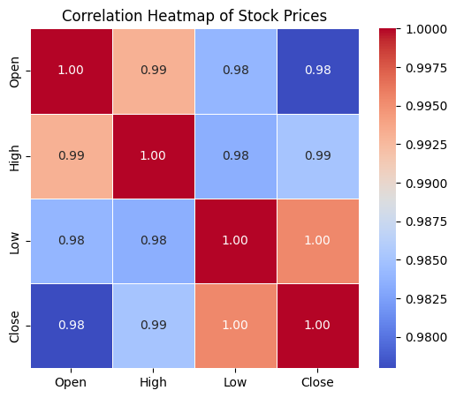
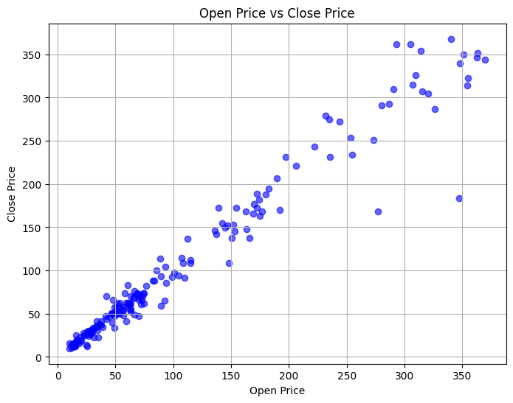
EXPLORATORY DATA ANALYSIS
Relationships Between Price Variables
All price pairs correlate above 0.97; Low-Close is strongest (≈0.995).
Open-Close correlation ≈0.978, confirming Open as a top predictor of Close.
High redundancy among Open, High, Low guided careful feature selection.
Yes Bank Stock Closing Price Prediction
7

Slide 8
BUILDING THE RIGHT SIGNALS
Feature Engineering
Open
Price_Range
Prior_Volatility
Strongest standalone linear signal for Close.
High - Low; captures the month's trading intensity.
Lagged 3-month rolling std. dev.; forward-looking, non-leaking.
MA_5 and Rolling_STD deliberately excluded - their windows include the current Close, causing target leakage.
Correlation-based feature selection removed highly redundant, overlapping predictors.
No categorical encoding, extra transformation, or dimensionality reduction needed - data was already compact and numerical.
Yes Bank Stock Closing Price Prediction
8

Slide 9


FROM DATA TO PREDICTIONS
Machine Learning Methodology
Scaled
Features
Train 3
Regressors
GridSearchCV
Tuning
Evaluate on
Held-Out Test
Select Best
Model
Three regressors trained on identical leakage-free features: Linear Regression, Random Forest, XGBoost.
GridSearchCV used for hyperparameter tuning with cross-validation on each model.
MAE, MSE, RMSE, and R² tracked consistently to compare models on the same held-out test set.
Yes Bank Stock Closing Price Prediction
9

Slide 10
COMPARING THE CONTENDERS
Model Performance
Linear Regression leads on both metrics; XGBoost is a close second; Random Forest trails.
Yes Bank Stock Closing Price Prediction
10

Slide 11
INSIDE THE WINNING MODEL
Prediction Results & Feature Importance
0.964
R² Score
17.92
RMSE (₹)
11.52
MAE (₹)
Open dominates the prediction; Price_Range has a smaller negative effect; Prior_Volatility contributes a minor adjustment.
Yes Bank Stock Closing Price Prediction
11

Slide 12
WHAT THE ANALYSIS SHOWED
Key Findings
Open, High, and Low are near-perfectly correlated (>0.97) with Close - strong, legitimate predictors.
Linear Regression (R² ≈ 0.964) outperformed both Random Forest and XGBoost on this dataset.
The Open-Close relationship is close to linear, so tree ensembles gained no real advantage.
Hyperparameter tuning did not improve any model - defaults already performed well on 185 rows.
Careful leakage prevention (excluding MA_5, Rolling_STD) was critical to trustworthy evaluation.
The stock shows three regimes: 2005-2009 volatility, a 2009-2018 rally, a post-2018 collapse.
Yes Bank Stock Closing Price Prediction
12

Slide 13
CONCLUSION
A Reliable, Interpretable Predictor
The project's objective was successfully achieved through systematic EDA, leakage-aware feature engineering, and model evaluation.
Linear Regression delivered the best balance of accuracy, generalization, and interpretability.
Final model explains about 96% of the variance in Yes Bank's monthly closing price (R² ≈ 0.96).
Historical OHLC data alone, handled carefully, is sufficient for strong short-horizon price prediction.
Final Model
Linear
Regression
R² ≈ 0.964
RMSE ≈ ₹17.92
MAE ≈ ₹11.52
Yes Bank Stock Closing Price Prediction
13

Slide 14

WHERE THIS CAN GO NEXT
Future Scope
Richer Features
Advanced Models
Longer Horizons
Deployment
Incorporate macroeconomic indicators, trading volume, and news sentiment.
Explore LSTM/GRU or ARIMA-family models for sequential dependence.
Extend from monthly to weekly or daily prediction granularity.
Serve the saved model via an API or dashboard for live forecasting.
Yes Bank Stock Closing Price Prediction
14

Slide 15
Thank You
Yes Bank Stock Closing Price Prediction | Harini S | M.Sc. Data Science

