Slide 1

DIGITAL PORTFOLIO
STUDENT NAME:HARINIK REGISTER NO ANDNMID:asunm1112401111033014
DEPARTMENT: BCA
COLLEGE: L.N. Government College,madrasuniversity

Slide 2

Intro
Project Title
Digital portfolio using front end web development

Slide 3

AGENDA
1.Problem Statement
2.Project Overview 3.End Users 4.Tools and Technologies 5.Portfolio design and Layout 6. Features and Functionality 7.Results and Screenshots 8.Conclusion 9.Github Link

Slide 4
PROBLEM STATEMENT
Intoday’s world,traditionalresumesandCVsareno longerenough.Recruiters and clients
want to see real work andpractical applications.Students oftenstruggle to present academic projects in aprofessional format.Job seekers need aplatform that goes beyond plain text documents.Many professionals lack a central place to highlight their skills and experience.A digital portfolio solves this gap by combining resumes, projects, and skills in one place.It also offers interactivity with visuals, animations, and structured content.Without a portfolio, opportunities may be lost due to weak first impressions.A modern portfolio can act as a digital identity card in academic and career growth. This project addresses the need for a personal branding solution

Slide 5

PROJECT OVERVIEW
1. This projectis aboutcreating a studentdigitalportfoliowebsite.
2. The pWorrtitfoeliyoo ius ratporpoifcesosrioidneaal, structured,andinteraWctriivtee wyeobusritteopicoridea
3.P Irte sbeentgatiniosns w ariet hco am mHuonmicaeti osne tcootliso tnha, tg civanin bge an introduction and call-to-action
used as lectures, speeches, reports,
4.d Temheon Astbraotiounts sanedc mtiooren. highlights career goals, personal details, and passions 5. The Skills section lists technical abilities like HTML, CSS, JavaScript, and Python 6. The Projects section showcases practical works such as Al chatbots, web apps, and
designs. 7. Each project is displayed in attractive with hover effects for visual appeal
8. The Contact section provides a form, email links, and social profiles. The website is
fully responsive, working smoothly on mobile and desktop. It acts as a professiona
digital identity, leaving a strong impression on recruiters and collaborators.

Slide 6
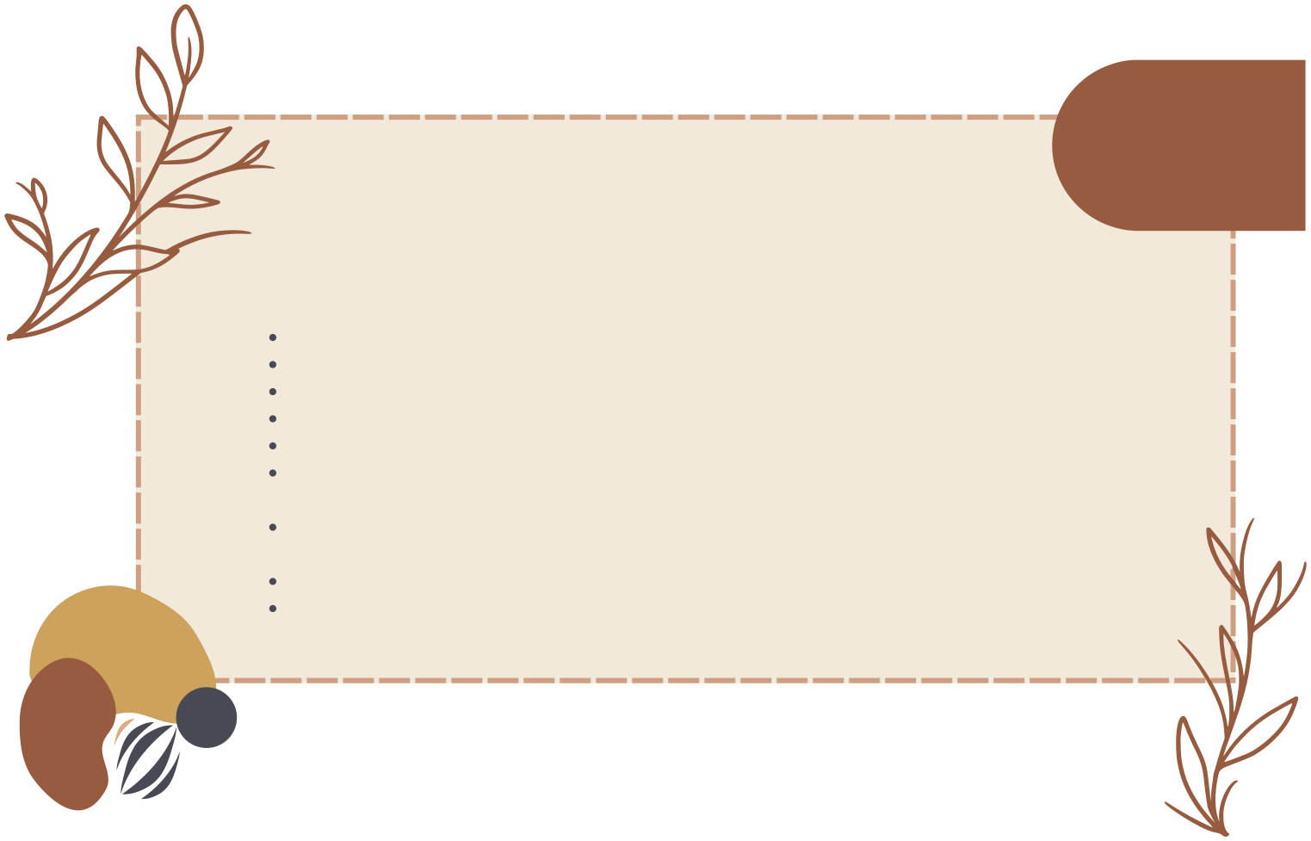
WHO ARE THE END USERS
Theportfolio is designedforawiderange of users
Students can use it to showcaseacademic projects, resumes,andskills Jobseekers can share theirportfoliolinks directlywithrecruiters Instead of long attachments,recruiterscan seework live onawebsite Freelancers can show completedprojects to attract clients. It acts as a project gallery, demonstrating creativity and professionalism. Professionals can highlight experience, skills, and achievements. It helps in building a personal brand for long-term growth End users gain a platform that makes them stand out in competition. The portfolio is useful for career, academic, and freelancing opportunities It en bcsures visibility and accessibility anytime, anywhere.

Slide 7

TOOLS AND TECHNIQUES
The portfolioisbuilt usingcore web developmenttools.
HTML providesthe structure of pages and sections. CSS adds styling, colors, layouts, and responsiveness foralldevices. JavaScript ensures interactivity such as navigation, animations, andform validatio The project uses modern coding practices for better performance. 7/11 Code editors like VS Code and CodePen were used for development. The portfolio is hosted on GitHub Pages / Netlify, making it globally accessable Responsive techniques ensure it works on mobiles, tablets, and desktops. Hover effects, smooth scrolling, and animations improve user experience. Together, these tools create a functional, attractive, and professional portfolio

Slide 8

POTFOLIO DESIGN AND LAYOUT
The design follows aclean andmodern layout.
The Home section welcomes visitorswith a professional intro. The About section shares career goals, skills, and aspirations The Skills section lists technical knowledge and tools used. The Projects section shows sample works with images and details. Each project card includes titles, descriptions, and live demo links. The Contact section provides a form and clickable links for communication. The design is fully responsive, ensuring accessibility on any screen. Smooth navigation allo visitors to reach sections easily. The layout creates a balanced mix of professionalism and creativity

Slide 9
FEATURES AND FUNCTIONALITY
1. Theportfolio provides easy navigationwith a cleaninterface.
2. Projects are displayed with visualappeal and animations. 3. It creates a memorable first impression for recruiters and clients. 4. Visitors can explore skills, projects, and achievements in one place. 5. The website works on all devices, from laptops to smartphones. 6. The contact form allows direct communication with potential employers. 7. It boosts professional credibility and builds trust with recruiters. 8. Users can share their portfolio link on Linkedin, email, and resumes. 9. The portfolio gives users a competitive advantage in applications.

Slide 10
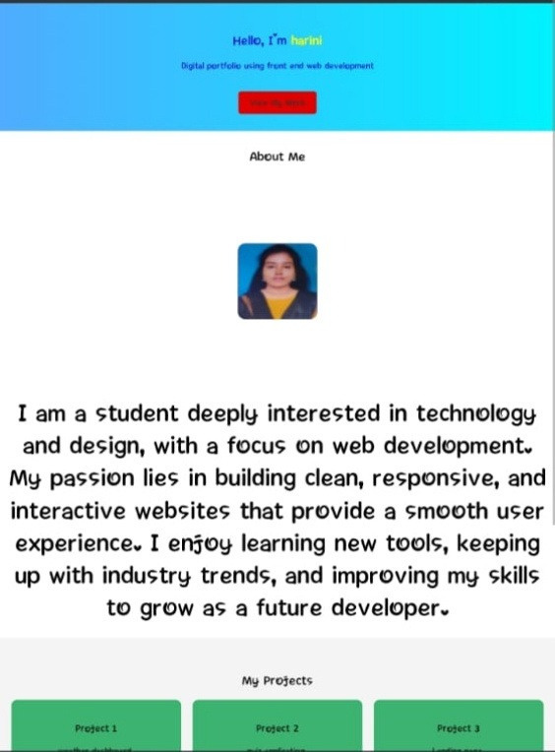
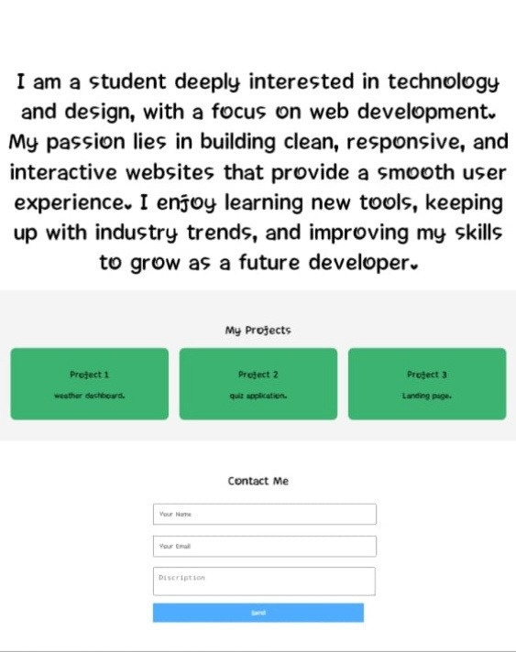
RESULTS AND SCREENSHOTS

Slide 11

Chapter 3
CONCLUSION
A digitalportfolioisamodern replacement fortraditional resumes.
It provides an interactive and professional identity. The project demonstrates knowledge of HTML, CSS, and JavaScript. It shows the ability to design and develop responsive websites. The portfolio highlights achievements, skills, and real-world projects It is useful for students, job seekers, freelancers, and professionals. Recruiters and clients gain confidence by seeing actual work samples. The portfolio boosts career opportunities and academic visibility. It leaves a lasting positive impression on potential employers. In conclusion, a digital portfolio is a gateway to success in the digital age

Slide 12
GITHUB link
https://github.com/Harini27032007/Myprofile1.git

