Slide 1


K.RAMAKRISHNAN COLLEGE OF TECHNOLOGY
(AUTONOMOUS), TRICHY.
EVENT SCHEDULING SYSTEM
PRESENTED BY
HARINI R
2303811710422054
SUPERVISOR
Mr. M. Saravanan, M.E.,
AP/CSE.

Slide 2
PRESENTATION OVERVIEW
Objective
Project Introduction
Problem Statement
Methodologies (Programming concepts relevant to problem statement)
Architecture of the proposed system
List of Modules
Merits
Results and Discussion
Queries

Slide 3
OBJECTIVE
To create a user-friendly solution for scheduling and managing events efficiently.
Automate task allocation, resource management, and timeline organization.
Provide real-time notifications and updates to ensure seamless coordination.
Integrate with external tools like calendars, emails, and productivity apps.
Offer customization options to cater to diverse event needs and preferences.
Deliver insightful analytics to track attendance, performance, and improvements.

Slide 4
PROJECT INTRODUCTION
An Event Scheduling System is a digital platform designed to streamline the planning, organization, and management of events. It automates the scheduling process by assigning dates, times, and resources, reducing manual effort and minimizing conflicts. By integrating real-time updates, reminders, and collaboration features, it ensures all participants stay informed and aligned. With added functionalities like calendar integration, customizability, and analytics, the system enhances productivity, optimizes resource utilization, and provides a seamless experience for both organizers and attendees.

Slide 5
PROBLEM STATEMENT
Managing events manually can be time-consuming, prone to errors, and inefficient, especially when dealing with overlapping schedules, resource conflicts, and last-minute changes. Traditional methods often lack real-time updates, effective communication, and proper integration with tools like calendars and emails, leading to mismanagement and reduced productivity. There is a need for a centralized, automated, and user-friendly solution to address these inefficiencies and deliver a streamlined event management experience.

Slide 6
METHODOLOGIES
Object-Oriented Design (OOD):
Use object-oriented principles like encapsulation, inheritance, and polymorphism to design reusable and modular components for event handling and user interaction.
Data Modeling:
Design a database schema to manage event data effectively, ensuring normalization to eliminate redundancy and ensure efficient data retrieval.
Documentation and Maintenance:
Create detailed documentation for both developers and users, ensuring ease of understanding and future system maintenance.

Slide 7
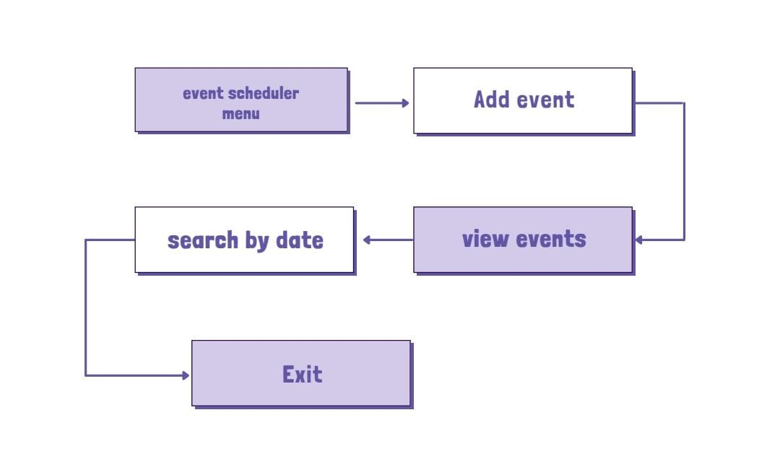
ARCHITECTURE OF THE PROPOSED SYSTEM

Slide 8
LIST OF MODULES
MODULE DESCRIPTON
Event Management Module:
An Event Management Module is a software solution designed to organize, plan, and execute events efficiently. It includes features for event scheduling, attendee registration, ticketing, venue management, and marketing. Additionally, it provides tools for collaboration, communication, and post-event reporting to streamline the entire process.
Add event module:
To add an Event Management Module, define the required features like registration, ticketing, and venue management, ensuring compatibility with your platform. Choose between custom development or integrating third-party solutions like Eventbrite or WordPress plugins. Finally, implement and test the module for seamless functionality and user experience.

Slide 9
Search event module:
A Search Event Module is a feature in event management systems that allows users to find specific events based on criteria such as date, location, event type, or keyword. It simplifies navigation for attendees and administrators, ensuring they quickly locate relevant events. Advanced search modules often integrate filters, tags, and real-time updates to enhance user experience
Exit module:
An exit module facilitates smooth transitions when users leave a system, app, or event. Common applications include website pop-ups for feedback or offers, employee offboarding tools for exit interviews and access revocation, or event systems to collect attendee feedback post-exit. It enhances user experience and gathers valuable insights

Slide 10
MERITS
Time Efficiency: Automates scheduling and resource allocation
reduce manual effort and saving time.
Cost Savings: Reduce reliance on manual processes minimizing errors and associating costs.
Smart Scheduling: Prevent overlapping events and double booking using algorithms

Slide 11
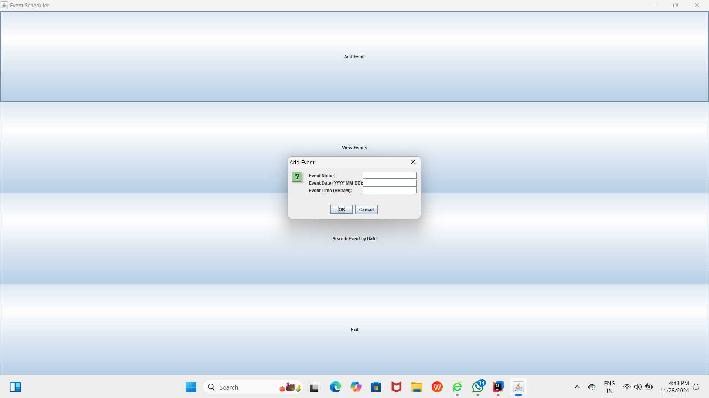
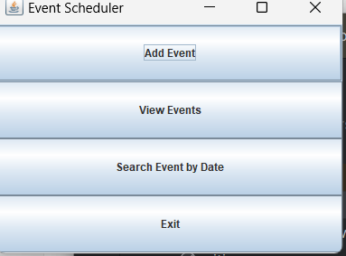
RESULTS AND DISCUSSION

Slide 12
QUERIES ?

