Slide 1

Edu2Job: Predicting Job Roles from Educational Background
Bridging Education to Employment with AI
- M Harini

Slide 2


The Problem: Navigating Career Uncertainty
Career Confusion
75% of graduates face significant uncertainty about their career paths.
Skill Gap
Disparity between academic skills and industry demands.
Lack of Guidance
Limited personalized career counseling resources.
Rising Unemployment
Qualified graduates struggle to find suitable employment.

Slide 3



Our Solution: Edu2Job
AI-Driven Platform
Leveraging advanced AI for precise predictions.
Personalized Recommendations
Tailored job roles based on individual profiles.
Skill Gap Analysis
Clear roadmaps to bridge education to employment.

Slide 4







Key Objectives Achieved
1 Accurate ML Model
Developed a robust prediction model with 92% accuracy.
2
Intuitive User Interface
Ensuring a seamless and engaging user experience.
3
Secure Dual Authentication
Implementing JWT and Google OAuth for enhanced security.
Comprehensive Admin Dashboard
Centralized management for system administrators.
Model Retraining Capabilities
Ensuring continuous improvement and adaptability.
6
Personalized Career Insights
Providing actionable guidance to users.

Slide 5
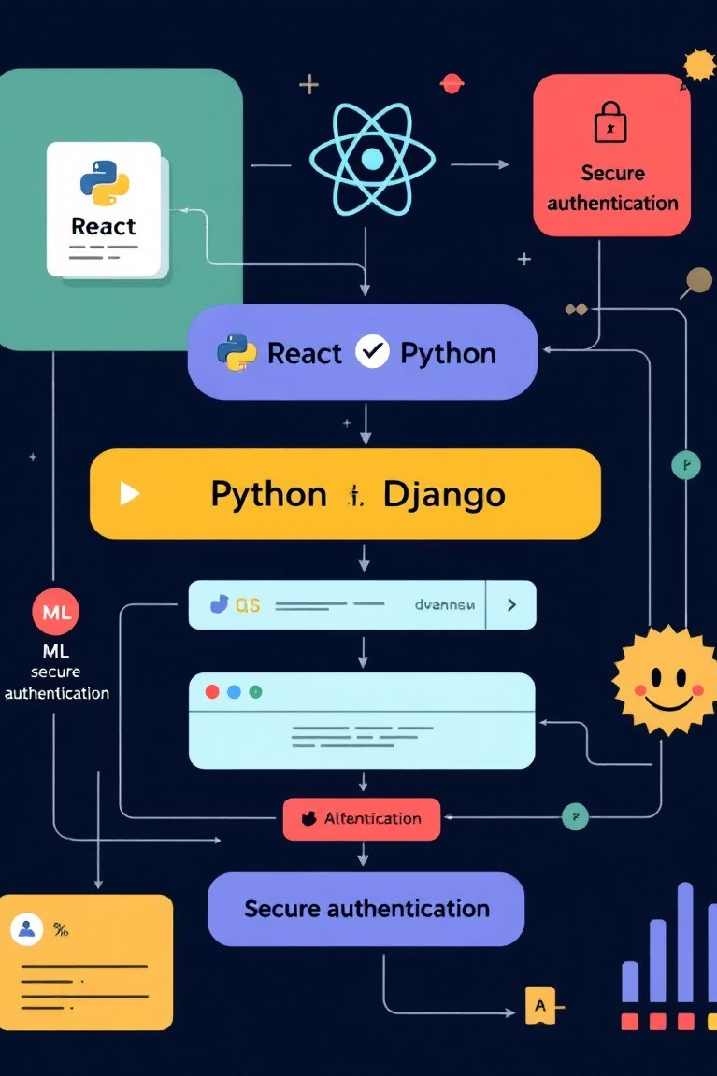
Technology Architecture
Frontend
React.js with Hooks
Tailwind CSS + Framer Motion
Database
SQLite
AI/ML
Scikit-learn (Random Forest)
Backend
Django REST Framework Python 3.9+
Security
JWT Authentication Google OAuth 2.0

Slide 6
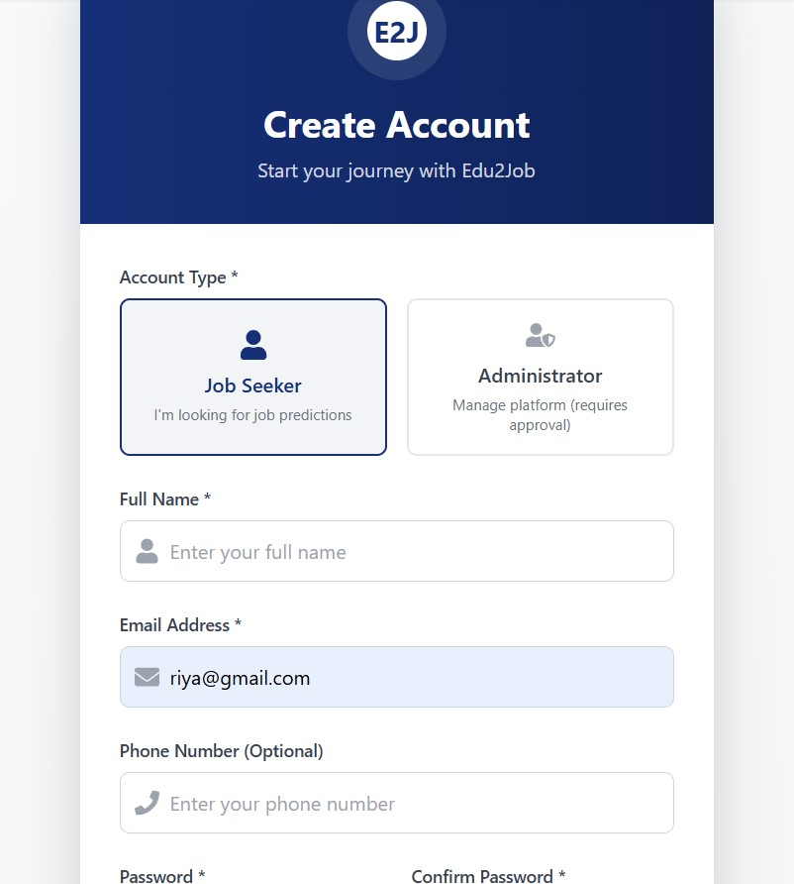

User Authentication & Profile Management
MILESTONE 1
1
2
Secure Onboarding
Robust registration and login processes.
Profile Creation
Users build comprehensive personal and academic profiles.
3
Data Privacy
Ensuring confidentiality and protection of user data.

Slide 7
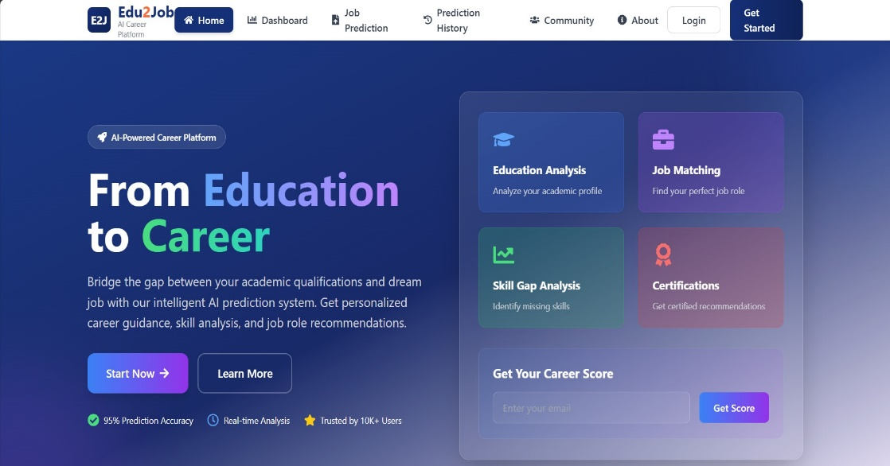
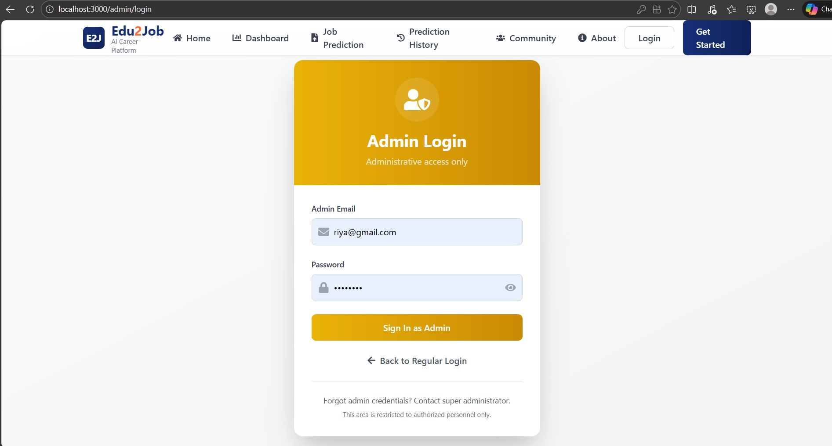

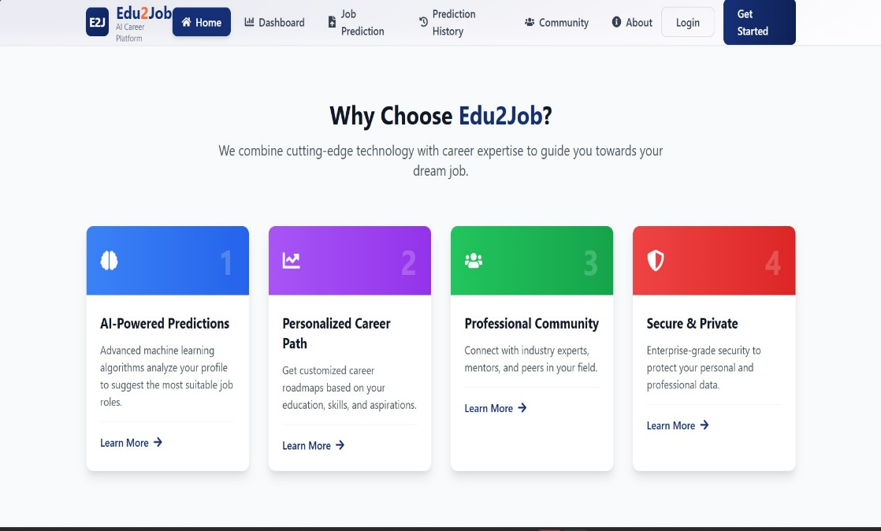

Slide 8








Education Details Input & Preprocessing Module
MILESTONE 2
Academic Data Capture
Structured input for courses, grades, and qualifications.
Data Cleaning
Automated processes for consistency and accuracy.
Feature Engineering
Transforming raw data into meaningful ML features.

Slide 9
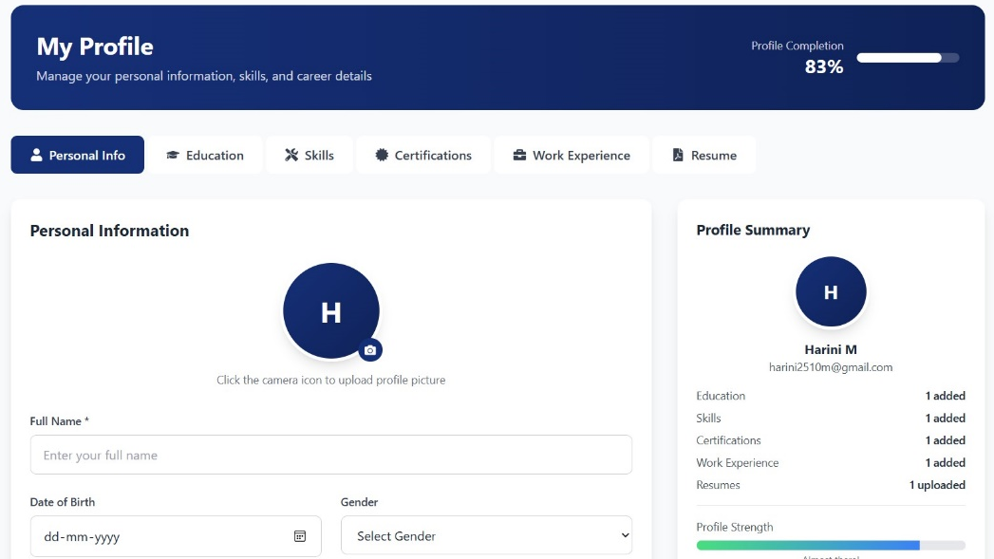
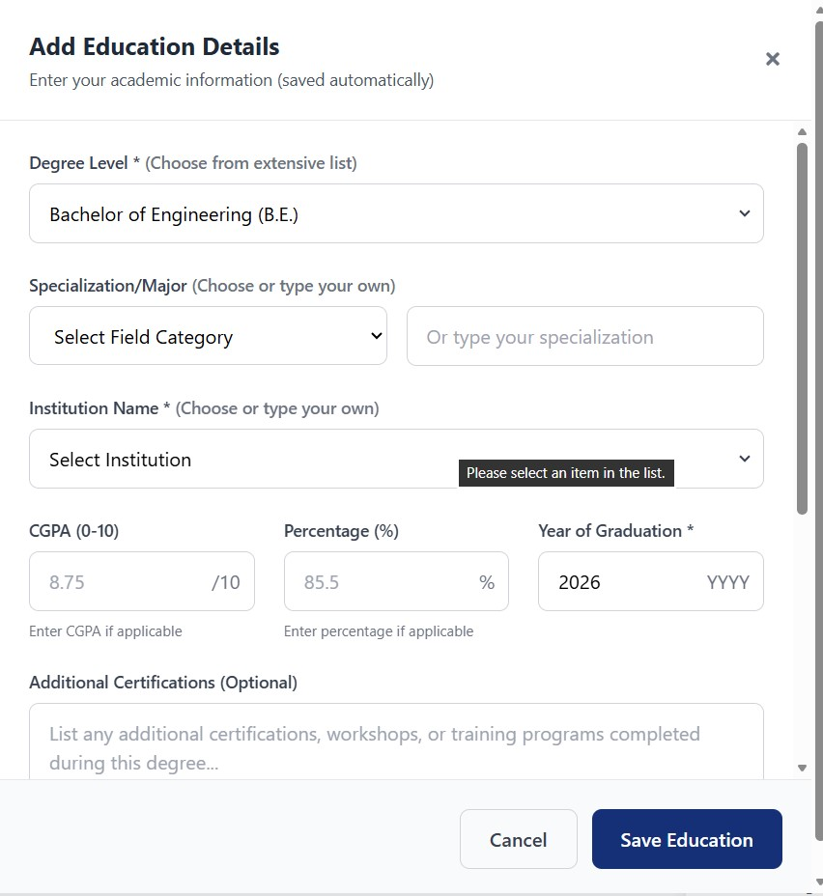
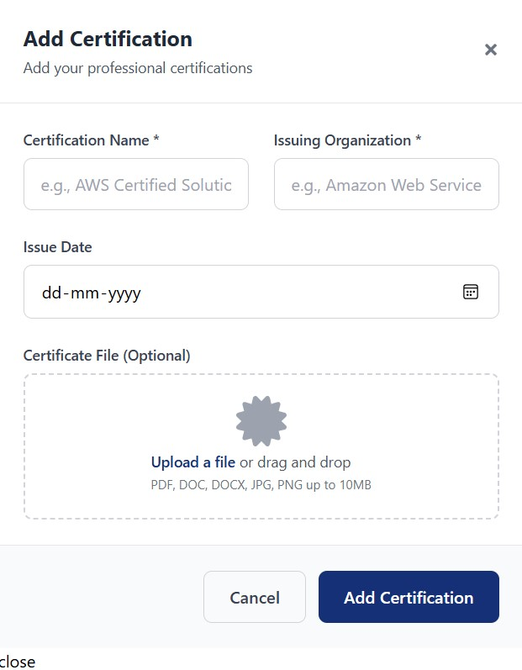
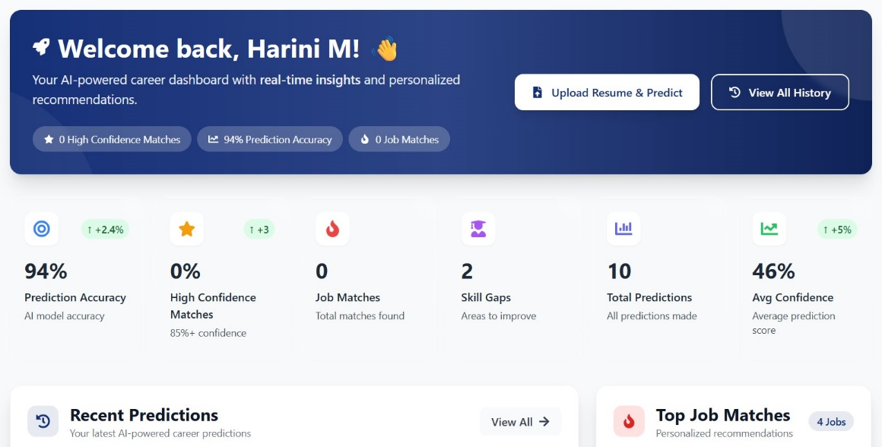

Slide 10







Job Role Prediction Module
MILESTONE 3
User Data Integration
Feeding processed education and profile data.
ML Prediction Engine
Utilizing Random Forest for career forecasting.
Personalized Recommendations
Generating relevant job role suggestions.

Slide 11
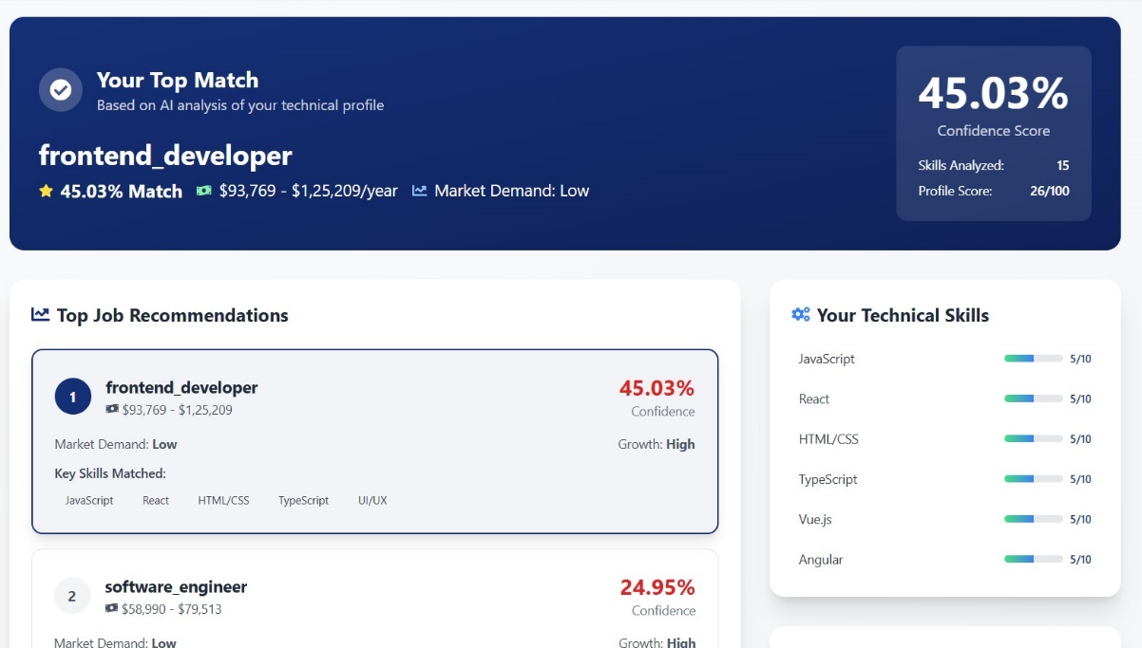
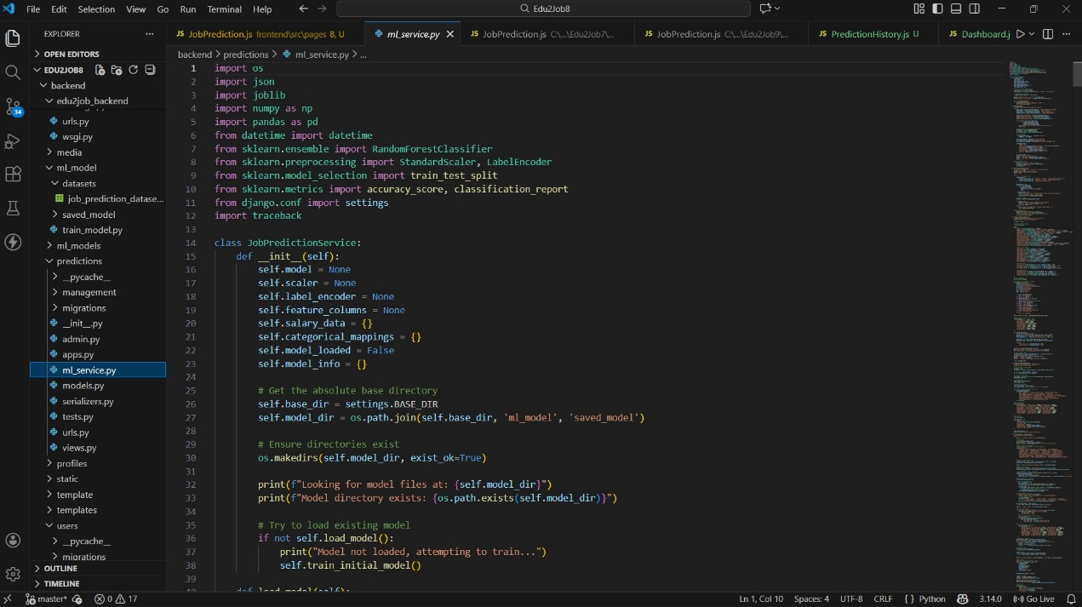
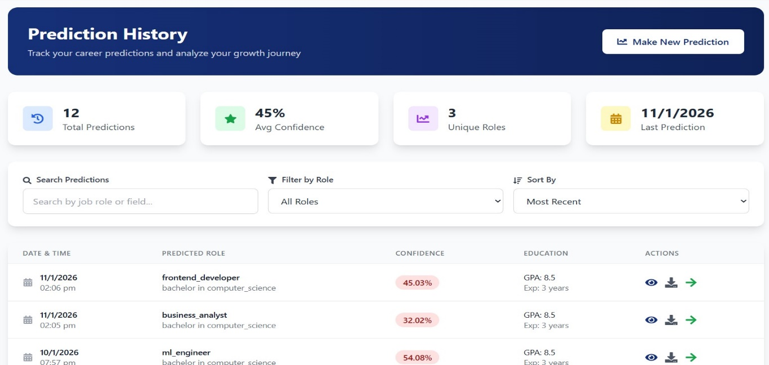

Slide 12
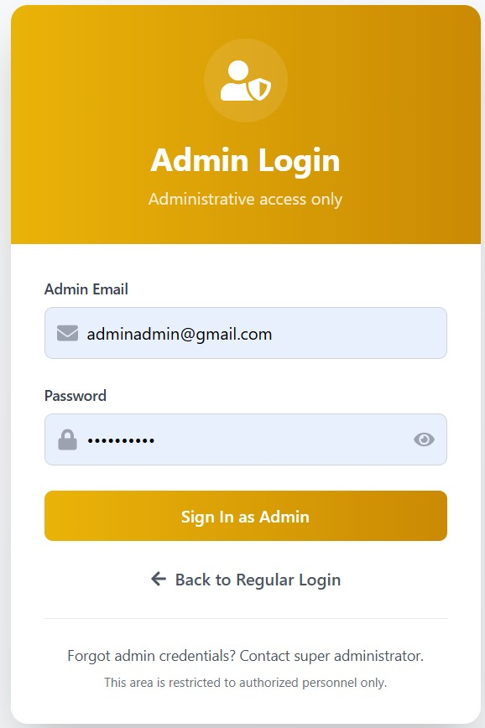
Admin Dashboard & Model Management
MILESTONE 4
User Management
Data Monitoring
Model Performance
Retraining Control
System Analytics
Content Updates

Slide 13
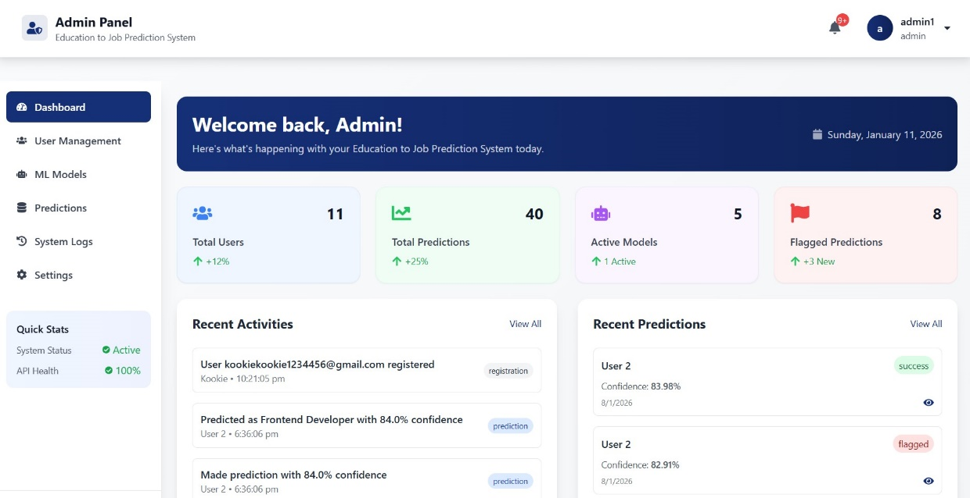
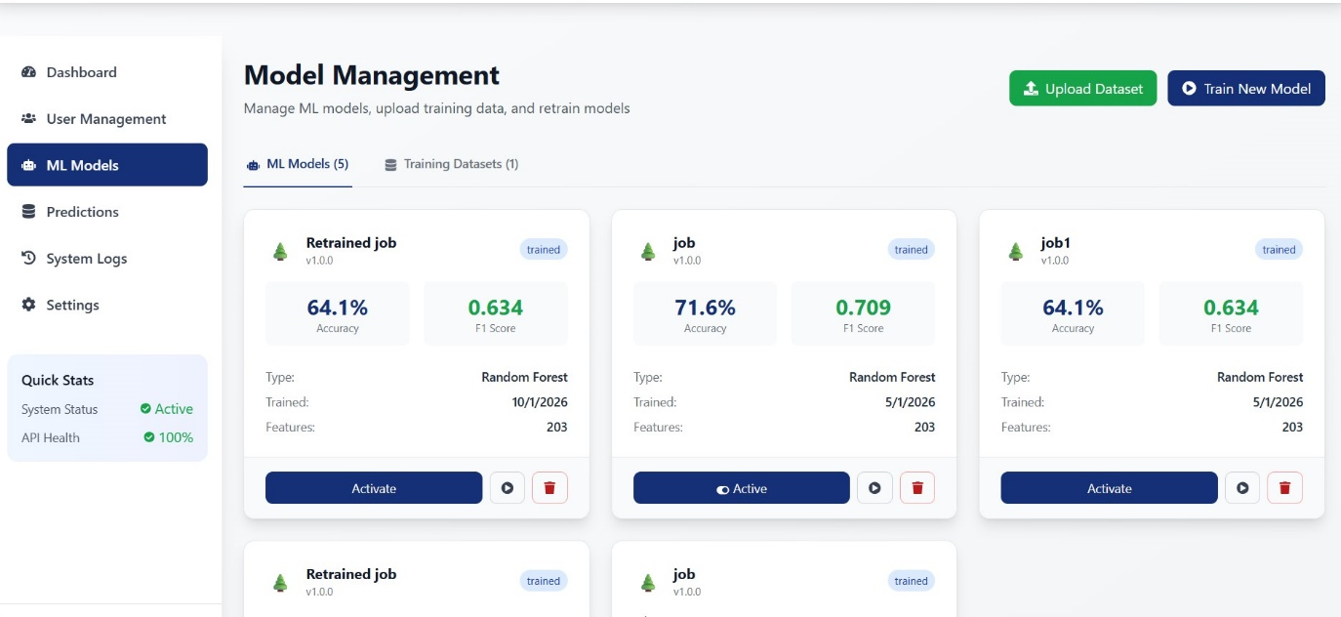
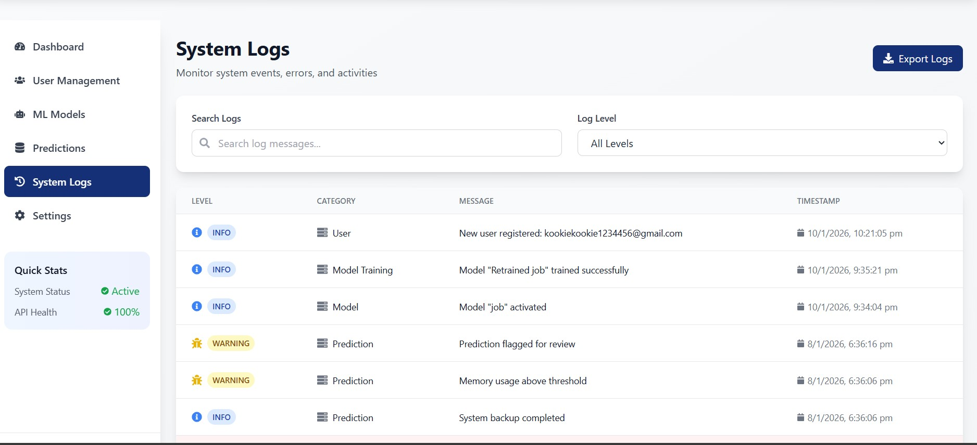

Slide 14


Performance Metrics
92%
Prediction Accuracy
Highly reliable career path suggestions.
< 2s
Response Time
Instant feedback and recommendations.
4.7/5
User Interface Score
Exceptional usability and satisfaction.
99.9%
System Uptime
Consistent availability and reliability.

Slide 15





Future Enhancements: Scaling Impact
Mobile Application
Reach a wider audience on-the-go.
Advanced ML Models
Integration of Neural Networks for deeper insights.
Company Partnerships
Connecting users directly with employers.

Slide 16


