Slide 1


SMART BANK LOAN MANAGEMENT AND AUTOMATION SYSTEM
A Low-Code Application built using Zoho Creator
LOW-CODE APPLICATION DEVELOPMENT USING ZOHO CREATOR
Presented By
HARINI NAGARAJAN
240701167
Notes:
Introduce the project: Smart Bank Loan Management and Automation System, built for the course CB23F35 Low-Code Application Development using Zoho Creator. Presented by Harini Nagarajan, roll number 240701167.

Slide 2




Problem Statement
Scattered records
Banks handle a large number of loan enquiries and applications. In many branches, applicant details, documents, approvals, disbursements and EMI repayments are kept in separate registers and spreadsheets.
As a result, a loan’s complete status is hard to find, wrong entries such as a zero loan amount are not caught, pending approvals and overdue EMIs are missed, and anyone with the file can change records.
A single, automated and role-controlled loan system is therefore needed.
No validation at entry
Missed reminders
No access control
Notes:
Explain the manual loan process and its four main pain points: scattered records, no validation at entry, missed reminders and no access control.

Slide 3
Abstract
The Smart Bank Loan Management and Automation System is a low-code application built on Zoho Creator to manage the whole loan lifecycle: branches, applicants, enquiries, loan applications, document verification, approval, disbursement and EMI repayment.
Workflows validate entries, set statuses and send emails. Schedules mark overdue EMIs and send reminders. Approvals and a Blueprint control decisions, and AI fields analyse sentiment, read salary slips and detect objects in photos.
Reports and dashboards give a single live view of loans and repayments.
10
18
14
5
Forms
Reports
Workflows
AI fields
Notes:
Summarise the system in one minute. The four numbers: 10 forms, 18 reports, 14 workflows (7 form workflows, 4 schedules, 2 approvals, 1 Blueprint) and 5 AI fields.

Slide 4


Existing vs Proposed
Existing System
Proposed System
Records in registers and spreadsheets
No validation when data is entered
Approvals pass through paper files
EMI dues tracked by hand
No role-based access control
Ten linked forms in one cloud app
Scripts reject invalid entries
Level 1 approval with email updates
Automatic Paid / Overdue EMI status
Roles and permission profiles
Notes:
Compare the manual process with the Zoho Creator system, point by point.

Slide 5
Objectives
1
2
3
Design ten forms covering the full loan lifecycle
Automate validation, status updates and emails
Control decisions with approvals and a Blueprint
4
5
6
Schedule overdue marking and reminders
Add AI: sentiment, OCR and object detection
Provide reports, dashboards and role-based access
Notes:
Read the six objectives. They map to the forms, workflows, approvals, schedules, AI fields and reports in the project report.

Slide 6
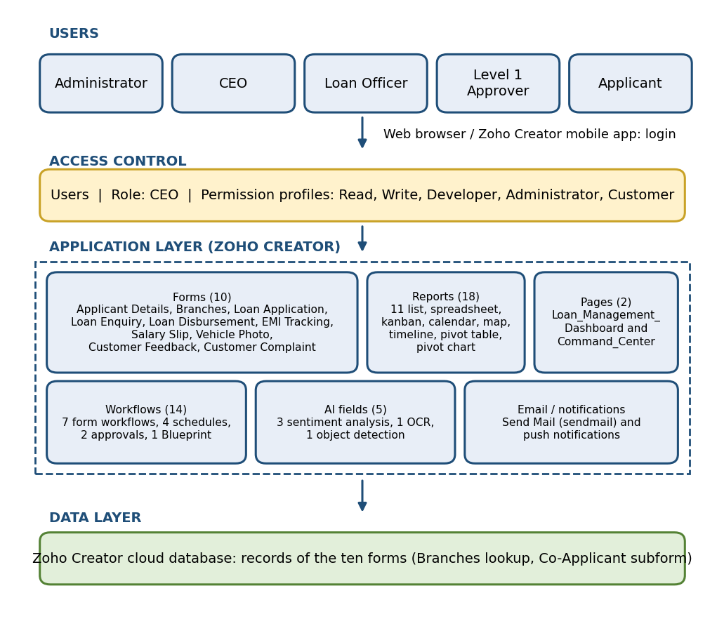



Architecture Diagram
Users and Access
Five user types, controlled by roles and permission profiles.
Application Layer
Ten forms, 18 reports, two pages, workflows, approvals, Blueprint and AI fields.
Data Layer
Zoho Creator cloud database with a Branches lookup and a Co-Applicant subform.
Notes:
Walk through the architecture from top to bottom: users and roles, then the application layer, then the cloud data layer.

Slide 7




Key Modules
Branches and Applicants
Loan Application
Verification
Branch master with IFSC and manager; applicant profile with income and credit score.
Branch lookup, co-applicant subform, address map, signature and QR code.
Salary slip OCR and vehicle photo check with object detection.
10 forms
18 reports
2 dashboards
Disbursement and EMI
Enquiry and Feedback
Blueprint for disbursement and automatic EMI status.
Loan enquiries, customer feedback and complaints with sentiment.
Notes:
Five groups of forms. The green card summarises the totals: 10 forms, 18 reports and 2 dashboards.

Slide 8



Automation and AI
Form Workflows (7)
Schedules and Approvals
Blueprint and AI
Validate loan amount and rate
Set EMI status automatically
Set disbursement status
Autofill disbursement date
Welcome email to applicant
Daily: mark overdue EMIs
Daily: EMI due in 3 days mail
Weekly: pending-loan reminder
Loan application approval
EMI payment approval
Blueprint: Pending, Processing, Disbursed
Sentiment on feedback and complaints
OCR on salary slips
Object detection on vehicle photos
Notes:
Seven form workflows, four schedules, two approvals, one Blueprint and five AI fields. The schedules run in the Asia/Kolkata time zone.

Slide 9
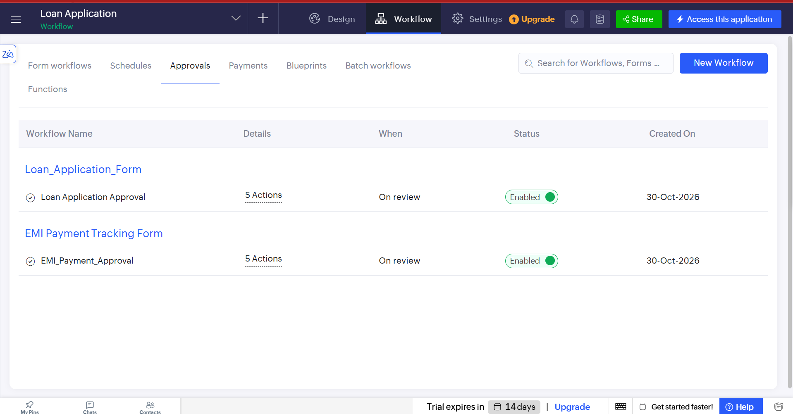
Implementation and Output
Platform
Zoho Creator, a cloud low-code platform
Logic
Deluge scripts: 10 in workflows and schedules
Data
10 forms, Branches lookup, co-applicant subform
Approvals: Loan Application Approval and EMI_Payment_Approval, both enabled
Email
Deluge sendmail and approval notifications
creatorapp.zoho.in/harininagarajan.2024.cse1592/loan-application
Notes:
Implementation facts on the left. The screenshot shows the two approval workflows enabled in the Workflow tab. Replace or add more screenshots (dashboard, reports) if needed.

Slide 10

Thank You
HARINI NAGARAJAN
Roll Number: 240701167
Smart Bank Loan Management and Automation System
Low-Code Application Development using Zoho Creator
Notes:
Thank the audience and invite questions.

