Slide 1
LOAN Dataset
Harini B
DataAnalyst - 01

Slide 2
Project Workflow
Creating three .py files
Executing these files in .ipynb file
Visualizing the outputs

Slide 3
OVERVIEW OF THE DATASET
Loan id
No of dependents
Education
Self employed
Income annum
Loan amount
Loan term
Cibil score
Residential assests value
Bank assests value
Loan status

Slide 4
APPENDING TO SQL
import MySQLdb - interact with MySQL databases using Python code.
import pandas as pd - data manipulation and analysis
From sqlalchemy import create_engine - create a connection engine for interacting with various types of SQL databases
Connect to a MySQL database using MySQLdb.
Retrieve data from the database and store it in a pandas dataframe for analysis and manipulation

Slide 5
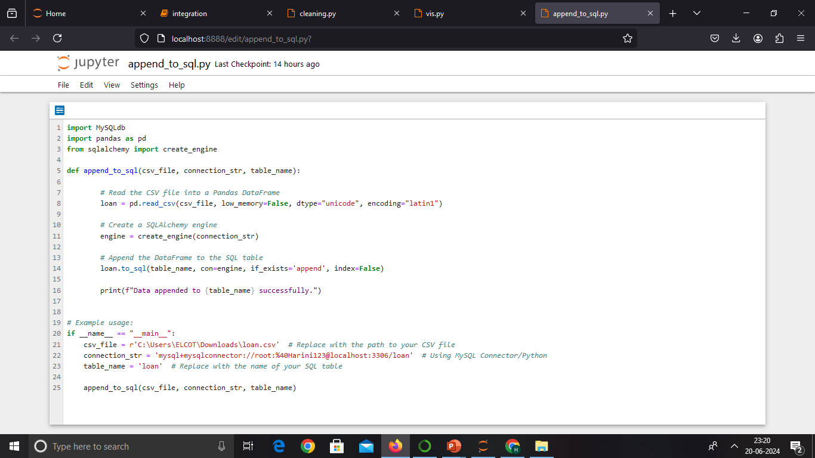
Append to SQL

Slide 6
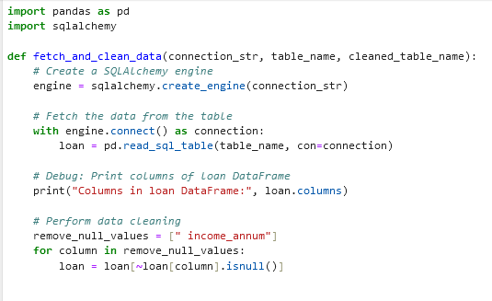
CLEANING

Slide 7
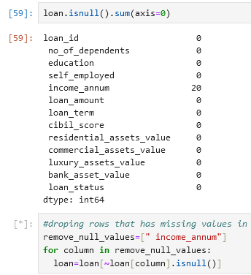
HANDLING MISSING VALUES

Slide 8
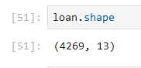
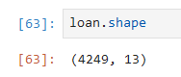
SHAPE OF THE DATASET
cleaned data appended to a new table

Slide 9
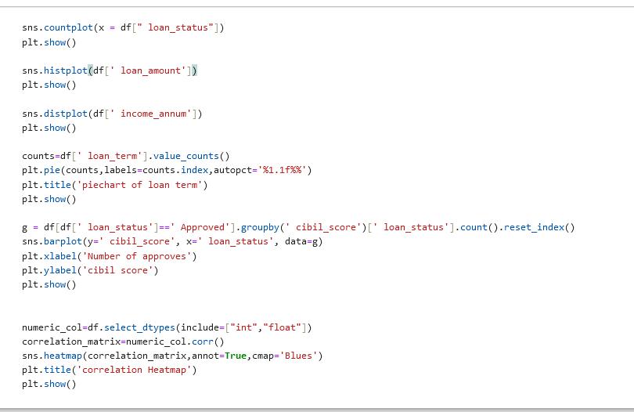
VISUALIZATION

Slide 10
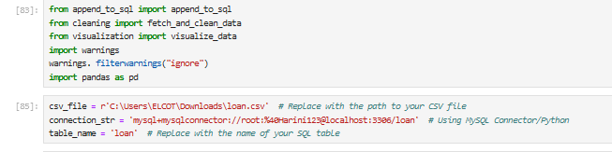
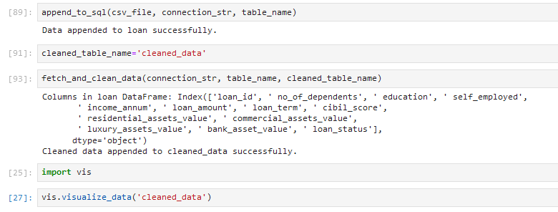
Execution

Slide 11
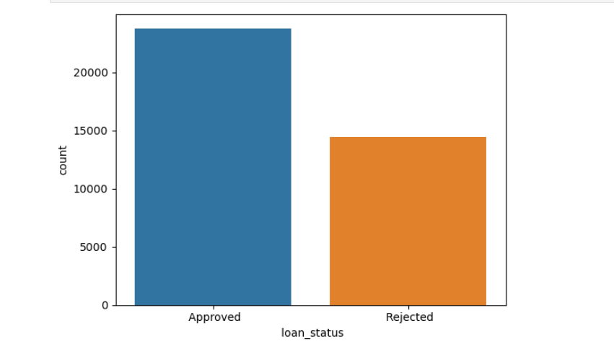
VISUALIZATION

Slide 12
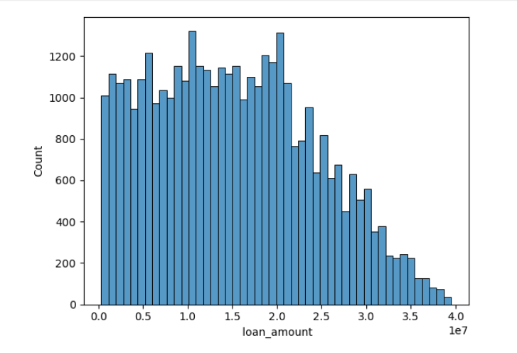
Histogram of loan amount (count decreases with larger loan amount)

Slide 13
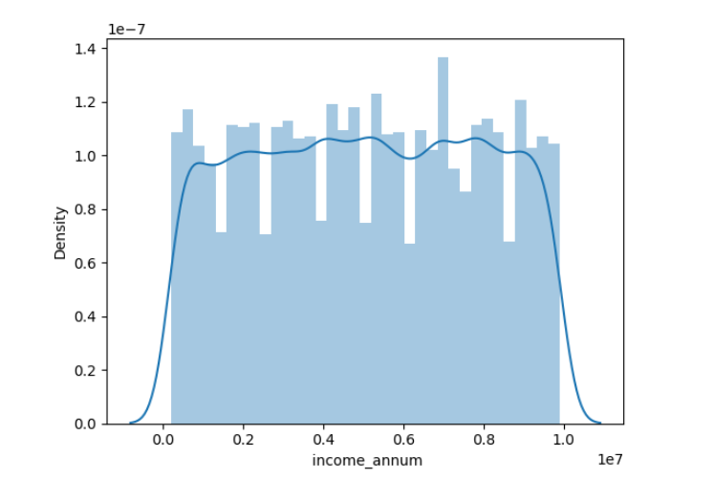
Income annum is evenly distributed

Slide 14
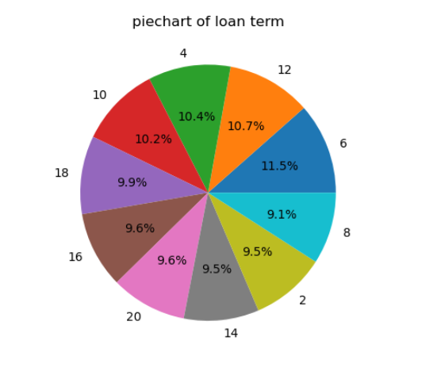
Loan term is almost equally distributed in terms of years

Slide 15
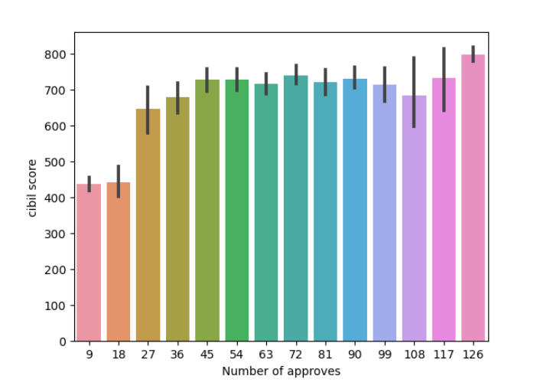
Number of approves increases when the cibil score increases

Slide 16
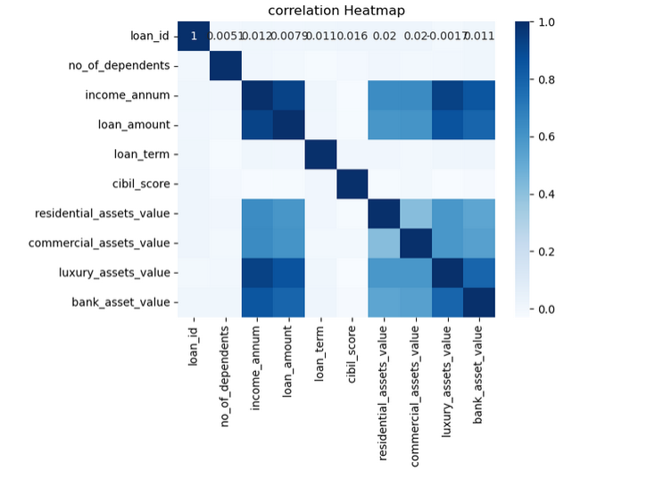
Income annum and loan amount are highly correlated

Slide 17
THANK YOU!

