Slide 1



Time Spent on Social Media
HARINI B
DATA ANALYTICS
BATCH – 01

Slide 2
INTRODUCTION
This dataset captures user profiles across various social media platforms, detailing demographic information, interests, and personal attributes. It aims to provide insights into social media usage patterns and consumer behavior based on user characteristics.

Slide 3
ABSTRACT
The dataset includes variables such as
Age
Gender
Time spent on different platforms
Demographic details.
Analysis will focus on identifying trends in social media usage and preferences among different user groups, providing actionable insights for targeted marketing and engagement strategies.

Slide 4
TOOLS and METHODS USED
Data Import and Transformation:
Import the dataset from various sources (Excel, CSV, etc.) and perform data cleaning, transformation
Data Visualization:
Visualizations: Use various chart types to represent the data.
Slicers and Filters: Add slicers to filter data by age, gender, location, or platform.

Slide 5
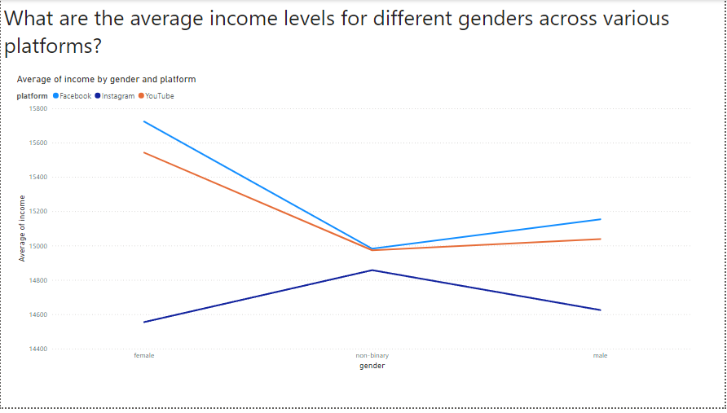

Slide 6
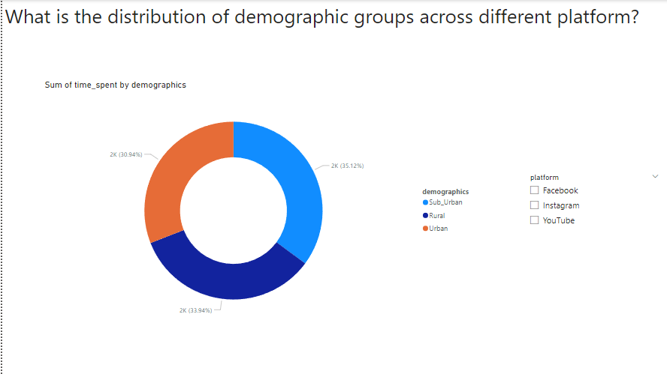

Slide 7
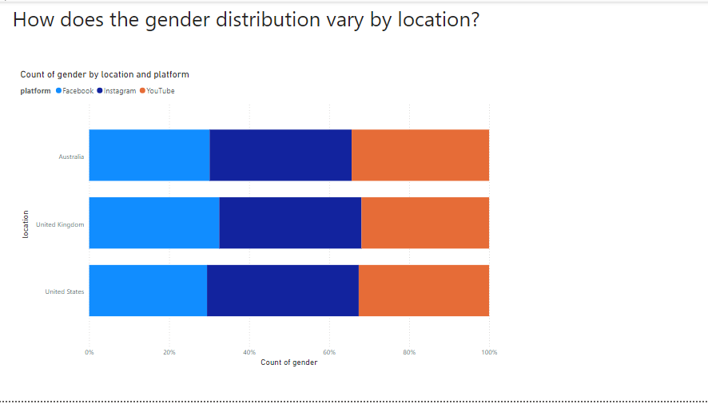

Slide 8
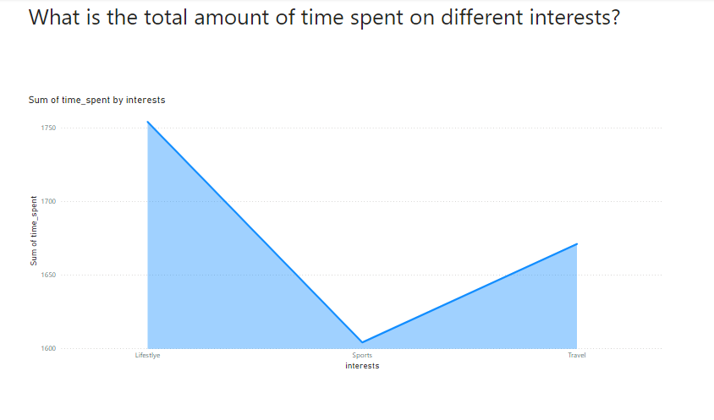

Slide 9
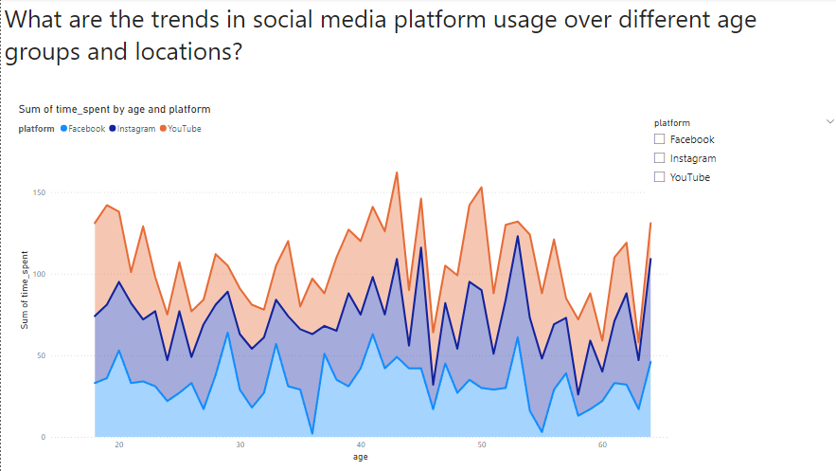

Slide 10
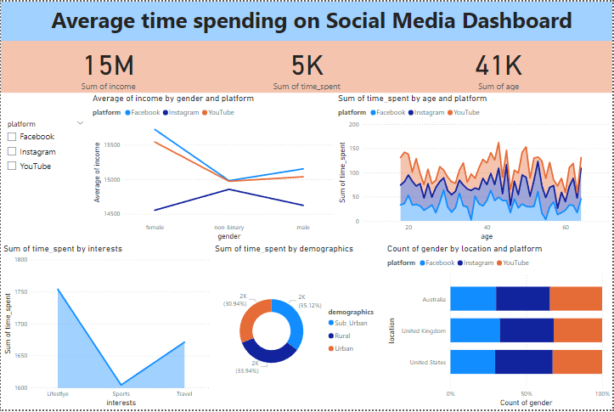

Slide 11
RECOMMENDATIONS
Use demographic distribution data to customize marketing, content, and engagement strategies for different platforms.
Address gender distribution variations by location to support inclusive practices and localize recruitment and development efforts.
Focus on high-engagement interests and social media trends by age and location to refine content strategies

Slide 12
THANKYOU

