Slide 1
Superstore Sales Dashboard
Data Analytics Internship – Task (Dashboard Design & Visualization)
Harini G S

Slide 2
Objective & Dataset
Objective:
Build an interactive dashboard to analyze sales performance, profit, and customer trends.
Provide KPIs and insights for business decision-making.
Dataset Used:
Superstore Sales Dataset (Kaggle / Tableau Sample Dataset)
Records: 9,000 orders
Fields: Order Date, Sales, Profit, Category, Region, Customer, etc.

Slide 3
Key KPIs
KPIs Included:
💰 Total Sales: $2.29M
📈 Total Profit: $286K
📦 Total Orders: 5,009
Insights:
Overall sales and profit are positive.
Opportunity to analyze by category, region, and product to improve profitability.

Slide 4
Sales by Category & Time
Sales by Category:
Technology and Office Supplies lead sales.
Furniture lags slightly.
Sales Trend (Time Series):
Sales increase steadily toward the end of the year.
- Seasonal spikes suggest promotions/holiday effect.

Slide 5
Regional & Product Analysis
Profit by State:
West region contributes strongly to profits.
Some states show negative profit → need discount strategy review.
Top Products:
Certain products (Canon imageCLASS, Cisco TelePresence) generate high sales.
Focus on promoting high-margin products.

Slide 6
Dashboard Snapshot
Interactive Features:
- Filters by Region, Year, Category.
- Clicking a category updates all visuals.
- Users can drill down to state and product-level insights.

Slide 7
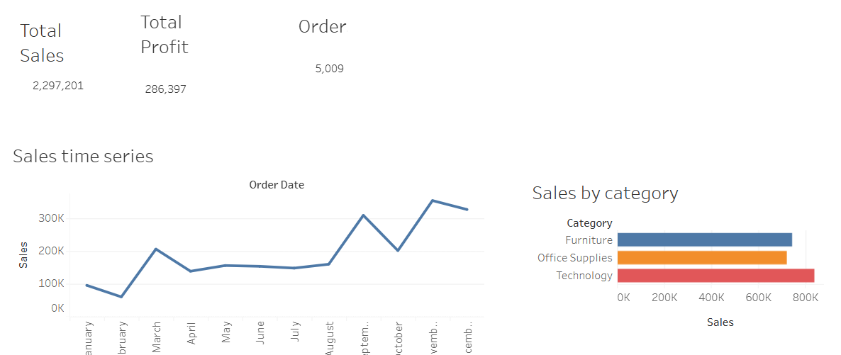
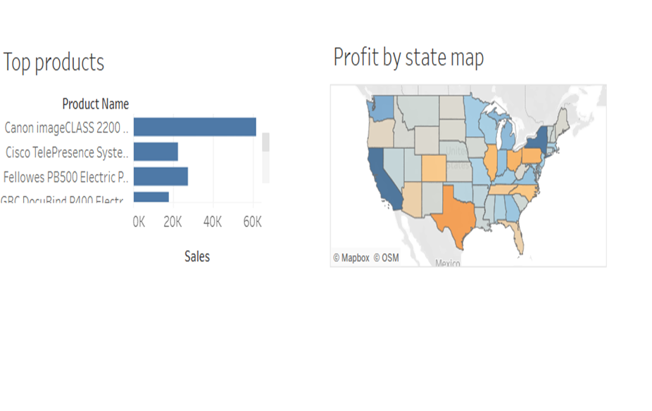
Dashboard Snapshots

Slide 8
Conclusion & Next Steps
Conclusion:
Dashboard provides quick view of key KPIs (Sales, Profit, Orders).
Visuals highlight top categories, products, and regional performance.
Interactive filters enable stakeholders to explore data dynamically.
Next Steps:
Analyze discount policies in low-profit states.
Explore customer segment profitability.
Extend dashboard to include forecast for future sales.

