Slide 1


K. RAMAKRISHNAN COLLEGE OF ENGINEERING
(AUTONOMOUS), SAMAYAPURAM – TRICHY
DEPARTMENT OF ARTIFICIAL INTELLIGENCE AND DATA SCIENCE
CGB1201- JAVA PROGRAMMING
PERSONAL FINANCE MANAGEMENT
PRESENTED BY SUPERVISOR
HARINI.V.K Mrs. G.ISWARYA
8115U24AD035 AP/AI&DS.

Slide 2
PRESENTATION OVERVIEW
Project Introduction
Objective
Problem Statement
Architecture Diagram
Modules Used
Output Screenshots
Conclusion
Future Scope
References

Slide 3
PROJECT INTRODUCTION
This project is a Personal Finance Management System designed to help users record their income and expenses, manage budgets, and monitor monthly financial activity.

Slide 4
OBJECTIVE
To provide an easy-to-use platform for managing personal income and expenses.
To help users create budgets and track spending patterns.
To generate financial reports and visual insights for decision making.

Slide 5
PROBLEM STATEMENT
Many individuals fail to manage their money efficiently due to lack of planning and real-time tracking of income and expenses. Manual methods such as notebook or spreadsheets are time consuming, error-prone, and lack automation.

Slide 6
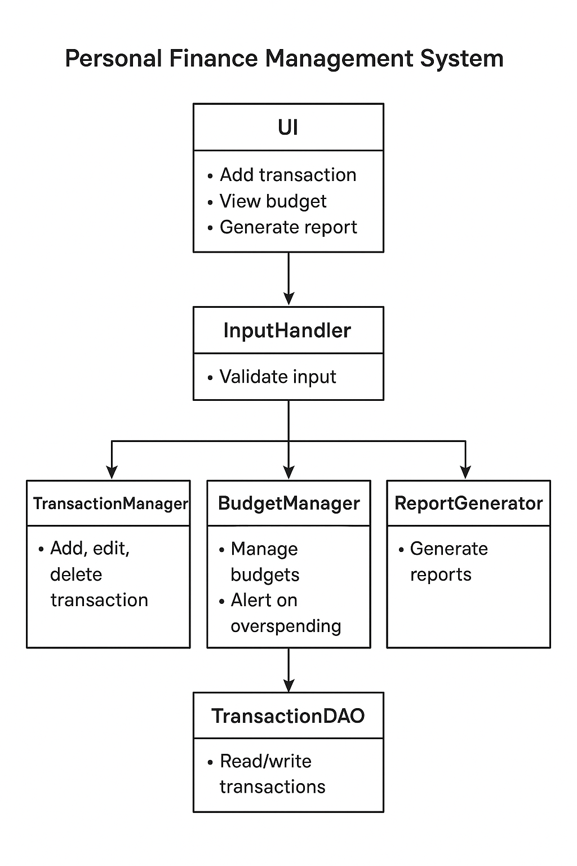
ARCHITECTURE DIAGRAM

Slide 7
MODULES USED
User Authentication Module – For secure login and user management.
Income Management Module – To record different sources of income.
Expense Tracking Module – To categorize and track expenses.
Budget Planner Module – To set financial goals and monthly budgets.
Savings & Investment Module – To track savings accounts

Slide 8
MODULE 1 - USER AUTHENTICATION
For secure login and user management.
Ensures that only authorized users can access the system.
Manages user registration, login, password protection, and session handling.

Slide 9
MODULE 2 – INCOME MANAGEMENT
To record different sources of income.
Helps to record, organize, and monitor all source of income.
Forms the foundation of financial planning, as accurate income details are required for budgeting, saving, and investment decision.

Slide 10
MODULE 3 – EXPENSE TRACKING
Allows users to record daily expenses with date, category, description, type, and amount.
Stores each expenses entry securely in the system database.
Helps users track spending patterns and identify high - expense areas .

Slide 11
MODULE 4 – BUDGET PLANNER
Allows users to set monthly or category - wise budgets.
Helps users define spending limits for categories like food, teansport, rent, etc.
Displays remaining budget amount for each category.

Slide 12
MODULE 5 – SAVINGS & INVESTMENT
Allows users to set monthly or yearly savings goal.
Helps track the amount saved over time compared to the target.
Provides summaries showing total savings and investments.

Slide 13
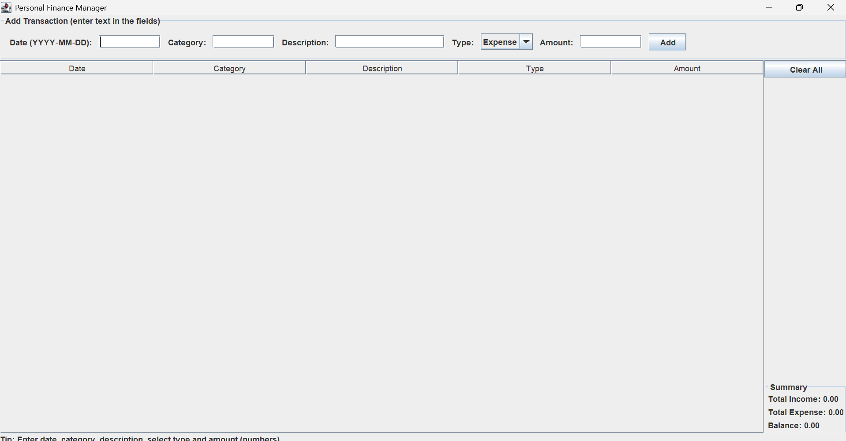
IMPLEMENTATION

Slide 14
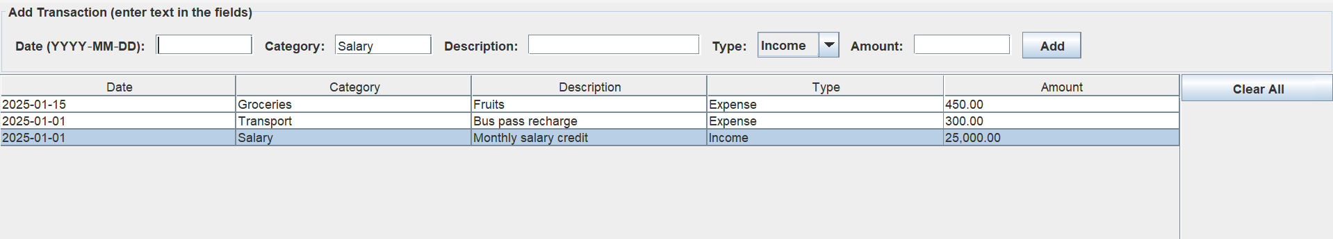
IMPLEMENTATION

Slide 15
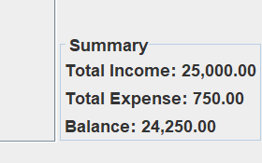
IMPLEMENTATION

Slide 16
CONCLUSION
This project provides a simple and effective platform for managing personal finances digitally. By integrating budgeting, expense tracking, and investment monitoring, the system enables users to take control of their financial health.

Slide 17
FUTURE SCOPE
Integration with bank accounts for automatic transaction updates.
AI-based financial advice and investment recommendations.
Multi-user family budget management system.

Slide 18
REFERENCES
Code Complete — by Steve McConnell. Not Java specific, but an excellent guide to writing clean, maintainable, high quality code.
Design Patterns: Elements of Reusable Object-Oriented Software (by the “Gang of Four”) — helps you understand common object oriented design patterns.

Slide 19


