Slide 1

AI-Powered Fraud Detection on Ethereum
Presentation by Supervisor
HARINI MM (23AM041)
JEEVANTHIKA T (23AM047)
23-03-2025 II Year Core Course Project- Final Review 1

Slide 2
CONTENTS
I.Module
II.Architecture Diagram of Proposed Setup
VII.Aim and Scope of the work
III.Tasks /Steps to be Conducted
VIII.Literature Review
IV.Implementation Setup i)Front End Evaluation ii) Back End Evaluation
IX.Drawbacks of existing work
X.Proposed Performance Metrics and Comparison
V Result and Testing / Introduction
XI. Conclusion
VI.Problem Statement and Description
XII .Future Work
XIII. References
23-03-2025 II Year Core Course Project- Final Review 2

Slide 3
INTRODUCTION
Ethereum is a decentralized blockchain platform that enables smart contracts and decentralized applications (DApps).
It uses Ether (ETH) as its native cryptocurrency for transactions and computational services.
Transactions on Ethereum are stored in a public, immutable ledger that enhances transparency and security.
Block Timestamp – The time when the transaction was recorded. From Address – The sender of the transaction. To Address – The recipient of the transaction. Value (ETH) – The amount of Ether transferred. Gas Price & Gas Used – The transaction fee paid for processing. Transaction Hash – A unique identifier for each transaction.
23-03-2025 II Year Core Course Project- Final Review 3

Slide 4
Problem Statement & Description
Problem:
Existing fraud detection techniques struggle to identify evolving fraudulent patterns in blockchain transactions.
Challenges:
No labeled dataset for supervised learning.
High volume and speed of transactions.
Need for real-time fraud detection in decentralized environments.
Proposed Solution:
Implement an unsupervised Isolation Forest model to detect anomalies.
Deploy as a Flask + JavaScript web application for user interaction.
23-03-2025 II Year Core Course Project- Final Review 4

Slide 5
Aim & Scope of the Work
Aim:
Develop an Ethereum fraud detection system using machine learning and deploy it as a web-based application.
Scope:
Use Isolation Forest to detect anomalies in Ethereum transactions.
Implement a Flask backend for model inference.
Create a React/JavaScript frontend for visualizing transaction analysis.
Provide an interactive dashboard with anomaly scores and transaction insights.
23-03-2025 II Year Core Course Project- Final Review 5

Slide 6
Literature Review
Unsupervised learning identifies previously unknown fraud patterns. It reduces reliance on labeled data and adapts to evolving fraud techniques.
S.no
Algorithms
Description
1
Isolation Forest
An unsupervised machine learning algorithm that isolates anomalies by randomly selecting features and partitioning data.
2
Matplotlib
Helps visualize the fraud detection threshold and distribution of anomaly scores.
3
Recharts
Used in the React frontend to display line charts of transaction values and fraud trends over time.
4
LIME
Generates local approximations of model behavior, making the decision-making process transparent.
23-03-2025 II Year Core Course Project- Final Review 6

Slide 7
Drawbacks of Existing Works
Rule-based approaches are static and cannot adapt to new fraud patterns.
Supervised models require labeled data, which is scarce in blockchain.
Graph-based methods are computationally expensive.
Current solutions lack real-time transaction scoring for users.
23-03-2025 II Year Core Course Project- Final Review 7

Slide 8

Proposed module
Data Collection & Preprocessing:
Extract Ethereum transactions from Etherscan API, Kaggle, or BigQuery datasets
Anomaly Detection with Isolation Forest:
Unsupervised Learning Approach: Detects outliers by isolating minority cases.
Why Isolation Forest? Efficient for high-dimensional data, detects fraud without labeled data.
Flask Backend:
Exposes an API to predict transaction anomalies
React Frontend:
Provides an interactive dashboard for users.
23-03-2025 II Year Core Course Project- Final Review 8

Slide 9





Architecture Diagram
Ethereum Transaction Data
Fraud Detection Model
Flask API
React Frontend
23-03-2025 II Year Core Course Project- Final Review 9

Slide 10

Tasks to be Conducted
Phase 1: Data Acquisition & Preprocessing
Phase 2: Model Development & Training
Phase 3: Backend Development (Flask API)
Collect Ethereum transactions.
Train Isolation Forest on historical transaction data.
Develop REST API endpoints for model inference.
Clean and preprocess the data (handle missing values, normalize).
Tune hyperparameters for better fraud detection.
Implement request handling for transaction anomaly detection.
Phase 4: Frontend Development (React)
Phase 5: Testing & Deployment
Build a user-friendly dashboard for fraud detection results.
Validate the model with test datasets.
Integrate APIs for dynamic transaction scoring.
Deploy on a cloud server
23-03-2025 II Year Core Course Project- Final Review 10

Slide 11
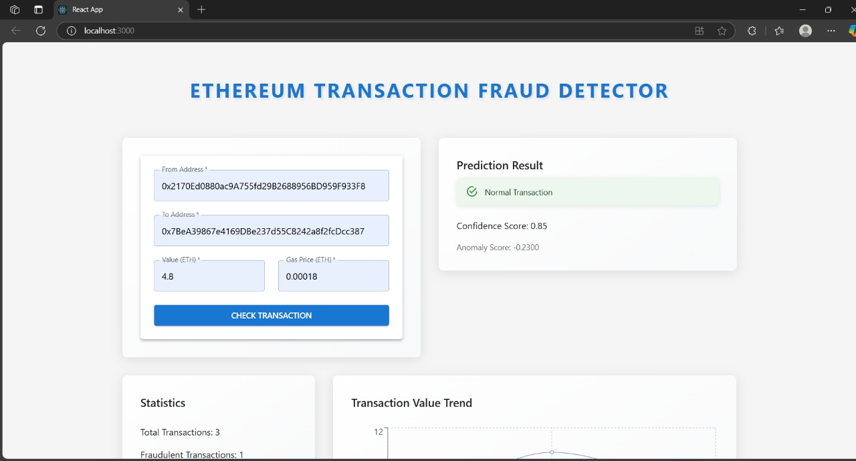
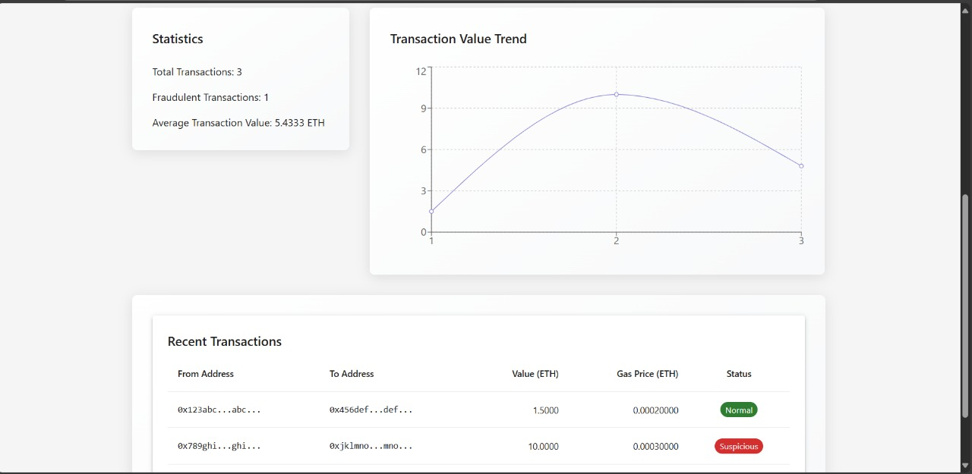
Frontend
Transaction Form:
Allows users to submit transaction data for fraud detection.
Calls the Flask backend API for anomaly prediction.
Prediction Result Display:
Shows whether a transaction is fraudulent or normal.
Displays a confidence score and anomaly score for transparency.
Transaction Visualization (Line Chart):
Uses Recharts to plot Ethereum transaction values over time.
Helps users track suspicious transaction patterns.
Transaction List:
Displays recent transactions retrieved from the backend.
Updates automatically after fraud prediction.
Error Handling & Loading Indicators:
Displays error messages if transaction retrieval fails.
Shows a loading spinner when fetching data.
23-03-2025 II Year Core Course Project- Final Review 11

Slide 12
Backend
Framework: Flask (Python)
API Endpoints:
/predict → Accepts a transaction and returns anomaly score.
/upload → Allows batch transaction uploads.
Libraries Used:
scikit-learn → Train Isolation Forest.
pandas → Data handling.
flask → API framework.
requests → API communication with frontend.
23-03-2025 II Year Core Course Project- Final Review 12

Slide 13
Result and Testing -Model Performance
Model Evaluation Metrics:
Silhouette Score:
Initial Score: {silhouette_avg: 0.7055}
Updated Score (after threshold tuning): {updated_silhouette_avg: 0.7078826421723412}
Indicates the separation between fraudulent and normal transactions.
Fraud Detection Results:
Initial Fraudulent Transactions Detected: {487}
Newly Identified Fraud Cases (After Threshold Tuning): {500}
Fraud Count in Test Data (Before Tuning): {34}
Fraud Count in Test Data (After Tuning): {76}
Key Observations:
The updated fraud threshold (-0.002) improved detection accuracy.
More fraud cases were identified, while reducing false positives.
23-03-2025 II Year Core Course Project- Final Review 13

Slide 14
Performance Metrics & Explainability
Anomaly Score Analysis: Mean Anomaly Score: {0.1632}
Standard Deviation of Anomaly Scores: {0.0737}
Fraudulent transactions generally have lower anomaly scores.
Normal transactions cluster around higher anomaly scores.
SHAP Feature Importance Analysis:
Transaction Count (More frequent transactions increase suspicion)
Gas Price Volatility (Unusual gas price fluctuations indicate anomalies)
Repeated TO Addresses (Frequent transactions to the same address raise flags)
Incoming-Outgoing Ratio (High imbalance in transaction flows is a fraud indicator)
23-03-2025 II Year Core Course Project- Final Review 14

Slide 15
Conclusion
Successfully built an Ethereum Fraud Detection model using Isolation Forest.
Implemented Feature Engineering to improve anomaly detection.
SHAP & LIME were used for interpretability, making fraud predictions more explainable.
The fraud detection accuracy improved after adjusting anomaly thresholds.
Anomaly Scores helped differentiate between fraud and normal transactions.
Challenges Faced:
High variance in Ethereum transactions makes fraud detection difficult.
Some legitimate transactions appeared fraudulent (False Positives).
Need for real-time processing to handle large transaction volumes.
23-03-2025 II Year Core Course Project- Final Review 15

Slide 16
Future Work
Enhancing Model Accuracy Try Autoencoders or Graph Neural Networks (GNN) for better fraud detection.
Test other anomaly detection models, such as One-Class SVM and DBSCAN.
Real-Time Transaction Monitoring Deploy a streaming pipeline using Apache Kafka or Google Pub/Sub.
Process transactions in real-time rather than batch mode.
Expanding Explainability Features Use Counterfactual AI to explain why a transaction is marked as fraud.
Add Heatmaps for anomaly scoring in the frontend dashboard.
Blockchain Integration Enable on-chain fraud flagging where users can report addresses.
Deploy the model on a smart contract-based fraud detection system.
23-03-2025 II Year Core Course Project- Final Review 16

Slide 17
References
Unsupervised Learning for Blockchain Fraud Detection – Research Papers
Isolation Forest for Anomaly Detection – Scikit-Learn Documentation
Ethereum Transaction Analysis – Kaggle & Etherscan API
SHAP & LIME Explainability – Official Documentation
Scalable ML Deployment with Flask & React – Developer Guide
23-03-2025 II Year Core Course Project- Final Review 17

