Slide 1

Gait Recognition for Worker Identification
Presented By:
HARINI PM -22MIS0447
NITHEESH KUMAR-22MIS0493

Slide 2
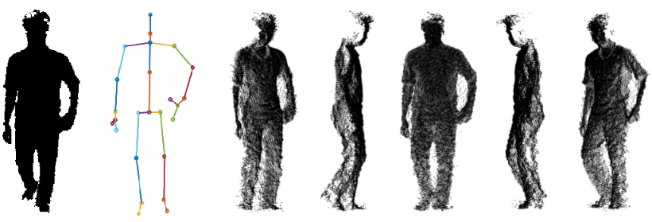
🧪 Methodology
The project aims to develop an accurate and reliable gait recognition system to identify individual workers based on their walking patterns. To achieve this, two parallel pipelines were developed: one using numerical gait features (non-image data) and another using image-based gait patterns. The models applied include Random Forest, Support Vector Machine (SVM), and Convolutional Neural Networks (CNN).

Slide 3
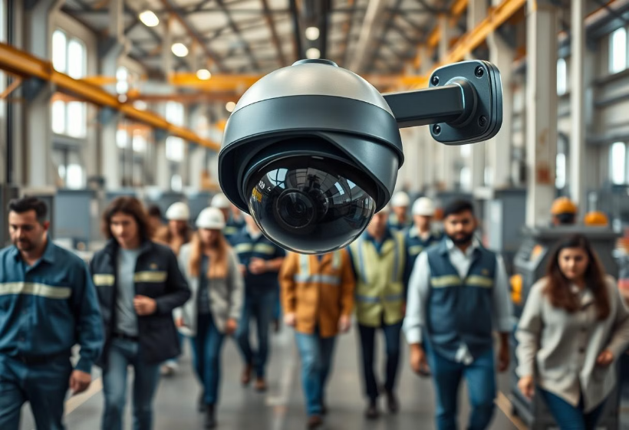
🔹 1. Problem Statement
Traditional biometric systems (like fingerprint or face recognition) can be intrusive or impractical in a workplace setting. Gait recognition offers a non-intrusive, camera-based identification system that can identify workers from a distance — even when faces are obscured or protective equipment is worn. This approach provides a more seamless and less invasive method for identifying individuals in various work environments, enhancing security and operational efficiency.

Slide 4
🔹 2. Data Collection
2.1 Non-Image Dataset
File Used: MGAD.csv
Content:
Numerical gait features including:
Step length
Stride duration
Hip/knee joint angles
Walking speed, cadence
Temporal and kinematic parameters
Target Variable: Unique Worker ID or class label
2.2 Image Dataset
Source: Pre-collected gait image sequences (uploaded separately)
Content:
Side-view silhouette frames or posture images of individuals walking
Images structured into folders by worker ID
Input Type: .png or .jpg

Slide 5
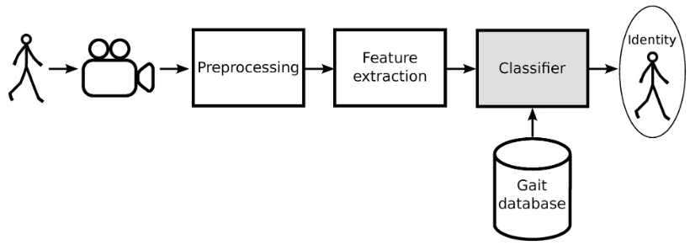
🔹 3. Preprocessing
For Non-Image Data: Missing Value Handling (rows with missing entries dropped or imputed using mean values), Feature Scaling (standardized using StandardScaler), and Label Encoding (Worker IDs encoded into numeric classes). For Image Data: Grayscale Conversion (to reduce color-related complexity), Resizing (images resized to 128×128 pixels), Normalization (pixel values scaled to [0, 1]), and Augmentation (Horizontal flipping, small rotations, random zoom) to increase data diversity and reduce overfitting.

Slide 6
🔹 4. Model Design and Implementation
Random Forest (RF)
With/Without Image:
Used for tabular data or CNN-extracted features
Ensemble of decision trees
Strengths: Fast, handles noisy features
📈 Support Vector Machine (SVM)
With/Without Image:
Good for high-dimensional spaces
Used after feature extraction
Strengths: Effective with small to medium datasets
🧠 Convolutional Neural Network (CNN)
Without Image Dataset:
Structured features reshaped for CNN input
With Image Dataset:
Full image input processed via multiple convolutional + pooling layers
Flattened, passed to dense layers for classification.

Slide 7
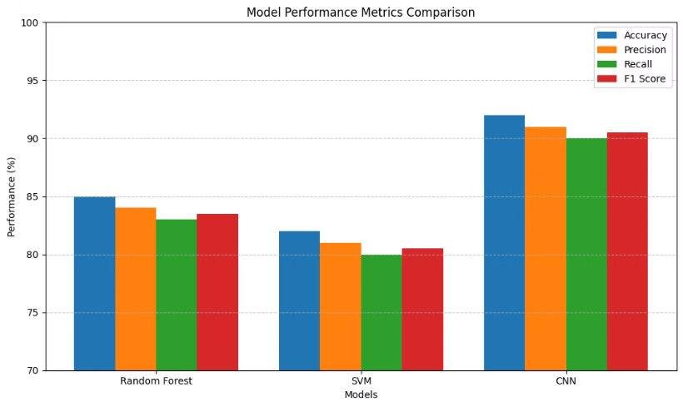
🔹 5. Model Evaluation
Metrics Used: Accuracy (Overall model performance), Precision, Recall, F1-Score (To measure per-class correctness), Confusion Matrix (For visual analysis of true vs. predicted worker identities), Training Curves (CNN): To monitor overfitting (loss vs. accuracy over epochs). The evaluation process provides a comprehensive understanding of each model's strengths and weaknesses, guiding further refinements and optimizations.
Train/Test Split: 80/20

Slide 8
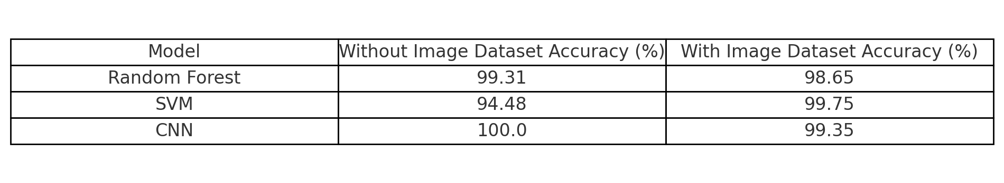
6.Result and comparison

Slide 9
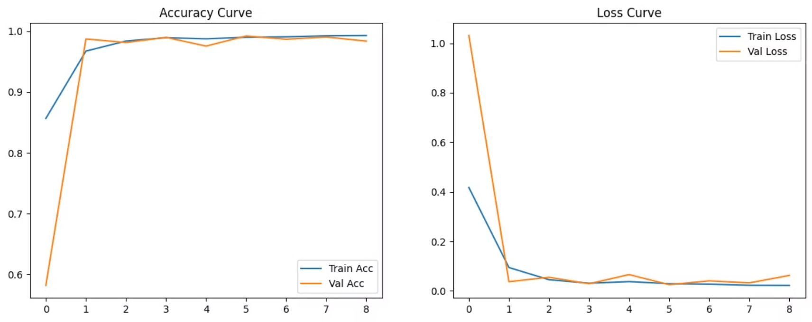
🔹 7. Final Outcome

Slide 10
🔹 8. Tools and Technologies Used
Google Colab – for development and GPU support
Python Libraries: pandas, numpy, matplotlib, scikit-learn, TensorFlow / Keras – for CNN, OpenCV – for image handling
Google Drive Integration – for dataset management

Slide 11

🔹 9. Conclusion
The dual-model gait recognition system proves that both numerical gait data and image data can be effectively used for worker identification. Combining these into a hybrid model (CNN + feature fusion) can potentially improve performance further. Future Scope: Real-time recognition using video input + object tracking, Multi-view gait recognition (front, side, back), Deployment using lightweight models (e.g., MobileNet, TensorFlow Lite).

