Slide 1
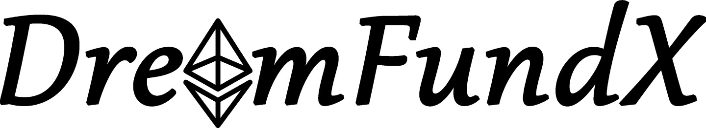
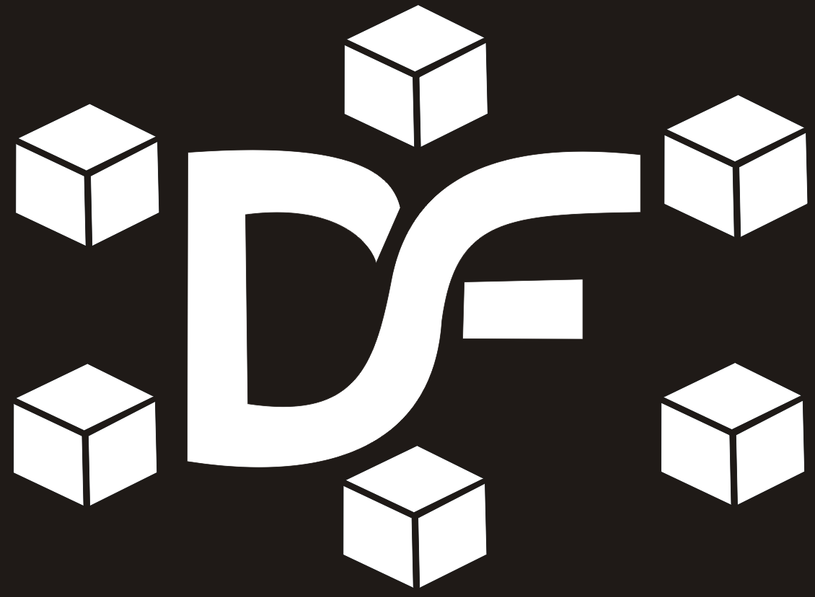
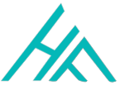

-A crowdfunding dapp!
DASH Truffles
Deepthi Sherly J
Om Arthy Sri B
Santhosh K
Harini M
HackOFiesta-Flagship Hackathon of India
01

Slide 2
About DreamFundX:
An app to provide instant access to credit for small business growth in India and develop a concept dapp for the use of smart contracts.
Donors would be able to use the dapp to fund small businesses in India using digital currency.Its vision is to empower individuals, businesses and markets by delivering financial inclusion and supporting change across India from the grass roots level.
It aims to provide 100% unsecured debt funding to self-employed informal market traders.
It also aims to enhance the conditions and prospects of small-scale entrepreneurs via a social network-like platform which is our future work.

Slide 3

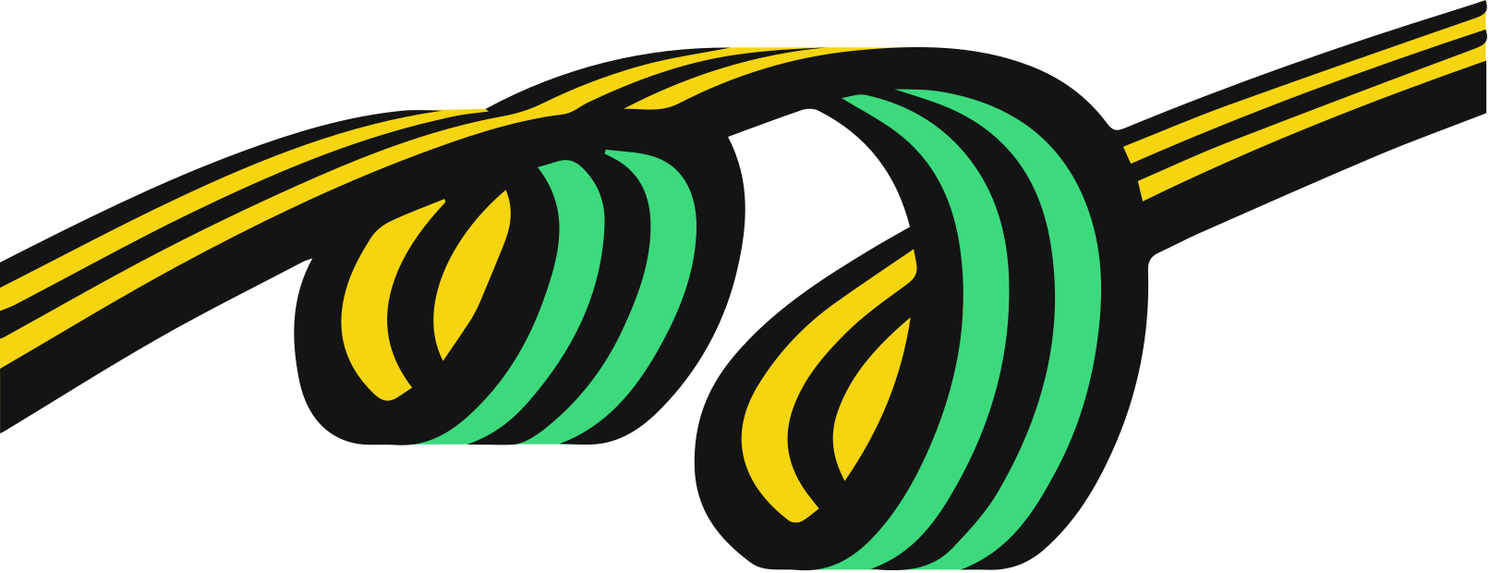
PROPOSED SOLUTION
The DreamFundX is a decentralized application that is a Ethereum based crowdfunding platform where the small scale entrepreneurs can look to raise funds for their startups.
It uses smart contracts which is built by the programming language solidity, which helps in the secured transaction without relying on third party.
As an investor on DreamFundX, one can able to view all the startups, so that one can invest in their desired startup.
As an owner of a startup on DreamFundX, one can able to sell all their products, so that they can look to raise funds.
The funds are raised in eth cyprtocurrency.

Slide 4

Features
1. Secured Transactions.
2. Flexible and convenient.
3. No margin of cost for publishing campaigns
4. No transaction fee is collected. Only Gas fees
5. User friendly.

Slide 5
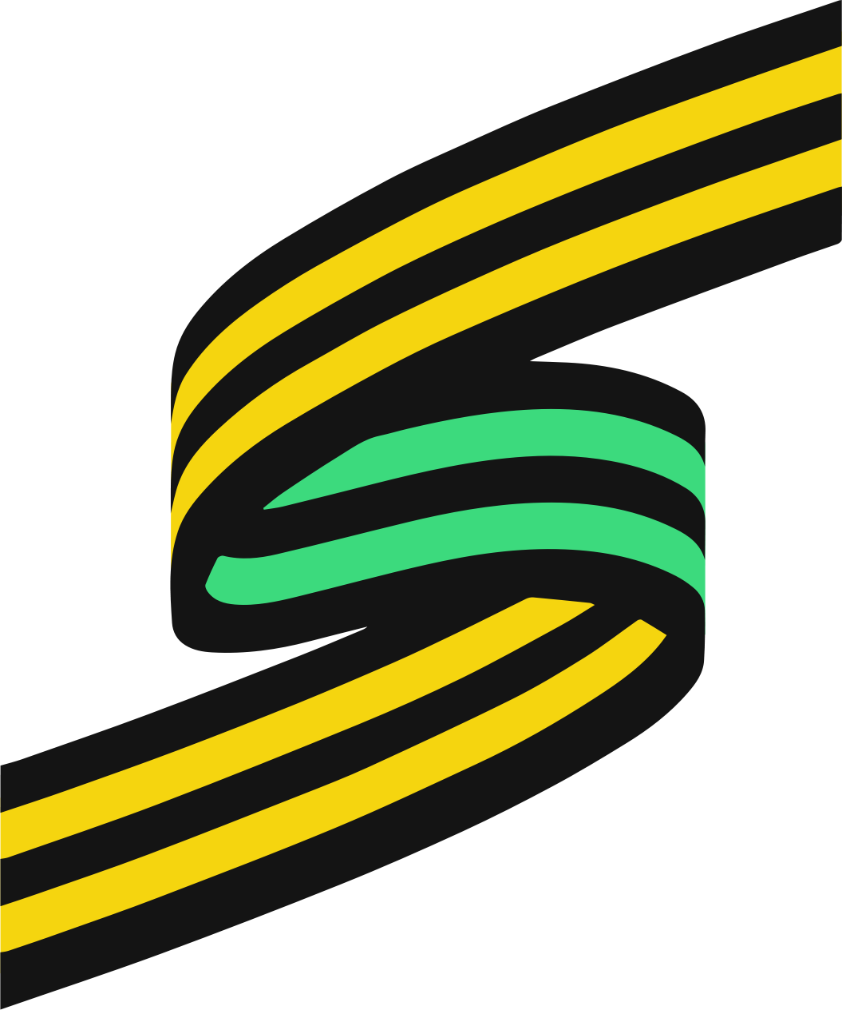
OUR TECH STACK
1.
React JS
React is an open-source, front end, JavaScript library for building user interfaces or UI components.
2.
HTML/CSS
HTML provides the basic structure of sites which is enhanced and modified by CSS. CSS is used to control presentation , formatting and layout.
3.
Solidity
Solidity is an object-oriented programming language for writing smart contracts. It is used for implementing smart contracts on Ethereum blockchain platform.
4.
Firebase
For User-Authentication

Slide 6
THANK YOU

