Slide 1
Investment Decision Recommendation System - Hackathon
HARINI P (21PT05)

Slide 2
TABLE OF CONTENTS:
INTRODUCTION
DATA EXPLORATION
FEATURE SELECTION
MODEL TRAINING AND EVALUATION
USER INTERFACE
MODEL TESTING
POWER BI DASHBOARD
CONCLUSION

Slide 3
INTRODUCTION :
Given a dataset comprising individual’s demographic and investment behavior data, the aim is to construct a recommendation system aiding individuals in making well-informed investment choices.
The system should analyze various factors such as age, role, investment influencer, gender, education, city, income, investment experience, and others to suggest the most suitable investment option for each individual

Slide 4
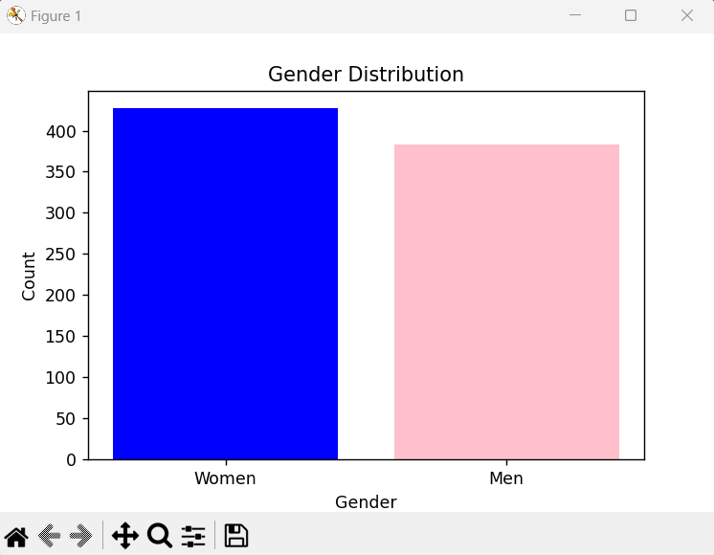
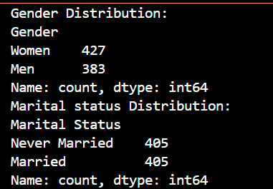
DATA EXPLORATION :

Slide 5
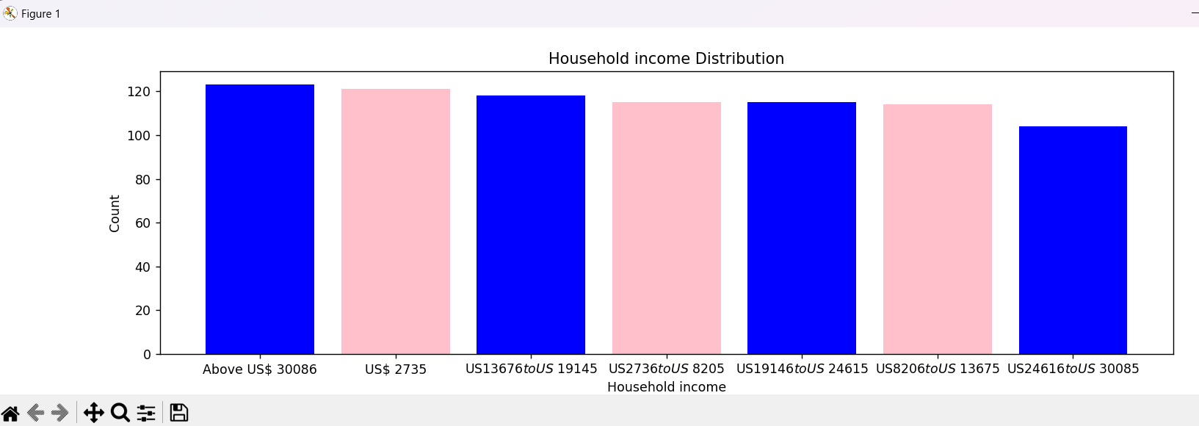
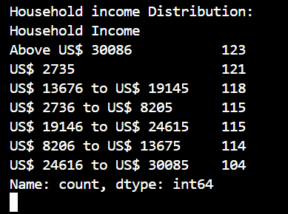

Slide 6
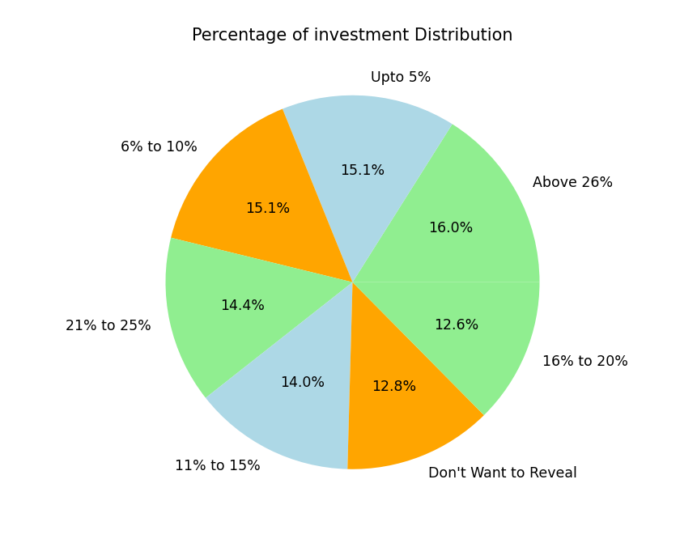
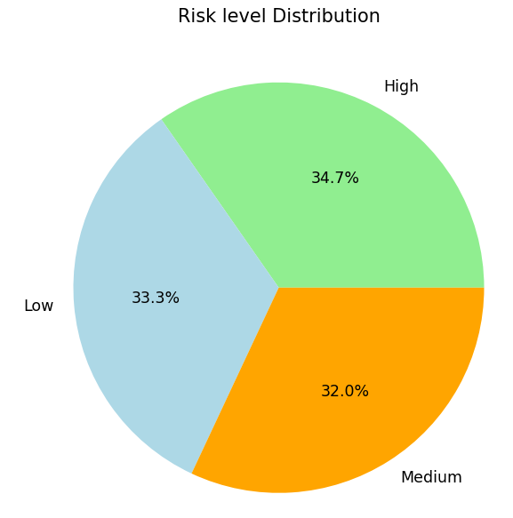
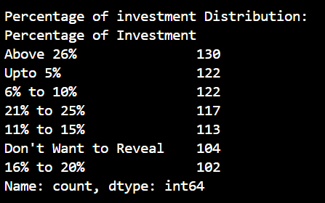
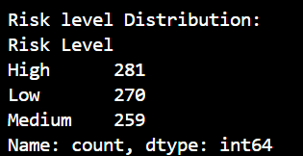

Slide 7
FEATURE SELECTION :
Utilizing RandomForestClassifier, I have determined the importance of each feature in predicting investment behavior.
After fitting the model, the top 10 features with the highest importance scores are selected for further analysis.
The feature importances are visualized using a bar plot, providing a clear representation of each feature contribution to the model.

Slide 8
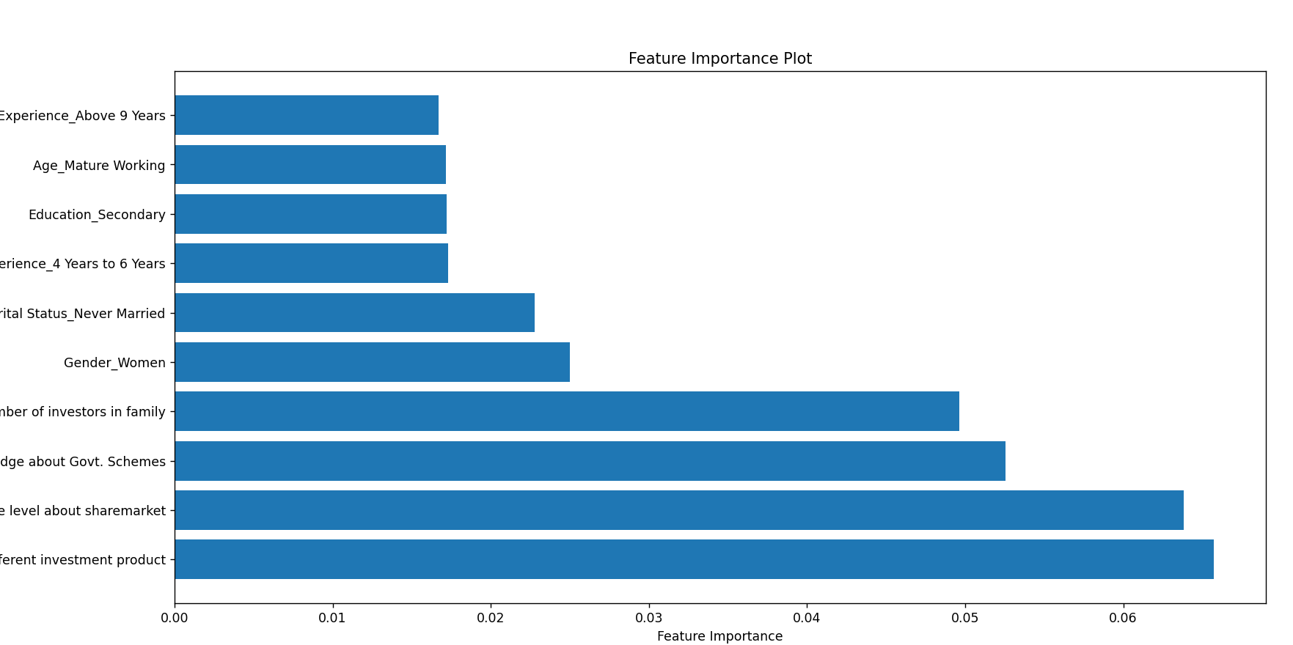

Slide 9
MODEL TRAINING AND EVALUATION:
Model Training: The RandomForestClassifier is trained on the dataset containing various individual and investment behavior attributes.
Multi-Output Classification: Utilizing the MultiOutputClassifier wrapper, the model is extended to handle multiple target variables, namely risk level and return earned.
Evaluation Metrics: The accuracy score and classification report are generated to assess the model's performance in predicting both risk level and return earned by investors.

Slide 10
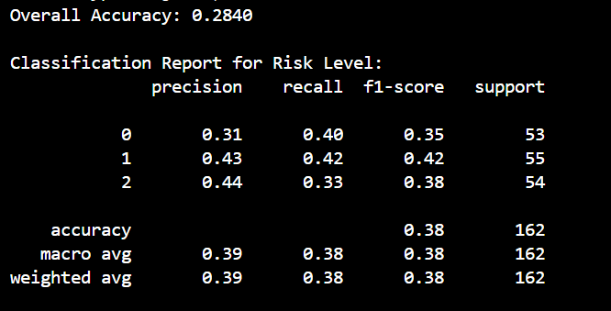
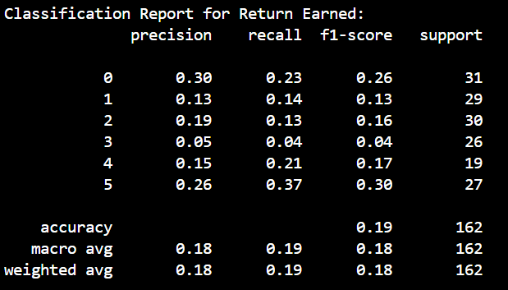

Slide 11
USER INTERFACE:
Utilizing the Tkinter library, a user-friendly interface is developed where users can select values for various features such as age, role, investment influencer, gender, education, city, income, and investment experience.
Upon selecting these attributes, the recommendation system predicts the corresponding risk level and return earned by the investor.
The predicted values are displayed to the user, providing personalized investment recommendations based on their input.

Slide 12
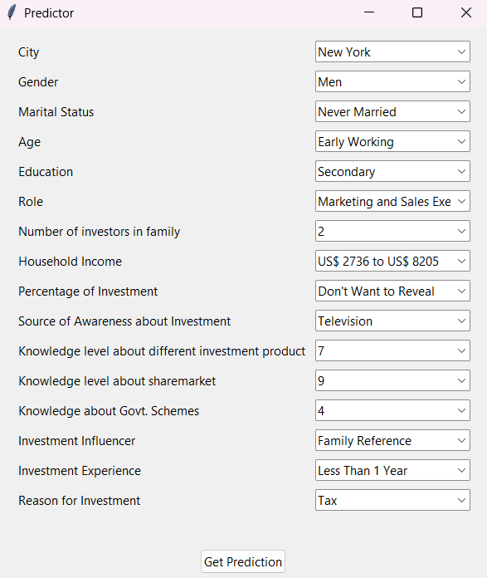
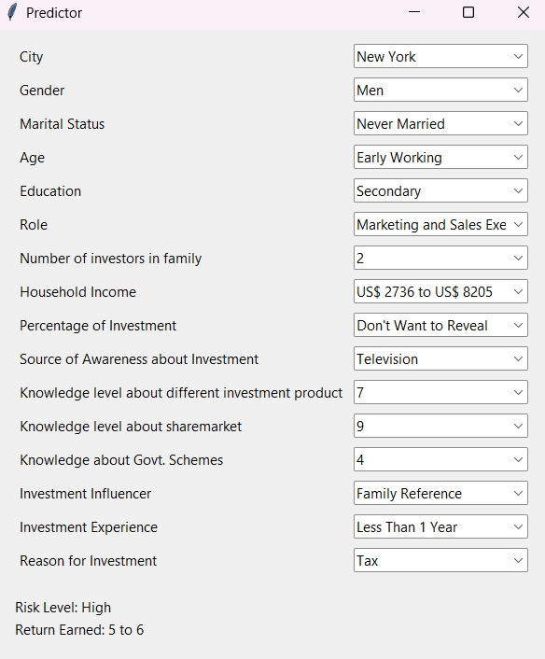

Slide 13
MODEL TESTING:
A sample test dataset (sample_test_data.xlsx) was utilized to evaluate the recommendation system's performance.
By feeding this test data into the trained model, predictions were generated for the risk level and return earned by investors.
Subsequently, the accuracy of the model on the test data was assessed and was similar to the training phase.

Slide 14
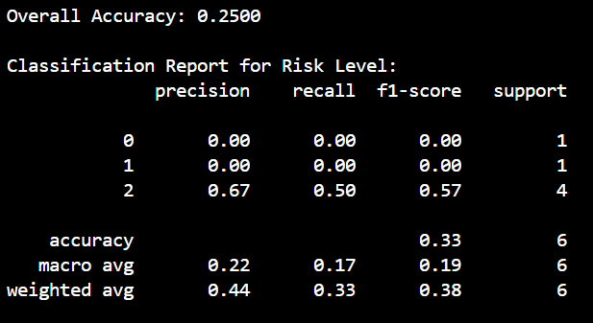
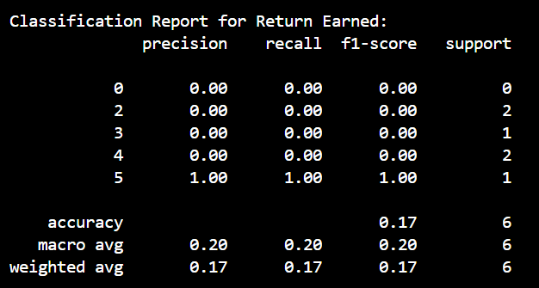

Slide 15
POWER BI DASHBOARD :
I've delved into numerous relationships within datasets, examining connections and dependencies to derive meaningful insights.
Count of Investment experience by household income
Return earned by knowledge level about share markets
Count of household Income By city
Count of percentage of Investment
High Risk by Reason for Investment
Return Earned By Age
Number of Investors in Family By household Income

Slide 16
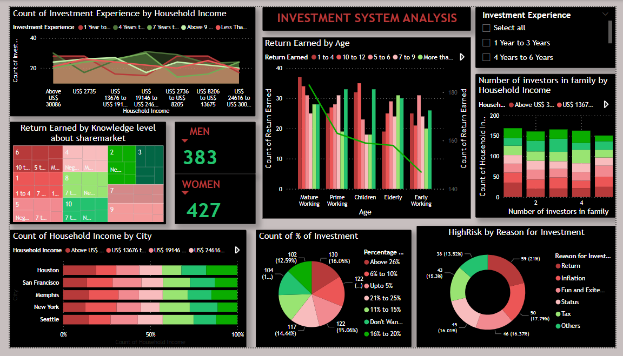

Slide 17
Conclusion:
The recommendation system facilitates a thorough evaluation of both risk levels and potential returns associated with different investment avenues.
Insights gleaned from dataset encompass relationships like investment experience across income brackets, returns based on share market knowledge, and household income distribution by city.
Such analyses offer better understanding into investor behavior, regional economic dynamics, and risk-return correlations.

