Slide 1
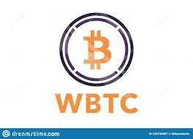
BLOCKCHAIN TECHNOLOGIES
ALTCOINS – WBTC
Presented by
Esther Keerthika B(2020178016)
Harini S(2020178021)

Slide 2
WRAPPED BITCOIN
Launched on August 2019.
It is a Ethereum Token that is intended to represent Bitcoin on the Ethereum blockchain.
The idea was first conceived by the Wrapped Token Project – join effort between Ren ,Kyber Network and the institutional custodian ,Bit go .
It is not Bitcoin, rather a separate ERC-20(Ethereum Request for comment) which is fully backed by bitcoin in a one-one ratio.
Every WBTC exists there is a bitcoin which is being held by custodian ,Bit Go.
WBTC is maintained by a group called the WBTC DAO that consists of over 30 members

Slide 3
continuation
In short , WBTC delivers the power of bitcoin with the flexibility of ERC-20.
ERC -20 – official protocol for proposing improvements to the Ethereum network.
This token standard defines a set of rules that apply to all ERC20 tokens that allow them to interact seamlessly with one another.
Bitcoin tokenization is a way to transfer the value of bitcoin to other blockchain.
The Process of locking up the bitcoin and tuning it into an ERC-20 token is known as “Wrapping”.
Official site: https://wbtc.network/

Slide 4
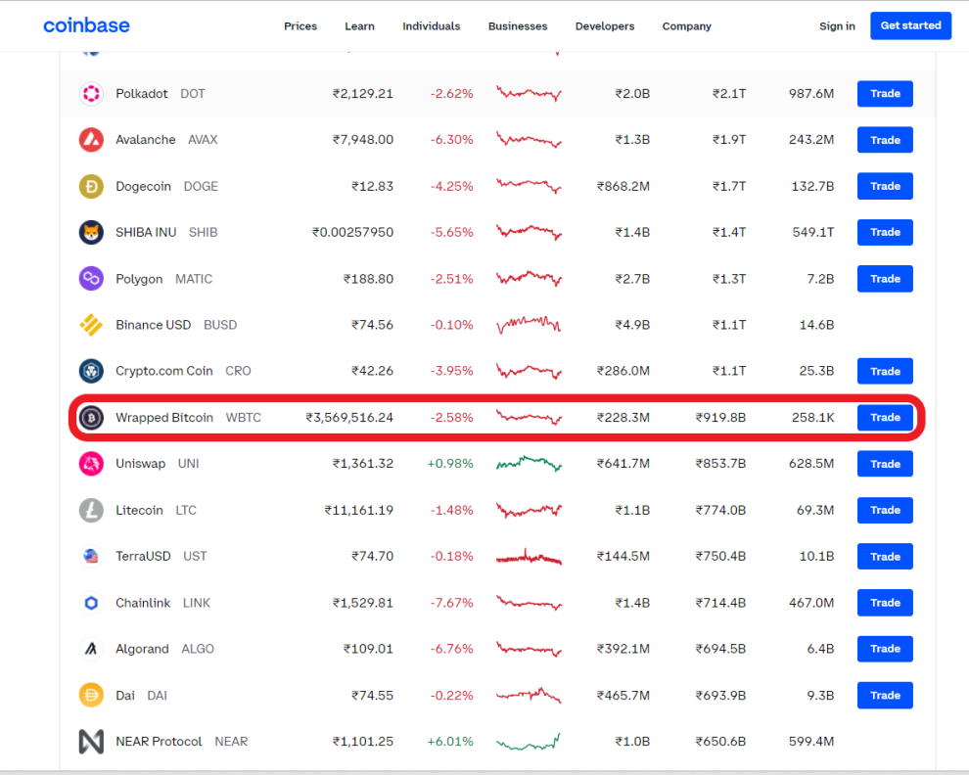
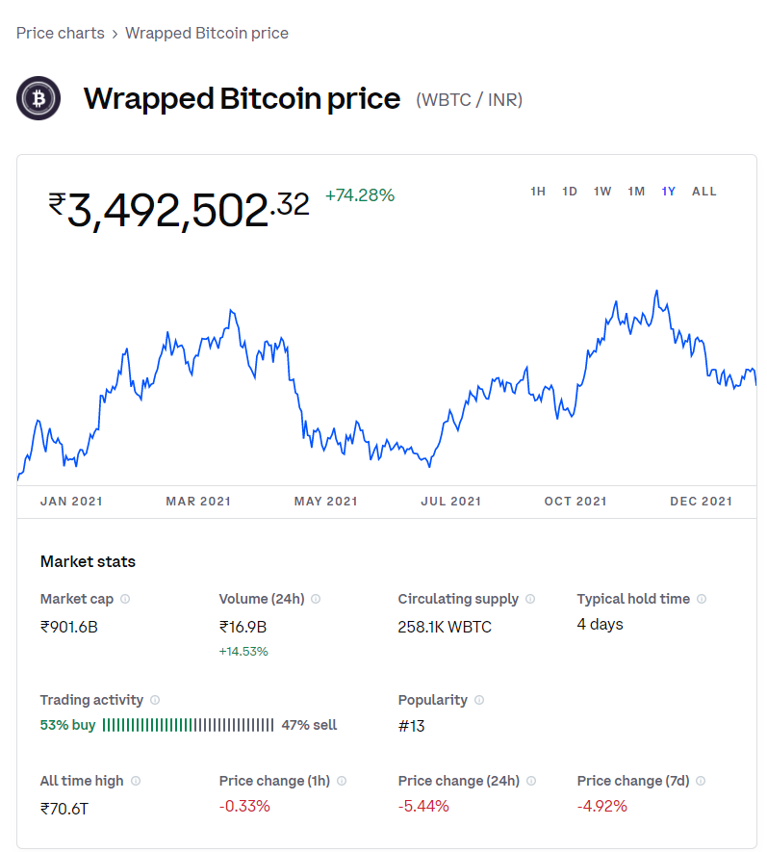
Over 8 billion dollars worth of WBTC has been minted and sent in to the Ethereum network .
For now , WBTC commands 72% of the tokenized bitcoin market.

Slide 5
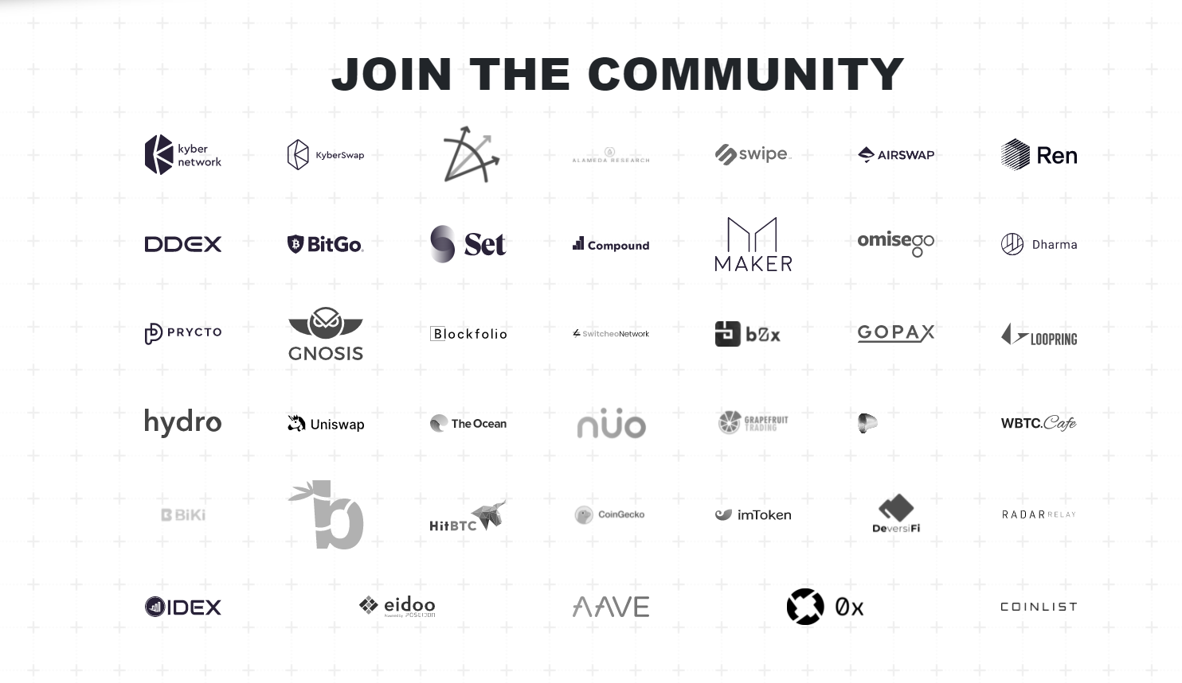
Who is behind wbtc ?

Slide 6
Why do we need wbtc?
WBTC brings greater liquidity to the Ethereum ecosystem including decentralized exchanges (DEXs) and financial applications.
Today, the majority of trading volume takes place on centralized exchanges with Bitcoin.
WBTC changes that, bringing Bitcoin’s liquidity to DEXs and making it possible to use Bitcoin for token trades.
WBTC standardizes Bitcoin to the ERC20 format, creating smart contracts for Bitcoin.
The WBTC holders can take out loans on decentralized lending platforms like MakerDAO, etc.
WBTC can also be used to provide liquidity on platforms such as Uniswap giving you a small percentage of the fees from the trade that happen in that specific pool.
Liquidity -> the ability of an asset to be converted to cash on demand. Reduces the investment risks.
But before WBTC can be minted onto the Ethereum blockchain ,every WBTC token has to be backed by exactly 1 bitcoin.
This guarantees the value of the asset whereas the security of the WBTC is backed by Ethereum .

Slide 7
partners
Users -> customers wants WBTC in exchange of BTC.
Merchants -> key role as administrators who initiate the process of minting newly wrapped tokens and burning wrapped tokens which is performed by the custodians
Custodians -> Provides the reliable and institutional grade for WBTC. All WBTC issued will be fully backed and verified through on chain proof of reserves.
Wrapped Token DAO -> Contract changes and additions or removal of custodians and merchants are controlled by a multi-sig contract .

Slide 8
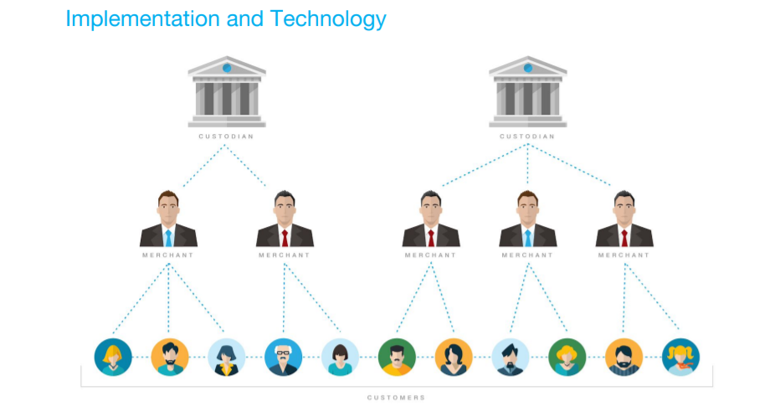
How does it work ?

Slide 9
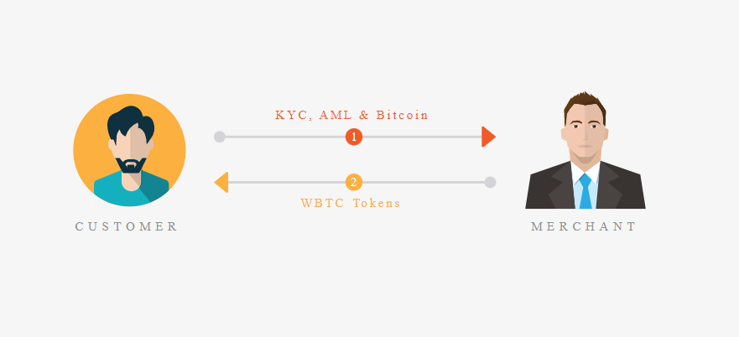
Sequence of events for users to receive WBTC tokens
Receiving
User requests wrapped tokens from a merchant
The merchant does the required AML (Anti money laundering), KYC procedures and gets identification information from the user
The user and merchant perform an atomic swap, or use a trusted exchange with the merchant receiving Bitcoin and the user receiving WBTC
Note: Atomic swaps can be used between merchants and users in order to exchange WBTC and BTC.

Slide 10
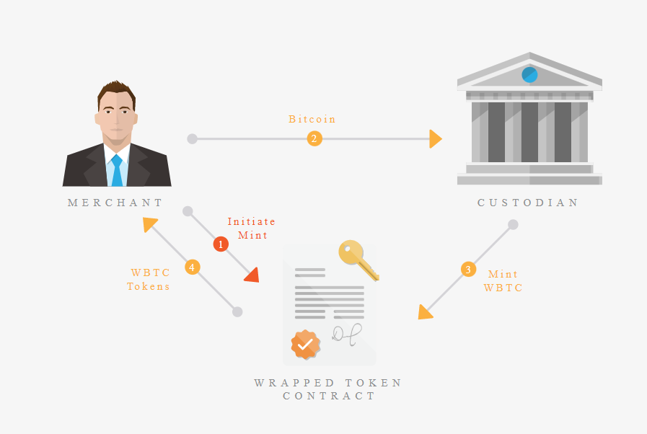
Sequence of minting events for WBTC
MINTING
Minting refers to the process of creating new wrapped tokens. Minting in the wrapped framework is initiated by a merchant and performed by a custodian.
The merchant sends the custodian X BTC.
Custodian waits for 6 confirmations of the BTC transaction
Custodian creates a transaction to mint X new WBTC tokens on the Ethereum chain

Slide 11
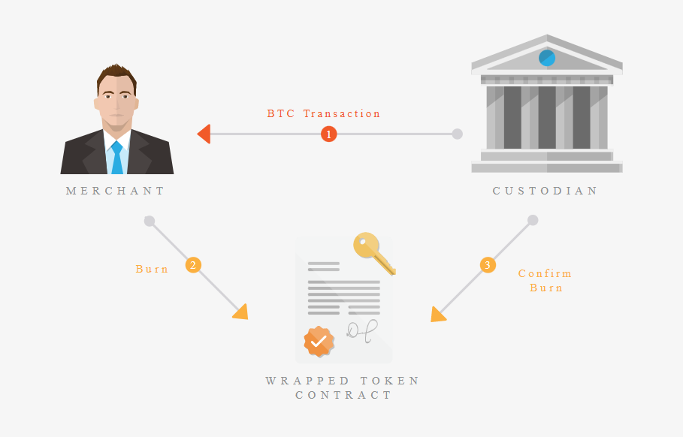
Burning
Sequence of events for burning WBTC tokens
Burning is the action of redeeming Bitcoin for WBTC tokens, and only merchant addresses can do this. The amount to be ‘burnt’ is deducted from the merchant’s WBTC balance (on chain) and the supply of WBTC is then reduced.
The merchant creates a burn transaction, burning X WBTC tokens
Custodian waits for 25 block confirmations of the ETH transaction
Custodian releases X BTC to the merchants Bitcoin address
Custodian makes an Ethereum transaction for balance reduction , thus marking the burn request as completed

Slide 12
the steps for users to atomically swap BTC for WBTC
Once KYC is completed, the steps for users to atomically swap BTC for WBTC with the merchant are:
User generates a secret key and a hash of it is provided to the merchant. The user and the merchant also agree on other swapping details such as receive addresses (ETH and BTC)
The user creates a Bitcoin HTLC (Hashed Time Lock Contract) using the merchant’s Bitcoin address, user’s refund address, secret hash, and expiration time. This is used to create a P2SH address which the user funds with X BTC

Slide 13
Cont…
After 6 confirmations, the merchant will create an HTLC contract on Ethereum, by using the user’s Ethereum address, merchant’s refund address, secret hash, and expiration time. The merchant then transfers X WBTC to the atomic swap contract.
The user reveals the secret in order to move X WBTC from the atomic swap contract to the user’s Ethereum address
The merchant uses the secret in order to move Bitcoin funds from the P2SH address
If the user does not claim the WBTC within the expiration time, the transaction does not go through and the user can claim the BTC back

Slide 14
FEES
Fees Transfers of WBTC between users will have no cost apart from network fees.
There are two ways in which different parties in the network can earn fees:
Custodian fees: This is taken by the custodian at the time when a merchant mints or burns wrapped tokens.
Merchant fees: This is taken by the merchant who the user exchanges wrapped tokens with for the asset

Slide 15
ADVANTAGES and Disadvantages
-> Bitcoin is equivalent of gold ,whereas WBTC equivalent of banknotes.
-> It is much easier and cheaper to send an ERC 20 transaction representing bitcoin rather than bitcoin itself.
-> Decentralized application on the Ethereum network can use WBTC
-> Increased transaction speed, liquidity
By holding WBTC you have given your bitcoin to a custodian which means you no longer owns private keys of the bitcoin (if you don't own the private key of the bitcoin you simply don't own the bitcoin)

Slide 16
Thank you!!

