Slide 1
Courses Registration system

Slide 2
System Cover Some Features
You can do all insertion by c# forms.
You can search by name of trainee, trainer or course name … etc.
Our database has 11 tables which are entities or result of many to many relationships.
Our System make validation on e-mail address attribute in trainer, trainee and employee tables.
Our System takes the attendance of every session, and the numbers of these sessions is calculated automatically according the total hours of each course.
We use Transaction technique to insert into Trainee table and two sub-classes Student or Graduated tables.

Slide 3
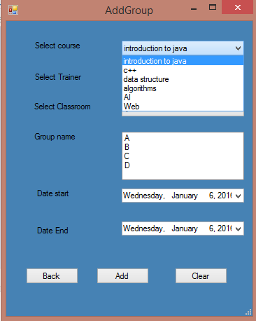
Some Snapshots of the System
Theses images to help you if the app can’t run correctly for any reason.

Slide 4
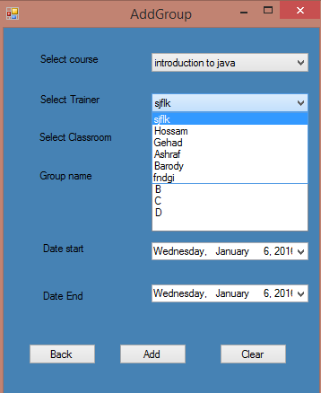

Slide 5
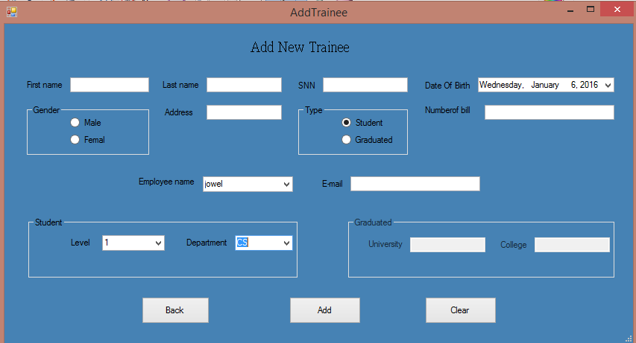

Slide 6
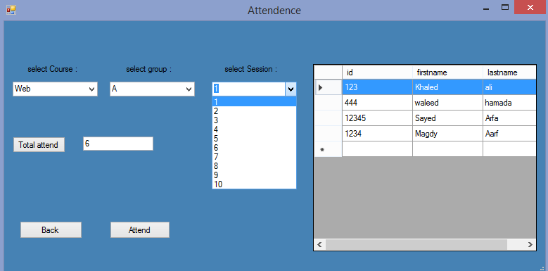

Slide 7
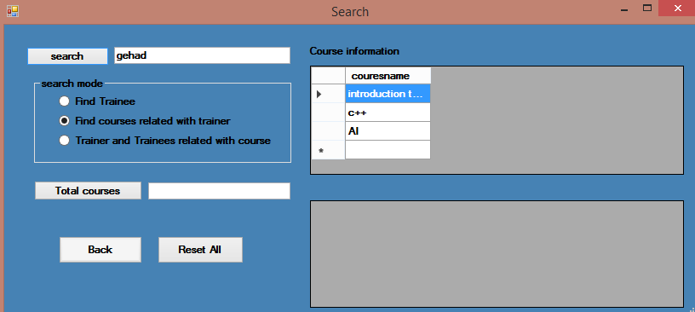

Slide 8
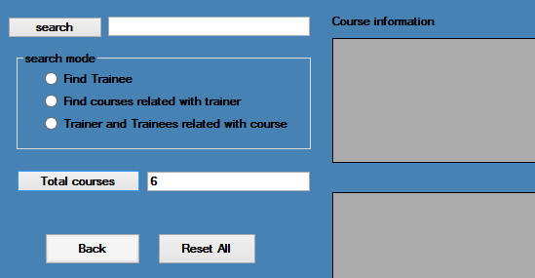

Slide 9
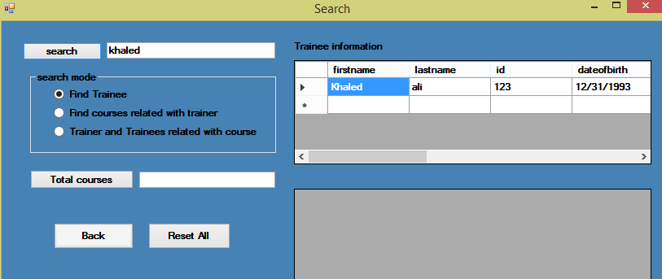

Slide 10
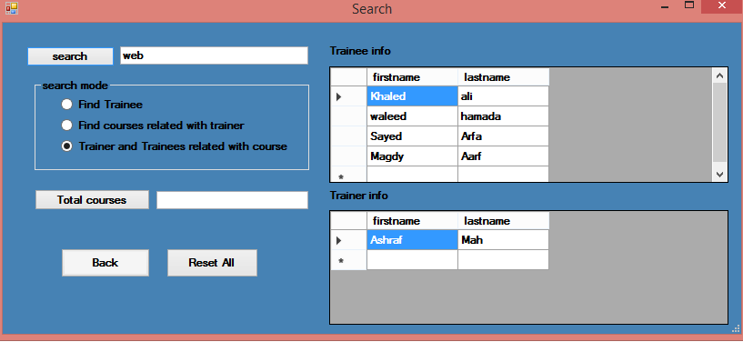

Slide 11
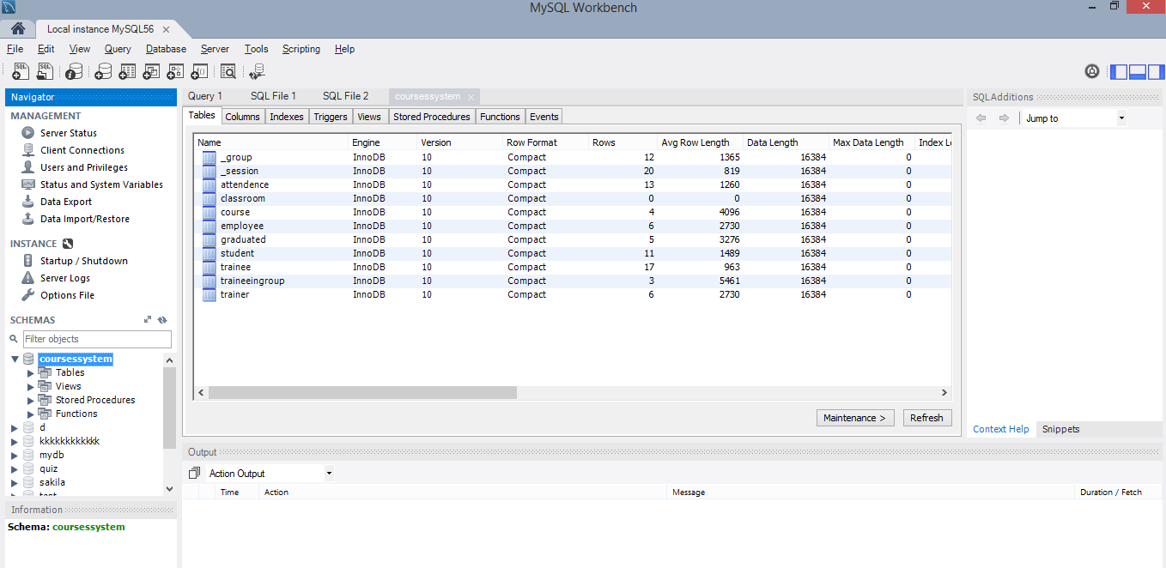

Slide 12
