Slide 1



Plant Disease Detection System for Sustainable Agriculture

Slide 2

Learning Objectives
Understand the application of CNN in plant disease detection.
Preprocess plant leaf images for model training.
Train and evaluate deep learning models for accurate classification.
Deploy a plant disease prediction model effectively.
GOAL
Source :
www.freepik.com/

Slide 3
Tools and Technology used
Programming Language: Python (due to its extensive support for data science and deep learning)
Frameworks: TensorFlow and Keras for building and training deep learning models
Libraries:
> NumPy for numerical computations
> Matplotlib and Seaborn for data visualization
> OpenCV for image processing
> Sklearn for performance evaluation tools
IDE: Jupyter Notebook for interactive model development and visualization
Dataset: PlantVillage dataset, with labeled images of diseased and healthy leaves
Hardware: GPU (if available) for faster training of deep learning models

Slide 4
Methodology
Data Collection: Acquired image dataset from PlantVillage, consisting of high-resolution images of plant leaves in various conditions (healthy and diseased).
Preprocessing: Resized images to consistent dimensions (e.g., 128x128), normalized pixel values, and performed data augmentation to artificially expand the dataset and reduce overfitting.
Modeling: Designed a multi-layer CNN architecture with convolutional, pooling, dropout, and fully connected layers to extract image features and classify disease categories.
Training: Used categorical cross-entropy as the loss function and the Adam optimizer. Trained over multiple epochs while monitoring validation performance.

Slide 5
Evaluation: Assessed model performance through training/validation accuracy and loss curves. Generated confusion matrix and classification reports to understand class-wise predictions.
Prediction: Tested the model on unseen data and predicted disease classes for new input images, demonstrating high accuracy in identifying various plant diseases.

Slide 6
Problem Statement:
Develop a CNN-based model capable of detecting and classifying plant diseases from images of leaves of various crops such as apple, cherry, grape, and corn. The model should accurately identify both healthy and diseased leaves while predicting the specific type of disease. This system will aid in precision agriculture by enabling early detection and effective disease management.

Slide 7
Solution:
The solution involves designing and implementing a convolutional neural network (CNN) model to accurately detect and classify plant diseases from images of leaves. By analyzing visual patterns, the model can distinguish between healthy and diseased plants. This early detection supports precision agriculture, allowing farmers to identify problems before they spread extensively. The system enhances crop management by providing timely and accurate disease diagnosis. Consequently, it helps reduce crop losses and improve yield quality. Overall, the approach leverages deep learning to promote healthier crops and more efficient farming practices. This contributes to sustainable agriculture and food security.

Slide 8
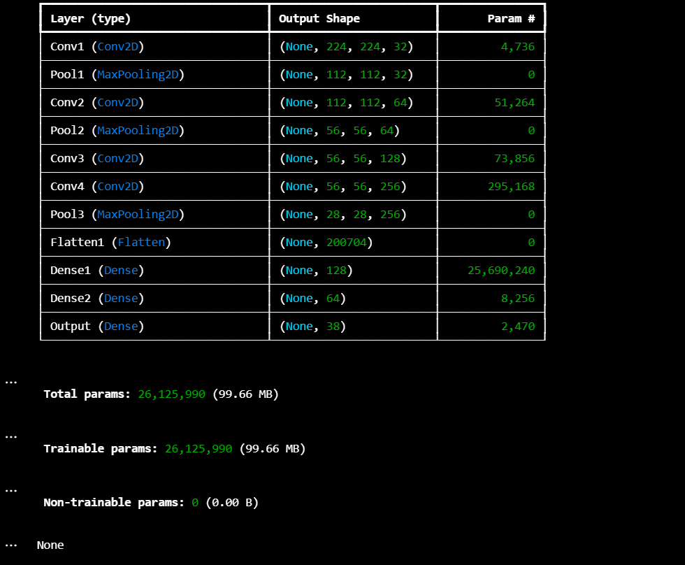
Screenshot of Output:

Slide 10
Conclusion:
The project successfully demonstrates the effectiveness of CNNs in detecting and classifying plant diseases in various crops such as apple, cherry, grape, and corn. The model accurately identifies both healthy and diseased leaves, offering a practical solution to aid precision agriculture and crop health monitoring.

