Slide 1
SIGNATURE VERIFICATION SYSTEM
Name : D.Harini

Slide 2
The Problem and solution:
Government offices, courts, and banks often depend on signatures for authentication; however, forgery poses a significant problem, causing fraud and disputes.
Our Signature Verification System leverages advanced deep learning models to accurately verify signatures, streamlining the process and improving security.
Verify banking, government, legal, and corporate sectors signatures efficiently.

Slide 3
Technology Stack
Programming Language: Python
Framework: Django
Database: SQLite
Frontend: HTML, CSS, JavaScript

Slide 4
Workflow Overview
Register a new user.
Log in to verify user credentials.
Navigate to the homepage (index page).
Upload files using a form.
Submit the form and view the details in a table.
Verify the signature to determine whether it matches or not.

Slide 5
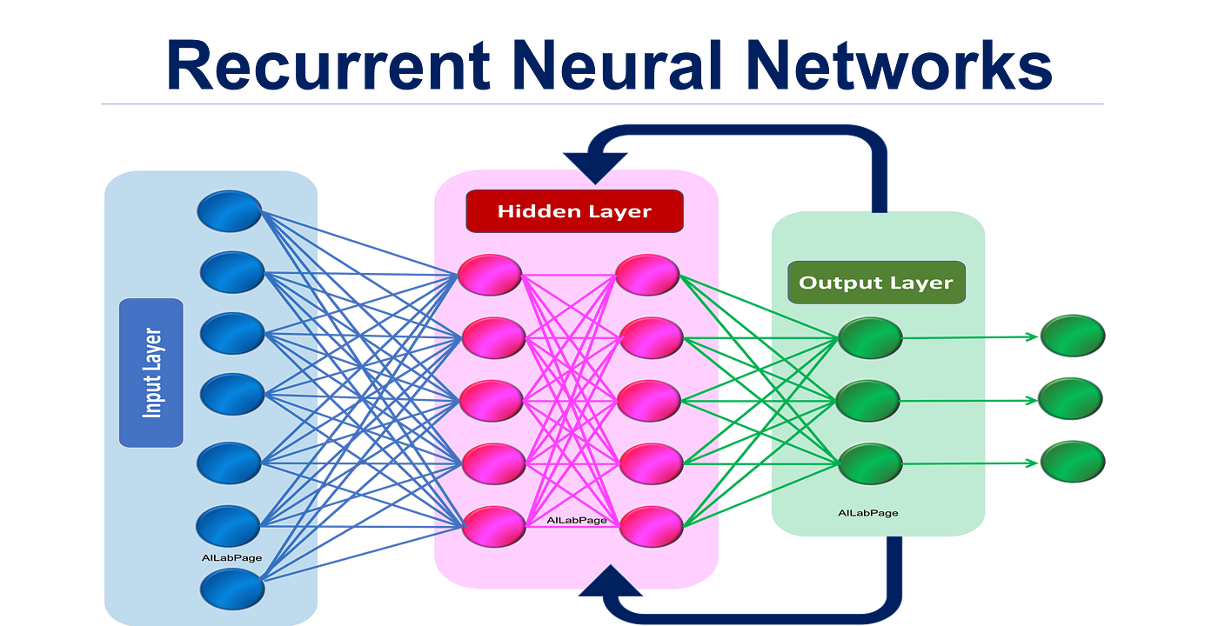
Models Used :
RNN is a neural network designed to process sequential data by using feedback loops to capture temporal dependencies.

Slide 6
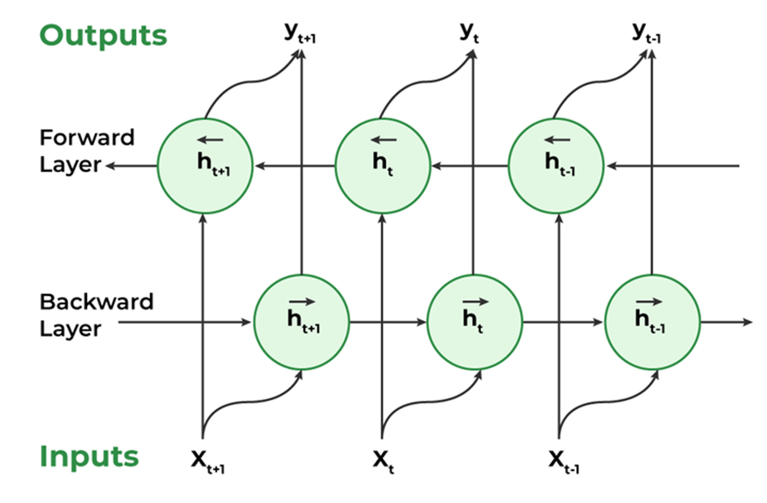
birnn
A Bi-RNN processes data in both forward and backward directions, capturing context from both past and future inputs.

Slide 7
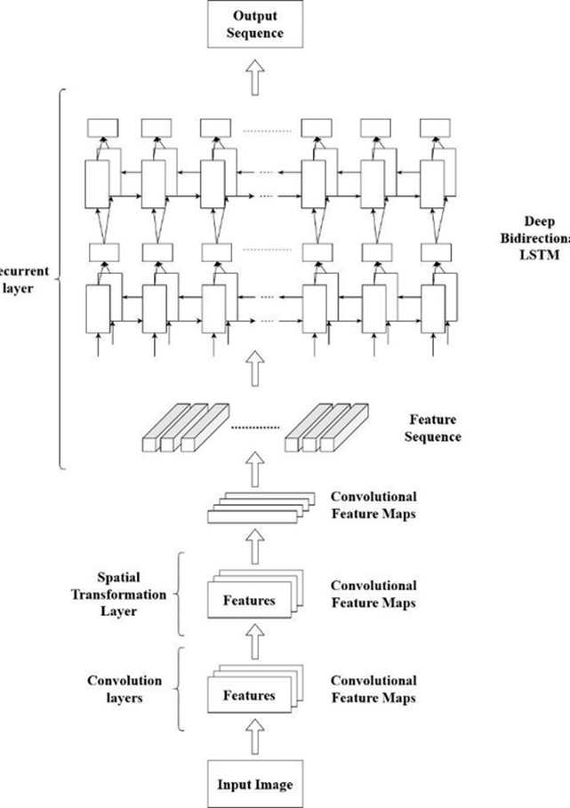
crnn
CRNN combines convolutional layers for feature extraction and recurrent layers for sequence modeling, making it ideal for tasks like signature verification.

Slide 8
WORKFLOW OVERVIEW:
Input Signature: The user provides a signature image as input.
Image Upload: The system allows the user to upload the signature image.
Preprocessing: The uploaded image is preprocessed through steps like resizing and augmentation to ensure compatibility with the model.
Verification: The extracted features are analyzed by a trained classifier to determine if the signature is authentic or forged.
Prediction Output: The system displays the prediction result (Match/No Match) along with the accuracy level.

Slide 9
Result
Objective: Create a deep learning-based system to automatically identify handwritten signatures as authentic or forged.
Dataset: Signature images labeled as authentic or forged, preprocessed into grayscale and resized to 256x256 pixels for training.
Models Used: Utilizes trained Bi-RNN, CRNN, and RNN models to achieve precise signature classification.
Approach: Employs deep learning techniques to extract features from signature images and determine their authenticity.
Applications: Suitable for fraud detection, identity verification, and document authentication tasks.

Slide 10


