Slide 1

PRESENTATION ON SPAM SMS CLASSIFIER
PRESENTED BY:
HARINI KK
DIVYA VM
DIVYABHARATHI

Slide 2
INTRODUCTION
Spam sms can be not only annoying but also dangerous to
consumers.
Spam sms are message randomly sent to multiple addressees by all sorts of groups, but mostly lazy advertisers and criminals who wish to lead you to phishing sites.

Slide 3
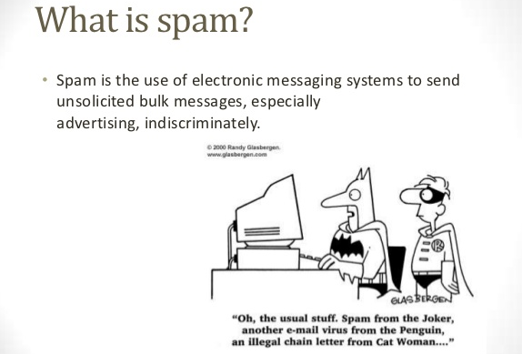
SMS SPAM
Any SMS that is irrelevant with respect to our interests, opposes a threat to us and our well being, or consumes our time can be regarded as a spam SMS.

Slide 4
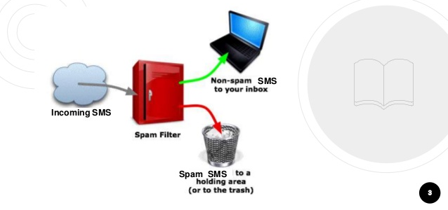

Slide 5
THE WIDESPREAD USE OF TEXT (SMS) MESSAGING
❖ Billions of mobile phone users send trillions of text messages daily.
❖ The annual worldwide SMS traffic had risen to over 6. 8 trillion all over the world at the end of 2010.
❖ Although the use of real-time messaging applications tends to surpass the preference of SMS usage nowadays, communication via SMS is still widely used throughout the world.

Slide 6











NAÏVE BAYS CLASSIFIER
Simple probabilistic classifier that calculates a set of probabilities by counting the frequency and combination of values in a given dataset.
Represent as a vector of feature values.
It is very useful to classify the sms properly
The precision and recall of this method is known to be very effective

Slide 7









PROBLEM STATEMENT
Unwanted sms irritating internet connection
Critical sms message are missed and / or delayed.
Millions of compromised computers
Billions of dollars lost worldwide
Identity theft
Spam can crash sms servers and fill up hard drives

Slide 8

OBJECTIVE
The objective of identification of Spam sms are :
To give knowledge to the user about the fake sms and relevant sms
To classify that sms spam or ham.
Spam SMS detection serves as a defense wall against the security and privacy issues of the SMS environment and provides a much more relevant and understandable SMS inbox to mobile phone users.

Slide 9










LITERATURE REVIEW
We consulted from G. He, Spam Detection, 1st ed. 2007 and
learned about this problem.
Spam prevention is often neglected, although some simple measures can dramatically reduce the amount of spam that reaches your message.
Before they are able to send you spam, spammers obviously first need to obtain your ip address, which they can do through different routes.

Slide 10








SCOPE OF THE PROJECT:
It provides sensitivity to the client and adapts well to the
future spam techniques.
It considers a complete message instead of single words with respect to its organization.
It increases Security and Control.
It reduces IT Administration Costs.
It also reduce Network Resource Costs.

Slide 11







OUTPUT
Any external esms can be detected and classified as spam e-
sms. So the users will be aware of such sms.
Mails are classified into spam and ham.
From the classified data we have calculated the accuracy as
99.18 %
Recall = 99.07%
F-measure= 99.53

Slide 12
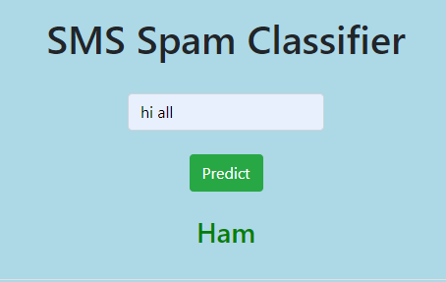
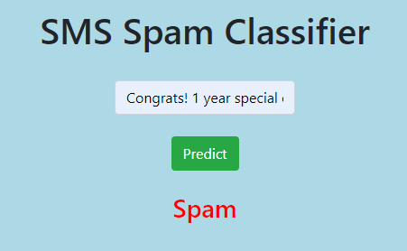
Output screen

Slide 13
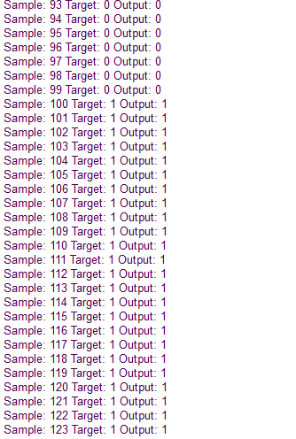
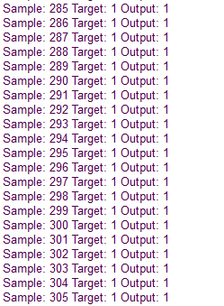

Slide 14
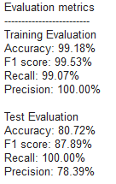

Slide 15
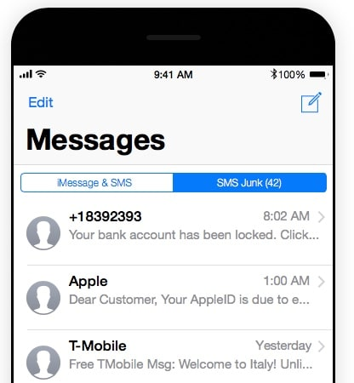

Slide 16
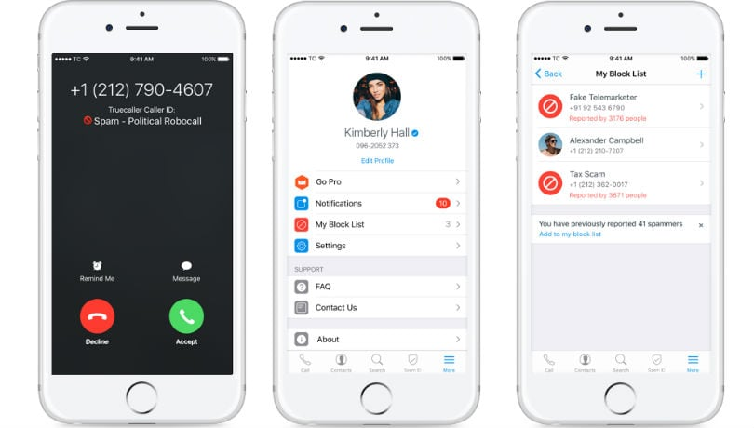

Slide 17

CONCLUSION
We are able to classify the sms as spam or ham. With high number of sms, lots if people using the system it will be difficult to handle all possible sms, as our project deals with only limited amount of corpus.

Slide 18
REFERENCES
[1]. S. M. Abdulhamid et al., “A Review on Mobile SMS Spam Filtering Techniques,” in IEEE Access, vol.5.
[2]. JOUR Lota, Lutfun, Hossain, “A Systematic Literature Review on SMS Spam Detection Techniques”, International Journal of Information Technology and Computer Science.
[3]. CHAP, Choudhary, Neelam, Jain, Ankit, “Towards Filtering of SMS Spam Messages Using Machine Learning Based Techniques”.
[4]. “SMS Spam Detection using Machine Learning Approach”, Houshmand Shirani-mehr,2013.

Slide 19
THANK YOU

