Slide 1
SALARY SURVEY
COMPENSATION AND BENEFITS

Slide 2

SALARY SURVEY

Slide 3
Meaning of Salary Survey
Surveys collecting information about employee compensation including salary and benefits , are commonly called salary survey

Slide 4
Objectives
To compare or draft company HR policy
To find out the income level of similar industry.
To understand wage differentiations
To examine the competitiveness of entry level employees
To increase employees satisfaction and morale
To learn about the benefits
To resolve existing labour problems concerning compensation.

Slide 5
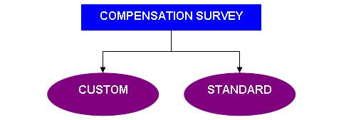
Types of salary survey

Slide 6
process
Planning
Source and sample selection
Conducting surveys
Analysing and interpreting data
Concluding

Slide 7
Benefits of salary survey
Helps in maintaining equity
Act as basis for decision making
Assists in setting compensation policy
Identifies key job position
Provides information about new trends

