Slide 1
SoundFinder -Urban sound prediction
Harini Praveen

Slide 2
AGENDA
Background
Business idea
Business plan
Problem dataset
Approach
Results
Future work

Slide 3
Background:
The automatic classification of environmental sound is a growing research field with multiple applications to largescale
Relatively scarce work on the analysis of urban acoustic environments
Can learn to control sounds
Help Urban decisions
Monitor the acoustic events in the environment

Slide 4
Business Idea
Develop a model to analyse and extract several types of valuable information from urban sounds related to human activities.
Classify if the recorded sound is safe and known or unknown noise
Identify the source and origination of the sound.
Report to the service seeker of any misconduct or provide information about the urban soundscape to the interested parties

Slide 5
Business plan
To create a prototype of the model with a basic UI
Deploy to cloud environment and share it with users
Collect more number of sound files and use it to fine tune model
Improve model based on comments and suggestions from service users
Approach interested parties – Security services, urban planners and city council.

Slide 6
Dataset
UrbanSound8K
Source: https://urbansounddataset.weebly.com/urbansound8k.html
8732 labeled sound excerpts (<=4s) of urban sounds from 10 classes
5436 – Train sounds and 3297 test sounds
air_conditioner, car_horn, children_playing, dog_bark, drilling, enginge_idling, gun_shot, jackhammer, siren, and street_music
Sounds chosen according to Urban sound taxonomy

Slide 7
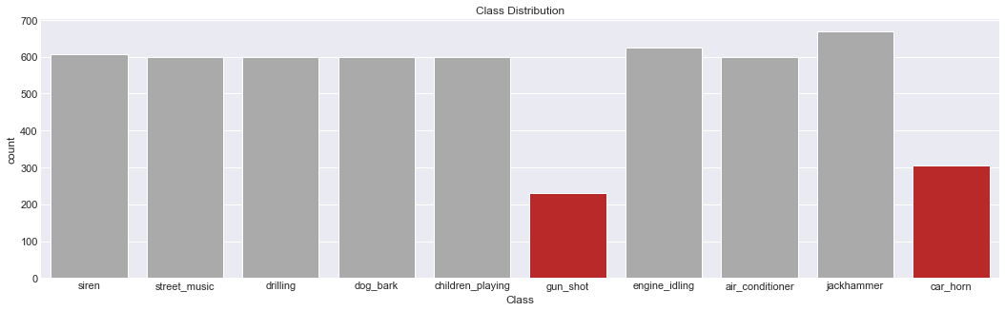
Number of occurrences of sounds in each class

Slide 8
Approach Used:
Extracting features from sound – Using Librosa library
Mel-frequency cepstral coefficients(MFCC)
chorma-stft: Compute a chromagram from a waveform or power spectrogram
melspectrogram: Compute a Mel-scaled power spectrogram
Multiclass classification using Keras Deep learning model
3 hidden layers with 256 nodes each
50% dropout for each layer
Relu Activation function
500 epochs
Adam optimizer
categorical_crossentropy
Train acc – 89% Val_acc – 90%

Slide 9
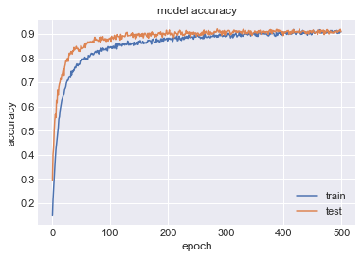
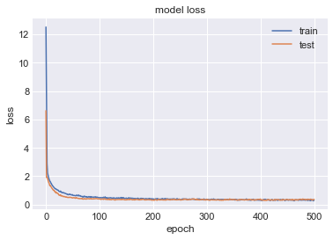
Results Accuracy and loss Vs epochs – for Train and validation set

Slide 10
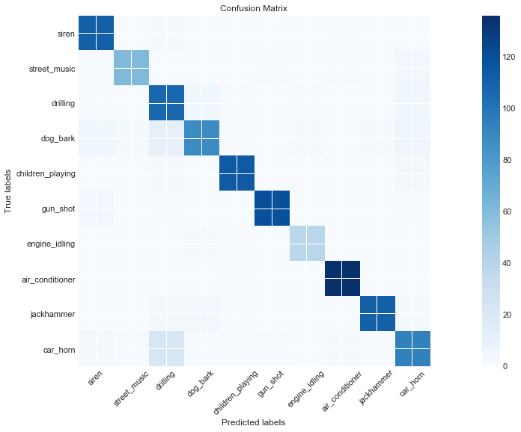
Confusion matrix for Keras model

Slide 11
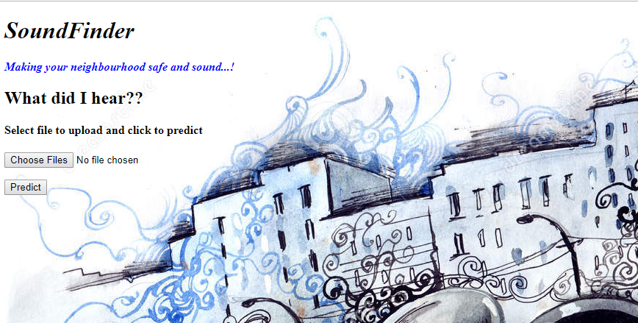
UI creation with Flask and HTML – Page 1: Index page

Slide 12
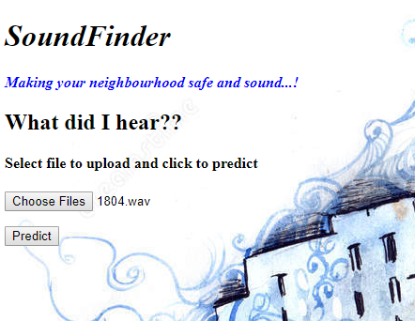
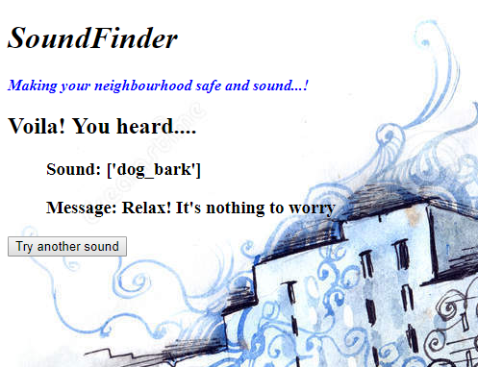
UI creation with Flask and HTML – Page 2: Upload and predict file

Slide 13
Future work:
More number of features can be extracted
Audio can be represented as spectrogram images and classified using CNN
The application can render visualisation of sounds to the user to make it more attractive and intuitive

Slide 14
Thank You!!

