Slide 1

Task-2. MEDICAL NO-SHOW APPOINTMENT DATA REPORT
"Understanding Patient No-Shows: A Data-Driven Exploration and visualization"
HARINIPRIYA.SELVAM
harinipriya1047@gmail.com

Slide 2
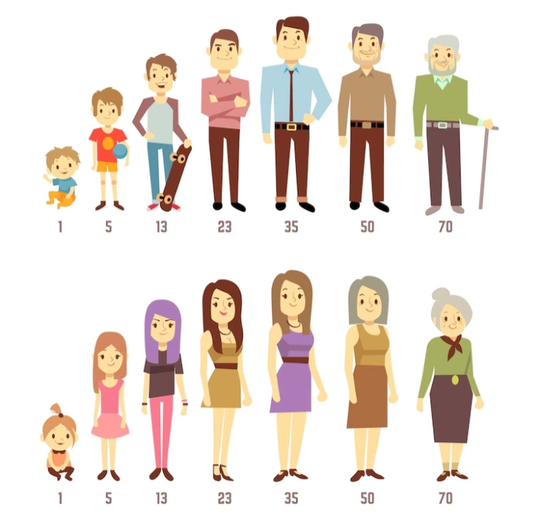
Key Questions Explored
1. Who Misses Appointments? Age groups (Children vs. Seniors) Gender (Male vs. Female) Insight: "Young adults (20-30) and parents of young children have higher no-show rates. Could scheduling conflicts or forgetfulness play a role?“
2. Does SMS Reminder Help? No-shows for patients who received SMS vs. those who didn’t. Insight: Surprisingly, SMS reminders didn’t always reduce no-shows. Did the message timing or content matter?
3. Chronic Conditions and Attendance Insights: Patients with chronic conditions (e.g., Hypertension) were more likely to attend Prioritizing health?
4. Neighborhood Trends Insight: Nova Palestina had the highest no-shows. Is transportation or clinic accessibility a barrier?

Slide 3

FINDINGS
Patients with scholarships (financial aid) had lower no-shows.
Weekend appointments had higher attendance than weekdays.
The Problem Key Message:20% of appointments are missed - costing time and resources
Supporting Points: - $X monthly revenue loss - Y wasted doctor hours per week

Slide 4
Who Misses Appointments?
Teens and young adults are our highest-risk group
Age groups comparison (28% for 15-30 yrs) Highlighted : Seniors are most reliable (12% no-show)"
What Works? SMS Reminders
SMS reminders reduce no-shows by 8 percentage points"
16% (with SMS) vs. 24% (without)
Where to Focus?
Downtown neighborhood needs special attention"
31% no-show in downtown Recommendation: Partner with local transit providers
Chronic Patients Show Up
Patients with chronic conditions are most consistent Hypertension (14%), Diabetes (13%) , Alcoholism (21%)
Health engagement drives attendance

Slide 5

RECOMMENDATIONS
Targeted Reminders: Customize SMS content for high-risk groups.
Flexible Scheduling: Offer more weekend slots.
Community Outreach: Partner with neighborhoods like Nova Palestina in particular.

Slide 6

CONCLUSION
Better attendance = More efficient care + Higher revenue
Let’s use data to ensure no patient falls through the cracks.
Next steps: Track interventions and measure impact.

Slide 7
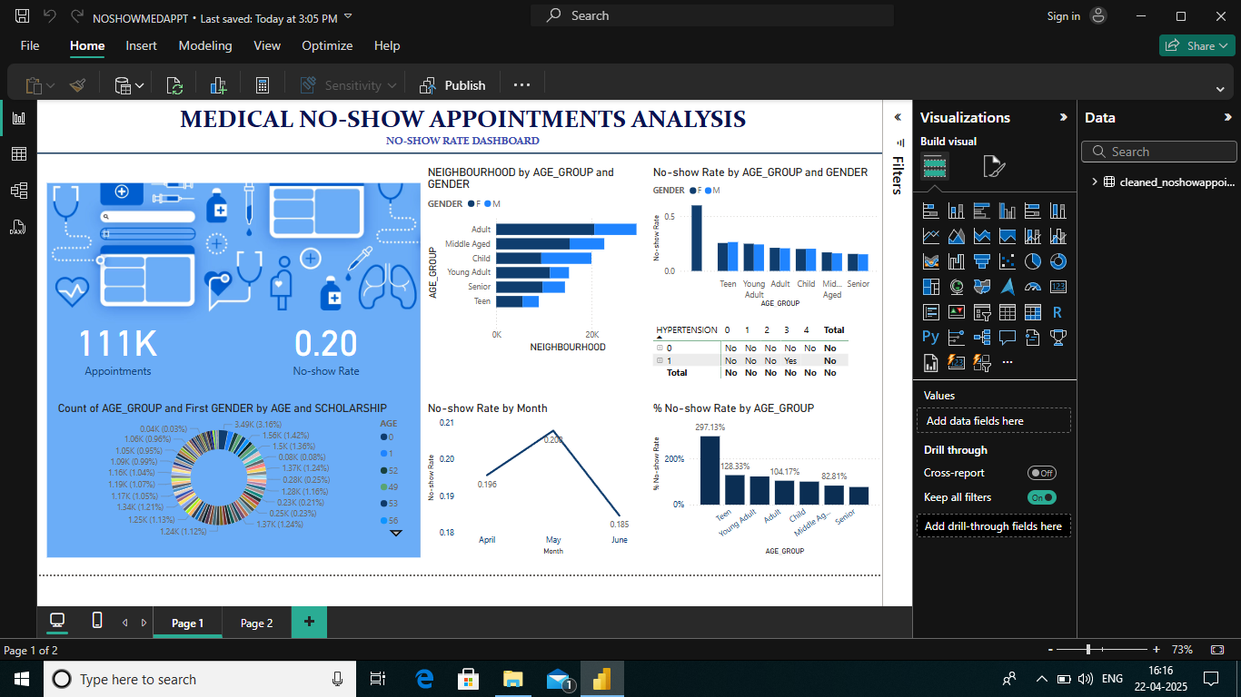
DASHBOARD

