Slide 1
01
Problem Statement
IDEA / PROJECT TITLE
TEAM / ORGANIZATION
THEME
Multi Mode AI Smart Glass with contextual task
guidance like cooking and visual memory for visually impaired users
Neural Nexus/Chennai Institute Of Technology
Other Frontier Technologies
CORE PROBLEM
TARGET USERS / BENEFICIARIES
  Visually impaired people face difficulty identifying ingredients, following recipes, monitoring cooking and handling heat safely.
  Existing tools mainly provide recipes, voice assistance or basic object detection.
  They do not understand the complete cooking process or provide continuous guidance based on what is happening in the kitchen.
Primary: Visually impaired individuals
Secondary: Elderly and low-vision users
Application: Assistive healthcare, rehabilitation and independent living
KEY PAIN POINTS
1. Difficulty identifying ingredients
2. Difficulty following cooking steps
3. Risk of burns, gas leaks and cooking mistakes
4. Dependence on caregivers for daily cooking
MSME Idea Hackathon 6.0 | 1/5 | CITBIF

Slide 2
02
Proposed Solution
PROPOSED INNOVATION
Ingredient Recognition
Step-by-Step Cooking Guide
  VisionChef is an assistive cooking system that combines lightweight smart glasses, Edge AI, a smart pantry and kitchen safety sensors.
  The glasses capture the user's view and voice, while a Raspberry Pi 5 based Edge AI Hub processes the information locally.
  It identifies ingredients, understands the cooking step, detects common mistakes and provides voice guidance.
  The system is designed specifically for independent cooking rather than general object detection.
  It also includes a physical camera shutter, local processing and multilingual voice interaction for privacy and accessibility.
Identifies common ingredients and kitchen utensils using the camera and AI vision.
Provides spoken instructions based on the current recipe and cooking stage.
Cooking Mistake Detection
Kitchen Safety Monitoring
Warns the user when the wrong ingredient or cooking action is detected.
Detects risks such as gas leakage, smoke, flame and excessive temperature.
Smart Pantry
Privacy & Voice Assistant
Uses RFID/QR identification, tactile labels and voice guidance to help users locate ingredients.
Uses local Edge AI, a physical camera shutter and multilingual voice interaction.
EXPECTED OUTCOME
Safer and more independent cooking, reduced dependence on caregivers, faster local assistance, improved privacy and a practical path toward an affordable commercial assistive product.
MSME Idea Hackathon 6.0 | 2/5 | CITBIF

Slide 3
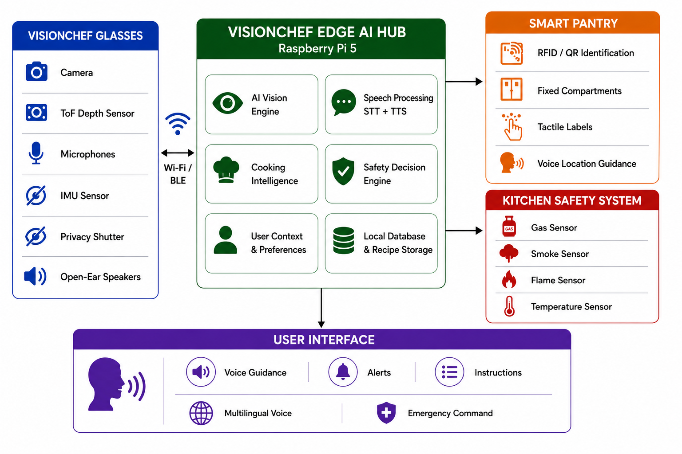
03
Schematic Diagram / System Architecture
COMPONENTS
TECHNOLOGY STACK
OUTPUT / APPLICATION
  Hardware: Raspberry Pi 5, camera, ToF sensor, ESP32, MEMS microphones, speakers and kitchen sensors
  AI / Software: Python, OpenCV, YOLO, speech-to-text, text-to-speech and local AI models
  Communication: Wi-Fi and Bluetooth Low Energy
  Control: Edge AI decision engine, local database and sensor processing
1. VisionChef Smart Glasses
Camera + Audio + Motion Sensors
2. VisionChef Edge AI Hub
Raspberry Pi 5 + Edge AI
3. Smart Pantry
Ingredient Location + Guidance
4. Kitchen Safety System
Gas + Smoke + Flame + Temperature
Product Output: Real-time cooking guidance and safety alerts through open-ear speakers.
Performance Metrics: Ingredient recognition accuracy, response time, battery endurance and safety detection reliability.
End Use: Homes, rehabilitation centres, assisted-living environments and other accessibility-focused settings.
MSME Idea Hackathon 6.0 | 3/5 | CITBIF

Slide 4
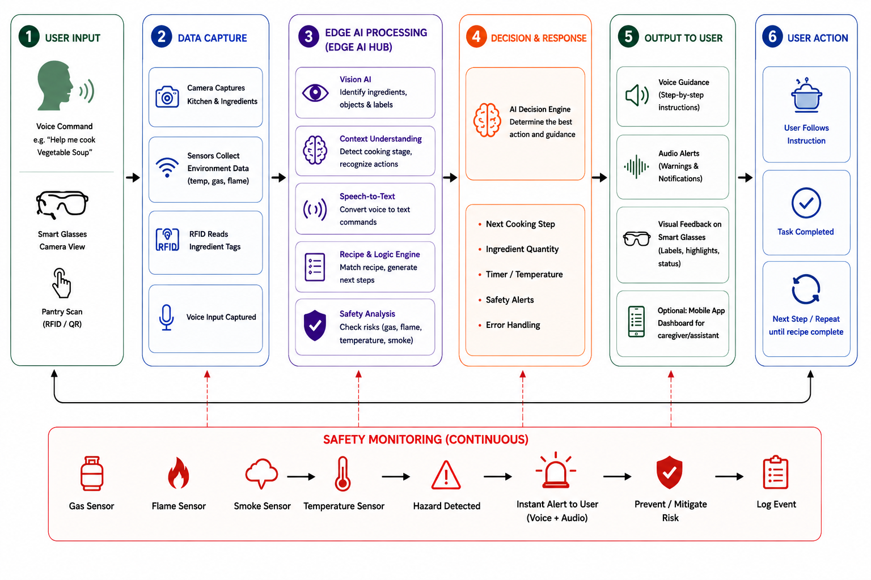
04
Process Flow
KEY OPERATING PRINCIPLE
KEY PERFORMANCE INDICATORS
VisionChef listens to the user's voice and receives visual and sensor information from the kitchen. The Edge AI Hub processes the information locally, identifies the cooking context, checks the recipe and safety conditions, and provides short voice instructions through the open-ear speakers.
  Ingredient Recognition Accuracy — How reliably VisionChef identifies ingredients.
  Voice Response Time — How quickly the system responds after a user command or detected event.
  Safety Detection Reliability — How reliably the system detects gas, smoke, flame and temperature risks.
MSME Idea Hackathon 6.0 | 4/5 | CITBIF

Slide 5
05
Market Potential
TAM
₹ 20,800 Cr
India assistive-tech market
SAM
₹ 730 Cr
Vision / independent-living focus*
SOM
₹ 22 Cr
Initial 5-year target*
TARGET MARKET
Primary: Visually impaired users
Secondary: Elderly & low-vision users
Partners: Rehabilitation & assisted-living centres
Market: Tamil Nadu → India → Global
MARKET OPPORTUNITY
COMPETITIVE / MARKET ADVANTAGE
  Large need for affordable assistive technologies.
  Visually impaired users need greater independence in daily activities.
  Hands-free voice assistance can reduce dependence on caregivers.
  Edge AI makes local and privacy-focused processing possible.
  The product can expand from individual homes to rehabilitation and assisted-living environments.
  Cost-Fixed-location smart pantry reduces the need for multiple weight sensors.
  Technology-Combines smart glasses, Edge AI, cooking assistance and kitchen safety in one system.
  Performance-Local processing can provide low-latency responses without requiring continuous cloud access.
  Scalabilit-Modular glasses, pantry and sensor architecture can be adapted to different kitchen environments.
COMMERCIAL POTENTIAL
Affordable assistive product with direct-sales and healthcare partnership opportunities. Start with a Tamil Nadu pilot and scale across India through modular deployment.
MSME Idea Hackathon 6.0 | 5/5 | CITBIF

