Slide 1


Department of Computer Science and Engineering
EMBEDDED PROGRAMMING
WATER TURBIDITY MONITORING SYSTEM USING ARDUINO
Presentation by
Harini R (24CS0298)
Supervisor
Mr. K. Madhavan
PBL In-charge: Mr. Muthupandi G
EMBEDDED PROGRAMMING FINAL REVIEW PPT

Slide 2
CONTENTS
Introduction
Problem Statement & Objectives
Project Description
Aim and Scope
Literature Survey & Research Gap
Technical Background
Hardware & Software Components
Methodology
Logical Design
Block Diagram Design
Circuit Diagram
Physical Design & Prototype
Experimental Results & Performance Analysis
Cost Estimation
Future Scope & Conclusion
References
EMBEDDED PROGRAMMING FINAL REVIEW PPT

Slide 3
Introduction
Turbidity (cloudiness of water) is a key early indicator of water quality.
Suspended particles scatter or block light — the more particles, the higher the turbidity, measured in NTU.
Most households have no quick, low-cost way to check water turbidity.
This project builds a low-cost standalone embedded system: an analog turbidity sensor read by an Arduino UNO.
Firmware converts the sensor voltage to an estimated NTU value, compares it with a 50 NTU threshold, and shows a Safe / Unsafe verdict on a 16×2 I2C LCD and the Serial Monitor every 2 seconds.
EMBEDDED PROGRAMMING FINAL REVIEW PPT

Slide 4
Problem Statement
Problem Statement
Laboratory testing: accurate (nephelometry, EPA 180.1) but results take days and each test costs money.
Visual inspection: instant and free, but subjective — water above safe turbidity can still look clear.
Portable handheld meters: costly (₹5,000–20,000) and need manual testing each time.
No continuous monitoring and no automatic verdict a non-technical user can read.
Objectives
Build a low-cost standalone device that continuously measures turbidity.
Convert sensor voltage to estimated NTU in firmware and give an automatic Safe / Unsafe verdict (configurable 50 NTU threshold).
Show the result on a 16×2 I2C LCD and log ADC, voltage and NTU on the Serial Monitor.
Keep the build compact, portable and under ₹1,600.
EMBEDDED PROGRAMMING FINAL REVIEW PPT

Slide 5
Project Description
A self-contained device that continuously measures turbidity and gives an automatic Safe / Unsafe verdict.
Arduino UNO samples the analog sensor on A0 every 2 seconds and converts voltage to estimated NTU in firmware.
Verdict and NTU are shown on the 16×2 I2C LCD; every reading (ADC, voltage, NTU) is also logged on the Serial Monitor.
Threshold (50 NTU) is configurable in code; compact, portable build costing under ₹1,600.
Reports turbidity only — it indicates “no visible particulate contamination”, not guaranteed potability.
EMBEDDED PROGRAMMING FINAL REVIEW PPT

Slide 6
Aim and Scope of the Proposed work
Aim
To design and build a low-cost, standalone embedded system that continuously measures water turbidity using an Arduino UNO and gives an instant on-device Safe / Unsafe verdict.
Scope
Turbidity measurement only (analog sensor, 0–5 V, 10-bit ADC).
Continuous sampling every 2 seconds for household-level use.
Indicates “no visible particulate contamination”, not guaranteed potability.
Absolute NTU accuracy depends on per-sensor calibration (next step).
EMBEDDED PROGRAMMING FINAL REVIEW PPT

Slide 7
Literature Survey
Kori & Rajashekarappa (2022) [1]: turbidity can be assessed from light scattered or blocked by suspended particles — the principle used here.
Bankar et al. (2026) [2]: Arduino UNO system that classifies water into four turbidity bands (clean to heavily contaminated).
Ramadhan, Hidayat et al. (2020) [3]: Arduino UNO turbidity meter with LED/light sensor and LCD — same low-cost hardware combination as this prototype.
Mukta et al. (2021) [4]; Chettri (2023) [6]: multi-sensor and IoT/cloud water monitors — more capable, but costlier and more complex.
Research gap: existing options are either expensive or complex; a simple, always-on, low-cost device with an instant on-device verdict is still needed.
EMBEDDED PROGRAMMING FINAL REVIEW PPT

Slide 8
Technical Background
Sensing principle: an IR LED shines through the water sample; suspended particles scatter or block the light, so the phototransistor output voltage changes with cloudiness.
Unit: NTU (nephelometric turbidity unit); laboratory reference method is nephelometry (EPA 180.1).
Acquisition: analog sensor output (0–5 V) read on A0 by the Arduino’s 10-bit ADC (0–1023).
Processing: ADC → voltage → NTU using a calibration equation; negative NTU is clamped to 0.
Decision & output: compare with the 50 NTU threshold; verdict on the I2C LCD (A4 SDA, A5 SCL) and Serial Monitor at 9600 baud.
EMBEDDED PROGRAMMING FINAL REVIEW PPT

Slide 9
Hardware & Software Components
Hardware
Arduino UNO (ATmega328P) — controller
Analog turbidity sensor — probe (IR LED + phototransistor) + signal board
16×2 LCD with I2C backpack — display
Jumper wires and USB cable (5 V power, serial)
Transparent plastic enclosure
Software
Arduino IDE 2.3.10
Embedded C (Arduino sketch)
LCDIC2 I2C LCD library (Helder Rodrigues)
Serial Monitor at 9600 baud for ADC, voltage and NTU logging
EMBEDDED PROGRAMMING FINAL REVIEW PPT

Slide 10
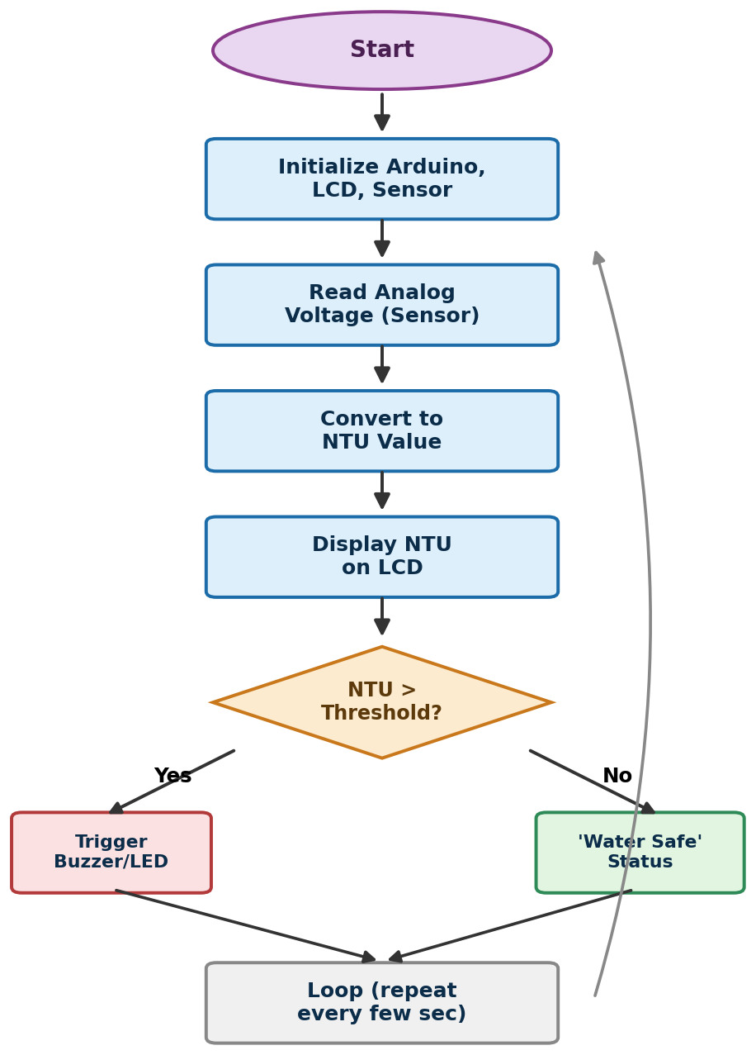
Methodology
Initialize LCD and Serial (9600 baud)
Read analog value on A0
Convert ADC → voltage → NTU
Clamp negative NTU to 0
Compare with 50 NTU threshold
Show verdict on LCD and Serial
Wait 2 s and repeat
EMBEDDED PROGRAMMING FINAL REVIEW PPT

Slide 11
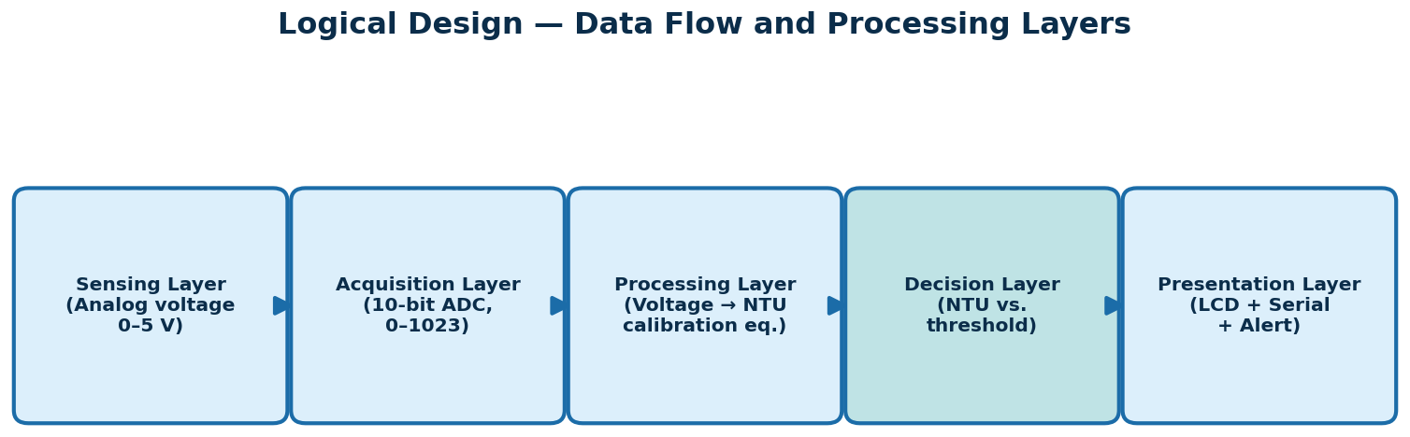
Logical Design
Five-layer data flow: sensing (analog 0–5 V) → acquisition (10-bit ADC) → processing (voltage → NTU) → decision (NTU vs. threshold) → presentation (LCD + Serial + alert).
EMBEDDED PROGRAMMING FINAL REVIEW PPT

Slide 12
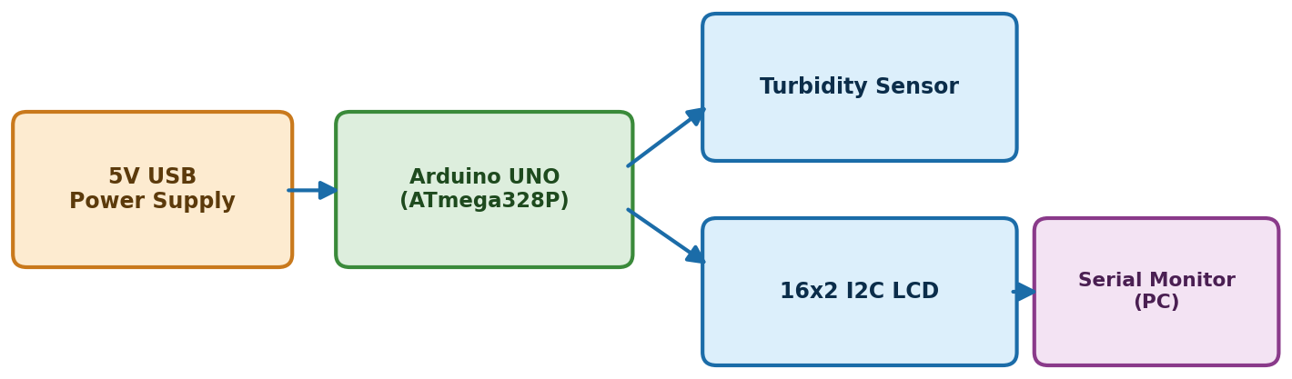
Block Diagram Design
A 5 V USB supply powers the Arduino UNO (ATmega328P), which reads the turbidity sensor and drives the 16×2 I2C LCD; readings are also sent to the Serial Monitor on the PC.
EMBEDDED PROGRAMMING FINAL REVIEW PPT

Slide 13
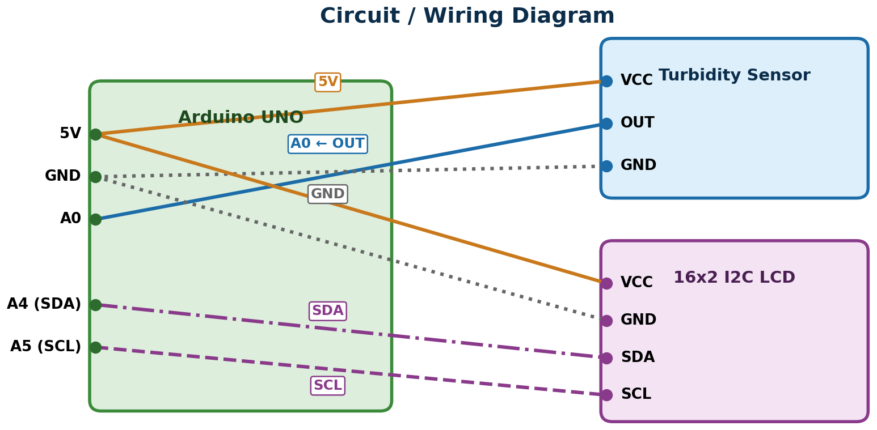
Circuit Diagram
Arduino pin | Connected to
5V | Sensor VCC, LCD VCC
GND | Sensor GND, LCD GND
A0 | Sensor OUT
A4 (SDA) | LCD SDA
A5 (SCL) | LCD SCL
EMBEDDED PROGRAMMING FINAL REVIEW PPT

Slide 14
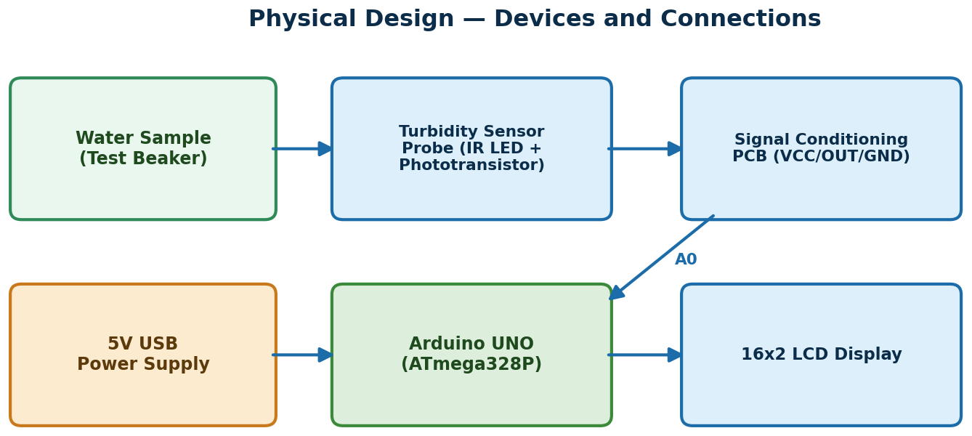
Physical Design & Prototype
Arduino UNO (ATmega328P) — controller
Analog turbidity sensor — probe + signal conditioning board
16×2 LCD with I2C backpack — display
Jumper wires and USB cable (5 V power, serial)
Transparent plastic enclosure
EMBEDDED PROGRAMMING FINAL REVIEW PPT

Slide 15
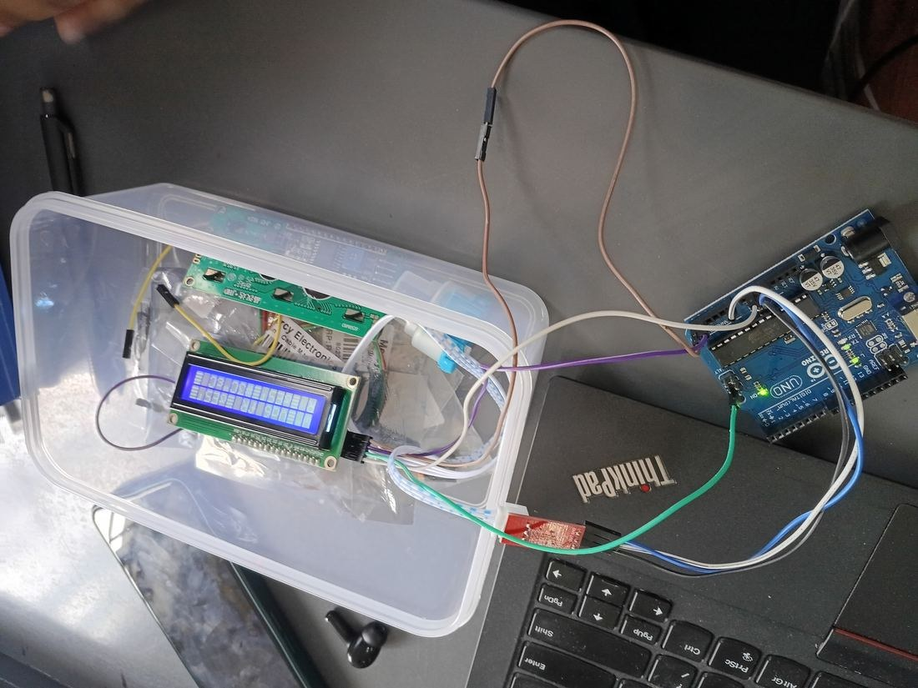
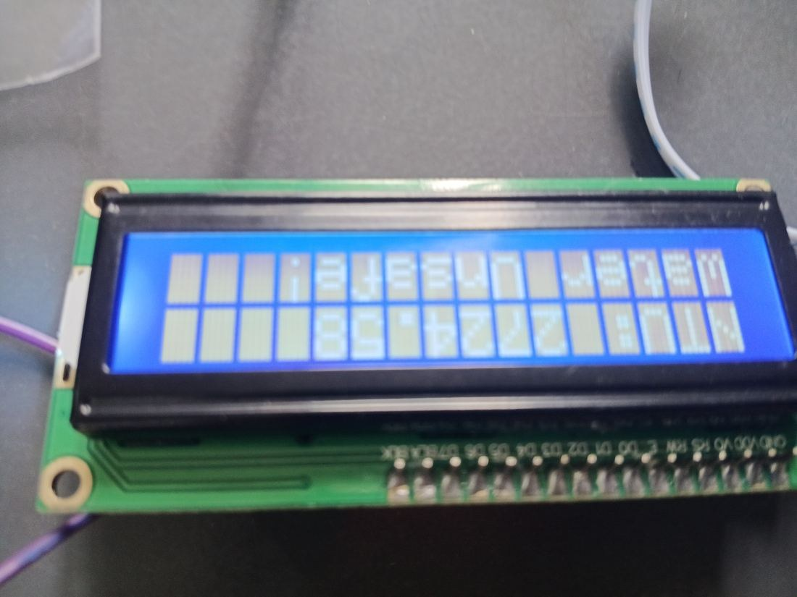
Hardware Model
Complete assembled prototype
LCD showing live NTU reading and verdict
EMBEDDED PROGRAMMING FINAL REVIEW PPT

Slide 16
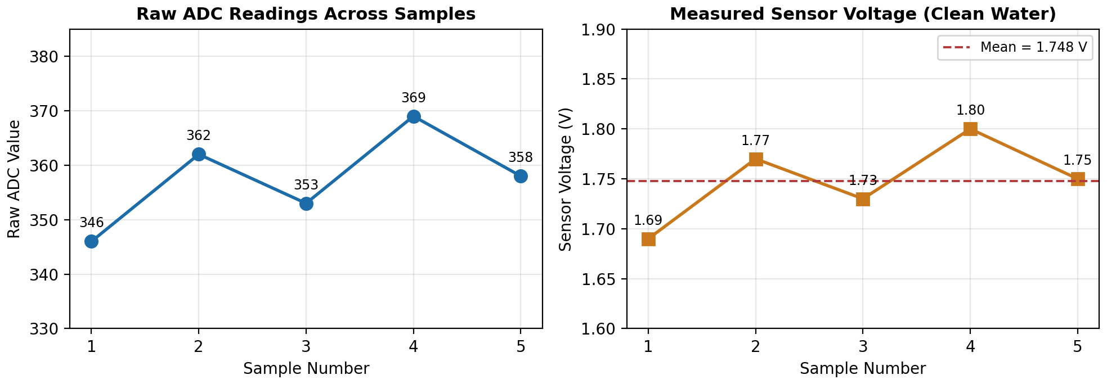
Experimental Results & Performance Analysis
Sample | ADC | Voltage (V) | Computed NTU
1 | 346 | 1.69 | 2153.77
2 | 362 | 1.77 | 2299.64
3 | 353 | 1.73 | 2219.27
4 | 369 | 1.80 | 2359.14
5 | 358 | 1.75 | 2264.45
Mean | 357.6 | 1.748 | 2259.25
Calibration mismatch: the equation assumes ≈4 V for clear water, but this sensor reads 1.69–1.80 V, so NTU values and the Safe/Unsafe verdict are not yet validated. Re-calibration is the next step.
Clean tap water. Voltage std. dev. ±0.042 V — the signal is stable and repeatable.
EMBEDDED PROGRAMMING FINAL REVIEW PPT

Slide 17
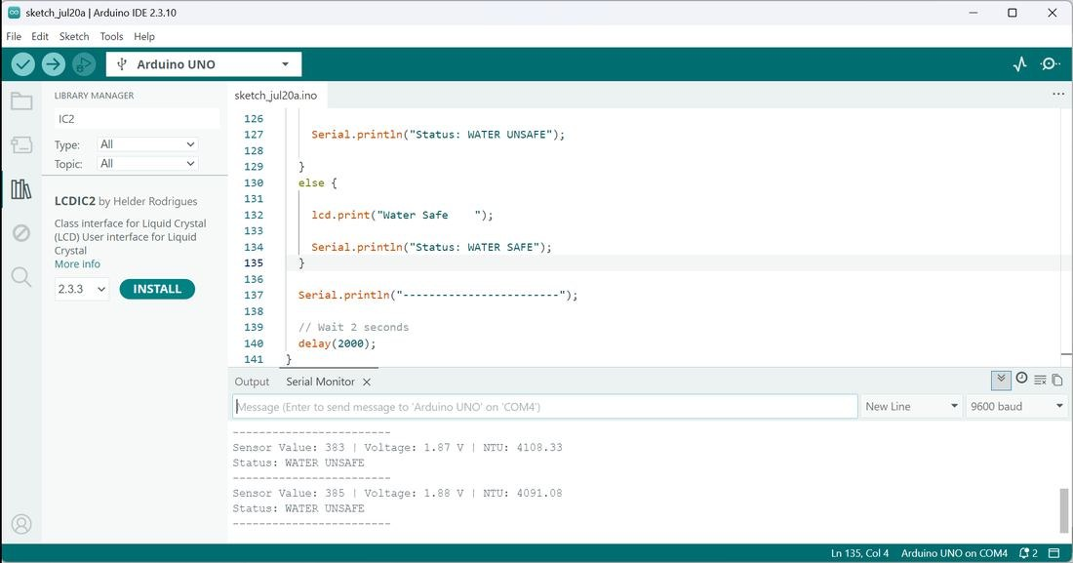
Testing & Simulation Result
A circuit simulator (Wokwi / Tinkercad) was not used for the final build.
The sensor’s real optical behaviour cannot be reproduced in a simulator, so the design was tested directly on physical hardware.
Serial Monitor output from the hardware test is shown here.
All functional test cases passed except absolute NTU accuracy.
Live Serial Monitor output
EMBEDDED PROGRAMMING FINAL REVIEW PPT

Slide 18
Comparison with Existing Systems
Parameter | Lab Nephelometer | Portable Meter | Proposed System
Approx. cost | ₹50,000+ | ₹5,000–20,000 | ₹960–1,600
Accuracy | Very high | High | Moderate (needs calibration)
Portability | Low | High | High
Continuous monitoring | No | No | Yes (every 2 s)
Operator skill | High | Moderate | Low
Household suitable | No | Limited | Yes
Strength: low cost with continuous monitoring. Limitation: absolute accuracy depends on per-sensor calibration.
EMBEDDED PROGRAMMING FINAL REVIEW PPT

Slide 19
Cost Estimation
Lab nephelometer
₹50,000+
Portable meter
₹5,000–20,000
Proposed system
₹960–1,600
Prototype build: Arduino UNO, analog turbidity sensor, 16×2 I2C LCD, jumper wires, USB cable and enclosure.
Total cost ₹960–1,600 — a fraction of a portable handheld meter, with continuous monitoring built in.
EMBEDDED PROGRAMMING FINAL REVIEW PPT

Slide 20
Future Scope & Conclusion
Conclusion
A low-cost Arduino turbidity monitor was built, enclosed and tested with real tap water.
The sensor signal is stable and repeatable (1.69–1.80 V, ±0.042 V); all functional tests passed.
Absolute NTU accuracy is not yet validated — the equation assumes ≈4 V for clear water.
Cost of ₹960–1,600 vs ₹5,000–20,000 for portable meters.
Future Scope
Sensor-specific calibration (re-calibration is the next step).
Wireless / IoT logging.
EMBEDDED PROGRAMMING FINAL REVIEW PPT

Slide 21
References
[1] S. Kori and Rajashekarappa, “Measurement of Turbidity Using Light Scattering,” Int. Conf. on Sensors and Instrumentation, 2022.
[2] S. Bankar et al., “Arduino-based Water Quality Monitoring System Using Turbidity Sensor,” J. Water Pollution & Purification Research, 2026.
[3] M. Ramadhan, R. Hidayat et al., “Arduino Uno-based Water Turbidity Meter Using LDR and LED Sensors,” J. Physics: Conf. Series, 2020.
[4] S. Mukta et al., “IoT Based Smart Water Quality Monitoring System,” IEEE Conf. Publication / ScienceDirect, 2021.
[6] P. Chettri, “IoT Based Water Quality Monitoring System Using Arduino Uno R3 & NodeMCU ESP8266,” ResearchGate, 2023.
[9] “IoT-Based Water Quality Monitoring System in Philippine Off-Grid Communities,” arXiv:2410.14619, 2024.
[11] DFRobot, “Turbidity Sensor SKU: SEN0189 — Wiki and Datasheet,” wiki.dfrobot.com.
[12] Arduino, “Arduino UNO Rev3 Product Reference,” docs.arduino.cc.
[14] U.S. EPA, “Method 180.1: Determination of Turbidity by Nephelometry,” Rev. 2.0, 1993.
[15] World Health Organization, “Guidelines for Drinking-water Quality,” 4th ed., Geneva.
[16] Bureau of Indian Standards, “IS 10500:2012 — Drinking Water Specification,” New Delhi.
Full list of 20 references: see Chapter 13 of the project report.
EMBEDDED PROGRAMMING FINAL REVIEW PPT

