Slide 1


Department of Computer Science and Engineering
MOBILE APPLICATION DEVELOPMENT
AI-POWERED SMART SHELF & FOOD SAFETY AUDITOR
Presentation by: Harini R (24CS0298)
Supervisor: Mrs. Lydia Shammi
MOBILE APPLICATION DEVELOPMENT – PROJECT REVIEW

Slide 2
Contents
Problem Statement
Aim, Objectives and Scope of the Proposed Work
Literature Review & Existing Systems
Technical Background & Development Environment
Data Collection & Input Data
Methodology & System Design
Implementation – Modules, Diagrams and App Screens
Notifications & SMS Alerts
Implementation Status, Testing & Results
Conclusion, Future Enhancements & Applications
MOBILE APPLICATION DEVELOPMENT – PROJECT REVIEW

Slide 3
Problem Statement
Stored food is forgotten and expires unnoticed.
No digital pantry record: duplicates are bought, expiry dates untracked.
Usable food is discarded, wasting money and resources.
Existing apps solve one part only: lists stop at purchase, trackers give no recipes, recipe apps ignore pantry stock.
Goal: link tracking, reminders, AI cooking and analytics in one loop.
Forgotten stock
No pantry record
One part only
Items sit at the back of the shelf until they expire
Duplicates get bought and expiry dates go untracked
Lists, trackers and recipe apps each cover just a piece
MOBILE APPLICATION DEVELOPMENT – PROJECT REVIEW

Slide 4
Aim and Objectives
Aim
To build a focused Android app that makes household food-waste reduction practical by joining expiry tracking, reminders, AI-assisted cooking and usage analytics in one continuous loop.
Read printed expiry dates from product packaging
Keep a persistent, searchable, offline-capable pantry record
01
02
Compute a dynamic, date-based expiry countdown
Send configurable reminders (7 / 3 / 1 day, on the day)
03
04
Suggest expiry-aware AI recipes with nutrition info
Log real cooked / expired events in a waste dashboard
05
06
MOBILE APPLICATION DEVELOPMENT – PROJECT REVIEW

Slide 5
Scope of the Proposed Work
In Scope (Implemented)
Out of Scope (This Phase)
On-device barcode / text scanning with ML Kit, plus manual entry
Room pantry database with live expiry countdown and colour-coded status
Configurable reminders delivered as push notifications (WorkManager + FCM)
Phone-OTP login by SMS (Firebase Phone Authentication)
Expiry-aware AI recipes with nutrition info through a secure backend
Cook Mode, “I Cooked This!” and food-waste analytics
Voice pantry assistant and five personality modes
Shared family pantry accounts across devices
Nutrition tracking against personal dietary goals
Purchase-history expiry estimates for undated items
Hands-free voice guidance inside Cook Mode
Analytics for money saved and environmental impact
Faded or handwritten labels (manual entry is the fallback)
Multi-household use: current design targets a single household
MOBILE APPLICATION DEVELOPMENT – PROJECT REVIEW

Slide 6
Literature Review – Papers 1–8
# | Paper / Author (Year) | Description
1 | FreshBot – AI Food Freshness Detector (RJPN, 2025) | VGG16 CNN trained in Colab, 97% accuracy classifying fruits/veg fresh vs rotten; deployed via Streamlit + Flutter with a chatbot assistant.
2 | Recent Advances of AI-Aided Intelligent Packaging (PMC, 2023) | Review of AI-assisted packaging for freshness testing; flags the field as experimental, with no unified materials + AI system.
3 | Intelligent Equipment for Quality Deterioration Detection (Foods, 2024) | Survey of computer vision, e-nose, hyperspectral imaging, and NIR sensors for real-time quality tracking across the supply chain.
4 | Food Freshness Detection via Computer Vision (IEEE, 2024) | Pixel-neighborhood difference algorithm detects freshness change from image regions, without deep-learning overhead.
5 | FreshDNN: Deep Learning for Fruit/Veg Freshness (2023) | Lightweight custom CNN benchmarked against 6 pretrained models on merged Kaggle + Mendeley data, 16 produce classes.
6 | Application of Machine Vision in Food Computing (ScienceDirect, 2024) | Reviews ML/deep-learning image recognition across food safety, nutrition analysis, and process monitoring.
7 | Freshness Detection via Deep Features + PCA (2023) | Hybrid EfficientNetB7/VGG16/VGG19/ResNet50 model — 99.92% precision, 1.2s average response, near real-time.
8 | IoT-Based Smart Inventory Management for Kitchen (2025) | Real-time kitchen inventory via IoT sensors to track stock levels and prevent spoilage/waste.
MOBILE APPLICATION DEVELOPMENT – PROJECT REVIEW

Slide 7
Literature Review – Papers 9–15
# | Paper / Author (Year) | Description
9 | Smart Inventory System for Expiry Date Tracking – ESP32 (2025) | ESP32 smart rack notifies owners a week before expiry via LCD + push alerts; adds smoke/moisture sensors.
10 | Smart Grocery Kit: IoT-Based Automated Inventory (2025) | Reviews IoT camera-based inventory tracking; cites federated-learning-driven freshness monitoring via gas/temp sensors.
11 | Extracting Nutritional Info from Bilingual Labels Using LLMs (2025) | Benchmarks GPT-4V, GPT-4o, and Gemini on label nutrition extraction; GPT-4o edges out Gemini on non-English text.
12 | Multimodal Fine-Grained Grocery Product Recognition (2024) | Combines product images with OCR label text to outperform image-only or text-only models on SKU recognition.
13 | Harmful Ingredient Detection via OCR + bi-LSTM (WellnessCare, 2025) | OCR pipeline feeds a bi-LSTM model to flag harmful ingredients, matched against a curated hazard database.
14 | OCR-Based Ingredient Recognition for Consumer Well-Being (2024) | Android app using Google ML Kit OCR + Levenshtein matching to flag toxic/allergenic ingredients from label scans.
15 | NutriScan: AI-Based Ingredient Detection & Evaluation (IJERT, 2025) | Tesseract OCR + Random Forest (200 trees) sorts ingredients into Healthy/Neutral/Harmful using E-number/additive features.
Research Gap: Papers 1–7 tackle freshness detection, 8–10 tackle inventory tracking, and 11–15 tackle label reading / ingredient analysis — none of them joins on-device label scanning, a persistent pantry with reminders, and AI cooking in one household mobile app. This project targets exactly that gap.
MOBILE APPLICATION DEVELOPMENT – PROJECT REVIEW

Slide 8
Research Gap – Where This Project Fits
Freshness Detection
Inventory Tracking
Label Reading / Ingredients
Papers 1–7
Papers 8–10
Papers 11–15
CNNs, computer vision, packaging and sensing for fresh vs rotten
IoT racks, ESP32 and camera-based stock tracking
OCR + ML / LLMs that read and evaluate product labels
AI-Powered Smart Shelf & Food Safety Auditor
Scan → track expiry → remind → cook → analyse, all in a single Android app
MOBILE APPLICATION DEVELOPMENT – PROJECT REVIEW

Slide 9
Existing Systems vs Smart Pantry
Type of app | Expiry | AI recipe | Waste stats | Offline | Home
Grocery list (Bring!…) | No | No | No | Part | Part
Expiry tracker (NoWaste…) | Yes | Limited | Limited | Yes | Yes
Recipe apps (Yummly…) | No | Manual | No | No | No
Retail inventory apps | No | No | No | Part | No
Smart Pantry | Yes | Yes | Yes | Yes | Yes
Only Smart Pantry covers expiry tracking, AI recipes, waste statistics, offline use and a home-focused design together.
MOBILE APPLICATION DEVELOPMENT – PROJECT REVIEW

Slide 10
Technical Background – Software Stack
Kotlin
Coroutines / Flow
Jetpack Compose + XML
Room (SQLite)
Primary language for all application logic
Asynchronous work and live, reactive pantry queries
Declarative UI for the app screens
On-device pantry database that survives app close
ML Kit
WorkManager
Firebase Phone Auth
Firebase Cloud Messaging
On-device barcode and text recognition for scanning
Expiry reminder scheduler that runs in the background
OTP login delivered by SMS
Push notifications naming the expiring item
Retrofit / OkHttp
Secure Backend / API
Android Studio
Git / GitHub
Network calls to the secure AI backend
Keeps API keys off the APK (HTTPS only)
IDE, emulator (Pixel 6, API 34) and debugging
Version control and team collaboration
MOBILE APPLICATION DEVELOPMENT – PROJECT REVIEW

Slide 11
Technical Background – Core Concepts
On-device scanning
Local-first pantry
ML Kit reads the printed expiry date and barcode on the phone. If the label is unreadable the app asks for manual entry instead of inventing a date.
Room DAO + Flow keep the pantry on the device, so the core pantry keeps working offline while AI features fail gracefully.
One shared expiry utility
Secure backend & auth
Days remaining is always recalculated from the current date, so countdowns and colours stay consistent on every screen.
Only AI / nutrition requests go through the backend over HTTPS with keys kept off the APK; Phone-OTP login gates the whole app.
MOBILE APPLICATION DEVELOPMENT – PROJECT REVIEW

Slide 12
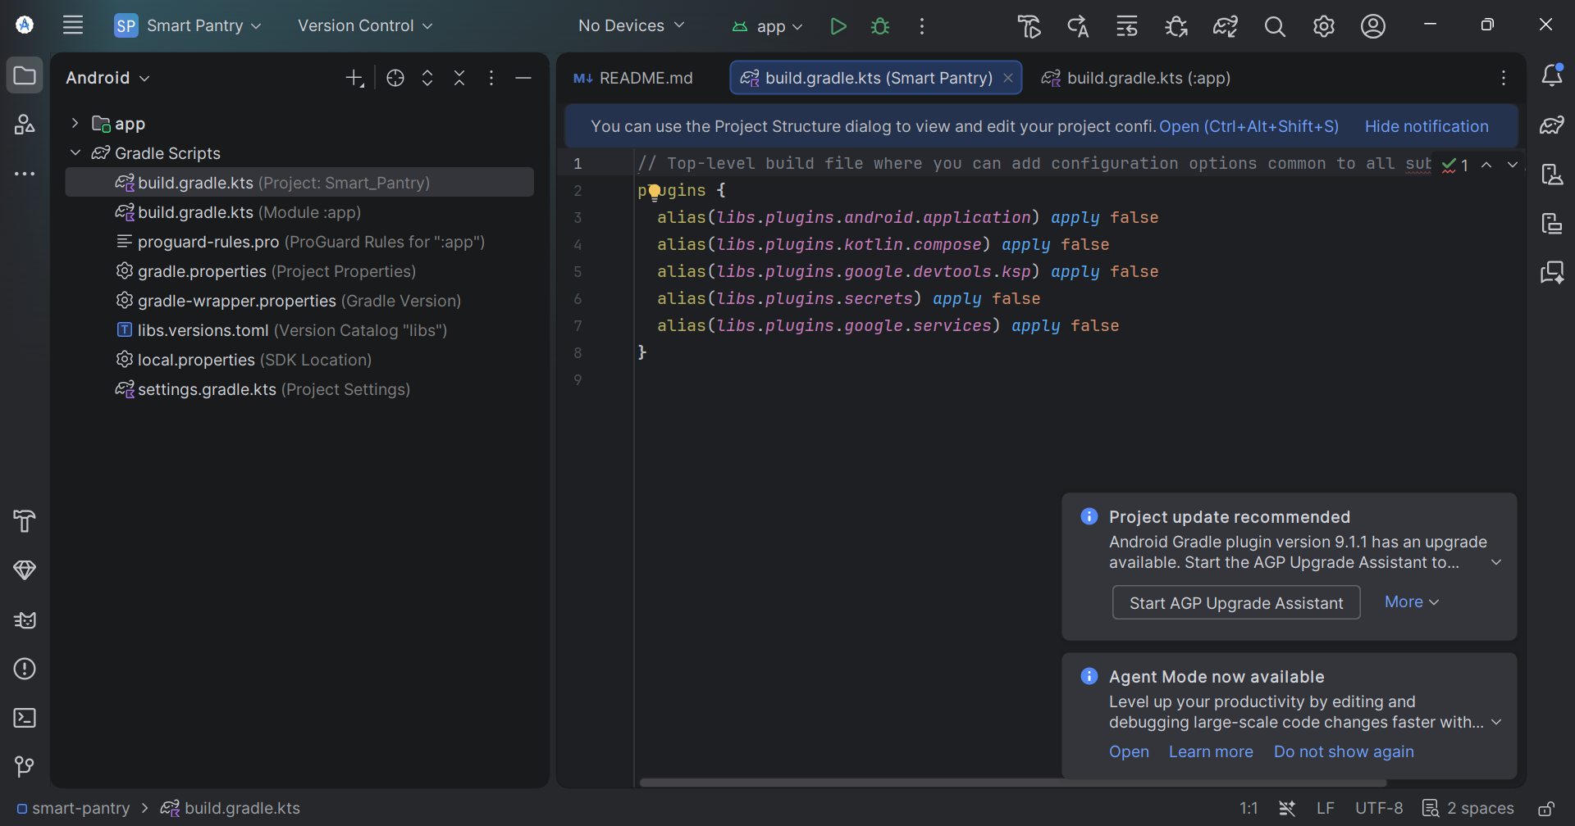
Development Environment – Android Studio
What the screenshot shows
Project Smart_Pantry with the :app module
Gradle scripts: build.gradle.kts (project + module), libs.versions.toml, settings.gradle.kts, proguard-rules.pro
Plugins applied: android.application, kotlin.compose, google.devtools.ksp, secrets, google.services
Smart Pantry project workspace in Android Studio (Gradle Kotlin DSL build scripts)
MOBILE APPLICATION DEVELOPMENT – PROJECT REVIEW

Slide 13
Data Collection & Input Data
No external dataset
PantryItem record
The app works on live user scans only: a package image is converted to text / barcode on the device and the user confirms the result.
name, brand, category, quantity, expiryDate, addedDate, image and notes — one row per item in the Room database.
Voice pantry queries
Where it was tested
The voice assistant takes spoken pantry questions as an additional input, using fixed intents.
Measured on the Android Studio emulator (Pixel 6, API 34); OTP, camera and push were verified on a physical phone.
MOBILE APPLICATION DEVELOPMENT – PROJECT REVIEW

Slide 14
Methodology – Closed-Loop Workflow
01
02
03
04
05
06
07
Scan
Identify
Read Expiry
Save
Remind
Cook
Reduce Waste
Camera + ML Kit
Name, brand, category
Printed date, else manual
User confirms → Room DB
7 / 3 / 1 / 0 days
AI recipe + Cook Mode
Analytics updated
↻ Repeats for every product entering the home · Phone-OTP login gates the whole flow
MOBILE APPLICATION DEVELOPMENT – PROJECT REVIEW

Slide 15
System Architecture
CLIENT LAYER (DEVICE)
SECURE MIDDLE LAYER
AI / EXTERNAL SERVICES
Android App (UI): Home · Scan · Pantry · Recipes · Analytics
Secure Backend / API: keeps API keys off the APK
AI Recipe Generation: LLM-based
ML Kit: on-device barcode / text scan
Firebase Phone Auth: OTP via SMS
Nutrition Info Provider
Room Database: local pantry store
Firebase Cloud Messaging: push notifications
Product Identification: OCR + product lookup
WorkManager: expiry reminder scheduler
Voice Assistant Engine: speech-to-text / intent
Pantry data stays local (offline-first); only AI / nutrition requests go through the backend over HTTPS.
MOBILE APPLICATION DEVELOPMENT – PROJECT REVIEW

Slide 16
Implementation – Modules & Logic
MVVM modules
Room DAO + Flow
auth, scan, pantry, recipes, cook mode and analytics, wired together through the ViewModel layer; each module exposes only what the next one needs.
The Pantry module exposes expiring items as a Flow sorted by days remaining; one shared expiry utility keeps every screen consistent.
Scan → confirm → save
WorkManager + FCM, Retrofit
Items are written to the Room database only after the user has reviewed and approved the detected fields.
WorkManager checks expiry dates and FCM sends reminders naming the item; Retrofit calls the secure AI backend; Firebase handles OTP login.
MOBILE APPLICATION DEVELOPMENT – PROJECT REVIEW

Slide 17
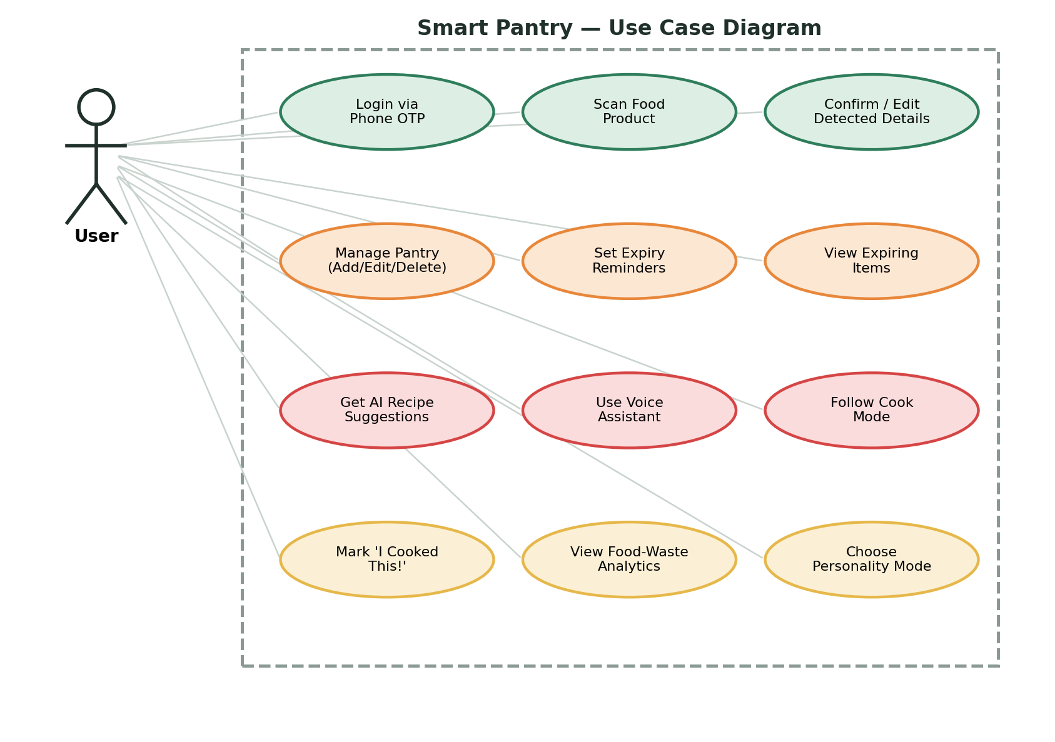
Use Case Diagram
What the user can do
Login via Phone OTP
Scan food product; confirm / edit detected details
Manage pantry; set expiry reminders; view expiring items
Get AI recipe suggestions; use voice assistant; follow Cook Mode
Mark “I Cooked This!”; view food-waste analytics; choose personality mode
MOBILE APPLICATION DEVELOPMENT – PROJECT REVIEW

Slide 18
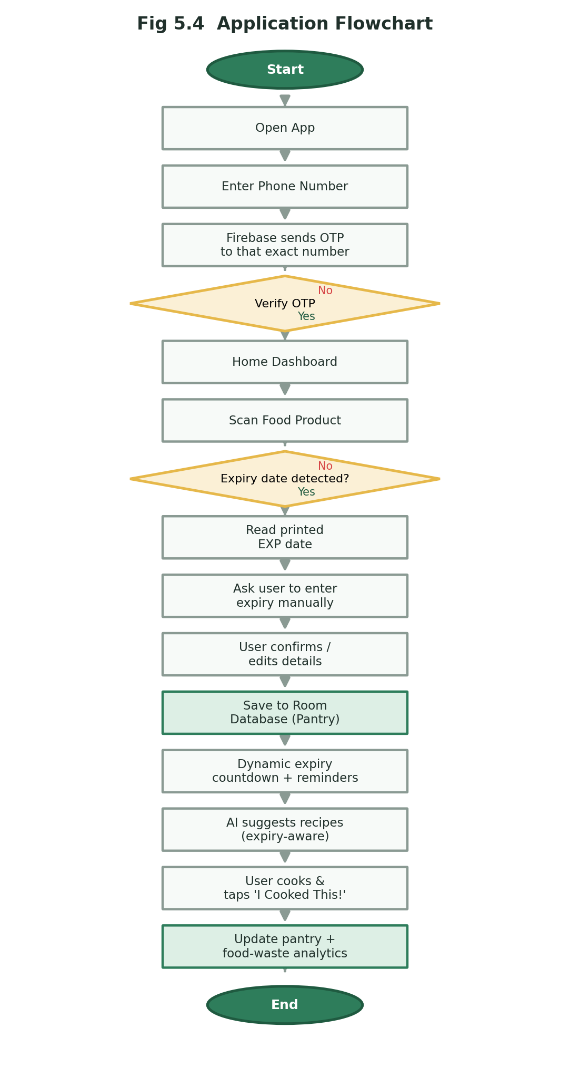
Application Flowchart
Main flow
Then the loop closes
Start → open app and verify phone OTP
Home dashboard → scan food product
Confirm / edit details → save to pantry (Room DB)
Expiry countdown and reminders
AI recipe suggestions
Cook Mode step by step
“I Cooked This!” updates the pantry and analytics
End
MOBILE APPLICATION DEVELOPMENT – PROJECT REVIEW

Slide 19
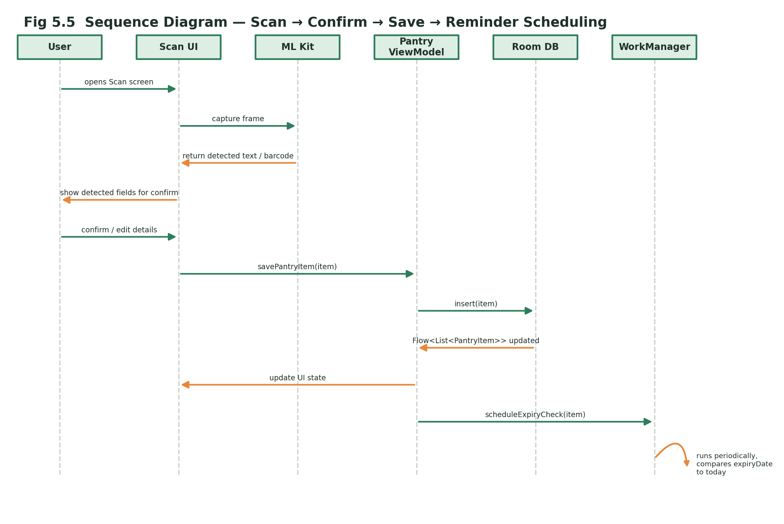
Sequence Diagram – Scan to Reminder
Participants
User, Scan UI, ML Kit
Pantry ViewModel, Room DB
WorkManager
The user scans, ML Kit returns the detected fields, the user confirms, the ViewModel saves to Room and WorkManager schedules the reminders for that item.
MOBILE APPLICATION DEVELOPMENT – PROJECT REVIEW

Slide 20
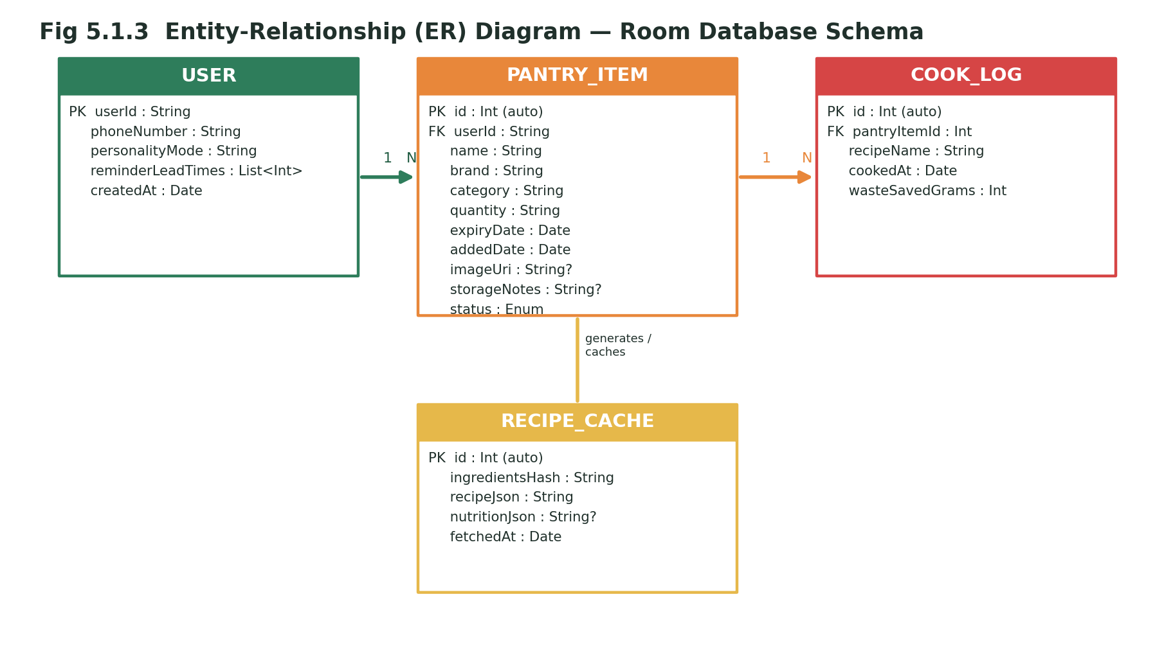
Database Design – ER Diagram
Room entities
USER – phone, personality mode, reminder lead times
PANTRY_ITEM – product details, expiry date, status
COOK_LOG – recipe, cooked date, waste saved (g)
RECIPE_CACHE – cached AI recipe and nutrition
MOBILE APPLICATION DEVELOPMENT – PROJECT REVIEW

Slide 21
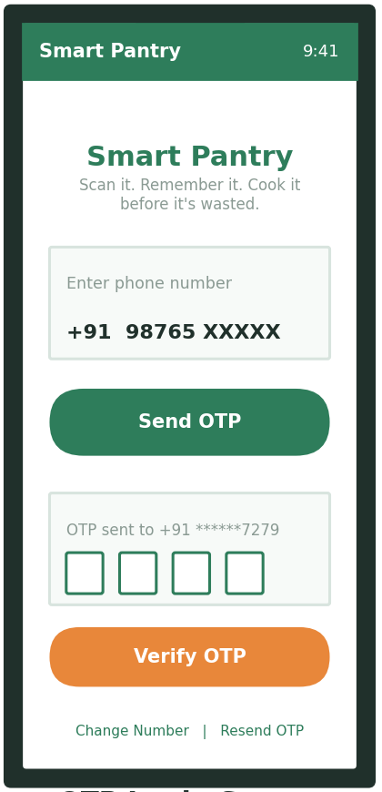
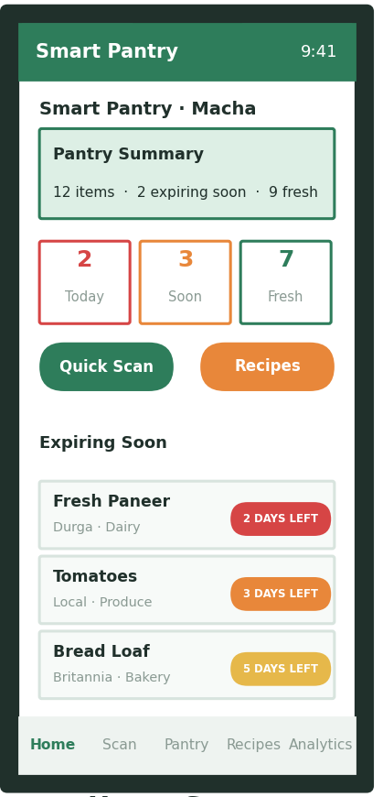
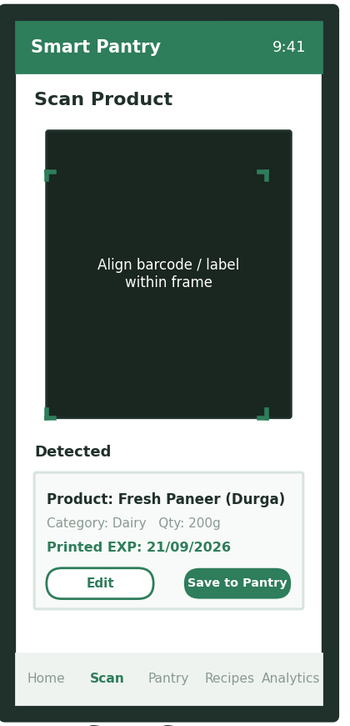
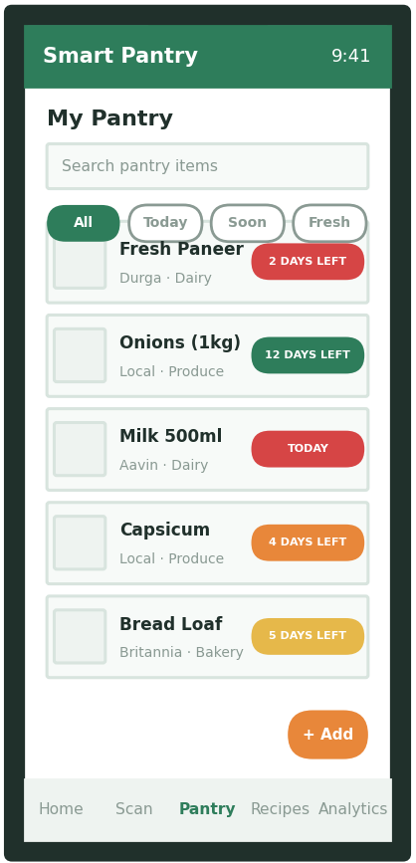
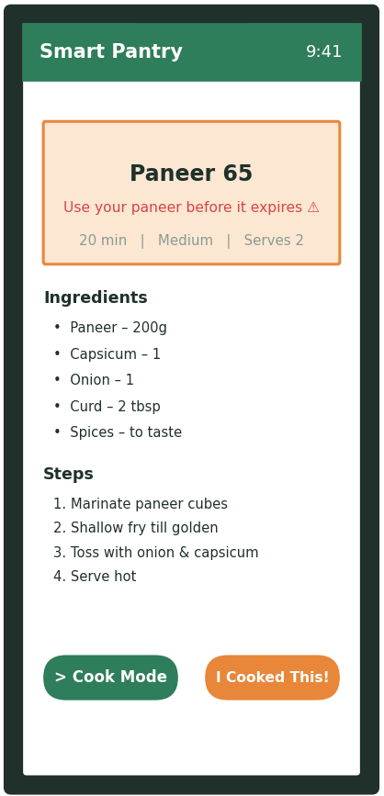
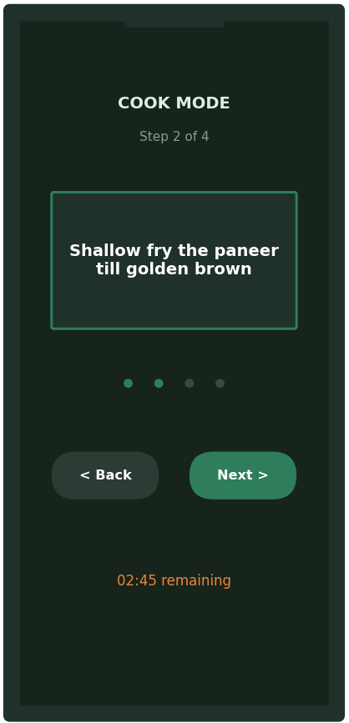
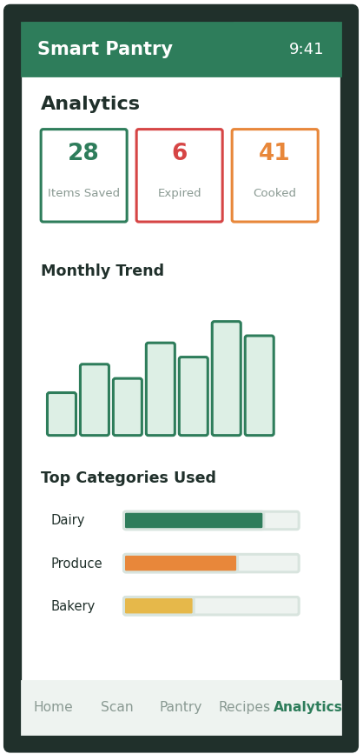
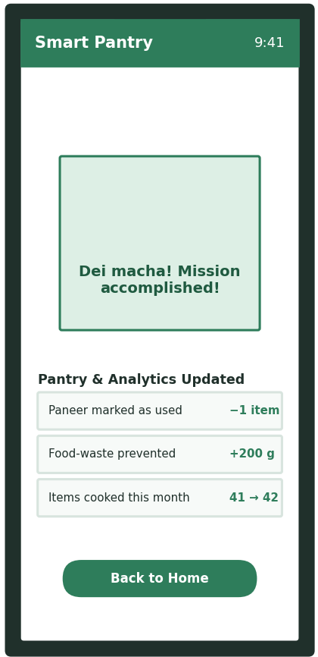
Developed App – Prototype Screens
OTP Login
Home
Scan
My Pantry
Recipe
Cook Mode
Analytics
Cooked
MOBILE APPLICATION DEVELOPMENT – PROJECT REVIEW

Slide 22
App Screen 1 – OTP Login
Login by SMS OTP
OTP bug fixed
Enter phone number, tap Send OTP
Firebase sends a real OTP SMS to that exact number
Verify OTP; “Change Number | Resend OTP” links
A stale cached number was being reused
The typed number is now the single source
Number normalised to E.164 (+91…)
No pantry screen, scan action or recipe request is reachable until Firebase Phone Authentication has verified the session.
Phone-OTP login screen
MOBILE APPLICATION DEVELOPMENT – PROJECT REVIEW

Slide 23
App Screen 2 – Home Dashboard
At-a-glance summary
Expiring Soon list
Pantry Summary card
Today / Soon / Fresh counters
Quick Scan and Recipes buttons
Colour-coded days-left badges
Bottom navigation: Home, Scan, Pantry, Recipes, Analytics
Personality greeting in the header
The same Room data feeds the dashboard, the Recipes module and the reminder scheduler, so every screen shows the same countdown.
Home dashboard
MOBILE APPLICATION DEVELOPMENT – PROJECT REVIEW

Slide 24
App Screen 3 – Scan Product
On-device scanning
User stays in control
Camera frame reads barcode / label with ML Kit
Detected card shows product, category, quantity and printed EXP
Edit the detected details or Save to Pantry
Unreadable date → manual-entry prompt
No invented expiry date
Items are saved to the Room database only after the user confirms the detected fields.
Scan screen with detected details
MOBILE APPLICATION DEVELOPMENT – PROJECT REVIEW

Slide 25
App Screen 4 – My Pantry
Pantry list
Manage items
Search pantry items
Filters: All / Today / Soon / Fresh
Live colour-coded countdown per item
+ Add for manual entry
Countdown recalculated from the current date
Works offline from the Room database
Filters are Room DAO queries, so “Expiring Today”, “Expiring Soon” and “Fresh” always return exactly the matching items as the date changes.
Pantry list with filters
MOBILE APPLICATION DEVELOPMENT – PROJECT REVIEW

Slide 26
App Screen 5 – Recipe Details
Expiry-aware recipes
Cook from the pantry
Dishes use the ingredients closest to expiry
“Use your paneer before it expires” prompt
Time, difficulty and servings shown
Ingredients and steps on one screen
> Cook Mode starts the walkthrough
I Cooked This! closes the loop
Recipes and nutrition info come from the AI backend through Retrofit; the suggestion list is biased by the Room expiry list.
Expiry-aware AI recipe
MOBILE APPLICATION DEVELOPMENT – PROJECT REVIEW

Slide 27
App Screen 6 – Cook Mode
Guided cooking
Why it matters
One step at a time (Step 2 of 4)
Back / Next controls
Countdown timer for the step
Keeps the cook on the recipe, not the phone
Finishing the recipe leads to “I Cooked This!”
Cook Mode turns a recipe suggestion into an action, which is the step that actually prevents waste.
Step-by-step Cook Mode
MOBILE APPLICATION DEVELOPMENT – PROJECT REVIEW

Slide 28
App Screen 7 – Food-Waste Analytics
Usage counters
Real data only
Items Saved, Expired and Cooked
Monthly trend chart
Top categories used
Updated by “I Cooked This!” events
Updated by “item expired” events
No dummy numbers
The dashboard shows real cooked and expired events, so users can see their waste pattern change over time.
Analytics dashboard
MOBILE APPLICATION DEVELOPMENT – PROJECT REVIEW

Slide 29
App Screen 8 – “I Cooked This!” Output
What gets updated
Personality modes
Paneer marked as used (−1 item)
Food-waste prevented (+200 g)
Items cooked this month 41 → 42
Friendly confirmation message in the chosen mode
Comedy Mode is suppressed for expired items
A plain safety warning is shown instead
Only the target item and the analytics counters change; other pantry items are left untouched.
Output: cooked confirmation
MOBILE APPLICATION DEVELOPMENT – PROJECT REVIEW

Slide 30
Alerts – Push Notifications & SMS
7 days before expiry
3 days before expiry
1 day before expiry
On the day before expiry
Push notifications (WorkManager + FCM)
SMS (Firebase Phone Auth)
WorkManager checks stored expiry dates against the configured lead times in the background, even if the app is not opened
Firebase Cloud Messaging delivers a notification naming the specific item
Tapping it opens the pantry item or an expiry-aware recipe for it
Real OTP delivered by SMS to the number typed on the login screen
India (+91) SMS region enabled in the Firebase project
Resend OTP / Change Number supported
Alerts are delivered only as push notifications and SMS — the app does not use email.
MOBILE APPLICATION DEVELOPMENT – PROJECT REVIEW

Slide 31
Implementation Status
100% Complete — all modules implemented and tested
Literature review & requirement analysis
DONE
Room database, DAO and shared expiry utility
DONE
On-device scanning (ML Kit) and manual entry
DONE
Phone-OTP login with Firebase (SMS)
DONE
Reminders: WorkManager + FCM push notifications
DONE
AI recipes and nutrition info through the secure backend
DONE
Cook Mode, “I Cooked This!” and food-waste analytics
DONE
Voice pantry assistant and personality modes
DONE
End-to-end testing: 9 / 9 scenarios passed
DONE
MOBILE APPLICATION DEVELOPMENT – PROJECT REVIEW

Slide 32
Testing – Nine Scenarios, Nine Passed
Scenario | Expected Result | Status
Scan item with printed EXP date | Stored date matches printed date exactly | Pass
Scan item with unreadable expiry | Manual-entry prompt, no invented date | Pass
Countdown after 1 day passes | '2 DAYS LEFT' becomes '1 DAY LEFT' | Pass
OTP requested for a different number | OTP delivered to the number just entered | Pass
'Change Number' then 'Resend OTP' | OTP goes to the newly entered number | Pass
'I Cooked This!' on an item | Pantry and analytics update; others unaffected | Pass
Comedy Mode on expired item | Comedy suppressed; safety warning shown | Pass
App launched with no internet | Pantry viewable; AI features fail gracefully | Pass
Reminder at 3-day lead time | Notification names the specific item | Pass
MOBILE APPLICATION DEVELOPMENT – PROJECT REVIEW

Slide 33
Results & Performance
9 / 9
Cold app start
~1.8 s
Scan-to-detection
~1–2 s
TEST CASES PASSED
AI recipe latency
~2–4 s (network dependent)
0
1 s
2 s
3 s
4 s
< 50 ms
~28 MB
Smooth
Room filtered query (~50 items)
debug APK (incl. ML Kit, Firebase)
50-item list scroll, no dropped frames
Measured on the Android Studio emulator (Pixel 6, API 34); OTP, camera and push verified on a physical phone.
MOBILE APPLICATION DEVELOPMENT – PROJECT REVIEW

Slide 34
Key Findings & Discussion
Printed date is the source
One shared expiry utility
Storing the printed date (manual entry if unreadable) keeps reminders trustworthy.
Countdowns and colours stay consistent on every screen.
OTP bug fixed
Offline-first pantry
A stale cached number was reused; the typed number is now the source.
The core pantry works offline via Room; AI features fail gracefully without internet.
Limits
Faded / handwritten labels need manual entry; AI needs internet; single household; fixed voice intents.
MOBILE APPLICATION DEVELOPMENT – PROJECT REVIEW

Slide 35
Conclusion
Smart Pantry shows that a focused Android app can make household food-waste reduction practical by joining expiry tracking, AI-assisted cooking and usage analytics in one continuous loop.
It relies on real printed expiry dates, real OTP verification and real usage data, and all nine test scenarios produced the expected result.
Scan
Track expiry
Remind
Cook
Waste less
MOBILE APPLICATION DEVELOPMENT – PROJECT REVIEW

Slide 36
Future Enhancements & Where It Applies
Future enhancements
Where it applies
Shared family pantry accounts across devices
Nutrition tracking against personal dietary goals
Purchase-history expiry estimates for undated items
Hands-free voice guidance inside Cook Mode
Analytics for money saved and environmental impact
Single-household kitchens (primary use)
Hostel / PG shared kitchens
Small home-based tiffin or catering services
Students sharing a fridge with flatmates
MOBILE APPLICATION DEVELOPMENT – PROJECT REVIEW

Slide 37
Thank You
AI-POWERED SMART SHELF & FOOD SAFETY AUDITOR
Harini R (24CS0298)
Supervisor: Mrs. Lydia Shammi
Queries & Suggestions
MOBILE APPLICATION DEVELOPMENT – PROJECT REVIEW

