Slide 1

Business Data management project - INSTAGRAM
Ann Chittilappilly & Harinishri Srikanth (TEAM 16)

Slide 2
ENTITIES & DEFINITIONS
Entity | Definition
Users | Users of Instagram (Eg. followers/followees)
Comments | One way of the ways that people engage with the content they see on instagram
Likes | A way that in which Instagram users show appreciation to a photo of another Instagram user
Photo Tags | Users of Instagram who are tagged in a particular photo
Photos | Content of Instagram that engages the users like pictures
Tags | Words that categorizes content and track topics on Instagram
Follows | Type of Instagram user - follower (person who follows an instagram user) & followee (person who is being followed by an instagram user)

Slide 3
BUSINESS RULES
An Instagram account (User) is unique
In order to engage (follow, like, comment, tag ) with posts on Instagram, the user should have an account registered with Instagram

Slide 4
METADATA
USER - id, username, created_at
TAGS - id, tag_name, created_at
PHOTOS - id, image_url, user_id, created_at
PHOTO_TAGS - photo_id, tag_id
LIKES - user_id, photo_id, created_at
FOLLOWS - follower_id, followee_id, created_at
COMMENTS - id, comment_text, user_id, photo_id, created_at

Slide 5

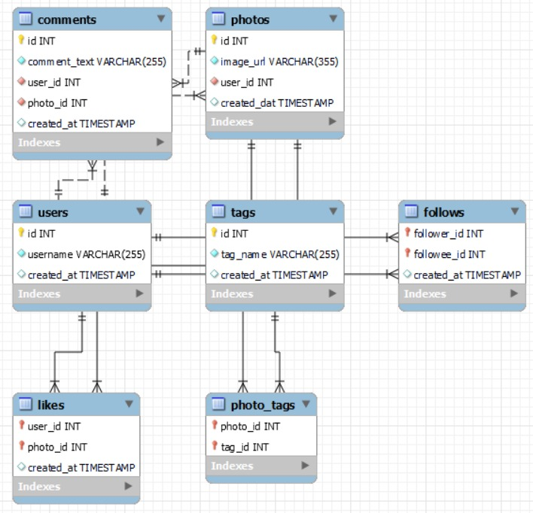
ER DIagram

Slide 6

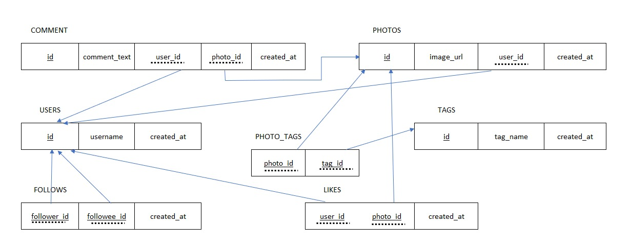
Relational schema

Slide 7

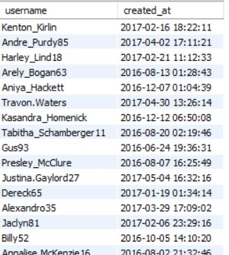
Tables (Contd)
USERS

Slide 8

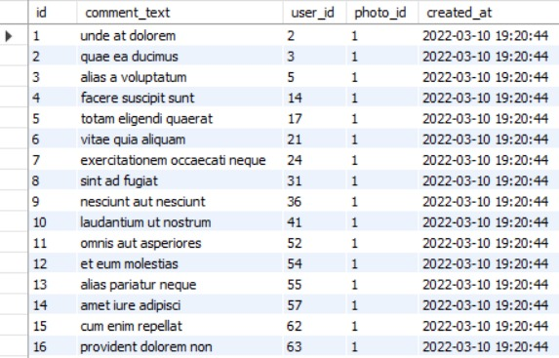
Tables
COMMENTS

Slide 9

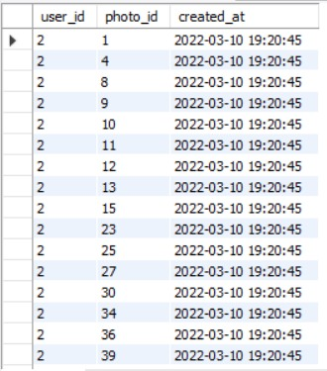
Tables (Contd)
LIKES

Slide 10

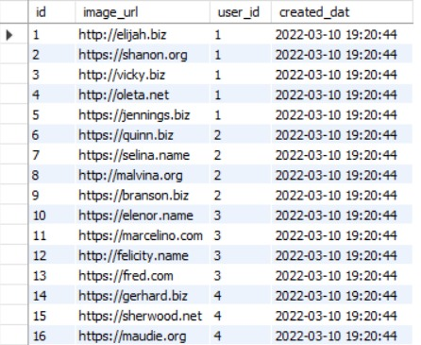
Tables (Contd)
PHOTOS

Slide 11

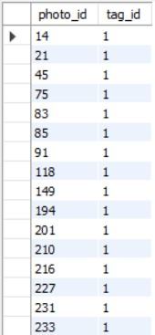
Tables (Contd)
PHOTO_TAGS

Slide 12
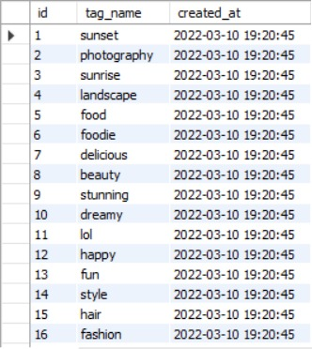
Tables (Contd)
TAGS

Slide 13

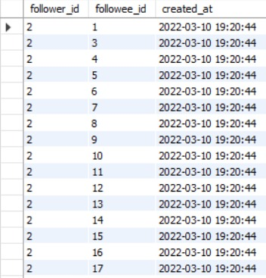
Tables (Contd)
FOLLOWS

Slide 14
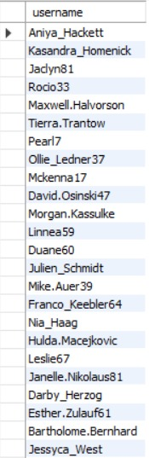
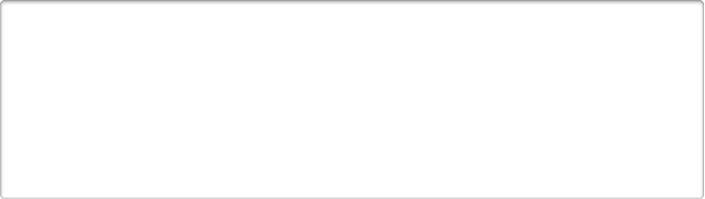
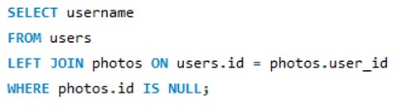
DAta analysis using Mysql
Query 1 - Finding users who has never posted a single photo

Slide 15

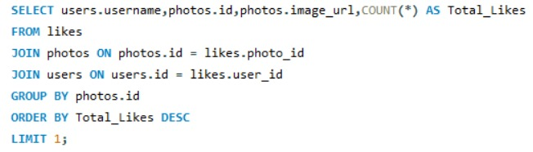

DAta analysis using Mysql (contd)
Query 2 - To find the photo posted by a user that has the most number of likes

Slide 16

DAta analysis using Mysql (contd)
Query 3 - Average number of times a user posts

Slide 17
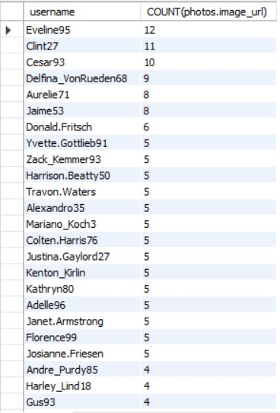

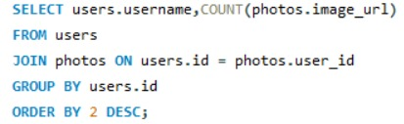
DAta analysis using Mysql (contd)
Query 4 - User ranking by number of posts

Slide 18

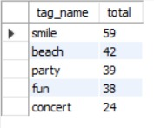
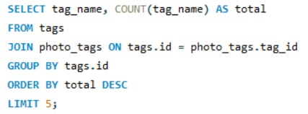
DAta analysis using Mysql (contd)
Query 5 - Top 5 commonly used hashtags

Slide 19
Importance of each query
Query 1 - We can find the inactive users, those who never post
Query 2 - We can find the trending post
Query 3 - Monitor activity of users on Instagram
Query 4 - We can find the active users of Instagram
Query 5 - Popular topics and tags can be found

Slide 20
Thank you

