Slide 1

ExaThon India 2026
SupplyLens
Shock-to-Decision Intelligence
for Indian SMBs
Powered by Exasol Personal · Open Source (MIT)
SupplyLens
01

Slide 2
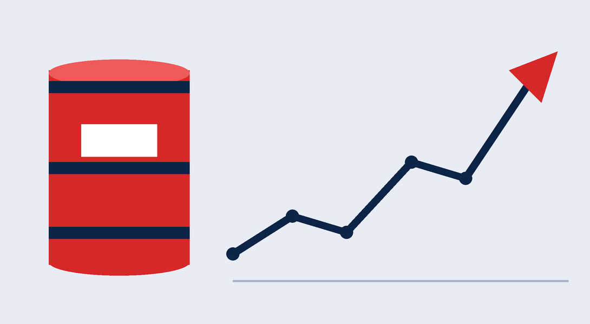
THE PROBLEM
Raw material is most of a manufacturer’s cost. A price shock leaves SMBs guessing.
63 M
30%
60–70%
MSMEs in India
of India’s GDP
of manufacturing cost is raw material
When Brent Crude jumps 20%, a plastics manufacturer has no idea…
01
Which materials are exposed?
02
By how much?
03
Can they switch suppliers, and can those suppliers actually deliver?
Result: reactive decisions, missed savings, concentrated supplier risk.
SupplyLens
02

Slide 3

THE SOLUTION
From a user-defined commodity shock to an auditable procurement decision.
SupplyLens models a hypothetical shock against purchase history, tests supplier alternatives against hard constraints, and recommends an action with traceable evidence.
01
02
03
Model
Evaluate
Recommend
Apply a shock to your real purchase history.
Check suppliers against hard feasibility constraints.
Produce an action, with evidence a human can review.
SupplyLens
03

Slide 4
HOW IT WORKS
Seven steps from market signal to a human decision.
Material mapping (exposure weights)
Exposure calculation (Exasol SQL)
Recommendation + evidence trace
1
2
3
4
5
6
7
Market history + user-defined shock
Purchase evidence (Exasol, 6 months)
Supplier comparison (feasibility constraints)
Human decision: approved / rejected / deferred
RUNS IN EXASOL
SupplyLens
04

Slide 5
EXASOL AT THE CORE
What Exasol does in SupplyLens
Analytics run inside the database.
01
Aggregates 6 months of purchase data by material and supplier
02
Calculates the Herfindahl–Hirschman Index for concentration risk
Why Exasol?
03
Executes the scenario impact query (JOIN across 4 tables)
Exasol SQL: HHI, exposure and multi-table joins run in the database
Parameterised SQL: safe, auditable, no arbitrary execution
Local database workflow; optional external LLM explanation is not wired into the current API
pyexasol: official Python driver, WebSocket-based, no ODBC
04
Evaluates supplier feasibility with parameterised constraints
05
Persists scenario results for reproducibility
SupplyLens
05

Slide 6
KEY DIFFERENTIATORS
What a spreadsheet and an ERP module don’t give you.
Feature | SupplyLens | Spreadsheet | ERP module
Commodity exposure mapping | Transparent rules | No: manual | Black box
Supplier feasibility check | Hard constraints | No: manual | Partial
Evidence trace | Full chain | No | No
Data stays local | Exasol Personal | N/A | No: cloud
No real data required | Synthetic demo | N/A | No: requires ERP data
Open source | MIT | N/A | No
SupplyLens
06

Slide 7

DEMONSTRATION RESULTS
One shock, one exposed material, one supplier ruled out.
₹2.92 Cr
HHI 8,180
₹5.4 Lakhs
Total purchase spend, 6 months
M001 Steel Coil: HIGH concentration
SC001 (Brent +15%) incremental cost
M001 dominant supplier share (others: 10.1%)
89.9%
REJECTED
NorthWest Plastics (M002)
Capacity constraint (synthetic quote)
All data is synthetic (seed = 42). Values are Python-generated reference outputs; live Exasol comparison remains pending.
SupplyLens
07

Slide 8
TECHNICAL EXCELLENCE
Built to be auditable, tested and typed.
12
6
2
Exasol tables
Analytical views: HHI, exposure, supplier share
Parameterised SQL queries: scenario impact, supplier comparison
49
v2
TS
Tests passed; 3 live-Exasol tests skipped at latest audit
FastAPI with Pydantic v2 validation
TypeScript frontend, strict build
Full evidence chain from market signal to decision record.
SupplyLens
08

Slide 9
USER EXPERIENCE
Eight screens cover the full workflow.
01
Overview
02
Data Workspace
Spend, concentration, exposure at a glance
Load demo or upload your own CSV
03
Material Risk Explorer
04
Scenario Lab
Spend vs commodity price history
Configure shocks, compare baseline vs shocked
05
Supplier Comparison
06
Evidence Trace
Hard constraints surfaced explicitly
Inspect every number’s provenance
07
Decision Review
08
Reports
Approve / reject with signature and notes
Full JSON summary or compact CSV exposure table
SupplyLens
09

Slide 10
OPEN SOURCE & NEXT STEPS
A working MVP today. A clear path to production.
TODAY (MVP)
NEXT
Synthetic demo workflow implemented; live Exasol acceptance is pending
MIT licence, documented API
Backend tests and frontend production build
Real GST authorised-file ingestion
PDF report export
Docker Compose packaging
GSTN-linked material normalisation
Live market data connectors (MCX, BMD)
github.com/[team]/supplylens
Built for Indian SMBs. Powered by Exasol. Open to all.
SupplyLens
10

