Slide 1












DATA MINING (Week2)

Slide 2















DSBA CURRICULUMDESIGN
CORE COURSES
DOMAIN APPLICATIONS
FOUNDATIONS
Data ScienceUsing Python
Advanced Statistics
Data Mining
Financial Risk Analytics
Statistical Methods for Decision Making
(Week-2/5) Predictive Modelling
Web &Social Media Analytics
Machine Learning
Marketing Retail Analytics
Time Series Forecasting
Data Visualization

Slide 3
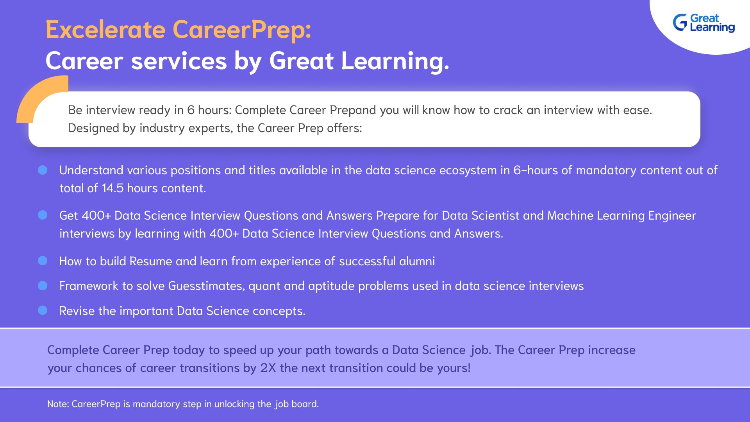



Slide 4
LEARNING OBJECTIVE OF THISMODULE
CART & Model Performance Measure

Slide 5

LEARNING OBJECTIVES OF THISSESSION-
CART
Model Performance Measures

Slide 6












TRY ANSWERING THEFOLLOWING
Does CART classification tree technique makes use of Euclidean Distance?
Is it preferable to do PCA before CART?
Name a few Model Performance techniques.

Slide 7

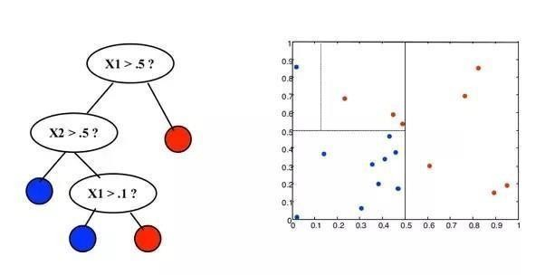
BROAD OVERVIEW- ClassificationTree
* Image created using one of the sample dataset

Slide 8

Industry Application - Predicting Supreme Court decisions using CART
In the US, the legal system operates at three levels - District Courts (makes initial decision), Circuit Courts (deals with appeals against the District Level decision) and Supreme Court (if still not resolved, it makes final decision on the appeal).
In the year 2002, Prof Andrew Martin, a professor of Political Science at Washington University decided to use statistical modelling techniques to predict the outcome of Supreme Court against a panel of Legal Experts. The data was collected from 1994 to 2001 in order to make predictions for the year 2002. The dependent variable was 0 (if the lower court decision was affirmed) or 1(if the lower court decision was reversed).
Using 628 cases from 1994 to 2005 predictions were made for 68 cases that were to be decided in October 2002.
A set of 83 legal experts recruited to perform the same predictions were able to deliver only 59% accuracy whereas the CART model delivered 75%accuracy.
Reference: http://www.wusct.wustl.edu/media/man1.pdf

Slide 9

CASE STUDY - Loan Delinquent
Based on the given loan data can we understand the major factors or characteristics of a borrower which makes them to get into delinquent stage.
Delinquency is a major metric in assessing risk as more and more customers getting delinquent means the risk of customers that will default will also increase.
The main objective is to minimize the risk for which you need to build a decision tree model using CART technique that will identify various risk and non-risk attributes of borrower’s to get into delinquent stage.

Slide 10


Apply Data Science at your workplace to gain some instant benefits:
Get noticed by your management with your outstanding analysis backed by data science.
Create an impact in your organization by taking up small projects/initiatives to solve critical issues using data science.
Network with members from the data science vertical of your organization andseek opportunities to contribute in small projects.
Share your success stories with us and the world to position yourself as a subjectmatter expert in data science.

Slide 11












ANY QUESTIONS

Slide 12

HAPPY LEARNING

