Slide 1













PREDICTIVE MODELING- WEEK-3

Slide 2






DSBA CURRICULUM DESIGN
CORE COURSES
DOMAIN APPLICATIONS
FOUNDATIONS
Python for Data Science
Advanced Statistics
Finance and Risk Analytics
Statistical Methods for Decision Making
Data Mining
Predictive Modelling(Week-3/ 5)
Machine Learning
Marketing and Retail Analytics
Time Series Forecasting
Data Visualization

Slide 3


LEARNING OBJECTIVE OF THIS MODULE
Linear Discriminant Analysis

Slide 4

LEARNING OBJECTIVES OF THIS SESSION
How a Linear Discriminant Analysis uses Bayes’ rule/Linear Discriminant Function to make predictions?
Applications of LDA
Context of usage of LDA

Slide 5











TRY ANSWERING THE FOLLOWING
Linear Discriminant Analysis uses a version or form of Bayes’ rule for computing the posterior probabilities. True or False? – Discuss.
What are the equivalent rules for classification in LDA .

Slide 6

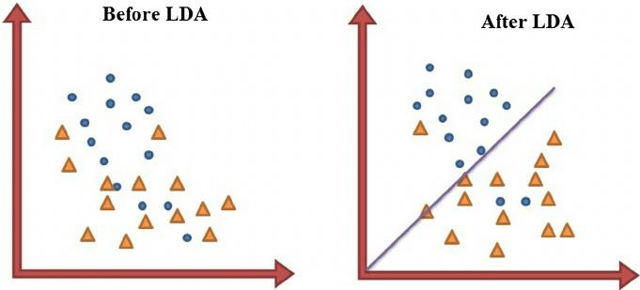
BROAD OVERVIEW

Slide 7
BROAD OVERVIEW – Usage of Bayes’ Rule for Prediction
Linear Discriminant Analysis (LDA) takes the help of prior probabilities to predict the corresponding target probabilities. Prior probabilities is the probability of y (say equal to 1) without taking into account any other data or variables.
The corresponding updated probabilities when the covariates (Xs) are available is called the posterior probabilities.
We want to find P(Y=1|X).
Thus, a Linear Discriminant Analysis (LDA) discriminates between the two classes by looking at the features (Xs)

Slide 8
Custom Probability Cut-off for predicting the Target Variable
A lot of software programs have default cut-off values for predicting the target classes from the probability outputs for different algorithms.
Sometimes, it might be necessary to change the default probability cut- off values for class predictions keeping in mind the desired model evaluation parameters like accuracy, precision, recall etc.

Slide 9
Industry Application - LDA helps when the decision isn’t binary
Many a times the decision to be made is not limited to two choices e.g. we may be working on computer vision where there are many different object classes to be identified in a given image e.g. children, cars, traffic signals, other vehicles etc. Essentially this is a multiclass classification problem.
Likewise in computerized face recognition, each face image is represented by a large number of pixel values. Linear Discriminant Analysis (LDA) has been successfully applied to face recognition which is based on a linear projection from the image space to a low dimensional space by maximizing the between class scatter and minimizing the within-class scatter. LDA allows objective evaluation of the significance of visual information in different features of the face for identifying the human face.
Reference:https://ieeexplore.ieee.org/document/5256630

Slide 10
More Industry Application of LDA
Identification- To identify type of customers that is likely to buy certain product in a store. Using simple questionnaires survey, we can get the features of customers. Discriminant analysis will help us to select which features can describe the group membership of buy or not buy the product.
Decision Making- Doctor diagnosing illness may be seen as which disease the patient has. However, we can transform this problem into classification problem by assigning the patient to a number of possible groups of disease based on the observation on the symptoms.
Pattern Recognition- For Autonomous Cars, to distinguish pedestrian from vehicles and animals using captured image sequence is a classification problem

Slide 11
When to use LDA?
Use LDA when the predictors are numerical in nature ,
and we want to classify our target variable which is categorical
Use LDA when we have lots of predictors as it will help in reducing dimensionality
Use LDA to find all the predictors which will play a major role in classification and which will not

Slide 12

CASE STUDY
Customer Churn is a burning problem for Telecom companies. Almost every telecom company pays a premium to get a customer on-board. Customer churn is a directly impacts company’s revenue.
In this case-study, we simulate one such case of customer churn where we work on a data of post-paid customers with a contract. The data has information about customer usage behaviour, contract details, and payment details. The data also indicates which were the customers who cancelled their service.
Based on this past data, Perform an EDA and build a model which can predict whether a customer will cancel their service in the future or not.

Slide 13











ANY QUESTIONS

Slide 14


Apply Data Science at your workplace to gain some instant benefits:
Get noticed by your management with your outstanding analysis backed by data science.
Create an impact in your organization by taking up small projects/initiatives to solve critical issues using data science.
Network with members from the data science vertical of your organization and seek opportunities to contribute in small projects.
Share your success stories with us and the world to position yourself as a subject matter expert in data science.

Slide 15
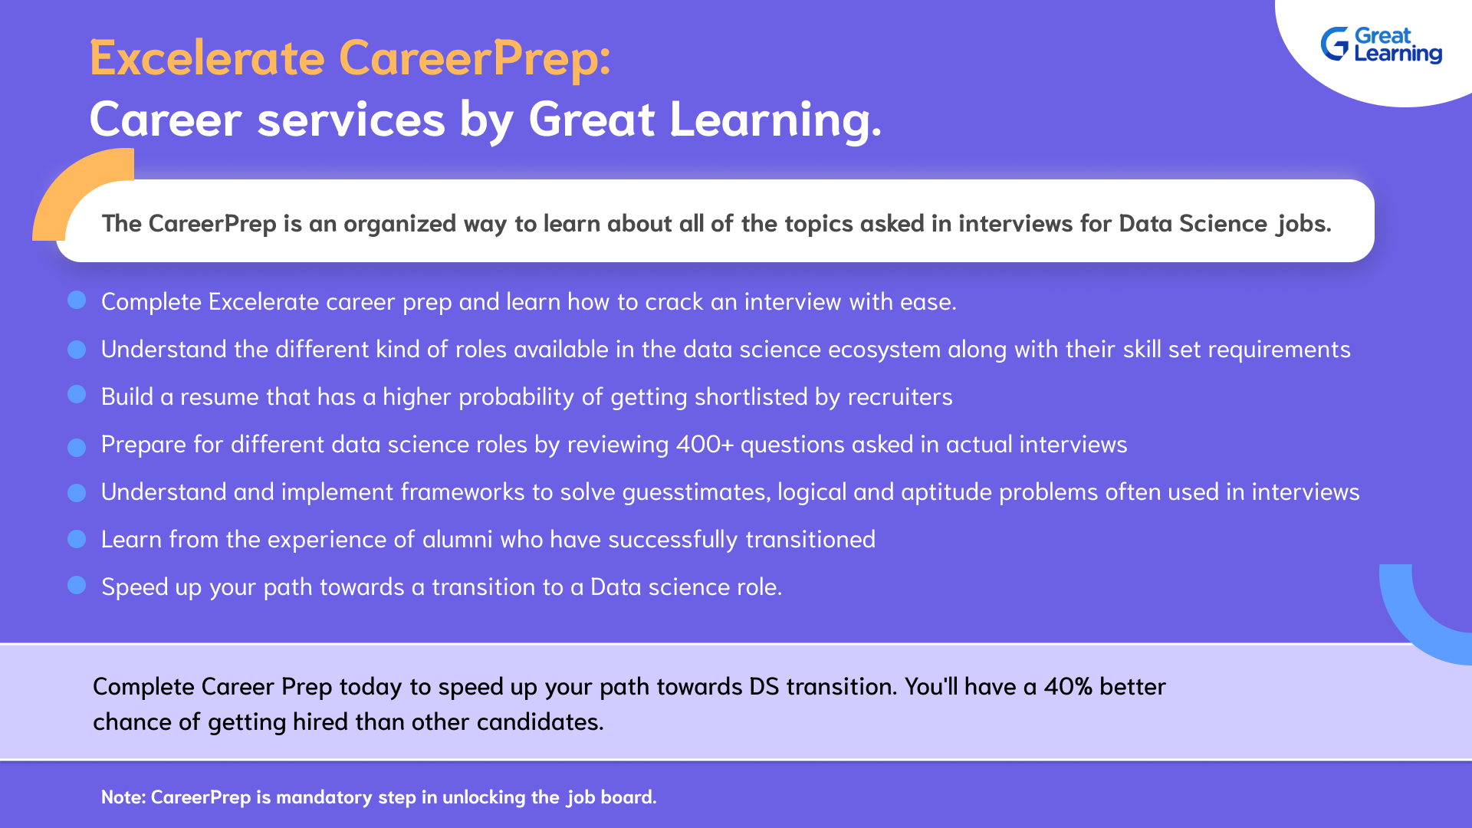

Slide 16

HAPPY LEARNING
Proprietary content. ©Great Learning. All Rights Reserved. Unauthorized use or distribution prohibited.

