Slide 1
Ecommerce Fashion Data Analysis
Presentation by – Harinivas ( Data Driven Guy )
https://www.linkedin.com/in/harinivas-sn/

Slide 2
CONTEXT : KEY INSIGHTS
Sales and Orders Overview
Channel Performance
Product Analysis
Regional Insights
Operational Efficiency
Inventory Management
Future Outlook
Competitor Analysis

Slide 3
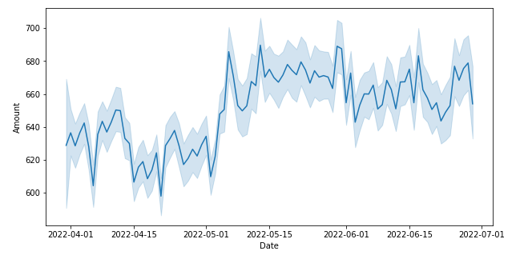
SALES AND ORDER OVERVIEW ( INDIA )
TOTAL SALES : 83.6 Million
B2B SALES : 609K
B2C SALES : 83 Million
TOTAL ORDERS : 128.98K
B2B ORDERS PLACED : 871
B2C ORDERS PLACED : 128.10K
TOTAL QUANTITY ORDERED : 116649
B2B QUANTITY ORDERED : 840
B2C QUANTITY ORDERED : 115809
Quick Tip : This May be any seasonality or any festival trend on that time , It may be a amazon great Indian Sales or prime day.
Increase in sales after that Spike on 2022-05-01
SALES OVERTIME

Slide 4
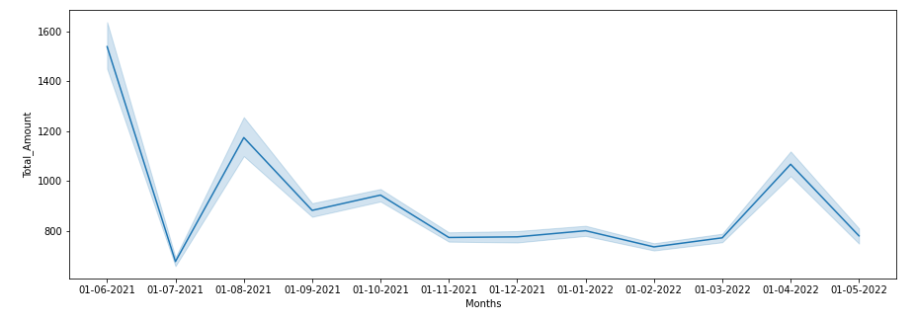
SALES AND ORDER OVERVIEW ( INTERNATIONAL )
* TOTAL INTERNATIONAL SALES – 1,61,27,035
TOTAL QUANTITY OF ORDERS – 24,017
There are fluctuations which are peaks and downs which is unpredictable trend.
INTERNATIONAL SALES OVER TIME

Slide 5
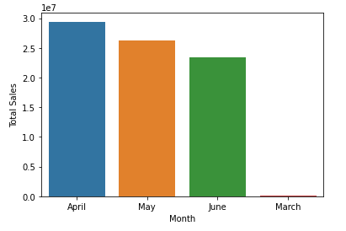
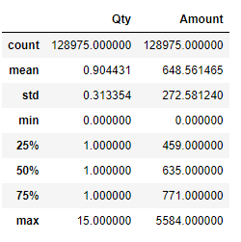
Sales over Month & Some Descriptive Statistics
Average Sales Amount in B2B Space who place the order for at Least Rs 700
Average Sales Amount in B2C Space who place the order for at Least Rs 648
Average Money spend by B2B ( Business to Business) - Companies or Organization who want to buy clothes they are spending more than that of Normal Customers ( B2C - Business to Consumers).

Slide 6
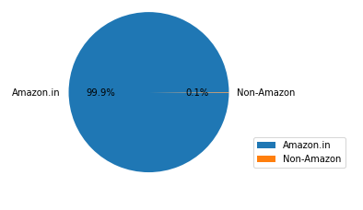
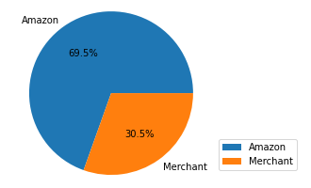
CHANNEL PERFORMANCE
99.9% All orders are directly purchased in the amazon website and 0.1% it can be redirected to amazon websites through ads on various platforms.
Fulfilment of Orders
We can able to see that 69.5% of goods or clothes are sold from amazon side of inventory where it has been stocked . Where 30.5% are sold by third-party ( Merchants ) due to unavailability of stocks , they have been connected and packed on the way.

Slide 7
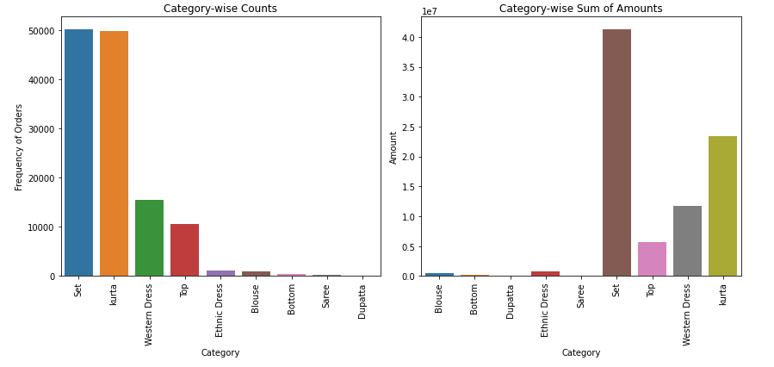
PRODUCT ANALYSIS
Where we can able to see that Frequency of orders and Amount of sales are positively correlated . That means any product increase in orders will increase in amount of Sales. For example , if you see means the set & kurta product category increase in frequency of orders , So there increase in sales amount of set & kurta product category. This Trend of product category follows the same in all months.

Slide 8
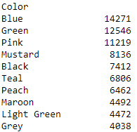
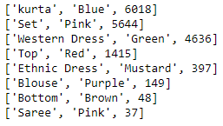
Product Analysis based on Colours
Top 10 Product Colours customers like
to place the orders are :
Key Insights : From each product category customers like specific one colour want to order the most.
Based on the above insight we can manage the stocks of each product based on colours.

Slide 9
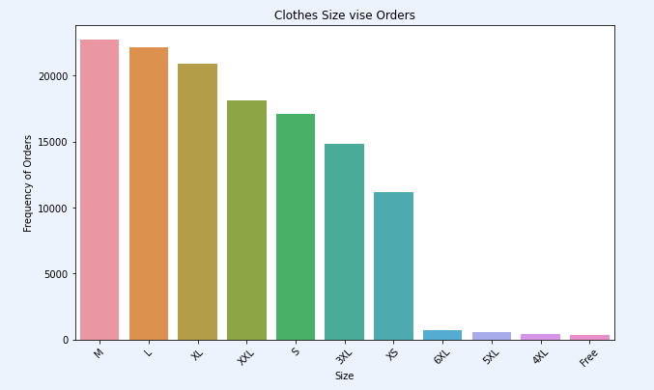
Product Analysis based on the Product Size
These are the product sizes where they frequently order by customers . Based on that we can manage stock of product based on the size and effectively allocate resources when it comes to resource management.

Slide 10
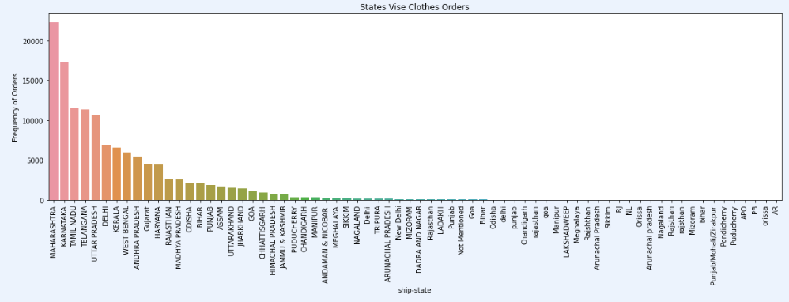
REGIONAL INSIGHTS – Frequency of Orders
If see from the above graph the two states Maharashtra & Karnataka where the high orders of clothes came because there two metropolitan cities where people engagement is high one is mumbai and bangalore . Based on that we need to increase the stocks and effectively allocate the resources.

Slide 11
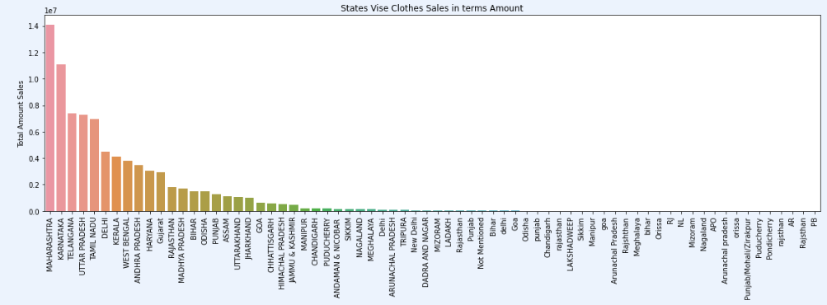
REGIONAL INSIGHTS – Sales Amount
If see from the above graph the two states Maharashtra & Karnataka where the high sales of cloths in terms of Amount came because there two metropolitan cities where people engagement is high one is mumbai and bangalore .Based on that we need to increase the stocks and effectively allocate the resources. Suprisingly if you see in third state in terms frequency of orders is Tamil Nadu and in terms total sales amount third state is Telangana . This because more than the Quantity of the cloths they order the Quality of cloths is more important . Of Course Quality of Cloths increases the Amount.

Slide 12
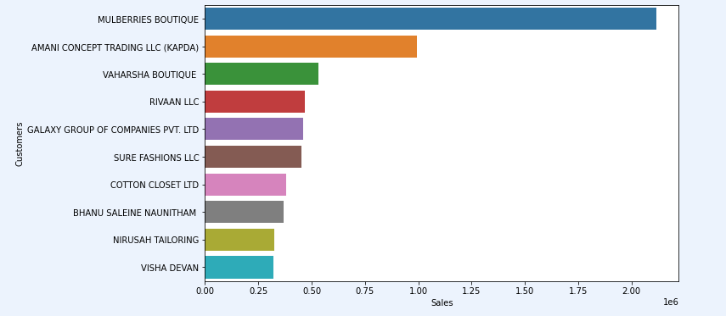
REGIONAL INSIGHTS – Top 10 International Customers based on Sales
Based on the top 10 customers , We can say that they are our loyal customers who contribute to our sales . We need to give some personalized recommendations for them and discounts , offers if it is possible.

Slide 13
OPERATIONAL EFFICIENCY
COMPARISION OF DELIVERY PARTNERS BETWEEN SHIPROCKET & INCERF COMPANY
All the cost we are going to see for a product ( Unit Price).
If you see overall cost for shiprocket that means sum of all work process cost is Rs.42 and for INCERF if you see means the over all cost for all the process is Rs 31 . So the INCERF is better partner in cost wise , But we consider how efficient is the work is like mainly timely delivery , customer satisfaction.

Slide 14
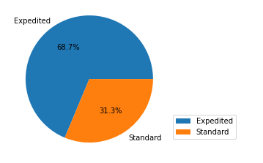
OPERATIONAL EFFICIENCY - SHIP SERVICE LEVEL
From the above plot we can tell that the most of time the clothes are fast shipped(Expedited) and some times it takes business day 5-7 and more days ( Standard ).

Slide 15
OPERATIONAL EFFICIENCY – COST CUTTING MEASURES
1. Strategic Logistics Optimization:
- Implement advanced route optimization algorithms for efficient last-mile delivery.
- Utilize real-time tracking systems to dynamically adjust routes and minimize fuel costs.
Diversified Carrier Partnerships:
- Negotiate competitive shipping rates by partnering with multiple carriers.
- Diversify carriers based on regions and delivery speed for optimized cost structures.
Warehouse and Inventory Efficiency:
- Strategically position warehouses to minimize shipping distances.
- Optimize warehouse layout and capacity to reduce handling costs.
Customer-Centric Delivery Solutions:
- Introduce flexible delivery time windows to consolidate shipments.
- Implement local pickup points and lockers to reduce home deliveries.
Data-Driven Decision Making:
- Leverage data analytics for route optimization and delivery performance.
- Implement machine learning algorithms to enhance delivery time predictions.

Slide 16
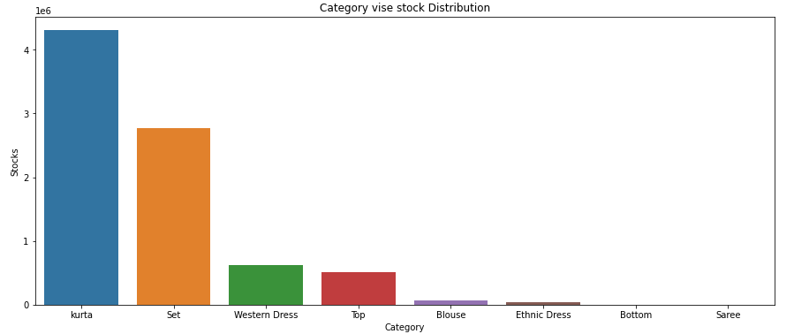
INVENTORY MANAGEMENT
From the above plot we can understand that kurta product category is highly stocked followed by Set and thirdly Western Dress . Where we cannot tell that this stock level of management will be constant , it will differ based on seasonality trends . But we should at least have X avg no of stocks constant even there is no seasonality or festival trends. For e.g. Kurta is traditional wear when it comes to festival times like Diwali we need to highly stock them.

Slide 17
FUTURE OUTLOOK – FORECASTING SALES
Historical Data to Train from 31-03-2022 to 29-06-2022 ( Given Data )
Forecasted the Sales from 30-06-2022 to 28-09-2022 with 95 % Confidence Interval of Upper Confidence Bound and Lower Confidence Bound.
I can 95% confidently tell that the sales will fall between the Upper bound and Lower Bound.

Slide 18
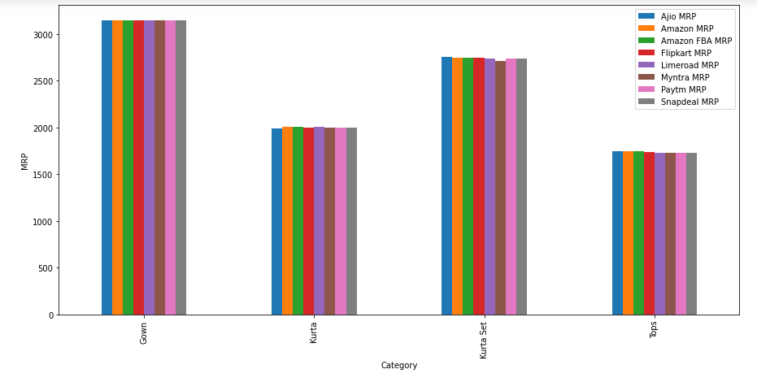
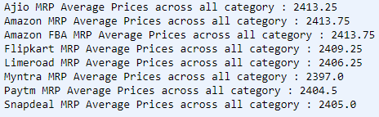
COMPETITOR ANALYSIS
Overall , If You see Myntra has been selling the goods affordably than others Ecommerce orgs.
After Myntra , Snapdeal & Paytm are good to see.
Again its not about how affordably they are selling the products , It all about Quality of Products , Diversity of Collections with Amazing user friendly 365 Degree Customer Satisfaction. Again We need to go through all Customers Feedback and Loop through it and rectify it to enhance the customers , Sales etc.
How much Value we are providing that much growth and Company Success will be , Always we need to aim for Quality.

Slide 19
THANK YOU

