Slide 1
BANKING APPLICATION
By,
HARINI V

Slide 2
CONTENT
Introduction
Requirements
Functionalities
Output
Conclusion

Slide 3
INTRODCUTION
Banking application is for maintaining a person's account in a bank.
It is used to keep the records of clients, employees, and others in the bank.
This system allows customers to creates accounts, deposit or withdraw money from their accounts and examine reports for all of their accounts.

Slide 4
SYSTEM REQUIREMENTS
SOFTWARE REQUIREMENTS
Operating System-Windows
Platform-Eclipse IDE
Language-Core Java
HARDWARE REQUIREMENTS
ServerProcessor-Intel Core Family
RAM-8 GB
Disk Space-500 MB or more

Slide 5
FUNCTIONALITIES
Create Account
Deposite
Withdraw
Check Balance

Slide 6
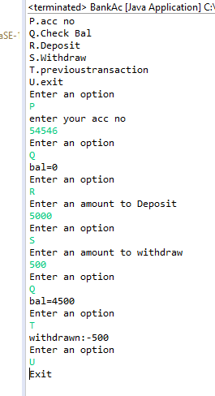
output

Slide 7
cONCLUSION
In this project you can create a new account , edit the details of an existing account, view and manage transactions and verify the details of an existing account.
Also, this project allows you to do banking operations just like you do in real bank.

Slide 8
Thank you

