Slide 1

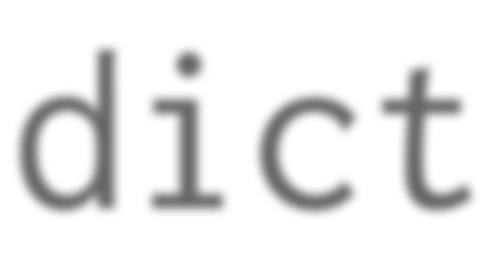
dict
mutable mappings of keys to values

Slide 2
Dict Literals
{k1: v1, k2: v2}

Slide 3
Dict Literals
keys
{k1: v1, k2: v2}

Slide 4
Dict Literals
keys
{k1: v1, k2: v2}
values

Slide 5







Summary: Dictionaries
Dictionaries associate keys with values
Literal dicts delimited by curly braces
Literal key-value pairs separated by commas, with a colon between each key and value
{k1: v1, k2: v2}

Slide 6






dict() constructor accepts:
•
iterable series of key-value 2-tuples
•
keyword arguments – requires keys
are valid Python identifiers
•
a mapping, such as another dict
Recap literals:
•
delimited by { and }
•
key-value pairs comma separated
•
corresponding keys and values
joined by colon
•
keys must be unique

Slide 7




Updating a dictionary
•
Extend a dictionary with update()
•
update replaces values
corresponding to duplicate keys
Copying
•
d.copy()
for copying dictionaries
•
or simply dict(d) constructor

Slide 8






Iteration
Use values() for an iterable view onto the series of values.
No efficient way to get the key corresponding to a value
keys() method gives iterable view onto keys - not often needed.
Iteration
•
Iteration is over keys
•
Get corresponding value with
d[key] lookup
•
Remember! Order is arbitrary!

Slide 9






Removal
Use del keyword to remove by key
•
del
d[key]
Membership
•
The in and
not
in operators work
on the keys.

