Slide 1
x = 1000
References to objects

Slide 2

x = 1000
int
1000
x

Slide 3
x = 500
int
1000
x
int
500

Slide 4
y = x
y
x
int
500

Slide 5
x = 3000
x
int
3000
y
int
500

Slide 6

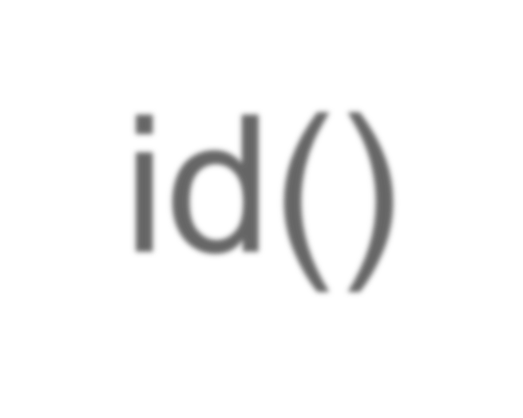
returns a unique identifier for an object

Slide 7
t
int
5

Slide 8
t
int
5
int
2
int
7
+
=

Slide 9
t
int
5
int
2
int
7

Slide 10
int
7
t

Slide 11
list
[2, 4, 6]
r

Slide 12
s
list
[2, 4, 6]
r

Slide 13
id() deals with the object, not the reference
list
[2, 4, 6]

Slide 14

Variables
Named references to objects
name
object

Slide 15
list
[4, 7, 11]
p
list
[4, 7, 11]
q

Slide 16


Value equality vs. identity
▪Value - equivalent “contents” Identity - same object

