Slide 1
Classes in Python
You can get a long way with Python’s builtin types.
But when they’re not right for the job, you can use classes to create custom types.

Slide 2
Structure and Behavior
Classes define the structure and behavior of objects.
An object’s class controls its initialization.

Slide 3


Classes are a Tool
Classes make complex problems tractable.
Classes can make simple solutions overly complex.
Python lets you find the right balance

Slide 4



class
used to define new classes
By convention, class names use
CamelCase

Slide 5
Methods
Method – A function defined within a class
Instance methods – functions which can be called on objects
self – the first argument to all instance methods

Slide 6
__init__()
instance method for initializing new objects

Slide 7
Initialization
init
() is an
initializer, not a constructor. self is similar to
this in C++ or Java.

Slide 8

Public!
Private!
Protected!

Slide 9

We’re all consenting adults here.

Slide 10
Class Invariants
Truths about an object that endure for its lifetime.

Slide 11
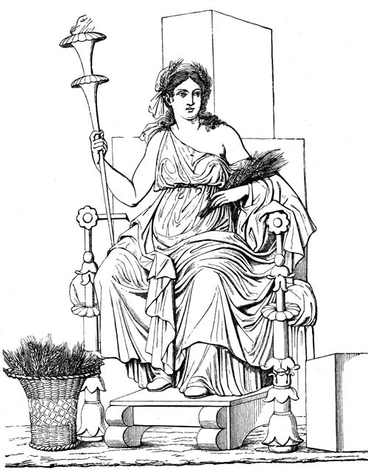
Law of Demeter
The principle of least knowledge.
Only talk to your friends.

Slide 12
Tell! Don’t ask.
Tell objects what to do.
Don't ask for their state.

Slide 13
Polymorphism
Using objects of different types through a common interface.

Slide 14

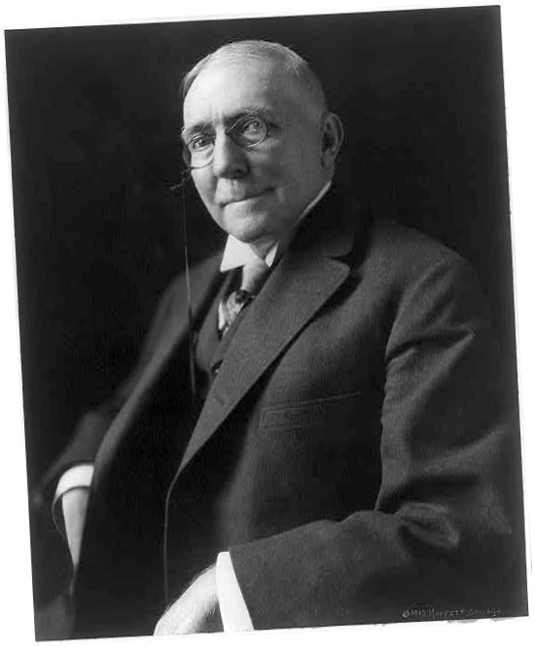


Duck Typing
“When I see a bird that walks like a duck and swims like a duck and quacks like a duck, I call that bird a duck.”
- James Whitcomb Riley
An objects fitness for
purpose is determined
at the time of use .

Slide 15
Inheritance
A sub-class can derive from a base-class, inheriting its behavior and making behavior specific to the sub-class.
In Python inheritance is
most useful for sharing
implementation.

Slide 16

Loose coupling is great!
wink-wink, nudge-nudge

Slide 17







Classes Summary
All types in Python have a 'class'
Classes define the structure and behavior of an object
!
Class is determined when object is created
"
normally fixed for the lifetime
Classes are the key support for Object-Oriented Programming in Python
Classes defined using the class keyword followed by CamelCase name
Class instances created by calling the class as if it were a function
Instance methods are functions defined inside the class
"
Should accept an object instance called self as the first parameter
Methods are called using instance.method()
"
Syntactic sugar for passing self instance to method
The optional __init__() method initialized new instances
"
If present, the constructor calls init ()
init () is not the constructor
"
Arguments passed to the constructor are forwarded to the initializer

Slide 18







Classes Summary
Instance attributes are created simply by assigning to them
Implementation details are denoted by a leading underscore
"
There are no public, protected or private access modifiers in Python
Accessing implementation details can be very useful
"
Especially during development and debugging
Class invariants should be established in the initializer
"
If the invariants can't be established raise exceptions to signal failure
Methods can have docstrings, just like regular functions
Classes can have docstrings
Even within an object method calls must be preceded with self
You can have as many classes and functions in a module as you wish
"
Related classes and global functions are usually grouped together this way
Polymorphism in Python is achieved through duck typing
Polymorphism in Python does not use shared base classes or interfaces
Class inheritance is primarily useful for sharing implementation
All methods are inherited, including special methods like the initializer

