Slide 1









Conditional Statements
if expr:
print("expr is True")
expr is converted to bool as if by
the bool() constructor

Slide 2






Conditional Statements
if expr:
print("expr is True")

Slide 3







Conditional Statements
if expr:
print("expr is True")
else:
print("expr is False”)

Slide 4



if h > 50:
print("Greater than 50")
else:
if h < 20:
print("Less than 20")
else:
print("Between 20 and 50 ")
Python provides the elif keyword to
eliminate the need for nested if ... else
structures in many cases.

Slide 5


Flat is better
than nested
if h > 50:
print("Greater than 50")
elif h < 20:
print("Less than 20")
else:
print("Between 20 and 50")
Python provides the elif keyword to
eliminate the need for nested if ... else
structures in many cases.

Slide 6


for-loop
visit each item in an iterable series

Slide 7
For-Loop Syntax
for item in iterable:
...body...

Slide 8







while loops
while expr:
print("loop while expr is True")
expr is converted to bool as if by
the bool() constructor

Slide 9








breaking out
while True:
if expr:
break
print("Go here on break")
The break
keyword terminates the
innermost loop, transferring execution
to the first statement after the loop

Slide 10
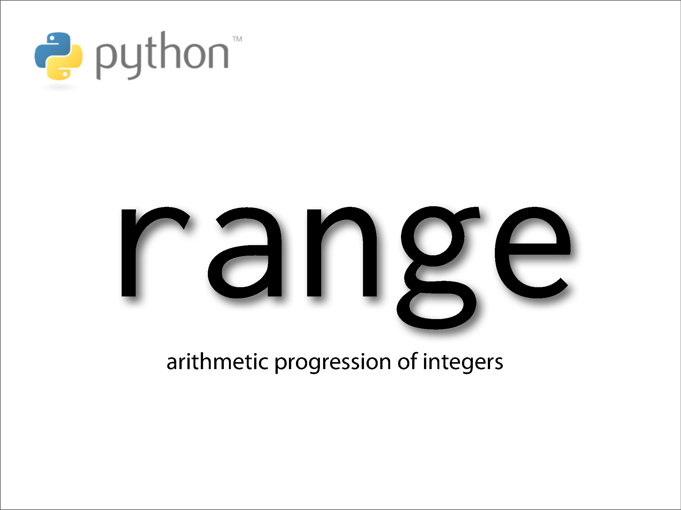

Slide 11
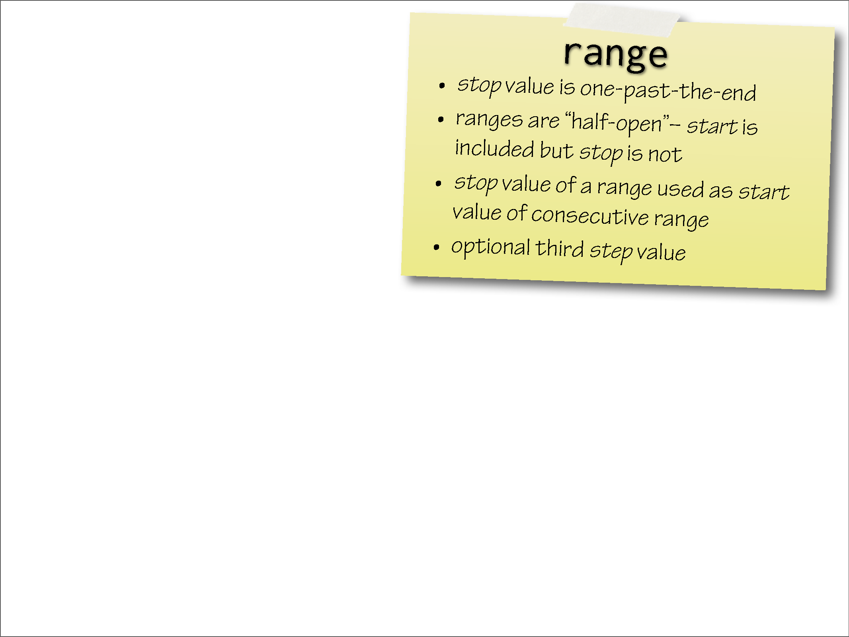

Slide 12
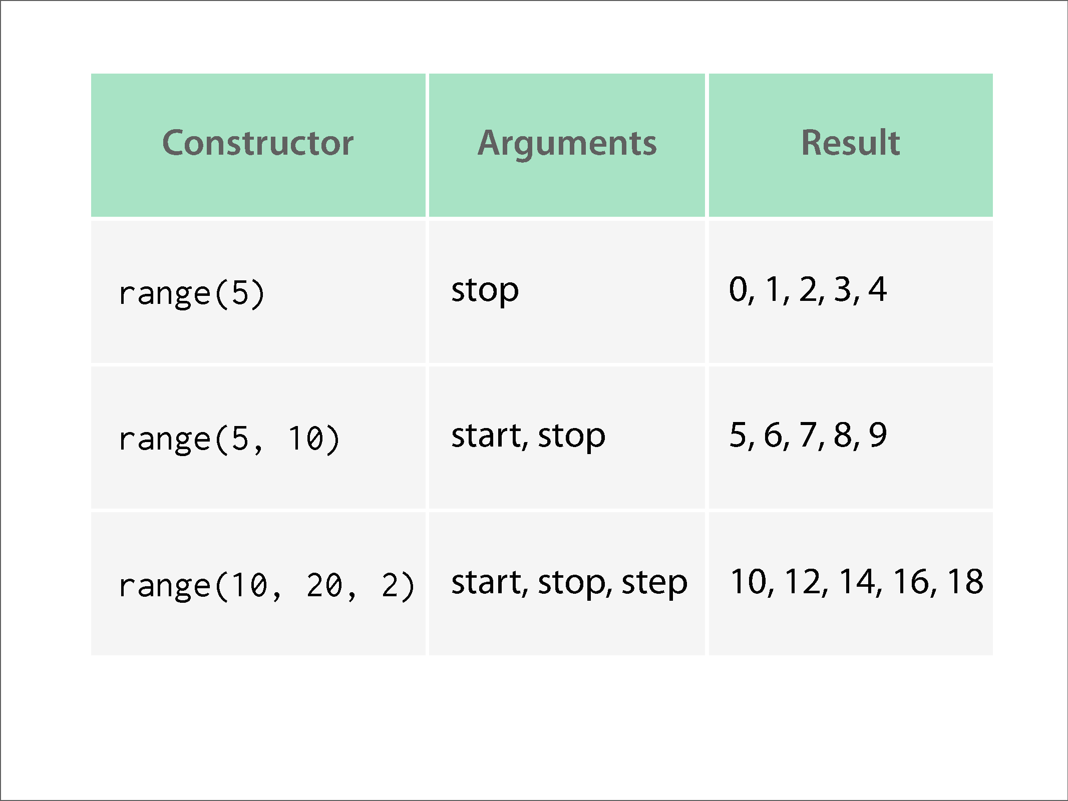

Slide 13
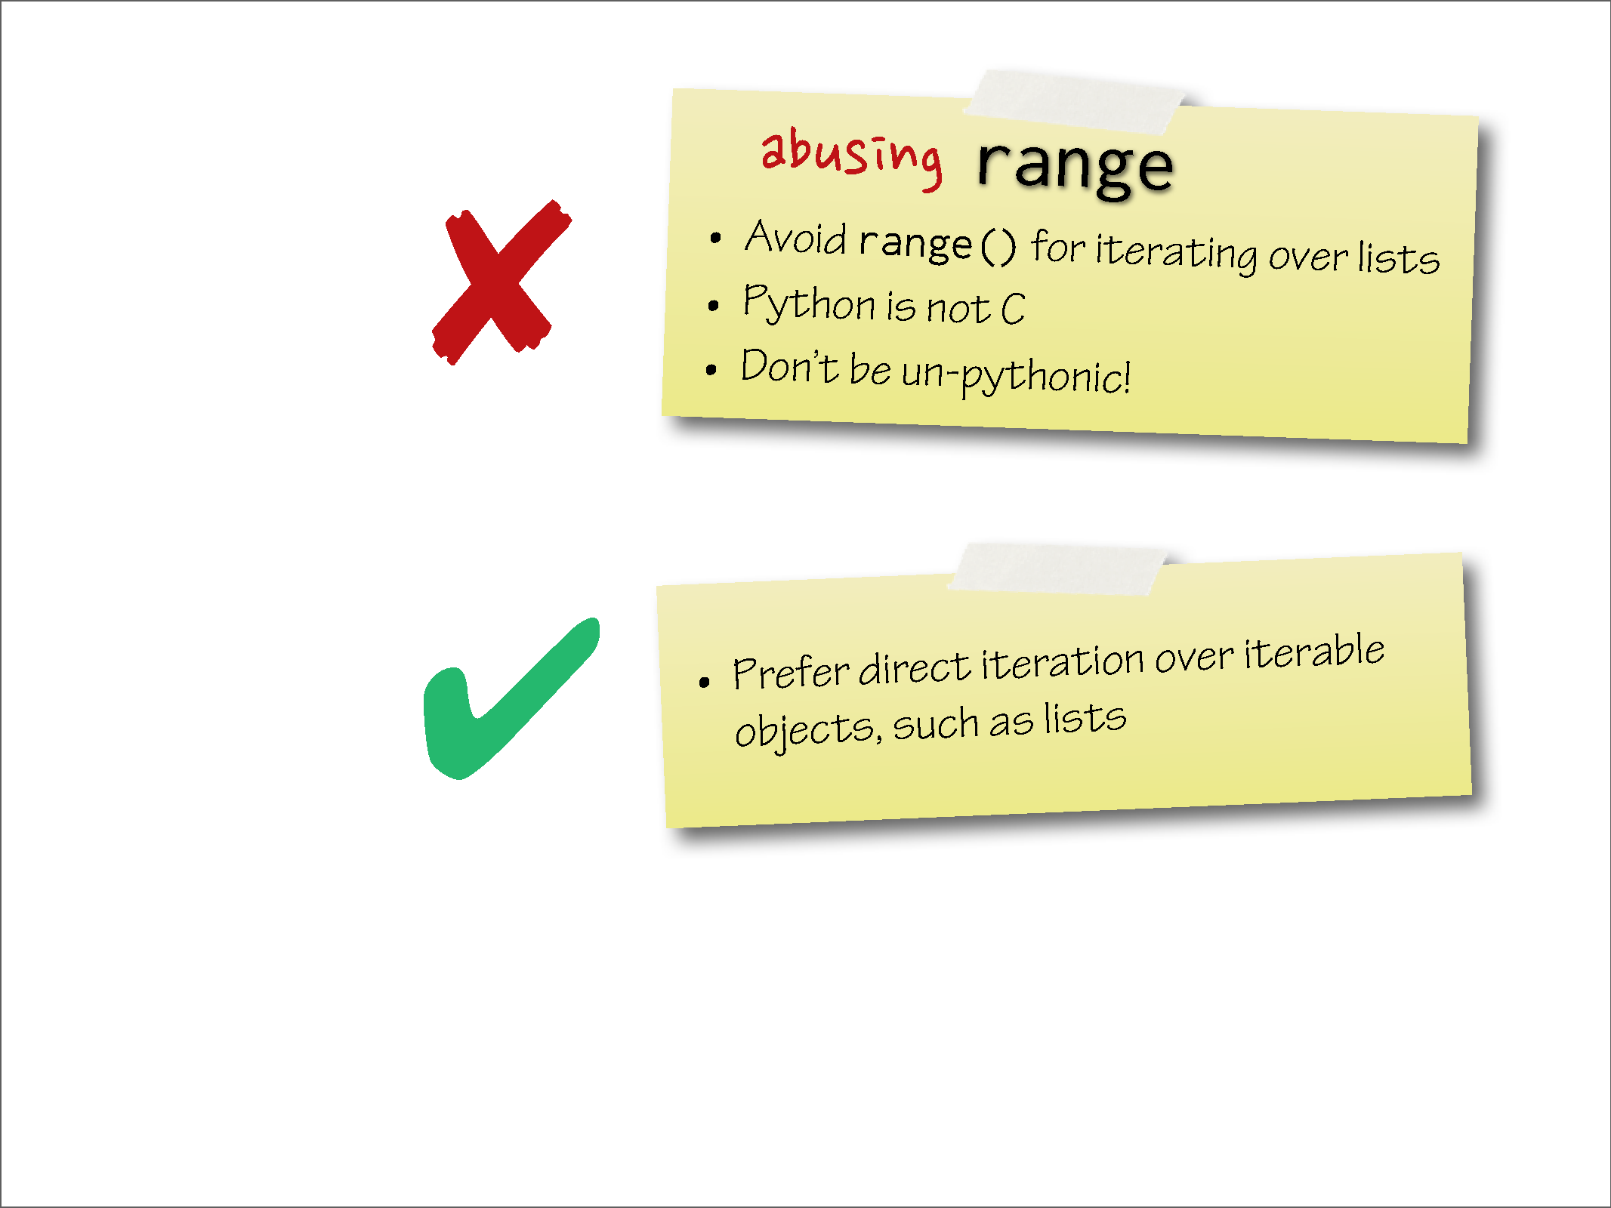

Slide 14
