Slide 1

Introduction to Frontend Development
Name : Hariom Singh
Div : D-1
Roll : 22

Slide 2
Introduction
The introduction slide provides a high-level overview of the course, emphasizing that it covers the foundational topics in frontend development such as HTML, CSS, Bootstrap, React, and web development tools.It highlights the key objectives of the course, including learning how to build responsive websites, understand the roles of frontend and backend developers, and using tools like developer consoles and IDEs.

Slide 3
Module 1: Introduction to the Program
Overview of Frontend Development: I learned about the three main types of developers—frontend, backend, and full-stack developers—and what each role entails.
Frontend developers work on the design and user experience, backend developers focus on the server-side logic, and full-stack developers handle both.
How the Web Works: This section helped me understand how the internet functions, including the role of web servers, hosting, and protocols that govern internet communication. HTTP (HyperText Transfer Protocol) is used for communication between browsers and servers.

Slide 4
Module 1: Introduction to the Program
Developer Tools: I got hands-on experience with browser developer tools to inspect and edit websites in real-time. I also learned how to debug JavaScript and modify HTML and CSS elements directly in the browser.
Frameworks & Libraries: I explored the importance of using frameworks and libraries in frontend development, and I got introduced to IDEs like Visual Studio Code, which streamline the development process.

Slide 5
Module 2: HTML & CSS Basics
HTML Fundamentals: I learned how HTML is the structure of a webpage. I practiced creating simple web pages with text, images, and links, and I also learned how to organize content using tables and forms.
CSS Basics: I explored how CSS allows me to style HTML elements, such as applying color schemes, text styles, and layout properties. I learned about the box model, which defines how elements are sized and spaced.

Slide 6
Module 2: HTML & CSS Basics
Web Accessibility: I discovered the importance of making websites accessible to people with disabilities. I learned how to ensure that websites are usable by all, for example, by adding alt text to images and ensuring high contrast for readability.
DOM (Document Object Model): I was introduced to the DOM, which represents the structure of a webpage. I learned how JavaScript can interact with the DOM to change content and structure dynamically.

Slide 7
Module 3: UI Frameworks
Responsive Design: I learned how to build websites that adapt to various screen sizes using responsive design techniques. This ensures that my website looks great on both desktop and mobile devices.
Bootstrap: Bootstrap is a CSS framework that simplifies creating responsive websites. I learned how to use Bootstrap’s grid system and various components like buttons and navigation bars to quickly build layouts.

Slide 8
Module 3: UI Frameworks
UI Frameworks:
UI frameworks like Bootstrap are incredibly helpful in frontend development, as they provide pre-designed components that save time. I learned how to use them to build consistent, user-friendly interfaces.
React Basics: React is a JavaScript library for building dynamic user interfaces. I learned about its component-based architecture and how it uses the Virtual DOM to enhance performance by minimizing direct interactions with the actual DOM.
Static vs. Dynamic Content: This section helped me understand the difference between static content (content that doesn’t change) and dynamic content (content that can change based on user input or other factors). React makes it easy to build dynamic web applications.

Slide 9
Module 4: Recap & Assessment
Course Recap: In this slide, I summarize the core topics from the course: HTML, CSS, Bootstrap, React, and UI frameworks. I reflect on how each of these tools contributes to building a modern, responsive website.
Final Assessment: The final assessment involved improving a biographical webpage using Bootstrap. This project allowed me to apply everything I learned throughout the course in a practical way.
Key Skills Assessed: In this module, I was assessed on my ability to use HTML, CSS, and frameworks like Bootstrap to build responsive, accessible, and user-friendly websites.

Slide 10
Conclusion
The conclusion highlights what I’ve learned in the course. Thanks to the knowledge of HTML, CSS, Bootstrap, and React, I now I can build a responsive and interactive websites.

Slide 11
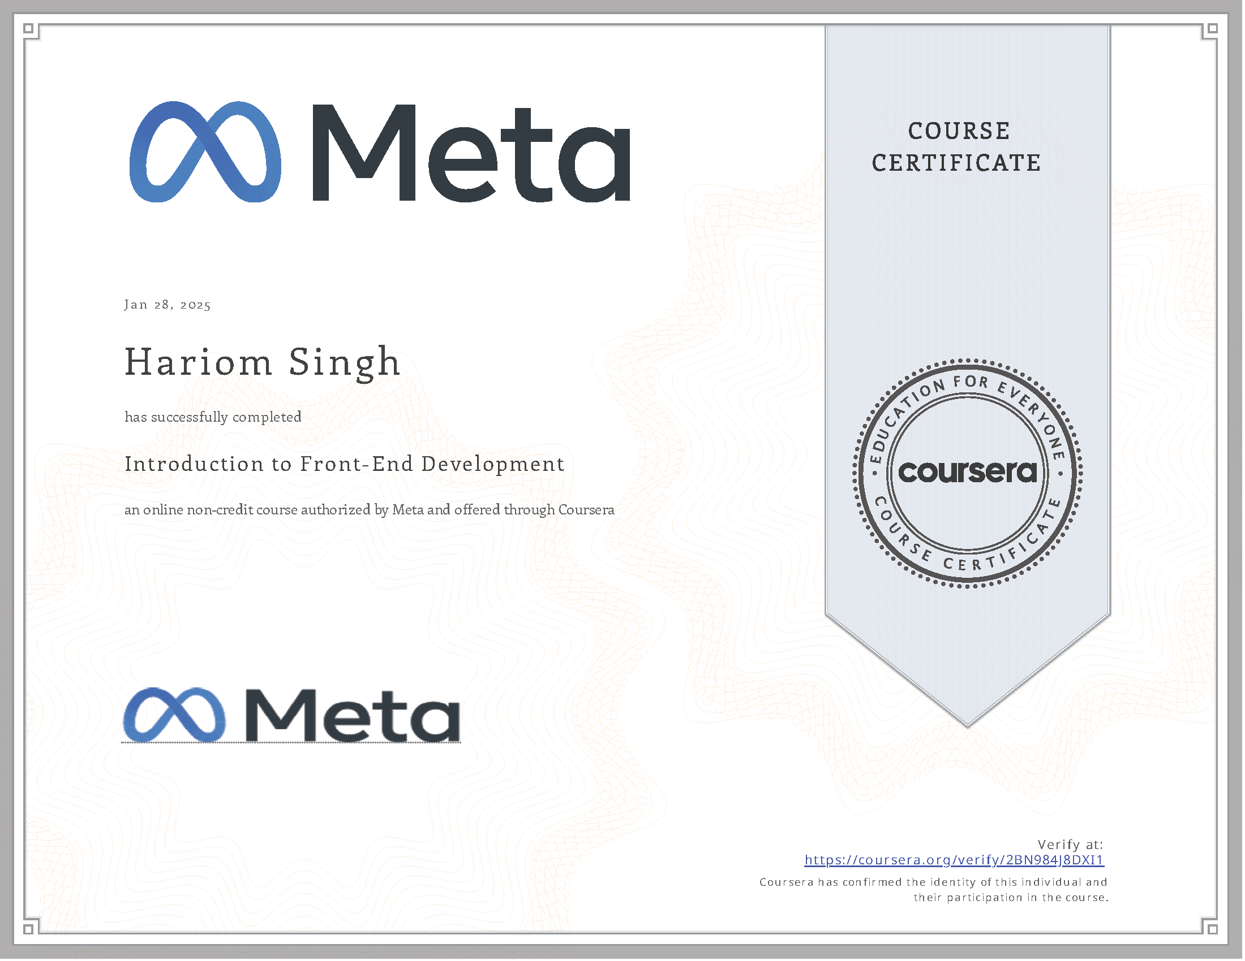
Course Certificate
GitHub Link : https://github.com/Hariom0/WP-D1-22.git

Slide 12
THANK YOU

