Slide 1
WasteOps Admin Panel
Complete Operator & Administrator User Guide
Multi-Country Operations, Real-Time Dispatching, Channels Simulator & Verification Systems
WasteOps Governance Systems | Version 1.1

Slide 2
CORE INTERFACE LAYOUT
Global Header & Navigation Shell
Every screen shares the same header bar and sidebar controls:
• Country Scope (Top Right flag dropdown):
Sets all visual stats to either Ghana (GHS), Nigeria (NGN), or Côte d'Ivoire (XOF).
• Theme Switcher:
Toggles layouts between Obsidian dark mode and Luminous light mode.
• Sidebar Links:
Accesses operational tasks, core service modules, verification channels, resources, and platforms.
VISUAL SHELL LAYOUT WIREFRAME
SIDEBAR
- Dashboard
- All Requests
- Dispatch
- Core Services
- SMS Gate
- Settings
TOPBAR [ 🇬🇭 Scope Dropdown ] [ ☀️/🌙 Toggle ]
[ WORKSPACE CONTAINER ]
Displays the currently selected module interface. Resizes dynamically.

Slide 3
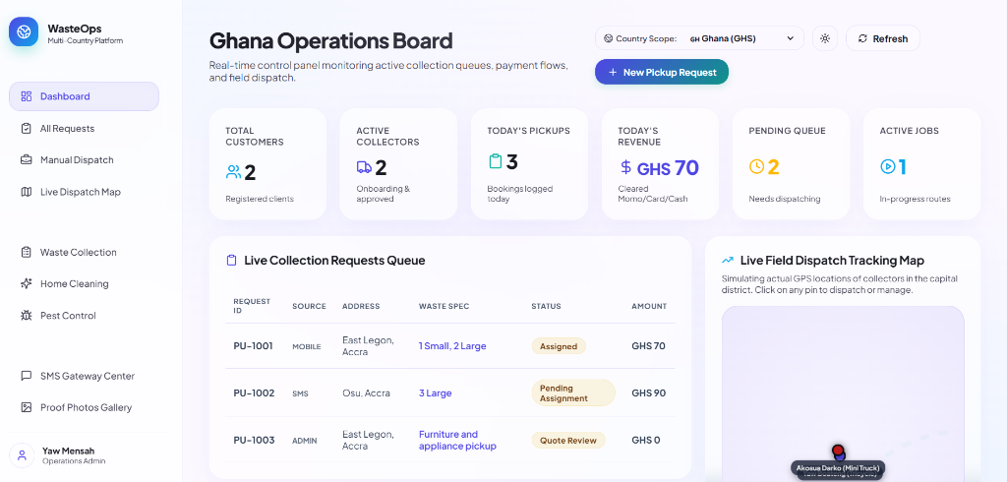
OPERATIONS PANEL
Operations Dashboard (Homepage)
The operational dashboard monitors volumes, dispatcher queues, and telemetry:
• KPIs (Top Cards):
Total Customers, Active Collectors, Today's Pickups, Today's Revenue, and Pending Queue.
• Live Collector Telemetry Map:
SVG tracking maps showing active driver coordinates. Click coordinates to review profiles.
• Requests Queue Table:
Overview of requests (ID, client names, address location, local currency, status badge).

Slide 4
OPERATIONS PANEL
Manual Dispatch & All Requests
Work order routing handles manual driver routing:
• All Requests Grid:
Lists all entries. Search by customer or address, and filter by status badges.
• Manual Dispatch Queue:
Shows only bookings in 'Pending Assignment' state.
• Dispatch Process Flow:
Click 'Assign Driver' -> Review available collectors modal (ratings, vehicle capacity) -> Click 'Confirm Dispatch'.
DRIVER ASSIGNMENT MODAL
DISPATCH ORDER PU-1002 (3 Sacks)
Yaw Boateng - Tricycle - 4.8 Rating - [ ASSIGN ]
Chinedu Obi - Van - 4.6 Rating - [ ASSIGN ]
Only online, approved drivers are listed in the dispatch modal.

Slide 5
OPERATIONS PANEL
Live Dispatch Telemetry Map
Tracking your field crew is essential for routing efficiency:
• Color Coded Pulsing Statuses:
🟢 Green Pin: Collector is online and available for bookings.
🟡 Yellow Pin: Collector has an active assigned job.
🔴 Red Pin: Collector is offline/off-shift.
• Real-Time Drifting Simulation:
Pins move dynamically on the SVG map using a mock coordinates generator to reflect actual movement.
• Zoom Controls & Overlays:
Zoom controls at the bottom right. Fleet cards at the bottom indicate active sectors (Accra, Lagos, etc.).
LIVE DISPATCH MAP INTERFACE
col-1 (Online)
[ Accra Street Network SVG Grid ]
col-2 (On Job)
[+]
[-]

Slide 6
CORE SERVICES
Waste Collection & Special Pickups
Waste collections are structured into two categories:
• Sack Pickups (Tab 1):
Houses standard collections. Bookings are made using small, medium, or large pre-paid bags.
• Special Pickups (Tab 2):
For oversized waste (furniture, tires). Shows custom photo attachments and description lists.
• Quoting Workflow (Special Pickups):
Find a pending special request -> Click pencil edit icon -> Enter price -> Confirm. Order shifts to dispatcher queue.
SPECIAL PICKUP QUOTING
SPECIAL PICKUP SP-1003
Client: Ama Mensah
Description: Large wooden wardrobe and cabinet
Enter Quote Amount (GHS):
GHS 120.00
[ Wardrobe Image Preview ]
CONFIRM QUOTE

Slide 7
CORE SERVICES
Cleaning & Pest Control Services
Operations controls extend beyond waste collection:
• Home Cleaning Module:
Exposes requests for cleaning. Bookings detail property types (Apartment, House, Office), rooms, and dates. Cleaners are dispatched via cards.
• Pest Extermination Module:
Treatment requests for termites, rats, bedbugs, and mosquitoes. Admins can upload inspection files and assign specialists.
• Cleaner & Specialist dispatch maps:
Both decks allow manual provider assignment by matching active status fields.
SERVICES DISPATCH CENTER
CLEANING JOB CL-2001 (Apartment - 3 Rooms)
Client: Ama Mensah | Deep clean kitchen and bedrooms.
Status: Assigned | Provider: Efua Cleaning Co.
PEST JOB PC-3001 (Termite Extermination)
Client: Kojo Appiah | Office warehouse inspection.
Status: New | [ ASSIGN EXTERMINATOR BUTTON ]

Slide 8
CHANNELS & VERIFICATIONS
SMS Gateway Center & Simulator
Test and manage bookings created by text messaging:
• SMS Feature Phone Simulator:
Type bookings (e.g., 'PICKUP 3 SACKS') and click send to test real-time parsing.
• Inbound Webhook Event Log:
Trace incoming SMS strings, customer phone matching, automated database registrations, and system responses.
• Template Editor:
Configure automated templates (e.g. invalid formatting alerts, confirmation replies, and completion notices).
SMS GATEWAY PHONE SIMULATOR
PICKUP 3 SACKS
Confirmation reply: PU-1002 registered.
Type here...
SEND

Slide 9
CHANNELS & VERIFICATIONS
Driver Proof Verification Gallery
Maintain quality control by reviewing photos uploaded by drivers on job completion:
• Proof Photos Feed:
Completed orders display photo attachments (bags collected at the curb).
• Audit Verification Actions:
Admins click green 'Approve Proof' (marks job as verified, releases driver payout) or red 'Flag Disputed' (marks job as disputed for supervisor review).
• Verification Compliance:
Enforces driver photo requirements before closure.
VERIFICATION PORTAL SCREEN
[ Complete Curb Sacks Photo Upload ]
ORDER PU-1001 | Driver: Yaw Boateng | 3 Sacks
APPROVE PROOF
FLAG DISPUTED

Slide 10
RESOURCE MANAGEMENT
Service Providers, Customers & Inventory
Operations require managing fleet providers, customers, and inventory levels:
• Service Providers Listing:
Shows collectors names, vehicle type, onboarding status (Approved, Pending, Suspended), star rating, and availability controls.
• Customer Directory:
Tracks client addresses, wallet balances, total spend logs, and active status switches.
• Sack Inventory Tracker:
Check Small, Medium, Large stock levels (warning bars show on low stock). Restock warehouse inventories via form.
SACK STOCK & INVENTORY
Small Sacks: 840 Sold / 2000 Stock
Medium Sacks: 910 Sold / 1800 Stock
Large Sacks: 760 Sold / 1200 Stock
⚠️ INVENTORY ALERT: Large sacks stock level is under 10% in Ghana region. Please submit restock wholesale form.

Slide 11
ADMINISTRATION
Financial Ledger & Platform Settings
Manage finance splits, security logging, and country parameters:
• Financial Ledger:
Tracks payments via MoMo, Card, Bank, and Cash. Calculates commission splits dynamically.
• Platform Settings:
Configure tax rates per country, enable payment providers, and adjust SMS provider credentials.
• System Audit Log:
Tracks all admin modifications (role changes, settings updates) with timestamps and details, ensuring transparency.
PLATFORM SETTINGS & AUDIT LOGS
GHANA REGION PARAMETERS
Tax Rate: 12.5% | Sms Gateway: Hubtel
Payment Providers: [x] MTN MoMo [x] Card [x] Cash
SYSTEM SECURITY AUDIT LOG
Time | Actor | Action | Details
14:20:05 | super_admin | settings.update | Tax rate -> 12.5%
14:18:10 | admin_ops | driver.assign | PU-1002 -> col-1

