Slide 1


Mini Project-I Exam
(Semester V )
Reconfigurable Co-Processor for Texture Segmentation Using Python And FPGA
Group Name : 1.618
1. Vaishnavi Chaudhari 07(D14B)
2. Hariom Dhage 09(D14B)
3. Samruddhi Diwane 10(D14B)
4. Meghna John 23(D14B)
Name of Supervisor: Mr.Mrugendra Vasmatkar
Vivekanand Education Society's Institute of Technology
An Autonomous Institute Affiliated to University of Mumbai
Electronics and Telecommunication Engineering

Slide 2
Contents
Introduction
Problem Statement
Literature Survey
Research Gap/ Target Customers
Proposed Solution
Block Diagram of System
Flow Diagram of System
Components requirement
Time Chart
Results
References

Slide 3
Introduction
The project focuses on developing a custom texture segmentation algorithm using Law's Texture Measure (LTM) to enhance control and efficiency in image analysis. By manually extracting texture features and deploying the algorithm on FPGA hardware, it aims to achieve real-time performance, making it suitable for various applications, including medical imaging and industrial automation.

Slide 4
Problem Statement
The project addresses the limitations of traditional texture segmentation methods by developing a custom algorithm using Law’s Texture Measure (LTM) for feature extraction. By deploying the Python-prototyped algorithm on FPGA hardware, it aims to improve speed and efficiency in real-time applications such as medical imaging and industrial automation.

Slide 5
Literature Survey
Sr. No. | Title of Technical paper | Name of Author | Year of publication | Name of Journal | Methodology | Results/ conclusion | Drawbacks/ limitations
1. | Texture Detection With Feature Extraction on Embedded FPGA [1]. | Raúl Lora-Rivera, Óscar Oballe-Peinado , and Fernando Vidal-Verdú | 2023 | IEEE Sensors Journal ( Volume: 23, Issue: 11, 01 June 2023) | 1. MATLAB, FPGA, feature extraction, FFT, sweep, texture detection. 2. Twelve textures, efficient classification, reduced feature vectors. | 1. Compared FFT and sweep algorithms for texture detection efficiency. 2. FPGA, implementation, reduced resource consumption. | 1. Artifacts, noise, blur, microscope image segmentation. 2. Factors, hinder, precise classification, microscopy applications.
2. | Model-Deown Dent uncertainty estimation of medical image segmentation [2]. | Tsachi Hershkovitch and Tammy Riklin-Raviv | 2018 | IEEE 15th International Symposium on Biomedical Imaging (ISBI 2018) April 4-7, 2018, Washington, D.C., USA | 1. Stochastic active contour method, segmentation consistency assessment. 2. Synthetic, real brain CT data, validation. | 1. Novel method, segmentation uncertainty, medical images, blurriness. 2. Stochastic active contours, synthetic, brain CT data, validation. | 1. Model-specific segmentation, limited versatility. 2. Iterative uncertainty estimation, time-consuming, large datasets.
3. | Image segmentation and classifcation for fssion track analysis for nuclear forensics using U‑net model [3] | Noam Elgad, Rami Babayew, Mark Last, Aryeh Weiss, · Erez Gilad, ·Galit Katarivas Levy, Itzhak Halevy | 2024 | Journal of Radioanalytical and Nuclear Chemistry | 1. Fission stars, Lexan detector, 700 overlapping microscope images. 2. Segmented 250 × 250 µm sections, cluster criteria. | 1. Model accuracy: 85%, 90%, 92% across epochs. 2. Effective segmentation, classification, FT clusters, increasing accuracy. | 1. Deep learning, substantial data, U-Net, effective, demanding. 2. Resource-intensive data labeling, artifacts, noise, microscopy challenges.
Table 1. Literature Survey

Slide 6
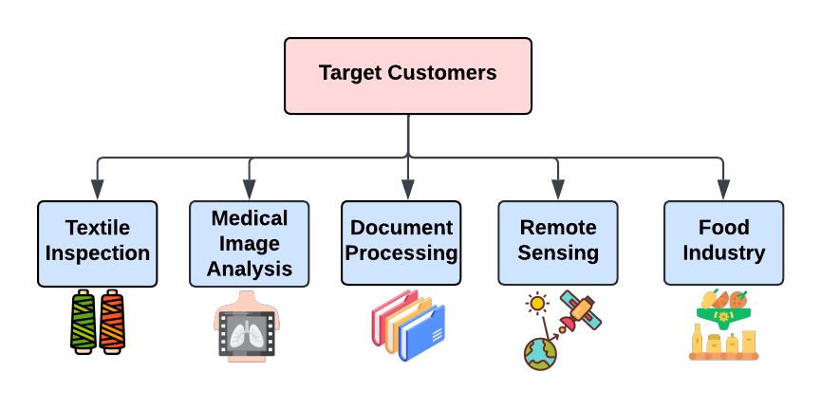
Research Gap And Target Customers
Traditional Software-based texture segmentation have the following shortcomings:
Struggles with speed and efficiency
Performance bottlenecks with increasing data sizes and complexity.
Consume significant energy
No integration with computer vision and pattern recognition systems

Slide 7
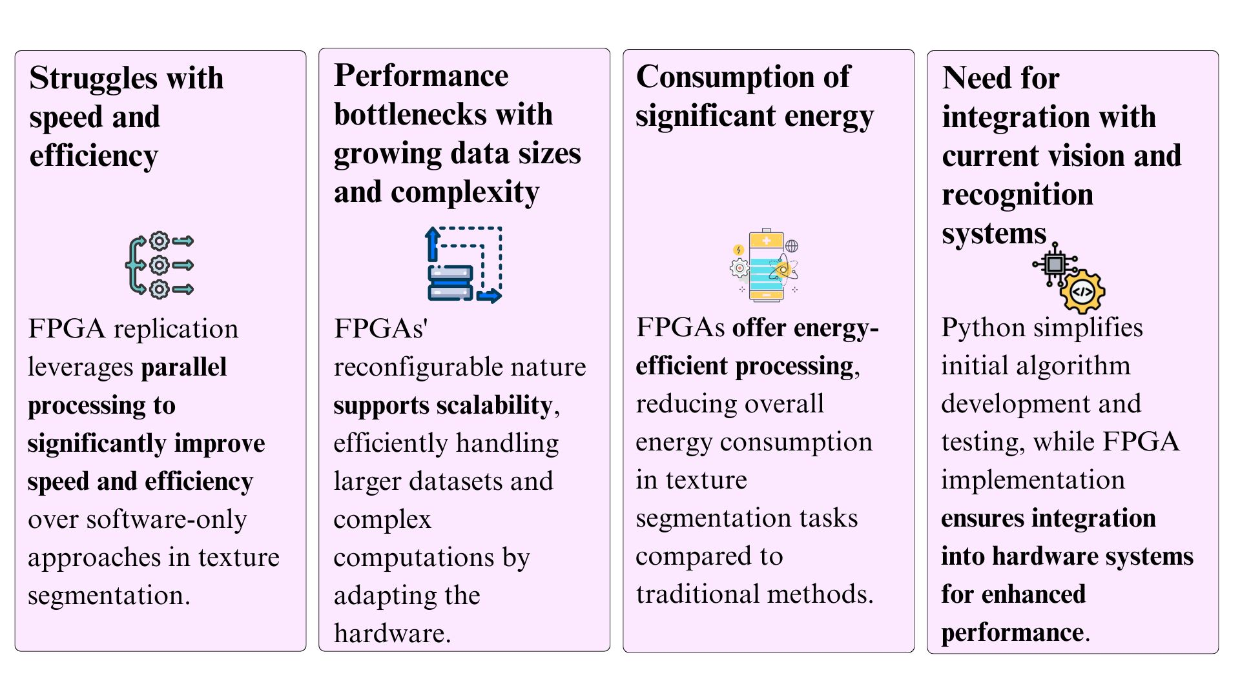
Proposed Solution
Fig.2 Proposed Solution

Slide 8
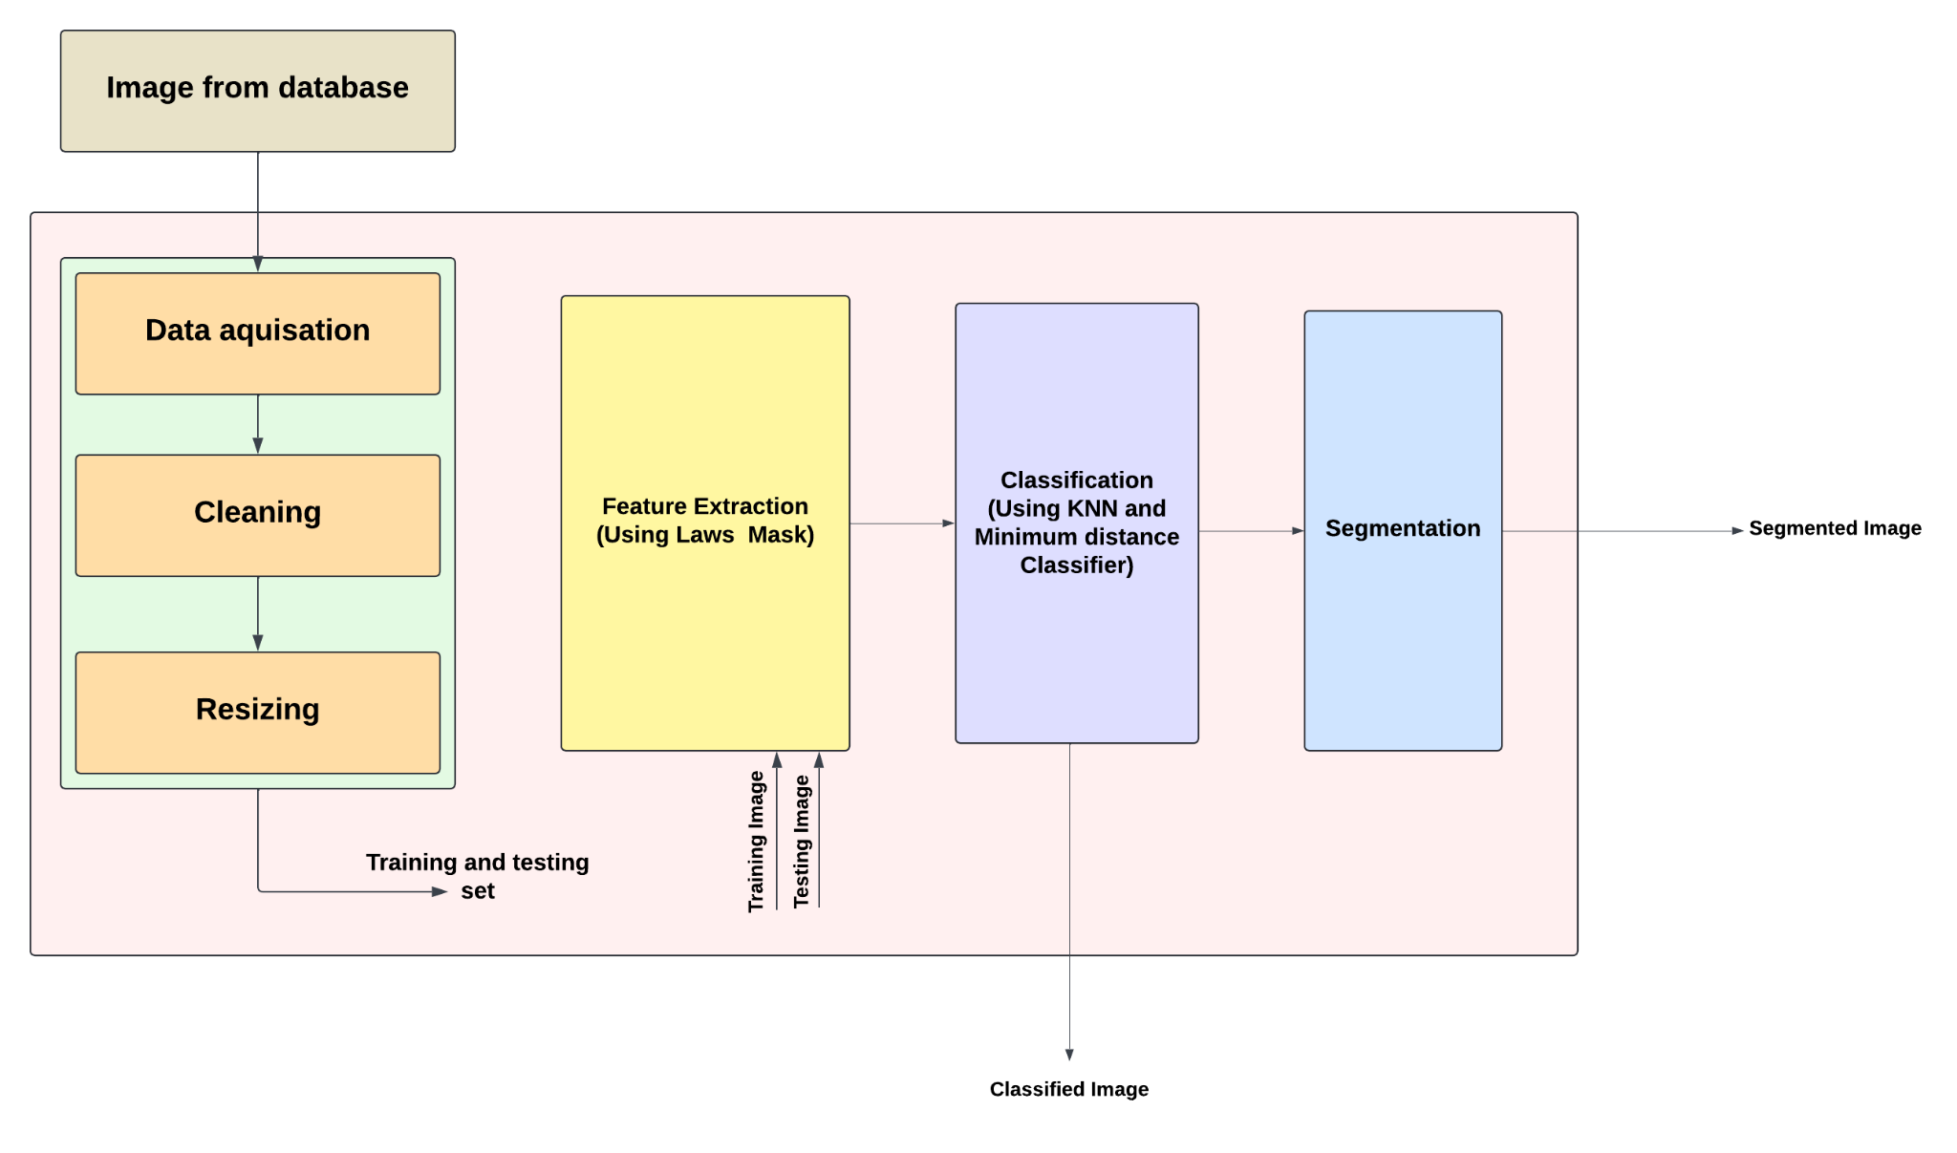
Block Diagram of Proposed System
Fig.3 Block Diagram

Slide 9
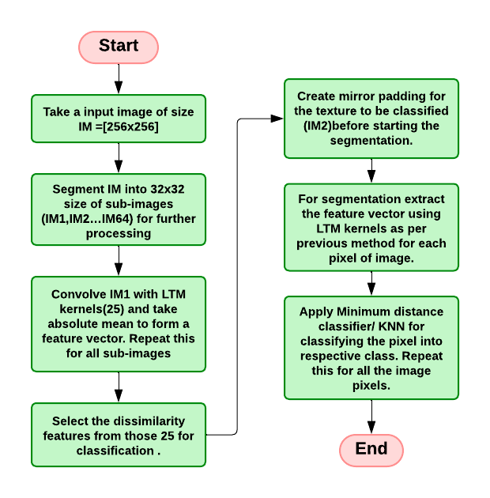
Flow Diagram of System
Fig.4 Flow Diagram

Slide 10
Laws’ Texture Measures
Laws' texture masks are used for efficient texture analysis and feature extraction in FPGA-based reconfigurable systems. The 2-D convolution kernels, used for texture discrimination are generated from the set of 1-D convolution kernels of length five.
L5(Level) = [ 1 4 6 4 1 ] Level Detection
E5(Edge) = [ -1 -2 0 2 1 ] Edge Detection
S5(Spot) = [ -1 0 2 0 - 1 ] Spot Detection
R5(Ripple)= [ 1 -4 6 -4 1 ] Ripple Detection
W5(Wave)= [ -1 2 0 -2 1 ] Wave Detection
2-D convolution kernels are generated by convolving a vertical 1-D kernel with a horizontal 1-D kernel.

Slide 11
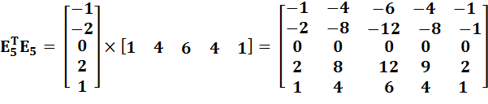
Laws’ Texture Measures

Slide 12
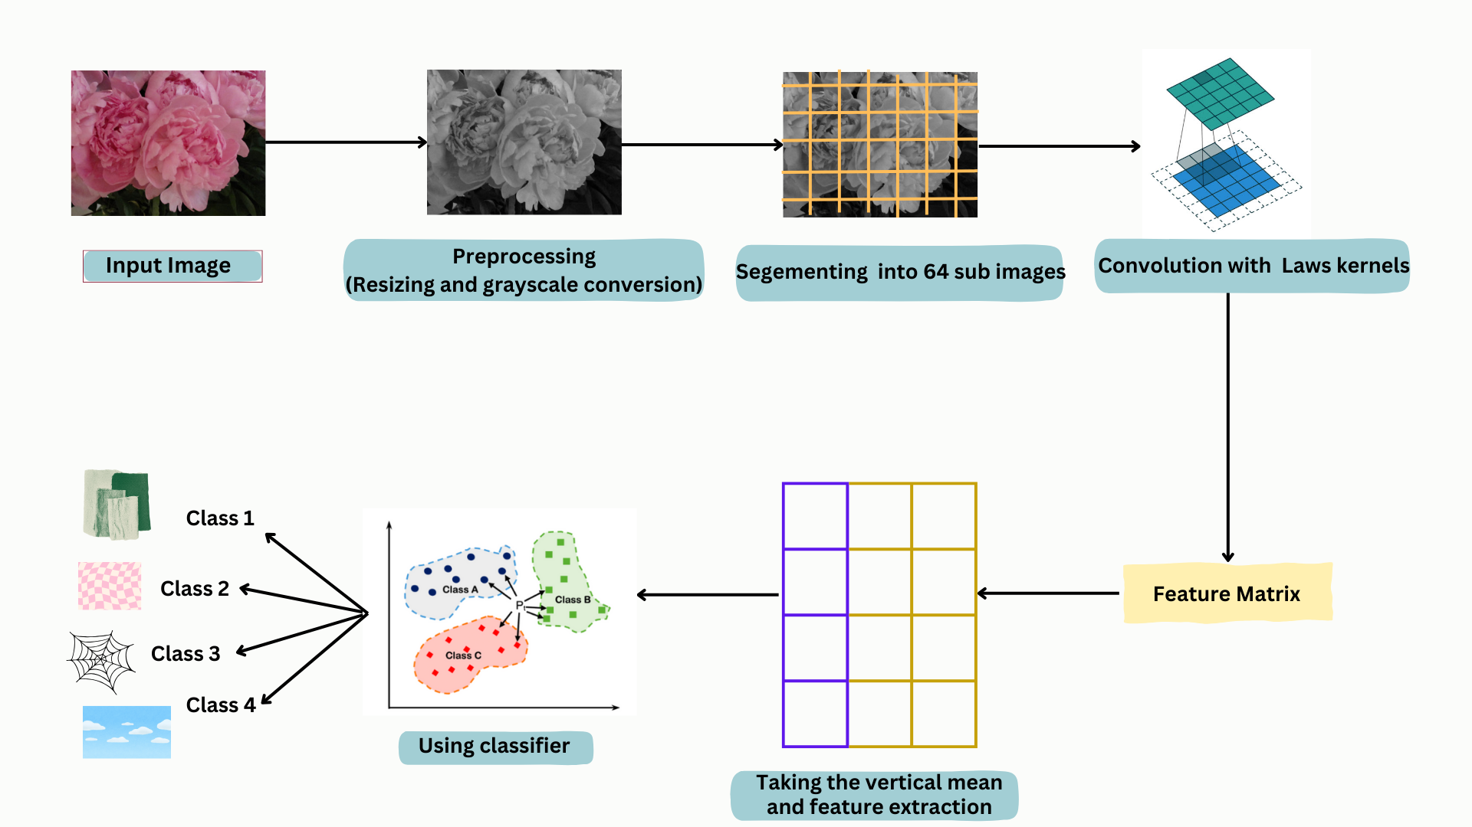
Fig.5 Pictorial representation of flow diagram

Slide 13
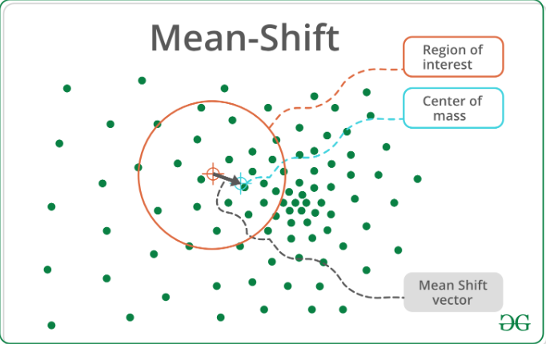
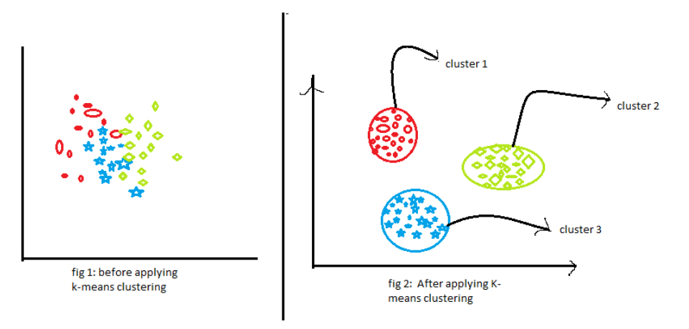
Classification Algorithm
K-Means Clusters
Mean Shift classifier
Fig.9 Mean shift
Fig.8 Mean shift
Key Point:-Clusters data into a fixed number of clusters (K=5).
Problem:-Struggles with complex data distributions, leading to lower recall
Key Point:-Adapts to the data automatically, finding the number of clusters (here, 8).
Problem:-Computationally intensive for large datasets.

Slide 14
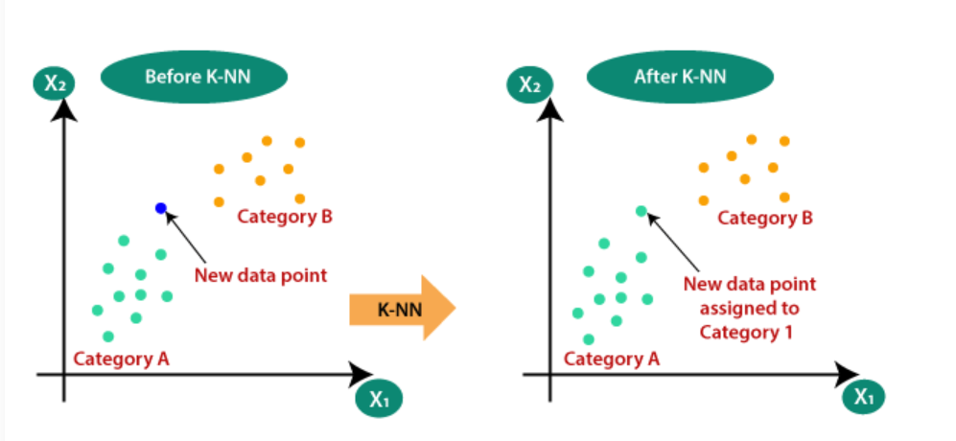
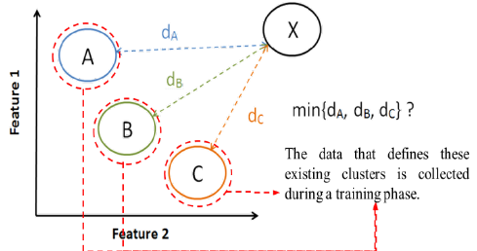
Classification Algorithm
K-Nearest Neighbor(KNN)
Minimum Distance classifier
Fig.7 Minimum distance
Fig.6 KNN
Key Point:-Classifies by calculating distance between data points and known class centers (M=50).
Problem:- A highly efficient classifier with minimal computation, ideal when data is well-separated and doesn’t need complex clustering like Mean-Shift.
Key Point:-Classifies based on the majority vote of the nearest neighbors (K=110).
Problem:-Works well but is slow with large datasets.

Slide 15
Proposed Project Components and Expenditure
Table 2. Hardware used in project
Sr. No | Name of components | Quantity | Cost in Rupees | Reference
1. | PYNQ FPGA board | 1 | 21500/- | Link
Table 3. Software used in project
Sr. No. | Name of components | Type(open source/paid)
1. | Jupyter | Open Source
2, | Google Colab | Open Source
3. | Broadatz Texture Database | Open Source

Slide 16
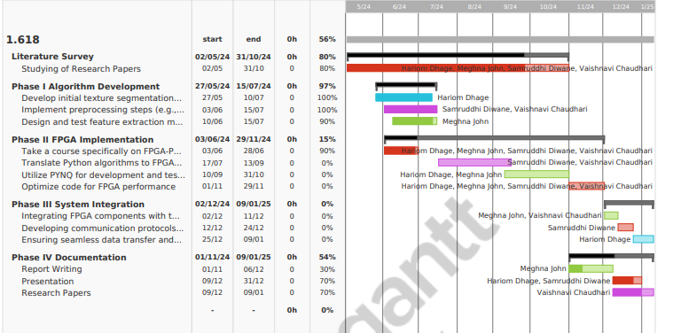
Timeline

Slide 17
Results
Classifiers | Accuracy | Precision | Recall | F1 Score | Confusion Matrix
Mean-Shift Classifier (Clusters = 8) | 100% | 1.00 | 1.00 | 1.00 | [[28 0] [ 0 2]]
K-means clusters (K = 5) | 80.00% | 1.00 | 0.80 | 0.89 | [[22 0] [0 2]]
K-Nearest Neighbors Classifier(KNN) (K=110) | 96.67% | 0.97 | 1.00 | 0.98 | [[28 0] [ 1 1]]
Minimum Distance Classifier (M= 50) | 98.00% | 1.00 | 0.98 | 0.99 | [[46 0] [3 0]]
Table 4. Classifiers & its Accuracy

Slide 18
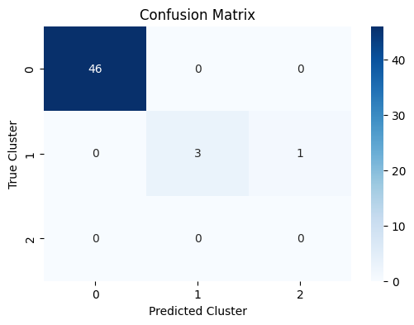
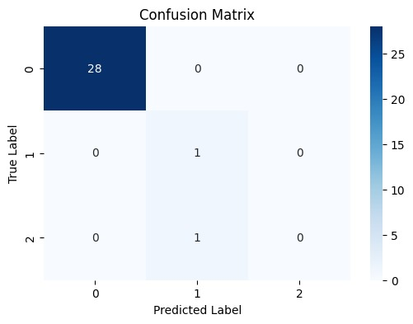
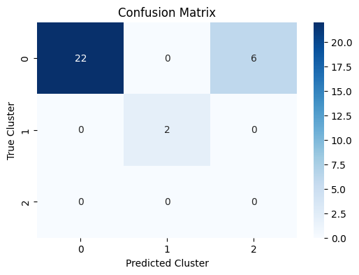
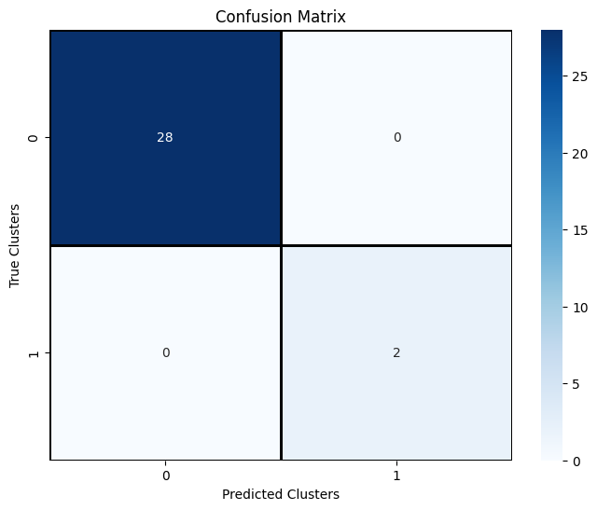
Results
Fig 10 Minimum distance
Fig 11 KNN
Fig 12 K- Means
Fig.13 Mean shift
https://drive.google.com/drive/folders/1pjL4fBPe2LX6cHBwgdetc-1n_O5A_Gd0?usp=sharing
Mini Project- I Exam

Slide 19
Work done in First Semester
Implemented Python-based texture segmentation algorithm for image analysis and classification.
Used KNN, K-Means, Minimum Distance, and Mean Shift classifiers for better accuracy.
Selected the DTD dataset for its diverse texture patterns, providing improved training and testing samples.
Chose DTD over Brodatz for more challenging and varied textures, aiding in better generalization.
Focused on testing and identifying the most suitable classifier for optimal segmentation accuracy.
Mini Project- I Exam

Slide 20
Comparison and Validation
Techniques | Accuracy | Key Contribution
FPGA-based Texture Detection | 89.17% | Feature extraction algorithm designed for FPGA implementation with reduced power/resource usage.
Uncertainty Estimation in Medical Imaging | N/A | Novel approach for model-dependent uncertainty estimation in medical image segmentation.
U-Net for Fission Track Analysis | 85% - 92% | Utilizes U-Net model for effective segmentation and classification across various epochs.
Texture Segmentation using LTM | 97.50% (Minimum Distance Classifier) | Python-based implementation emphasizing manual feature extraction for texture analysis.
Mini Project- I Exam

Slide 21
References
R. Lora-Rivera, Ó. Oballe-Peinado and F. Vidal-Verdú, "Texture Detection With Feature Extraction on Embedded FPGA," in IEEE Sensors Journal, vol. 23, no. 11, pp. 12093-12104, 1 June1, 2023, doi: 10.1109/JSEN.2023.3268794.
T. Hershkovitch and T. Riklin-Raviv, "Model-dependent uncertainty estimation of medical image segmentation," 2018 IEEE 15th International Symposium on Biomedical Imaging (ISBI 2018), Washington, DC, USA, 2018, pp. 1373-1376, doi: 10.1109/ISBI.2018.8363827.
Elgad, N., Babayew, R., Last, M. et al. Image segmentation and classification for fission track analysis for nuclear forensics using U-net model. J Radioanal Nucl Chem 333, 2321–2337 (2024). https://doi.org/10.1007/s10967-024-09461-2
S. Dash and U. R. Jena, "Multi-resolution Laws’ Masks based texture classification," Journal of Applied Research and Technology, vol. 15, no. 6, pp. 571-582, 2017. doi: 10.1016/j.jart.2017.07.005.
R. M. Haralick, "Statistical and structural approaches to texture," in Proceedings of the IEEE, vol. 67, no. 5, pp. 786-804, May 1979, doi: 10.1109/PROC.1979.11328.
P. Brodatz, “Textures - A Photographic Album for Artists and Designers”, Dover, 1966.
Kyong I. Chang, Kevin W. Bowyer and Munish Sivagurunath, “Evaluation of Texture Segmentation Algorithms, Computer Vision and Pattern Recognition”, 1999. IEEE Computer Society Conference.
Motofumi T. Suzuki, Yoshitomo Yaginuma, Tsuneo Yamada, Yasutaka Shimizu, “A Shape Feature Extraction Method Based on 3D Convolution Masks”, Proceedings of the Eighth IEEE International Symposium on Multimedia (ISM'06).

Slide 22
Thank You!

