Slide 1
E-COMMERCE SALES ANALYTICS DASHBOARD
Apex Planet Data Analytics Internship
Task 5: Final Reporting, Depolyment & Presentation
Prepared by Hariom Kumar Dubey

Slide 2
Project Overview
This project analyzes two year of retail sales transactions to uncover revenue trends, customer behavior, and product performance, culminating in an interactive Power BI dashboard.
1.6M
Total Sales
Clean and prepare raw transactional sales data
22k
Explore trends across time, geography, and demographics
Total Orders
Design an interactive dashboard for business monitoring
175k
Validate findings using statistical hypothesis testing
Total Profit
E-commerce Sales Analytics Dashboard | Apex Planet Internship - Task 5
2

Slide 3




Tools & Technologies Used
A combination of programming, data, and visualization tools supported every stage of the analysis.
Python
SQL
Excel
Power BI
Data cleaning & EDA
Querying & aggregation
Data prep & validation
Interactive dashboard
E-commerce Sales Analytics Dashboard | Apex Planet Internship - Task 5
3

Slide 4
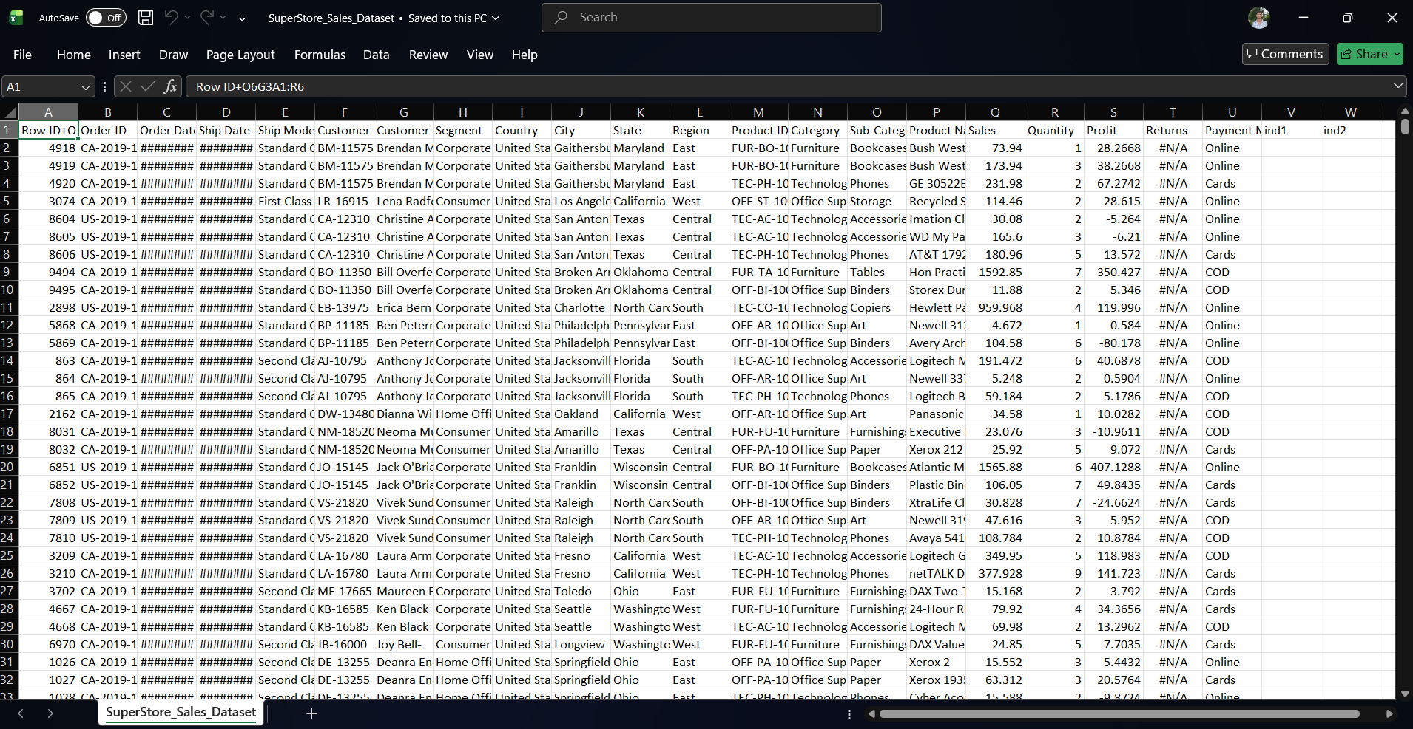
Dataset Overview
The raw dataset (“SuperStore_Sales_Dataset”) contains 5902 order details, customer demographics, product, and sales value.
E-commerce Sales Analytics Dashboard | Apex Planet Internship - Task 5
4

Slide 5
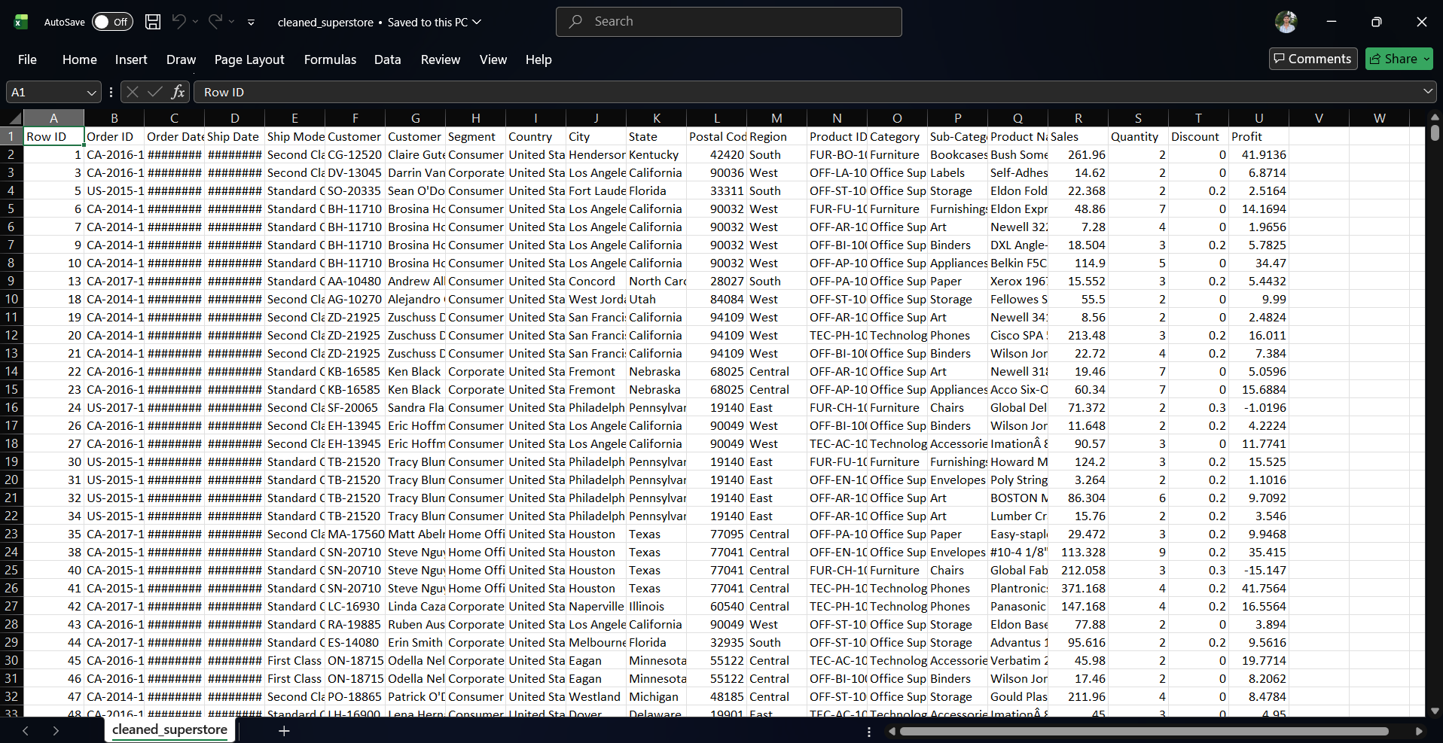
Data Cleaning Workflow
Raw records were cleaned and enriched in Excel/Python — handling duplicates, formatting dates, and deriving segmentation fields for analysis.
E-commerce Sales Analytics Dashboard | Apex Planet Internship - Task 5
5

Slide 6
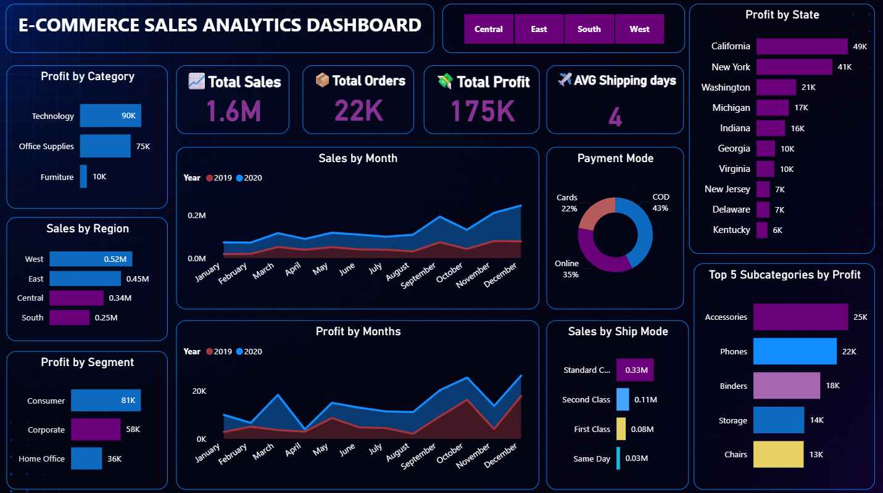
Power BI Dashboard
An interactive dashboard consolidating KPIs, trends, and breakdowns by region, category, segment, ship mode and payment mode.
E-commerce Sales Analytics Dashboard | Apex Planet Internship - Task 5
6

Slide 7
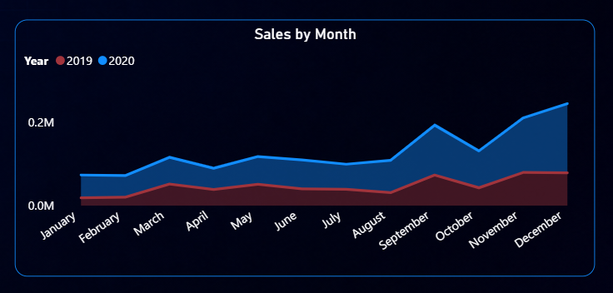
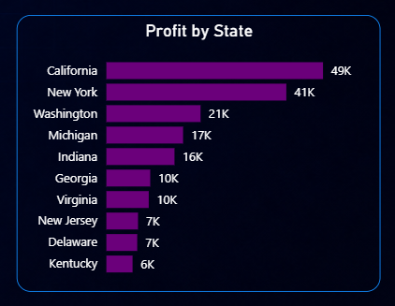
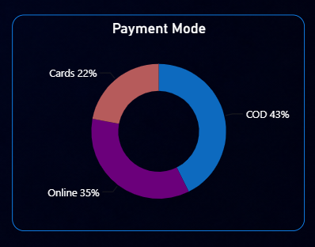
Key Charts
Monthly Sales Trend
Profit by States
Payment by Mode
E-commerce Sales Analytics Dashboard | Apex Planet Internship - Task 5
7

Slide 8

Key Insights
Total sales reached ₹1.6M across 22k orders.
Technology was the highest-profit category.
Consumer segment generated the greatest profit.
Accessories and Phones were the most profitable sub-categories.
California produced the highest state profit.
Standard Class dominated shipping.
E-commerce Sales Analytics Dashboard | Apex Planet Internship - Task 5
8

Slide 9
Statistical Validation
An Independent Sample T-Test was used to check whether average spending differs significantly between male and female customers.
H₀ (Null Hypothesis)
No significant difference in average spending between male and female customers.
H₁ (Alternative Hypothesis)
There is a significant difference in average spending between male and female customers.
Hypotheses
(H₀ vs H₁)
Independent T-Test
Decision
(Accept / Reject H₀)
A p-value below 0.05 leads to rejecting H₀, indicating a statistically significant difference in spending between genders.
E-commerce Sales Analytics Dashboard | Apex Planet Internship - Task 5
9

Slide 10

Conclusion
This project demonstrates how data analytics can transform raw sales data into meaningful business insights.
By combining Python, SQL, Excel, and Power BI, it was possible to identify sales trends, customer behavior, product performance, and regional opportunities.
The interactive dashboard provides an effective way to monitor business performance, while statistical validation strengthens confidence in the findings.
Overall, this project highlights the importance of data-driven decision-making in improving business growth and operational efficiency.
E-commerce Sales Analytics Dashboard | Apex Planet Internship - Task 5
10

Slide 11
Skills Developed
Throughout this internship project, the following skills were strengthened:
Data Cleaning
Exploratory Data Analysis (EDA)
Data Visualization
Dashboard Development
Business Intelligence
Statistical Analysis
Power BI
Python Programming
SQL Queries
Problem Solving
Data Storytelling
GitHub Project Documentation
E-commerce Sales Analytics Dashboard | Apex Planet Internship - Task 5
11

Slide 12

Thank You
Prepared By — Hariom Kumar Dubey

