Slide 1
BLINKIT
Sales Analytics Dashboard
Power BI | Excel | Data Analytics
Hariom Dubey St. Andrews Institute of Technology and Management

Slide 2
Project Overview
OBJECTIVE
Analyze Blinkit sales data to identify:
TOOLS USED
1
Sales Performance Track total and average revenue trends
Microsoft Excel Data organization & preliminary analysis
2
Customer Purchasing Trends Understand what and how customers buy
Power BI Interactive dashboard & visualization
3
Outlet Performance Compare outlets by size, type, and location
4
Product Category Analysis Identify top and low performing categories
Power Query Data extraction, cleaning & transformation
5
Business Insights Convert raw data into decisions
DAX Custom measures & calculated metrics
Blinkit Sales Analytics Dashboard
2

Slide 3
Dataset Information
Kaggle / Blinkit Public Dataset
8,500+
12
DATASET SOURCE
NUMBER OF RECORDS
NUMBER OF COLUMNS
DATA CLEANING STEPS
Removed duplicate records
Handled missing values
✓
✓
Corrected data types
Standardized category names
✓
✓
Blinkit Sales Analytics Dashboard
3

Slide 4




Dashboard KPIs
Core business metrics surfaced at the top of the report
Average Rating
Total Sales
Average Sales
Number of Items Sold
Sum of overall revenue generated across all outlets and product categories.
Mean sales value per item, indicating typical transaction performance.
Total count of unique products sold, reflecting overall demand volume.
Mean customer rating across items, signalling product & service quality.
Blinkit Sales Analytics Dashboard
4

Slide 5
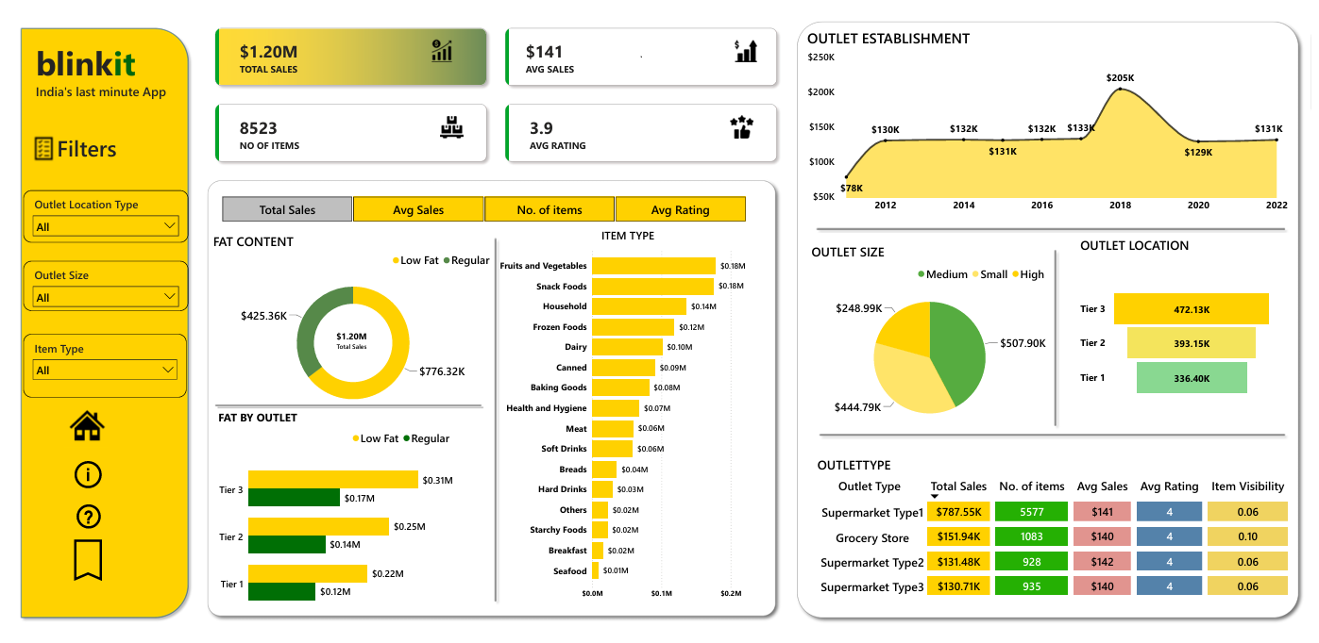
Dashboard Overview
Blinkit Sales Analytics Dashboard
5

Slide 6
Visualizations Used
Visualization | Purpose
KPI Cards | Business Metrics
Donut Chart | Fat Content Distribution
Bar Chart | Item Type Sales
Line Chart | Outlet Establishment Trend
Pie Chart | Outlet Size Contribution
Funnel / Column Chart | Outlet Location Analysis
Slicers | Interactive Filtering
7
Distinct visual types combined into one interactive report
Every chart is linked to the slicer panel for real-time cross-filtering.
Blinkit Sales Analytics Dashboard
6

Slide 7
Key Insights
Medium-sized outlets contributed the highest share of total sales $507.90k, making them the best-performing outlet size.
✓
Fruits & Vegetables and Snack Foods generated the highest revenue, indicating strong customer demand.
✓
Tier-3 outlets accounted for the highest share of total sales $207.37k, outperforming Tier-1 and Tier-2 locations.
✓
Regular Fat products contributed approximately XX% of total sales, reflecting higher customer preference compared to Low Fat products.
✓
Older outlets show more consistent revenue.
✓
Blinkit Sales Analytics Dashboard
7

Slide 8
Business Recommendations
01
02
03
Increase stock of top-selling categories.
Improve inventory planning.
Expand medium-sized outlets.
04
05
Launch offers for low-performing categories.
Improve customer ratings through better service.
Blinkit Sales Analytics Dashboard
8

Slide 9
Challenges & Learning
CHALLENGES
LEARNING
Missing values
Power Query
Data cleaning
DAX Measures
DAX calculations
Data Modeling
Dashboard layout
Interactive Dashboard Design
Business Insight Generation
Blinkit Sales Analytics Dashboard
9

Slide 10
Conclusion
Project Outcome
✔
Built an interactive Power BI dashboard.
✔
Reduced manual reporting by creating one interactive dashboard.
✔
Improved understanding of sales analytics and data visualization.
✔
Demonstrated the ability to transform raw data into business decisions.
Thank You
Blinkit Sales Analytics Dashboard
10

