Slide 1
HR WORKFORCE ANALYTICS PROJECT
Employee Attrition & HR
Analytics Dashboard
Prepared by: Hariom Kumar Dubey
Excel
SQL
Python
Power BI
Employee Attrition & HR Analytics Dashboard
1

Slide 2
THE CONTEXT
Project Overview
!
Business Problem
→
Project Goal
Losing employees is expensive — recruiting, onboarding, and lost productivity all add cost. But a single company-wide attrition number doesn't tell HR where to act.
Build an end-to-end HR analytics solution — from raw data to an interactive dashboard — that identifies attrition drivers and enables targeted, data-driven retention decisions.
WHY HR ANALYTICS MATTERS
Replacing an employee can cost 6–9 months of their salary once recruiting, onboarding, and lost productivity are factored in. HR analytics turns scattered employee records into a decision-making tool — helping organizations move from reacting to attrition after it happens, to predicting and preventing it before it does.
Employee Attrition & HR Analytics Dashboard
2

Slide 3
WHAT THIS PROJECT SET OUT TO DO
Project Objectives
01
Analyze Employee Attrition
Break down a flat company-wide attrition rate into department, tenure, age, and experience-level detail.
02
Identify High-Risk Employee Groups
Pinpoint exactly which segments of the workforce carry the highest attrition risk.
03
Evaluate Workforce Performance
Examine performance ratings, compensation, and training investment across departments.
04
Support Data-Driven HR Decisions
Translate findings into a dashboard and recommendations HR can act on directly.
Employee Attrition & HR Analytics Dashboard
3

Slide 4
THE DATA
Dataset Overview
KEY COLUMNS
DATASET NAME
EmployeeID
Unique employee identifier
IBM HR Analytics
Employee Attrition & Performance
Attrition
Target variable — Yes / No
Department
Sales, R&D, HR
Age
Employee age
4,327
Employees
Gender
Male / Female
31
Features / Attributes
JobRole
10 distinct roles
MonthlyIncome
Compensation
Kaggle
Data Source
WorkLifeBalance
1–4 rating scale
JobSatisfaction
1–4 rating scale
TotalWorkingYears
Career tenure
Source: IBM HR Analytics Employee Attrition & Performance dataset (Kaggle)
PerformanceRating
1–5 rating scale
MaritalStatus
Single / Married / Divorced
Employee Attrition & HR Analytics Dashboard
4

Slide 5
HOW IT WAS BUILT
End-to-End Workflow
Excel
↓
SQL (30 Queries)
↓
Python (EDA)
↓
Power BI Dashboard
↓
Business Insights
↓
Recommendations
Employee Attrition & HR Analytics Dashboard
5

Slide 6
DATA LAYER
SQL Analysis
WHAT WAS ANALYZED
TECHNIQUES USED
Employee Workforce Analysis
30 Business Queries
Attrition Analysis
Window Functions
Salary & Performance Analysis
Common Table Expressions (CTE)
Department Insights
CASE Statements
Advanced SQL Analytics
Aggregate Functions
From simple aggregations to window functions (RANK, DENSE_RANK, ROW_NUMBER), CTEs, and a composite CASE-based HR risk score — the SQL layer built the analytical foundation the dashboard was designed on top of.
Employee Attrition & HR Analytics Dashboard
6

Slide 7
ANALYSIS LAYER
Python Analysis
🧹
⚙
❓
Data Cleaning
Data Preprocessing
Missing Value Handling
Removed duplicates, standardized inconsistent category labels, and fixed data-type mismatches.
Bucketed continuous fields (age, tenure) and mapped numeric scales to readable labels.
Identified and treated null/missing entries so downstream analysis wasn't skewed.
🔍
Σ
📊
Exploratory Data Analysis (EDA)
Statistical Analysis
Data Visualization
Explored distributions and relationships across attrition, department, and satisfaction.
Quantified correlations between attrition and tenure, age, satisfaction, and work-life balance.
Built exploratory charts to validate patterns before they were built into the dashboard.
Employee Attrition & HR Analytics Dashboard
7

Slide 8
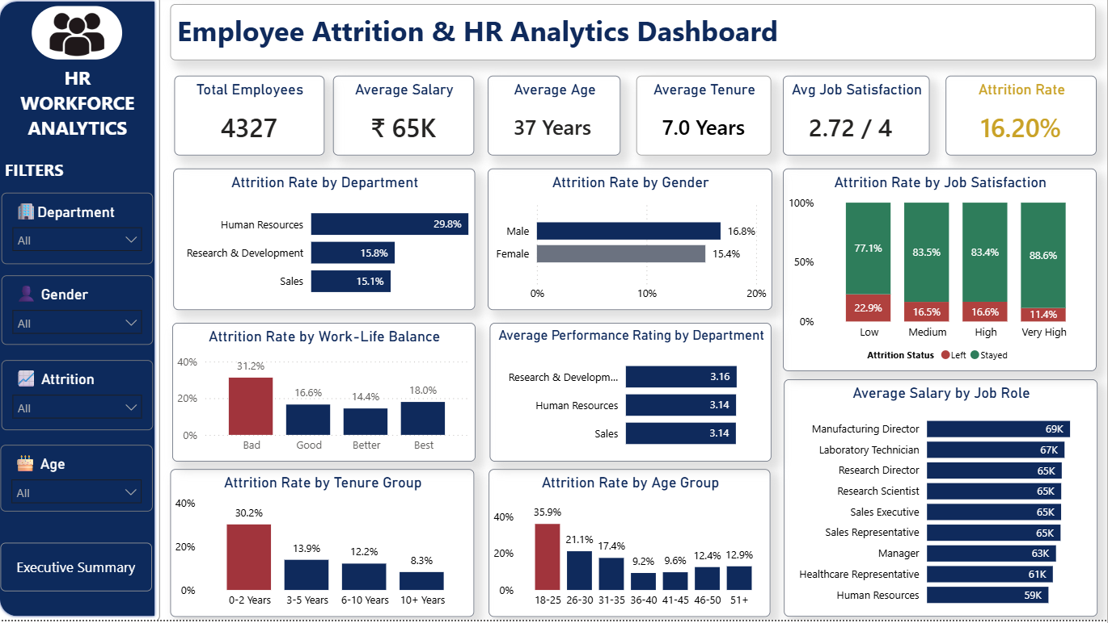
THE DELIVERABLE
Dashboard Overview
KPI Cards
Six headline metrics — headcount, salary, age, tenure, satisfaction, and attrition rate.
Filters
Department, Gender, Education, Attrition, Job Role, Marital Status, and Age slicers.
Charts
Attrition broken down by department, gender, satisfaction, work-life balance, and tenure.
Navigation
A dedicated button links to the Executive Summary page for stakeholder review.
Executive Summary
A condensed, decision-oriented second page for non-technical stakeholders.
Employee Attrition & HR Analytics Dashboard
8

Slide 9
WHAT THE DATA SHOWS
Key Business Insights
16.2%
Overall Attrition Rate
The company-wide baseline every other finding compares against.
29.8%
HR Has the Highest Attrition
Almost double Research & Development (15.8%) and Sales (15.1%).
30.2%
0–2 Year Tenure = Highest Risk
Nearly 4× the attrition rate of employees with 10+ years (8.3%).
35.9%
Younger Employees Attrite More
Ages 18–25 attrite at more than double the 26–30 cohort (21.1%).
31.2%
Poor Work-Life Balance Drives Attrition
Vs. 16.6% for employees reporting “Good” work-life balance.
Employee Attrition & HR Analytics Dashboard
9

Slide 10
TURNING INSIGHT INTO ACTION
Business Recommendations
✓
Improve Onboarding Programs
Structured onboarding and mentoring during an employee's first two years, when attrition risk is highest.
✓
Enhance Work-Life Balance
Flexible work policies and wellness initiatives to address the strongest experience-related driver.
✓
Increase Employee Engagement
Regular feedback, career development conversations, and recognition — especially for early-career staff.
✓
Review Retention Strategies
A focused retention review within Human Resources, given its disproportionate attrition rate.
✓
Monitor High-Risk Employees
Use the HR Risk Score to proactively flag and support employees before they leave.
Employee Attrition & HR Analytics Dashboard
10

Slide 11
CAPABILITIES APPLIED
Skills Demonstrated
TECHNICAL SKILLS
ANALYTICAL SKILLS
Excel
Data Cleaning
SQL
Exploratory Data Analysis (EDA)
Python
Dashboard Development
Power BI
KPI Reporting
DAX
Business Intelligence
Power Query
Employee Attrition & HR Analytics Dashboard
11

Slide 12
WRAPPING UP
Conclusion
Project Summary
An end-to-end HR analytics solution — Excel to SQL to Python to Power BI — that turns a flat 16.2% attrition rate into a segment-level view HR can act on.
Business Impact
Identifies exactly where retention efforts should focus first: early-tenure employees, younger staff, and the HR department itself.
Key Learnings
End-to-end pipeline thinking, SQL window functions and CTEs, DAX measure debugging, and translating analysis into stakeholder-ready visuals.
Thank You
Employee Attrition & HR Analytics Dashboard
12

