Slide 1

PHONEPE
DATA ANALYTICS & BUSINESS INTELLIGENCE
PhonePe Payment Analytics Dashboard
Turning raw transaction data into an interactive Power BI dashboard and business recommendations
Hariom Kumar Dubey
Aspiring Data Analyst | Power BI Developer
Excel
Power Query
Power BI
DAX

Slide 2
INTRODUCTION
Project Overview
Overview
✓
Business Goal
Analyzed a synthetic PhonePe-inspired payment transaction dataset.
To provide a centralized dashboard for understanding payment performance and identifying opportunities for business improvement.
Built an interactive Power BI dashboard to monitor payment performance and customer behavior.
Analyzed transaction volume, transaction value, payment status, services, demographics, and usage patterns.
Converted raw transaction data into KPIs, visual insights, and business recommendations.
PhonePe Payment Analytics Dashboard
2

Slide 3
SCOPE
Project Objectives & Dataset
Project Objectives
Dataset Overview
1
Analyze transaction volume and transaction value.
3,00,000
Monitor payment success, failed, and pending transactions.
Transactions
2
1,07,658
3
Identify high-value customer segments.
Unique Users
Jan – Dec 2024
4
Evaluate service-wise transaction performance.
Period Covered
5
Analyze monthly and weekday/weekend trends.
2
Tables: Transactions & Users
6
Generate actionable business recommendations.
Data Type: Synthetic PhonePe-inspired dataset
PhonePe Payment Analytics Dashboard
3

Slide 4
METHODOLOGY
End-to-End Workflow
1
Microsoft Excel
Key Activities
2
Data Preparation
✓
Data validation
3
Power Query
4
Data Cleaning & Transformation
✓
Data transformation
5
Power BI Data Model
✓
Data modeling
6
DAX Measures & KPIs
✓
DAX calculations
7
Interactive Dashboard
✓
Dashboard development
8
Business Insights
Recommendations
✓
Business analysis
9
PhonePe Payment Analytics Dashboard
4

Slide 5
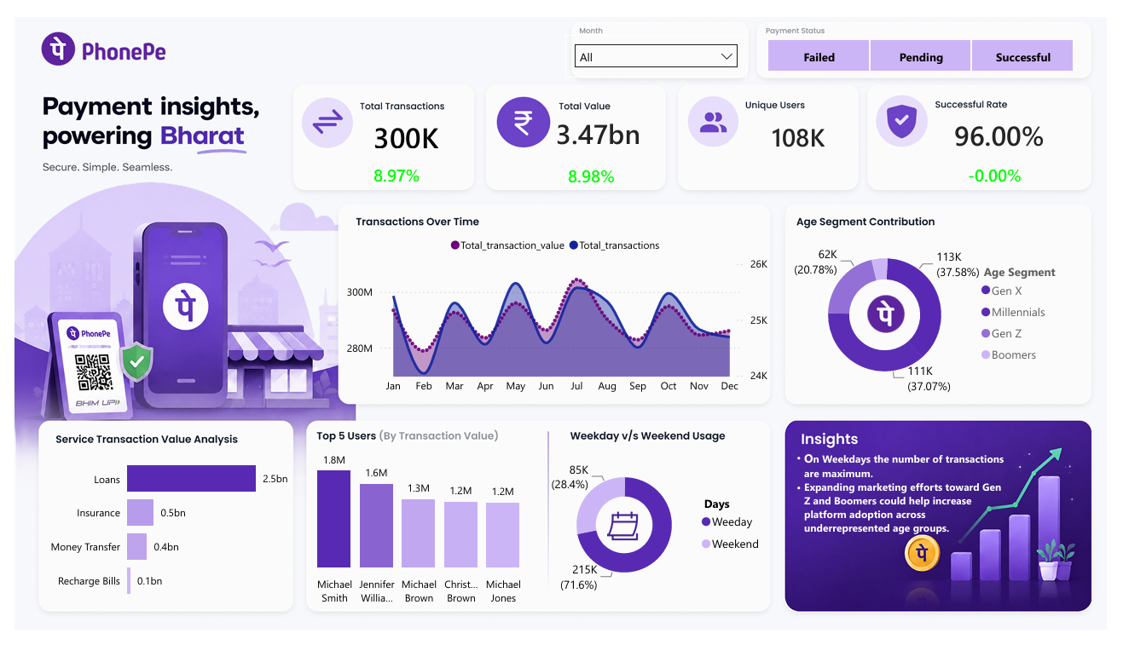
DELIVERABLE
Power BI Dashboard
PhonePe Payment Analytics
3,00,000
Interactive Filters
Month
Payment Status
Visualizations
Monthly Transaction Trends
Service Performance
Age Segment Analysis
Weekday vs Weekend Analysis
Top Users
PhonePe Payment Analytics Dashboard
5

Slide 6
MODELING
DAX & Analytical Analysis
DAX Analysis
Power BI Techniques
ƒ
Total Transactions
DAX Measures
ƒ
Total Transaction Value
Power Query
ƒ
Unique Users
Data Modeling
ƒ
Payment Success Rate
KPI Cards
ƒ
Transaction Growth
Interactive Slicers
ƒ
Transaction Value Growth
Conditional Formatting
ƒ
Service-wise Metrics
ƒ
Customer Segment Analysis
Dynamic Visualizations
PhonePe Payment Analytics Dashboard
6

Slide 7
FINDINGS
Key Business Insights
Transaction Performance
Customer & Usage Insights
₹3.47B
in transaction value generated from ~3,00,000 transactions.
74.5%
of transaction value contributed by Gen X + Millennials.
+8.97%
growth in transaction volume.
71.6%
of transactions occurred on weekdays.
+8.98%
growth in transaction value.
12.5%
of total transactions were UPI ID transfers.
96%
payment success rate — strong payment reliability.
72.9%
of transaction value contributed by Loans.
PhonePe Payment Analytics Dashboard
7

Slide 8
ACTION PLAN
Business Recommendations
1
Investigate and reduce the causes of failed transactions.
2
Improve the user experience for high-value services such as Loans and Insurance.
3
Launch targeted campaigns to increase weekend transaction activity.
4
Develop personalized strategies for high-value customer segments.
5
Increase engagement among lower-contributing customer segments.
6
Monitor transaction growth and payment success KPIs regularly.
Expected Business Impact
Higher Payment
Reliability
→
Better Customer
Experience
→
Increased
Engagement
→
Improved Business
Performance
PhonePe Payment Analytics Dashboard
8

Slide 9
CAPABILITIES
Skills Demonstrated
Technical Skills
Microsoft Excel
Power Query
Power BI
DAX
Data Modeling
Data Visualization
Analytical Skills
✓
Data Cleaning
✓
Data Transformation
✓
Exploratory Data Analysis
✓
Transaction Analysis
✓
Customer Segmentation
✓
KPI Reporting
✓
Dashboard Development
✓
Business Intelligence
✓
Data Storytelling
✓
Business Insight Generation
PhonePe Payment Analytics Dashboard
9

Slide 10
CONCLUSION
Project Summary
Developed an interactive PhonePe Payment Analytics Dashboard using Excel, Power Query, Power BI, and DAX.
Analyzed 300K transactions across 107K+ users.
Identified key patterns in payment performance, customer segments, service categories, and transaction behavior.
Converted analytical findings into actionable business recommendations.
Key Learning
This project strengthened my ability to transform raw data into interactive dashboards and translate business data into actionable insights.
Thank You
Hariom Kumar Dubey
Aspiring Data Analyst | Power BI Developer

