Slide 1

Project- Seasonal Agriculture Performance Analysis
Name- Hariom Kumar Dubey
College- St. Andrews Institute of Technology and Management
AICTE STU ID : STU68dc0e91a95301759252113

Slide 2

PROBLEM STATEMENT
Agricultural activities are influenced by seasonal variations in environmental conditions, farming practices, resource availability and market conditions. As a result, agricultural performance may differ from one season to another.
However, raw agricultural data does not clearly explain how agricultural performance changes across seasons or what patterns can be observed in different seasonal conditions.
The problem is to analyze the given agricultural dataset and investigate seasonal differences in agricultural performance by identifying meaningful patterns, trends, relationships and variations within the available data.

Slide 3
Project Description
Seasonal Agriculture Performance Analysis Using Python is a data analytics project focused on understanding how agricultural performance varies across different seasons.
The project analyzes farm-level data covering environmental conditions, farming inputs, crop production, economic performance, water usage, and disease/pest risk.
Using Python libraries such as Pandas, NumPy, Matplotlib, Seaborn, SciPy, and Scikit-learn, the analysis involves data cleaning, exploratory data analysis, seasonal comparisons, correlation and statistical analysis, outlier investigation, and performance evaluation.
The project identifies meaningful seasonal patterns and relationships in yield, production, profitability, resource usage, water efficiency, and agricultural risk, and uses these findings to develop evidence-based insights and practical recommendations for better seasonal agricultural planning.

Slide 4

WHO ARE THE END USERS?
Farmers: Optimize seasonal crop selection, irrigation planning, and resource utilization using data-driven performance insights.
Agricultural Planners: Evaluate seasonal and regional trends to support effective resource allocation and strategic agricultural planning.
Farm Managers: Monitor profitability, production efficiency, input costs, and water utilization to improve farm-level decision-making.
Researchers & Data Analysts: Leverage statistically supported seasonal patterns and relationships for deeper agricultural research and further analysis.

Slide 5

Technology Used
Python
Jupyter Notebook
Pandas
NumPy
Matplotlib
Seaborn
SciPy
Scikit-learn

Slide 6
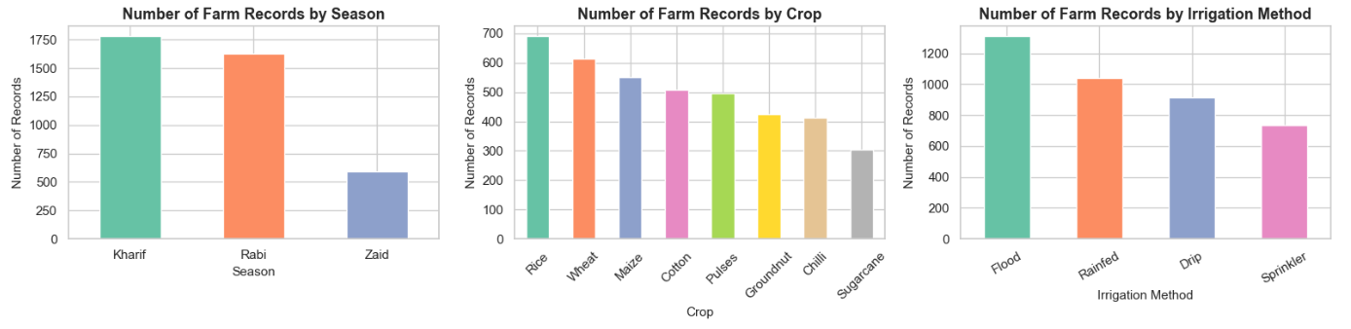
RESULTS
Explanation:
Kharif has the highest farm representation, while Zaid has the fewest records.
Rice is the most represented crop, and Flood is the most common irrigation method.
The uneven distribution highlights the importance of considering sample size when comparing groups.

Slide 7
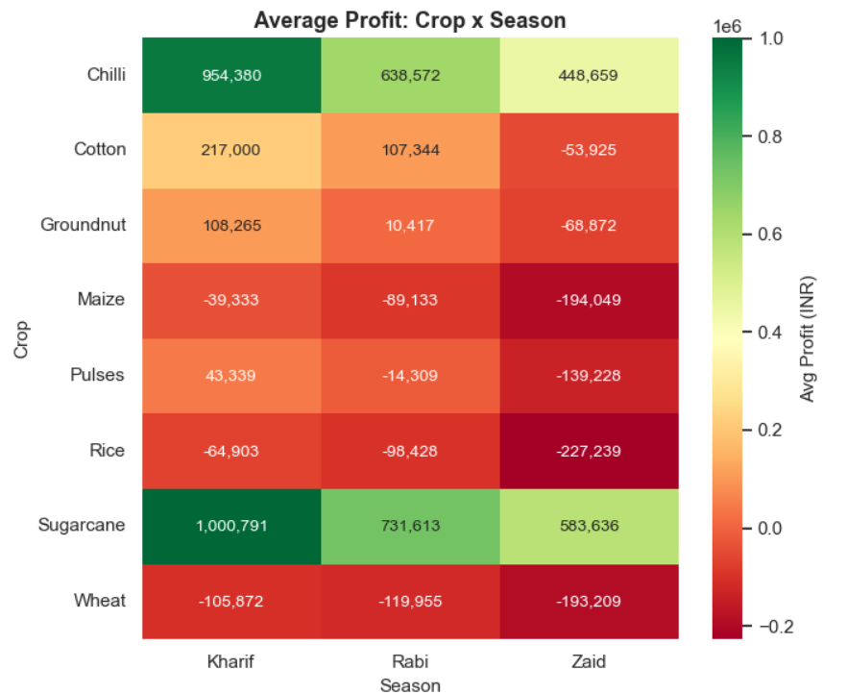
RESULTS
Explanation:
Crop profitability is strongly season-dependent.
Sugarcane and Chilli deliver the highest average profits, especially in Kharif, while Maize, Rice, and Wheat remain loss-making across seasons.
This highlights the importance of crop-season selection for improving farm profitability.

Slide 8
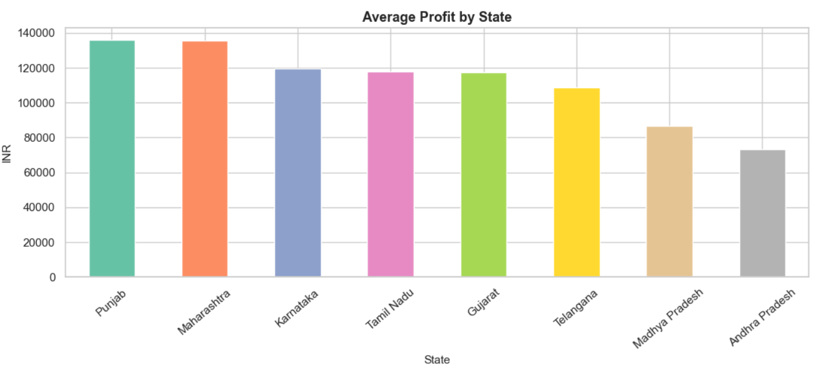
RESULTS
Explanation:
Punjab and Maharashtra show the highest average agricultural profitability, while Andhra Pradesh records the lowest.
The variation highlights differences in regional agricultural performance and the importance of considering location in farm-level decision-making.

Slide 9
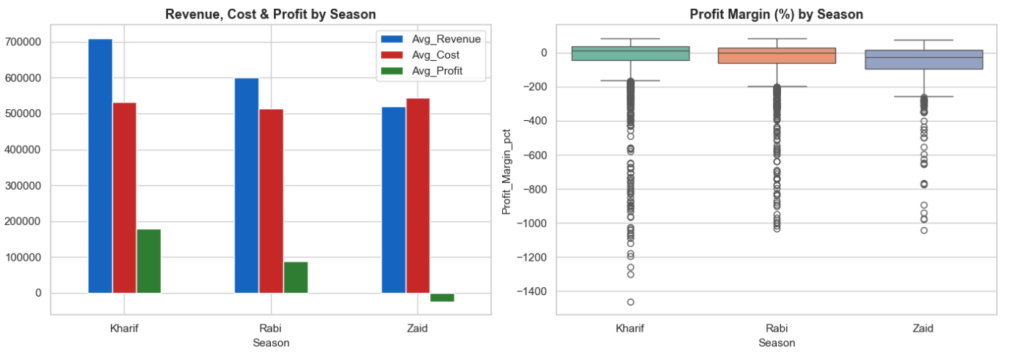
RESULTS
Explanation:
Kharif is the most profitable season, while Zaid shows the weakest financial performance.
Significant negative profit-margin outliers across all seasons indicate that profitability varies considerably among individual farms.

Slide 10
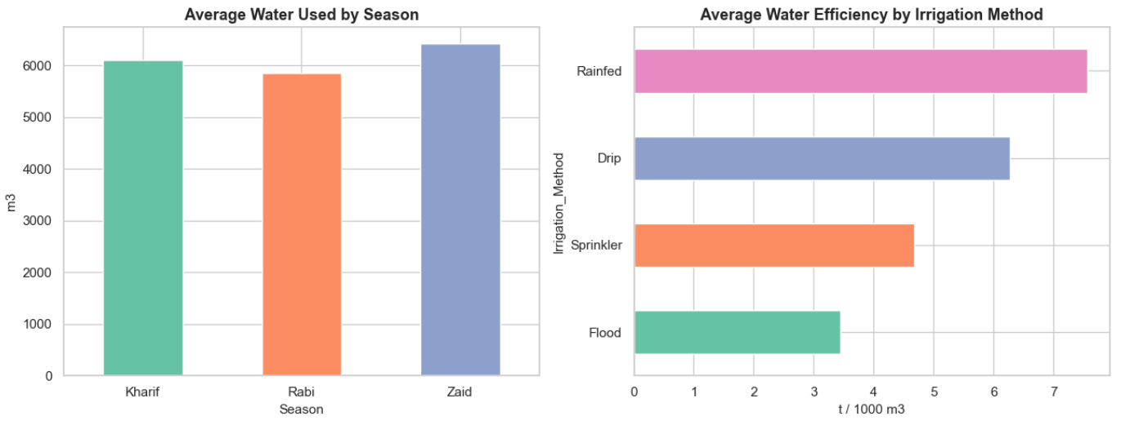
RESULTS
Explanation:
Zaid requires the highest average water usage, whereas Rainfed farming shows the highest observed water-use efficiency.
Flood irrigation records the lowest efficiency, highlighting substantial variation in water performance across irrigation methods.

Slide 11
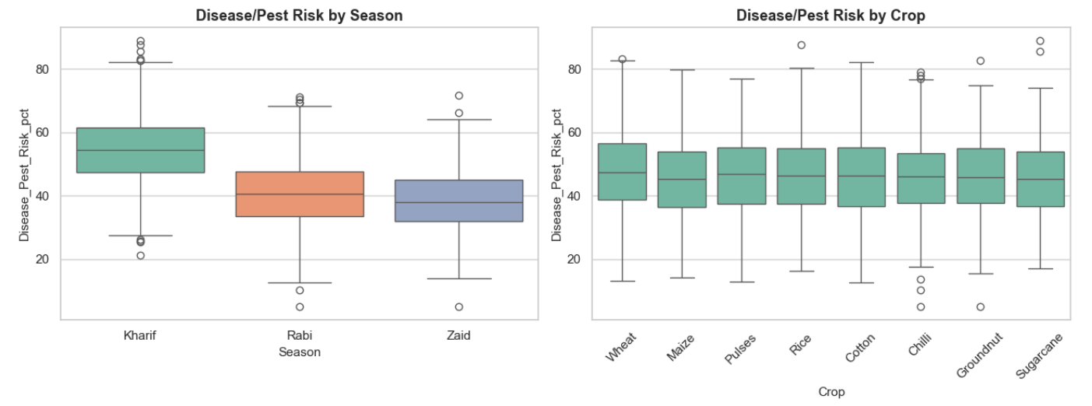
RESULTS
Explanation:
Kharif shows the highest disease/pest risk and the greatest variability, while Rabi and Zaid have lower median risk levels.
Crop-wise differences are comparatively moderate, while seasonal differences in observed disease/pest risk are more pronounced.

Slide 12
Future scope
Real-Time Data Integration: Incorporate live weather, rainfall, soil, and market-price data for timely seasonal decisions.
Predictive Analytics: Develop advanced models to forecast crop yield, profitability, and seasonal agricultural risks.
Regional & Crop-Level Expansion: Extend the analysis across more regions, crops, seasons, and diverse farming conditions.
Smart Resource Management: Build data-driven approaches for optimizing irrigation, fertilizer, pesticide, and other agricultural inputs.
Early Risk Detection: Integrate real-time disease and pest monitoring to support faster preventive action.
Advanced Decision Support: Develop interactive analytical solutions to support farmers, planners, and agricultural decision-makers.

Slide 13
GitHub Link:
https://github.com/Hariomdubey01/Seasonal-Agriculture-Performance-Analysis.git

Slide 14
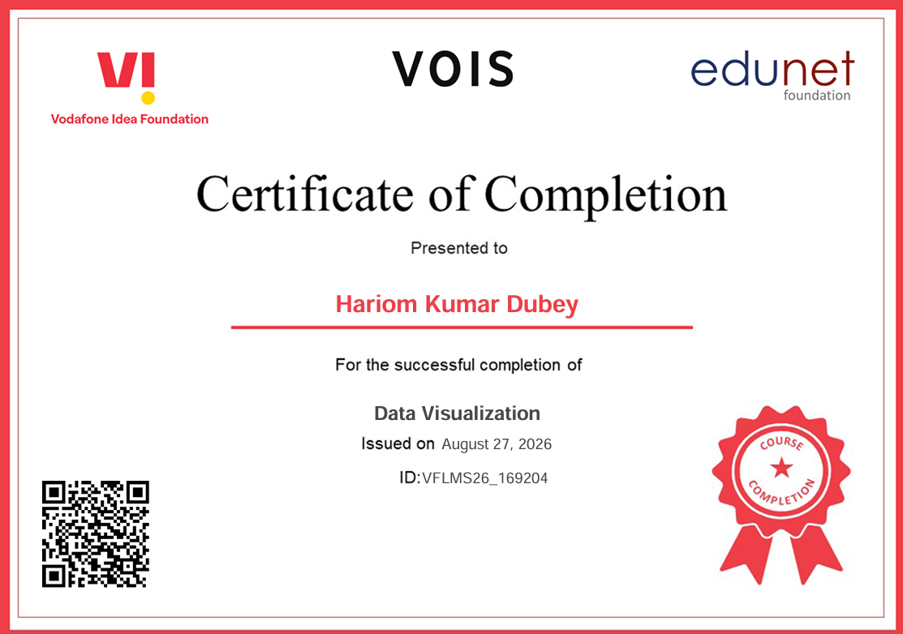
Course name- Data Visualization

Slide 15
Thank you
Thank you for your time and attention. I sincerely appreciate the opportunity to learn, grow, and showcase my skills through this internship.
I am grateful to Edunet Foundation, Vodafone Idea Foundation, VOIS, AICTE, and all the associated organizations for providing me with this valuable internship opportunity.

