Slide 1


SMART INDIA HACKATHON 2026
SMART INDIA
HACKATHON
2026
SMART SCAN STRATEGY FOR ELECTRONIC WARFARE
Problem Statement ID –
Problem Statement Title-
Theme-
PS Category- Software/Hardware
Team ID-
Team Name- Out of Bounds

Slide 2
SMART SCAN: AI-Driven ES Receiver Scheduler
Out of Bounds
SMART INDIA
HACKATHON
2026
Proposed Solution
A software “brain” for a swept Electronic Support (ES) receiver that decides, every 10 ms dwell, which frequency band to listen to next - learning from its own hits and misses, with no prior intelligence of emitters.
1
What we built
2
How it solves the problem
3
Innovation & uniqueness
RF environment simulator: radars, frequency-agile emitters, comms, pop-up threats, with ground truth per band per slot
Receiver model: noise floor, Pd / Pfa, sensitivity (-72 dBm)
ML scheduler: GRU activity predictor + Deep RL (Double-DQN)
Web dashboard with simple and annotated views
Replaces the open-loop, pre-planned sweep with a closed-loop scan
Learns scan periods and hop patterns online, then revisits exactly when a beam illuminates us
Coverage shield keeps sweeping for new / pop-up threats
Predicts intercept time and interception ratio
Zero prior intelligence: trained on thousands of randomised emitter laydowns
Residual learning: the neural net corrects a physics-based phase model
gcd / vernier rule removes periodic-scan lock-out
RL with a safety shield plus an explainable model-based fallback
Prototype result on 30 unseen scenarios: +78% interception ratio | +85% threat-weighted | 15% fresher emitter picture vs conventional sweep

Slide 3






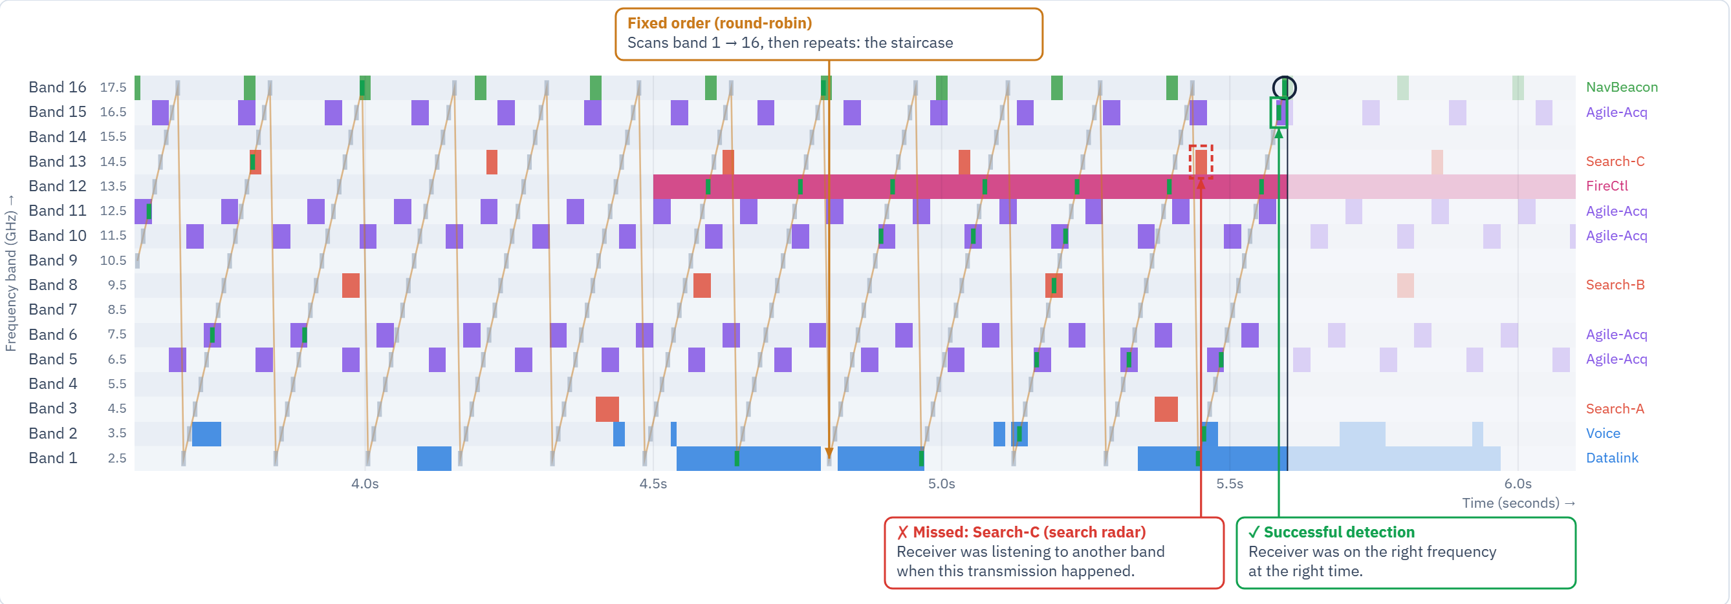


TECHNICAL APPROACH
Out of Bounds
SMART INDIA
HACKATHON
2026
Technologies
Methodology & implementation
Language
Python 3.11, JavaScript
1
2
3
4
5
RF environment simulator
emitters + ground truth per band / slot
Receiver model
Pd, Pfa, sensitivity, 1 band per 10 ms dwell
Observation tracker
scan-period & phase estimation from hits
ML scheduler
GRU forecast + Double-DQN policy
Dwell decision
band to listen to next
AI / ML
PyTorch: GRU predictor, Double-DQN
Signal model
NumPy, SciPy (energy detector)
Backend
FastAPI (REST API)
feedback: hit / miss / false alarm → reward & learning
Train
400 random battlefields, no prior intel; DQN trained on 250k dwells
Frontend
HTML5 + Chart.js dashboard
Validate
30 unseen scenarios vs round-robin, random sweep and bandit
Hardware
Runs on a laptop CPU, no GPU needed
Prototype
Working web app (right): live race, annotated graphs, lock-out designer
Live dashboard: fixed sweep shown as a staircase, with a real catch and a real miss called out

Slide 4
FEASIBILITY AND VIABILITY
Out of Bounds
SMART INDIA
HACKATHON
2026
1.3 ms
~40 min
End-to-end
per scheduling decision vs a 10 ms dwell: real-time capable
total training on a laptop CPU: no special hardware
prototype built, trained and benchmarked on 30 unseen scenarios
Challenge / risk | Strategy to overcome it
No prior intelligence of emitters | Train on thousands of randomised emitter laydowns (domain randomisation); learn online from hits and misses
Periodic-scan lock-out: a fixed sweep can miss a radar forever | Number-theoretic gcd / vernier rule picks the revisit period; randomised sweep order
Learned policy over-focuses on known emitters and misses new ones | Coverage shield: every band revisited within a bounded time (default 32 dwells)
Simulation-to-real gap | Physics-based receiver model (χ² detector); fine-tune on recorded field data; modular REST interface
Trust & explainability in a military system | Transparent model-based smart scan as fallback; analytic intercept predictions verified to within 12.8%

Slide 5
IMPACT AND BENEFITS
Out of Bounds
SMART INDIA
HACKATHON
2026
+78%
+85%
−15%
81% → 0%
interception ratio
threat-weighted interception
age of emitter information
periodic lock-out removed
Target users & benefits
Users: ES/ESM operators of the Army, Navy and Air Force; DRDO (DLRL) and BEL receiver programmes
Operational: earlier warning of pop-up fire-control and agile radars; better self-protection and SEAD
Economic: a pure software upgrade to existing swept receivers - no new hardware
Strategic: indigenous, Atmanirbhar EW capability that adapts without pre-mission intelligence
Dual-use: spectrum monitoring, cognitive radio, SIGINT and interference hunting

Slide 6
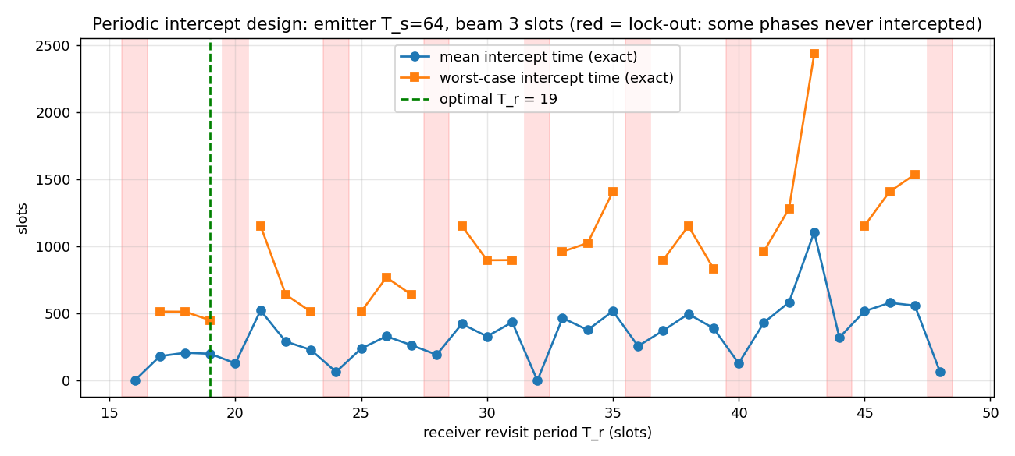
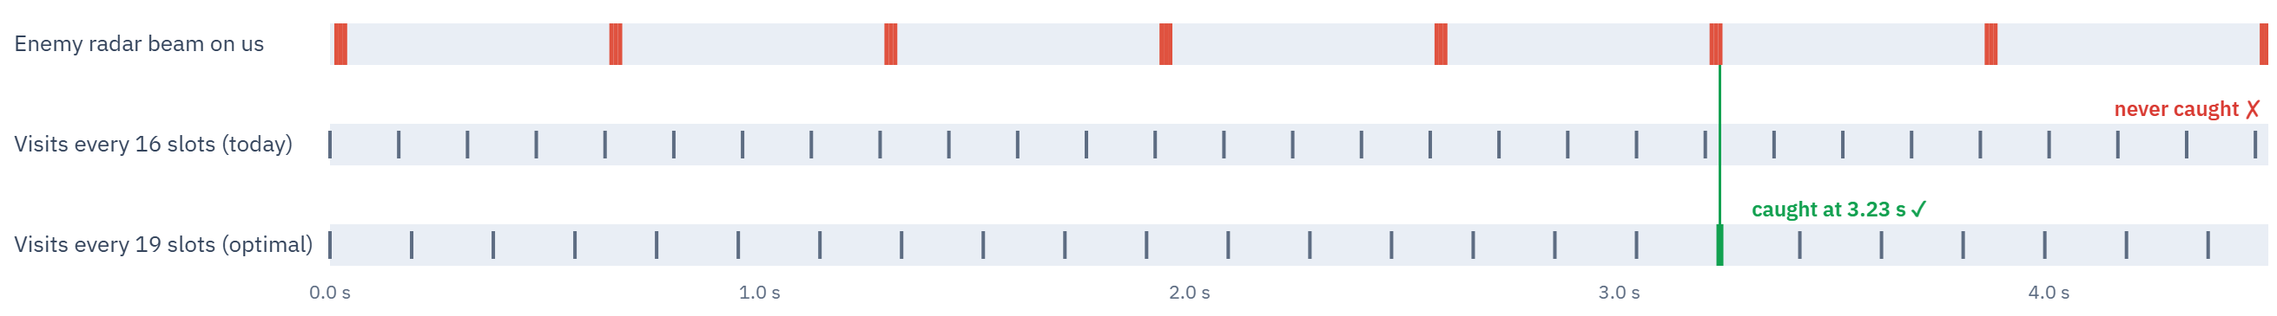
RESEARCH AND REFERENCES
Out of Bounds
SMART INDIA
HACKATHON
2026
References
Our research findings
[1] R. G. Wiley, ELINT: The Interception and Analysis of Radar Signals, Artech House, 2006.
[2] D. Adamy, EW 101: A First Course in Electronic Warfare, Artech House, 2001.
[3] I. V. L. Clarkson, J. E. Perkins, I. M. Y. Mareels, “Number theoretic solutions to intercept time problems,” IEEE Trans. Information Theory, 1996.
[4] A. G. Self, B. G. Smith, “Intercept time and its prediction,” IEE Proceedings F, 1985.
[5] H. K. Mardia, “New techniques for the deinterleaving of repetitive sequences,” IEE Proceedings F, 1989.
[6] H. Urkowitz, “Energy detection of unknown deterministic signals,” Proceedings of the IEEE, 1967.
[7] V. Mnih et al., “Human-level control through deep reinforcement learning,” Nature, 2015.
[8] H. van Hasselt, A. Guez, D. Silver, “Deep reinforcement learning with double Q-learning,” AAAI, 2016.
[9] K. Cho et al., “Learning phrase representations using RNN encoder-decoder…,” EMNLP, 2014 (GRU).
[10] O. Chapelle, L. Li, “An empirical evaluation of Thompson sampling,” NeurIPS, 2011.
Lock-out: a 16-band sweep never intercepts 81% of phase alignments of a 64-slot scanning radar; revisit period 19 guarantees intercept.
Prediction model: intercept time within 12.8% and interception ratio within 0.007 of Monte-Carlo simulation.
Learning beats hand-crafting: GRU cuts intercept-time prediction error from 32.5 to 12.3 slots.
Lock-out, visualised: visiting a radar every 16 slots never lands on its beam; every 19 slots catches it at 3.2 s.
Enemy radar beam on us
never caught ✗
Visit every 16 slots (today)
caught at 3.23 s ✓
Visit every 19 slots (optimal)
0.0 s
1.0 s
2.0 s
3.0 s
4.0 s
Red = radar beam pointing at us. Ticks = receiver visits. Green = caught. The AI goes further: it learns each radar's rotation and returns exactly when the beam is due.

