Slide 1
Socratic AI Tutor
Guiding learners to the answer
An intelligent small-scale tutor that guides a learner to the answer through probing questions, backtracking across levels when needed. One pipeline, any course.
Milestone 1 · Group 2 · Data Science and AI Lab, IIT Madras BS
Sandeep Nalla (21f1006125) · Hariom Kumar (23f2004225) · Hariom Pandey (21f3002112) · Mrityunjay Chakraborty (21f3001385)
October 2026

Slide 2
Objective
Help the learner reach the answer themselves, instead of giving it directly
1. Break down
the doubt into
sub-ideas
2. Probe
one question
at a time
3. Feedback
spot misconceptions,
link a resource
4. Backtrack
to an earlier level
if there is a gap
5. Climb back
raise difficulty
step by step
Domain-agnostic: each subject is a “course pack”
Concepts | Prerequisite links | Study material | Questions
topics with IDs and levels | “A is needed before B”, across levels | PDFs, slides, transcripts | answers, hints, difficulty
Primary: NCERT content (any subject)
public, complete data across classes and subjects
Secondary: IITM BS course material
Maths → MLF → MLT, e.g. “How does training happen in Linear Regression?”
Group 2 · Socratic AI Tutor · Milestone 1
2 / 10

Slide 3
Learning builds across levels
If a learner is stuck, the tutor finds the gap in an earlier level
Level 1
Addition · Subtraction
Multiplication
Level 2
Division
Fractions
Level 3
Decimals
Percentages
Example: stuck on “What is 20% of 50?”
Step | What the tutor does
1. Probe | “What does 20% mean: 20 out of how many?”
2. Backtrack | Gap found in fractions (Level 2) → checks division → multiplication (Level 1) if needed
3. Practise | A few division and fraction questions with hints and a link to the NCERT page
4. Climb back | 1/5 of 50 → 1/4 of 20 → back to 20% of 50 → harder: 15% of 60
Group 2 · Socratic AI Tutor · Milestone 1
3 / 10
Notes:
Learning is cross-referenced and propagated across levels. Levels map to NCERT classes (to be confirmed from the textbooks).

Slide 4
Existing solutions and their gaps
Solution | Good at | Missing for our problem
Khanmigo | Builds understanding by questioning students, based on their answers | External LLM (GPT-4) driven by prompts; no backtracking across levels; Khan content only
MathGPT.ai | Socratic tutor: withholds answers, guides with hints; 50+ US colleges | College maths only; no learner model or backtracking; closed
ChatGPT / Gemini / Claude learning modes | Natural conversation in a guiding, question-asking style | Driven by a system prompt; no memory of skills; can give away answers
MATHia | Adapts per student; step-by-step guidance, real-time feedback, targeted practice | Paid, closed; fixed maths curriculum; fixed step paths, no free conversation
Squirrel AI, ALEKS (adaptive) | Diagnose gaps on a knowledge graph; pick what to learn next | Recommend practice, no probing conversation; paid, closed
Alakh AI (Physics Wallah, NCERT) | 24/7 doubt answering (text, photo, voice); questions from NCERT books | Mainly answers doubts; no probing or backtracking; closed
BYJU'S WIZ, Embibe (NCERT) | Knowledge tracing; Embibe tracks gaps from earlier grades; TeacherGPT guides | Closed, self-reported results; practice-based, not a probing conversation
What we add: one open loop that converses, tracks the learner and backtracks across levels
• Our own trained models as the main brain (not an LLM API with a system prompt), evaluated openly
• Probing questions + backtracking across levels, then climbing back up to the learner’s question
• Links to the exact page, video or notes; works for any subject via course packs
Group 2 · Socratic AI Tutor · Milestone 1
4 / 10

Slide 5
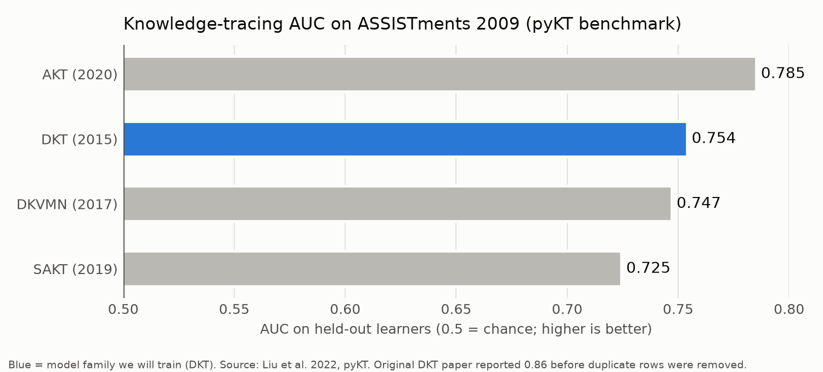
Research baselines
AI chat tutors
• Research on tutoring dialogues: prompted AI teachers often reveal the answer; fine-tuned models guide better
• Bastani et al. 2025: plain GPT-4 → +48% in practice but −17% on the exam
• Lesson: a system-prompted chatbot is not enough; the tutor needs its own trained models
Predicting student knowledge
DKT (Deep Knowledge Tracing, an LSTM we will train) scores AUC 0.754 on cleaned ASSISTments data. 0.5 = random guess, 1.0 = perfect.
Group 2 · Socratic AI Tutor · Milestone 1
5 / 10

Slide 6
Our approach: our own models are the main brain
Component | Built by us? | Role
Learner model (DKT) | ✓ trained | Estimates what the learner knows for each concept
Tutor controller | ✓ written | Decides: probe, hint, backtrack a level, retest, move up
Socratic question model | ✓ fine-tuned | Qwen3-4B + LoRA on tutoring dialogues + our NCERT and IITM examples: writes probing questions
Misconception detector | ✓ built | Spots common error patterns (e.g. 50 ÷ 20 instead of 20/100 × 50)
Search (RAG) | pretrained embeddings | Finds the page, video or notes for a concept
External LLM API | ✗ optional | Only drafts practice questions offline (checked) and serves as a baseline
Stack: React web app · FastAPI backend · PostgreSQL + pgvector · PyTorch
New course = new course pack + ingestion script. New course with no student data → simple fallback until DKT is retrained.
Group 2 · Socratic AI Tutor · Milestone 1
6 / 10
Notes:
LLM APIs play only a minor part; the main brain is our own DL/GenAI models.

Slide 7
Datasets and samples
Dataset | Use | Size
NCERT textbooks | Course pack (primary) | several classes and subjects
ASSISTments 2009–10 | Real student answer histories to train DKT | ~346k answers, 4,217 students
EdNet KT1 (optional) | Train DKT (larger) | ~95M answers
Tutoring dialogues + our examples | Fine-tune Socratic model | public set + written by us
IITM BS transcripts | Course pack (secondary) | gathered by us
NCERT training example → Socratic model
Input
Concept: percentages (Level 3); prerequisite: fractions (Level 2)
Question: What is 20% of 50?
Learner: “2.5”
Controller action: PROBE the meaning of percent; don’t reveal the answer
Resource: NCERT Mathematics, chapter on percentages
Target reply (probing)
“Let’s check together. What does 20% mean: 20 out of how many?”
Each example is labelled probing / focus / telling, so the model learns to probe instead of tell. Illustrative example written by the team.
Why ASSISTments for DKT: real, time-ordered student answers (none public for NCERT/IITM); the standard DKT benchmark, so our results can be checked; maths skills; free for research.
Licenses of all public datasets are checked before use.
ASSISTments row format
student | skill | correct | hints
64525 | Equivalent Fractions | 0 | 2
64525 | Equivalent Fractions | 1 | 0
Group 2 · Socratic AI Tutor · Milestone 1
7 / 10
Notes:
ASSISTments row format (data sample required by the brief): each row is one answer by one student. Row 1: student 64525 got an Equivalent Fractions question wrong on the first try (correct = 0) and needed 2 hints. Row 2: on the next question on the same skill, they got it right (correct = 1) with no hints. DKT reads thousands of such sequences and learns, e.g., that this student is improving at equivalent fractions. Values show the format; they are not real rows from the dataset.

Slide 8
Baselines, targets and evaluation
Part | Metric | Compared with | Target
Learner model | AUC | Simple accuracy; published DKT 0.754 | ≥ 0.74, better than simple
Socratic model | % replies revealing the answer | Base model; LLM API + system prompt | ≤ 5%, lower than both
Backtracking | % gaps found at the right level | LLM API + system prompt | ≥ 85%
Search | Correct resource in top 5 | Keyword search | ≥ 0.80
Full tutor | % test scenarios handled | Fixed rules; LLM API + system prompt | ≥ 90%
How we will evaluate
• 60–100 annotated NCERT scenarios (careless slip, gap 1 level down, gap 2 levels down…) + any provided test samples
• Compare: direct-answer chatbot vs LLM API with Socratic prompt vs our tutor; also vs published research numbers
• Same tests on the NCERT and IITM BS course packs, with no code changes
Group 2 · Socratic AI Tutor · Milestone 1
8 / 10

Slide 9
Expected output (mock-up)
Learner: What is 20% of 50? My answer: 2.5
Tutor: What does 20% mean: 20 out of how many? Learner: 100 ✓
Tutor: So 20% = 20/100. Simplest form? Learner: I don’t know
[gap at Level 2 → checking division]
Tutor: What is 100 ÷ 20? Learner: 5 ✓
Tutor: So 20/100 = 1/5. What is 1/5 of 50? Hint: 5 equal groups 📖
Learner: 10 ✓ Tutor: And 1/4 of 20? Learner: 5 ✓
[back to Level 3]
Tutor: Try again: 20% of 50? Learner: 10 ✓
Tutor: Earlier you divided 50 by 20; a percentage means “out of 100”.
Next: 15% of 60?
Progress report
Concept (level) | Correct | Readiness
Multiplication (1) | 3/3 | 0.90
Division (2) | 2/2 | 0.84
Fractions (2) | 1/2 | 0.66
Percentages (3) | 1/2 | 0.58 · practise
LLM API vs our tutor
API + prompt: “20/100 × 50 = 10.” Answer revealed; gap not found.
Ours: finds the fraction gap, practises Level 2, returns to Level 3; learner finds 10.
Group 2 · Socratic AI Tutor · Milestone 1
9 / 10

Slide 10




Summary and sign-off
Summary
Member | Signature
Sandeep Nalla (21f1006125)
Hariom Kumar (23f2004225)
Hariom Pandey (21f3002112)
Mrityunjay Chakraborty (21f3001385)
• A tutor that guides learners to the answer with probing questions
• Our own trained models are the main brain: DKT, controller, fine-tuned Socratic model
• Backtracks across levels to fix gaps, then climbs back up
• Links mistakes to the exact page, video or notes
• Works for any subject with study material: NCERT (primary) and IITM BS (secondary) via course packs
• Evaluated against an LLM-API + system-prompt tutor
Signed 22 October 2026
Group 2 · Socratic AI Tutor · Milestone 1
10 / 10

