Slide 1

GP-2 SUBMISSION
Navigating Algorithmic Anxiety
Evaluating the Role of a Growth Mindset in Managing Workplace Stress and Skill Obsolescence in the Age of Generative AI.
Methodology, Analysis & Recommendations, Influence Model, Project Review & Closure
INDIAN INSTITUTE OF TECHNOLOGY
MADRAS
Team Number
Team 52
BS in Data Science & Applications
Project Title
Navigating Algorithmic Anxiety
SPG Project May 2026
Domain
Resilience • Technological Literacy • Lifelong Learning • Stress Management • Growth Mindset
Submission Date
25th July 2026

Slide 2
Methodology
GP-2 Submission
How was the study conducted
Literature Review
Review: Academic literature concerning technostress and AI anxiety were referred (below).
Data Collection
Selection: Participants with ranging experiences from the IT industry, which happen to be one of the most affected with AI automation, were selected and interviewed.
Thematic Coding
Mapping: Process mapping of user interaction, behavioral breakdown and professional performance under compressed timelines, with agentic automation, tools and behaviors.
Questions: Based on it, 10 deep qualitative questions were formed.
Reich et al. (2026), Psychological Safety as the Key to AI Transformation (arXiv) https://arxiv.org/abs/2602.23279
Sinha & Sharma (2025), Artificial Intelligence and the Perception of Workplace Stress (IJIP) https://ijip.in/wp-content/uploads/2025/04/18.01.083.20251302-1.pdf
Xu et al. (2023), AI Awareness and Employee Depression (IJERPH) https://doi.org/10.3390/ijerph20065147
Zheng (2025), AI Awareness and Emotional Exhaustion (Behavioral Sciences) https://doi.org/10.3390/bs15040401

Slide 3
Analysis & Key Findings
GP-2 Submission
Systemic Realities of AI integration in Enterprise Workflows
Baseline Deadline Acceleration
The Root of Technostress
Growth Mindset as a Buffer
Avoiding the Two Extremes
Human-in-the-loop
Un-delegatable Liability
AI drastically compresses routine task execution, it elevates performance baseline rather than freeing up time, leading to workplace pressure.
Anxiety leads to two extremes blind reliance and total resistance. Growth mindset balances AI speed with human oversight.
While AI can do a substantial portion of routine tasks, AI algorithms cannot assume legal or operational liability. Human oversight is irreplaceable.
AI as a Curiosity Multiplier
The Learning Engine
Continuous Learning for Agency
Neutralizing Job Insecurity
Anchoring Security in Human Differentiators
Beyond Tool Fluency
Rather than viewing automation as a skill replacement, a growth mindset leverages easy access to information to stimulate deeper technical curiosity and learning.
Workplace stress reaches its peak when professionals feel helpless against rapid technological shifts. Adaptability is the key.
Anxiety subsides when professionals realise that career security is anchored in non automatable human qualities: critical thinking, ethics & domain specific judgement.

Slide 4
Recommendations
GP-2 Submission
For organizations and individuals
Target Audience | Core Focus Area | Actionable Recommendations
Individual Professionals | Parallel Upskilling & Parallel Execution | Leverage GenAI for rapid execution/prototyping while intentionally maintaining parallel manual practice of fundamental logic to avoid skill atrophy and platform dependency.
Individual Professionals | "Junior Teammate" Mental Model | Adopt a self-regulation framework that subjects all AI-generated outputs to strict human-in-the-loop validation, auditability, and contextual alignment before deployment.
Managers & Leaders | Outcome & Token-Aware Evaluation | Restructure performance metrics to evaluate final quality, domain logic, and cost-efficiency (token spend) rather than judging tool adoption optics alone.
Organizations | Cognitive Load & Baseline Adjustment | Realign project deadlines to prevent chronic burnout; ensure productivity gains from AI are re-invested into employee upskilling rather than compounding workplace stress.

Slide 5
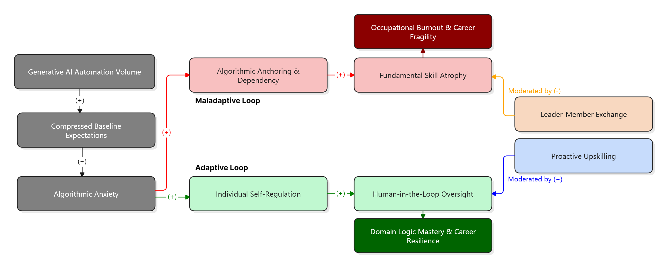
Influence Diagram
GP-2 Submission
Understanding the complete landscape schematically
Legend: (+) = Direct/Increases | (-) = Buffers/Reduces

Slide 6
Project Review & Closure
GP-2 Submission
Credits, Challenges and Ending Notes
Member | Contributions
Rishi Jain (21f1002476) | Idea Proposal, Interviews, Draft Interview Questions & Reports, Final Submissions
Harsh Vardhan (24f1002285) | Idea Proposal, Interviews, Final Submissions
Shrinidhi Kumar (23f1002153) | Idea Proposal, Interviews, Final Submissions
Ashirwad (23f2000650) | Idea Proposal, Interviews, Final Submissions
Hariom Kumar (23f2004225) | Idea Proposal, Interviews, Final Submissions
Challenges
Filtering Algorithmic Hype: Isolating specific, timestamped workplace behaviors from generalized industry commentary about Generative AI.
Cross-Domain Synthesis: Unifying insights across contrasting roles (e.g., frontline software engineers vs. product management leads) into a single cohesive behavioral model.
Best Practices
Timestamped Verbatim Coding: Directly linked every insight to exact transcript timestamps to ensure data fidelity and verifiability.
Multi-Tier Perspective Sampling: Paired frontline individual contributors with managerial decision-makers to capture both operational execution and evaluation metrics.
"AI does not replace human intellect; it elevates performance baselines. A growth mindset buffers technostress by channeling algorithmic anxiety into technical curiosity—anchoring career resilience in non-automatable human accountability, domain logic, and critical judgment."

