Slide 1
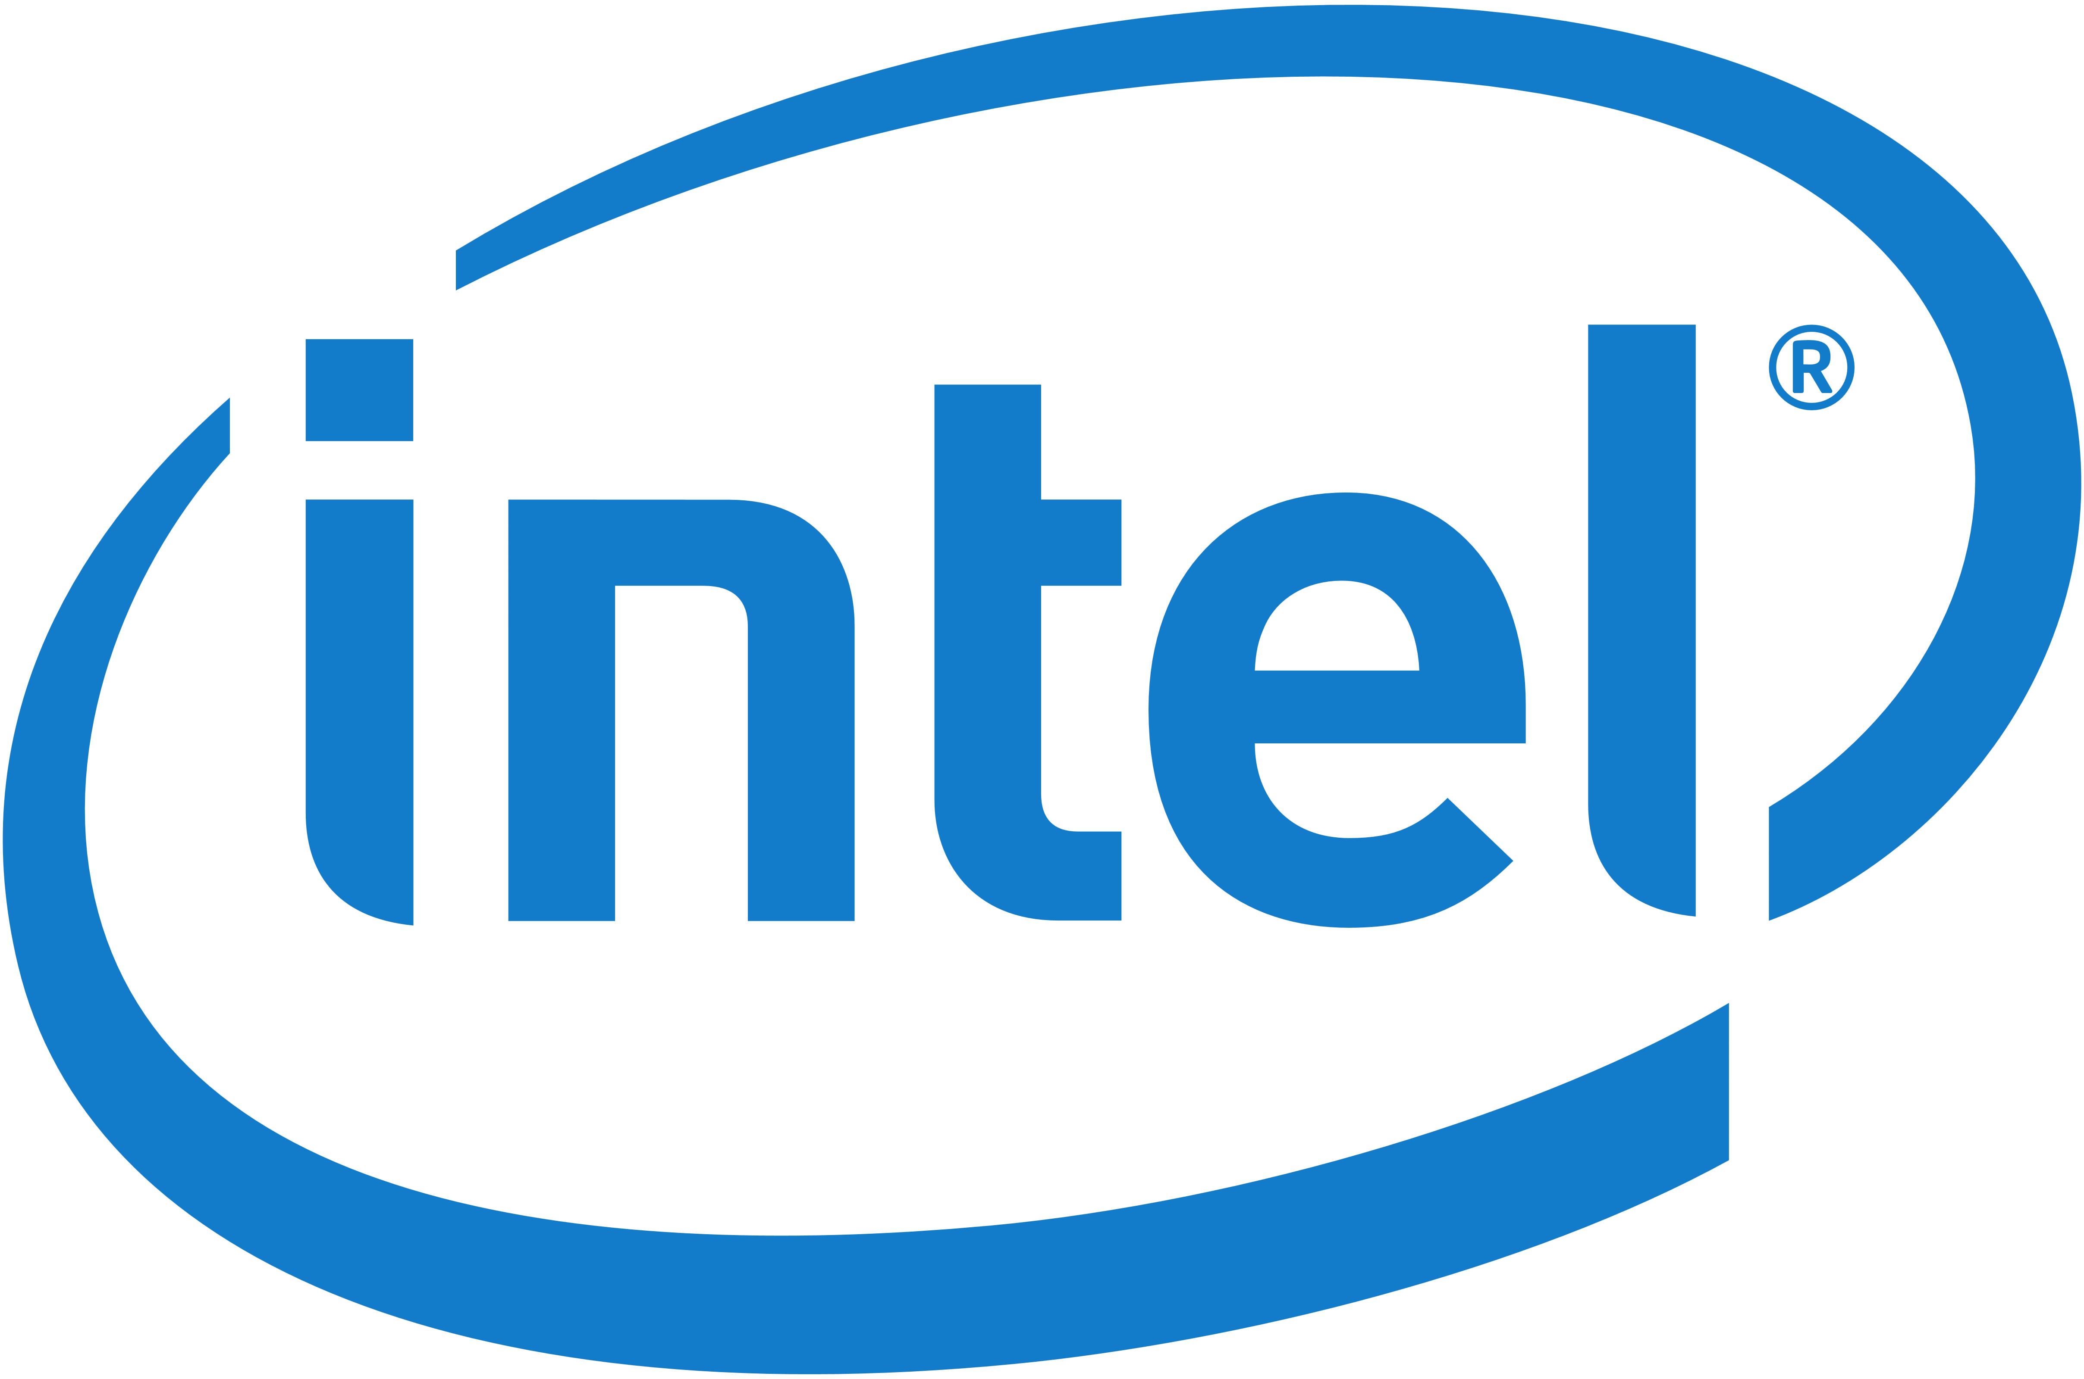

INTEL Workshop & Hackathon oneAPI Machine Learning title- Plant Disease Detection Using Image Recognition TEAM - VOIDION
By:
Hari Om (Reg no. 202000004)
Om Sinkar (Reg no. 202100308)
Ritik Kumar (Reg no. 202000389)
Aryan Raj Pradhan (Reg no. 202000012)

Slide 2
CONTENTS
S.No | Title | Page No.
1 | Introduction and Problem Definition | 3
2 | Libraries and Frameworks | 4
3 | Intel Devcloud and OneAPI AI Analytics toolkit | 6
4 | Result | 7
5 | References | 8

Slide 3

Introduction and Problem Definition
Machine learning provides the system the ability to learn from patterns derived the dataset.
Image Recognition involves using algorithms and machine learning techniques to analyze and interpret the content of images, with the goal of identifying specific objects or features within them.
Detect Plant Diseases Using Image Recognition
We Train A model using machine learning and image recognition taking a training set of images of plants and plants with some diseases.
The Model aims at detecting diseases and type of disease for various common commercial or food crops.

Slide 4
Libraries & frameworks
Python
Tensorflow
Matplotlib
Keras
Intel oneAPI AI Analytics Toolkit
Intel Devcloud for oneAPI

Slide 5
Intel Devcloud for oneAPI ^{[1]}
The Intel DevCloud is a development sandbox to learn about programming cross architecture applications with OpenVino, High Level Design (HLD) tools – oneAPI, OpenCL, HLS – and RTL.
We can use it to learn or apply Intel oneAPI Toolkits. And build prototypes of our projects.
We can Evaluate Performance and Acceleration with Multiple Hardware Configurations

Slide 6
Intel oneAPI AI Analytics Toolkit ^{[2][3]}
The AI Kit provides familiar Python tools and frameworks to accelerate end-to-end data science and analytics pipelines on Intel® architecture.
This toolkit maximizes performance from preprocessing through machine learning and provides interoperability for efficient model development.
Intel-optimized Frameworks - deep learning frameworks for TensorFlow and PyTorch
open source, pretrained, machine learning models that are optimized by Intel
automatic accuracy-driven tuning strategies along with additional objectives using low-precision optimizations.
Intel Optimized High Performance Python
direct access to analytics and AI optimizations from Intel

Slide 7
Results
We get the predicted output for the sample images with accuracy around than 90%.

Slide 8
References
Overview | Intel® DevCloud
Intel® AI Analytics Toolkit for Data Science
Intel® Optimization for TensorFlow*

Slide 9
Thank You

