Slide 1

Mini Project Synopsis Presentation
on
“TransSummarize: Leveraging NLP for Transcription and Summarization”
Hari Om (Reg. No. 202000004)
Sushma Oinam (Reg. No. 202000048)
Aryan Raj Pradhan(Reg. No. 202000012)
Under the guidance of:
Dr. Saumya Das
Department Of Information Technology, Assistant Professor
DEPARTMENT OF INFORMATION TECHNOLOGY
SIKKIM MANIPAL INSTITUTE OF TECHNOLOGY
(A constituent college of Sikkim Manipal University)
MAJITAR, RANGPO, EAST SIKKIM – 737136

Slide 2

CONTENTS
Sl. No. | TITLE
1. | Abstract
2. | Introduction
3. | Literature survey
4. | Problem definition
5. 6. | Solution strategy Algorithms
7. | Gantt Chart
8. | References

Slide 3
ABSTRACT
Speech recognition and Text summarization are popular areas in Natural Language Processing.
The project “TransSummarize” aims to combine speech recognition and text summarization in one whole.
In a small scenario like a seminar, this feature will be helpful to provide summary of conversation into a document without losing vital information.

Slide 4
INTRODUCTION
Natural Language Processing (NLP) is a tract of Artificial Intelligence and Linguistics, devoted to make computers understand the statements or words written in human languages.
Speech recognition is the ability of a machine or program to identify words spoken aloud and convert them into readable text, and text summarization will summarize the information in large texts for quicker consumption without losing vital information
This project aims to reduce the time and effort of manual documentation. Sometimes, the main points from a communication in the same language tends to be missed due to accent according to the person.

Slide 5

LITERATURE SURVEY
Sl. No. | Author(s) | Paper and Publication Details | Findings | Relevance to the project
1 | Shaikh Naziya S, R.R.Deshmukh | Speech Recognition System - A Review IOSR Journal of Computer Engineering(IOSR-JCE), Volume 18 (July- Aug, 2016) [1] | Techniques in Speech Recognition Systems(SRS) Various SRS modeling techniques are listed. The different models have their pros and cons. . | Vocabulary of HMM is very high - can be used for large amounts of data for speech recognition. Machine learning techniques for speech recognition.
2 | Nenkova A., & McKeown, K. | A survey of text summarization techniques Mining text data, 43-76.(2012) [2] | Topic Representation extracts topics discussed in the input document. Indicator representation scores the importance of each sentence which will come in the summary. | Provides ideas about how text summarization works.

Slide 6
3. | Kågebäck, M., Mogren, O., Tahmasebi, N., & Dubhashi, D. . | Extractive summarization using continuous vector space models Proceedings of the 2nd Workshop on Continuous Vector Space Models and their Compositionality (CVSC) (pp. 31-39). (2014, April) | evaluate different compositions for sentence representation on a standard dataset using the ROUGE evaluation measures. | the effects of using phrase embeddings for summarization, and showed that these can significantly improve the performance of the state-of-the-art summarization method
4. | Gupta, S., & Gupta, S. K. | Abstractive summarization: An overview of the state of the art. Expert Systems with Applications, 121, 49-65. (2019). | Its approaches are broadly divided into structure based and semantic based. sentence compression, concept fusion, calculation of path scores and summary generation are few common parts of an abstractive summarization system | abstractive summarization systems consist of 3 steps namely pre-processing, inferencing and Natural Language Generation.

Slide 7




PROBLEM DEFINITION
Currently, there are many speech-to-text tools available, but most of them simply transcribe the speech into text without providing any summary or analysis. This can be time-consuming and inefficient, as the user has to manually read through the entire text to understand the main points.

Slide 8
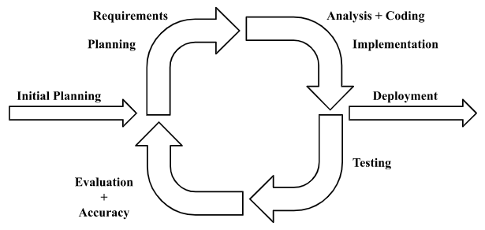
SOLUTION STRATEGY
Figure 1: Iterative Model

Slide 9
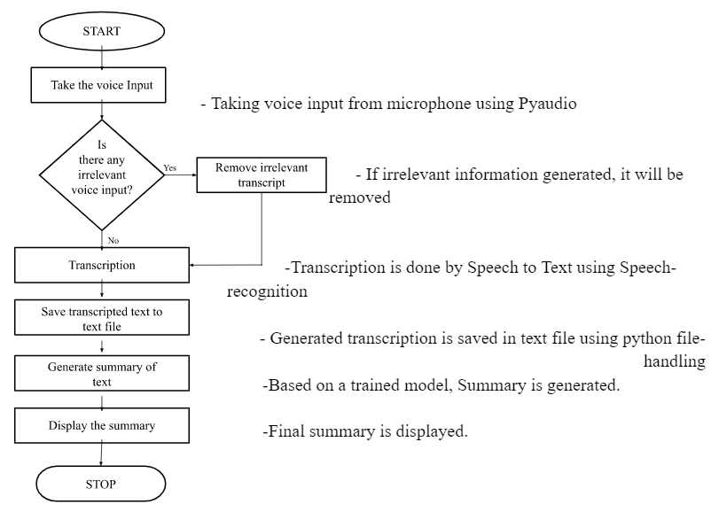
SOLUTION STRATEGY contd…
Figure 2: Flowchart

Slide 10
ALGORITHMS
Extractive Text Summarization
Extracts original sentences from the corpus directly if they are deemed important or ranked so. i.e subset of the corpus.
Text Rank
TextRank is based on the PageRank algorithm used on Google Search Engine.
It is a graph-based ranking model.
It prefers pages with a higher number of pages hitting it.
Originally “TextRank” algorithm used the percentage of words appearing among two sentences as the weights of an edge between them.
The algorithm then creates a graph with sentences as the nodes and overlapped words as the links.
Nlargest
nlargest is a function that finds n number of elements that is the largest or have the largest valve for a given key.
it can be used to find the rank of sentences in the corpus for extractive text summarization.

Slide 11
Abstractive text summary
Seq2Seq Model
Seq2Seq model is a deep learning model that takes in a sequence of inputs and gives a new sequence of outputs.
Takes into account the context words surrounding the input.
The basic idea behind Seq2Seq is to use a neural network to encode the input sequence into a fixed-length vector and then use another NN to decode the vector into the output sequence.
Two main components:
Encoder - That creates hidden layers from input words.
Decoder - That takes a hidden vector from the encoder, and the current word to produce the next hidden vector and predict the upcoming word.
Characteristics:
Sequences as a corpus
Word Embedding mechanism
Encoder-Decoder
Different model for training and testing

Slide 12
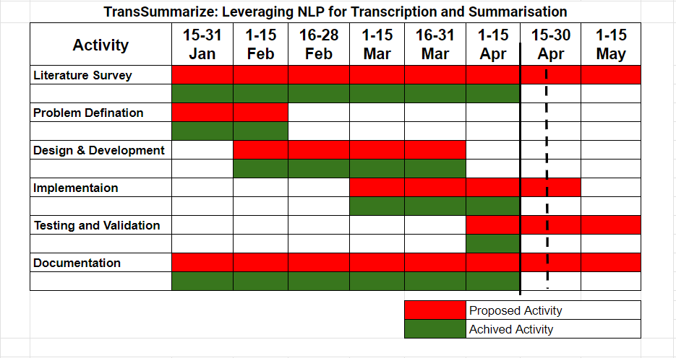
GANTT CHART
Notes:
‹#›

Slide 13
REFERENCES
[1] Shaikh Naziya, S., & Deshmukh, R. R. (2016). Speech recognition system—a review. IOSR J. Comput. Eng, 18(4), 3-8.
[2] Nenkova, A., & McKeown, K. (2012). A survey of text summarization techniques. Mining text data, 43-76.
[3] Kågebäck, M., Mogren, O., Tahmasebi, N., & Dubhashi, D. (2014, April). Extractive summarization using continuous vector space models. In Proceedings of the 2nd Workshop on Continuous Vector Space Models and their Compositionality (CVSC) (pp. 31-39).
[4] Gupta, S., & Gupta, S. K. (2019). Abstractive summarization: An overview of the state of the art. Expert Systems with Applications, 121, 49-65.

Slide 14
THANK YOU

