Slide 1

Mini Project Synopsis Presentation
on
“TransSummarize: Leveraging NLP for Transcription and Summarization”
Hari Om (Reg. No. 202000004)
Sushma Oinam (Reg. No. 202000048)
Aryan Raj Pradhan(Reg. No. 202000012)
Under the guidance of:
Dr. Saumya Das
Department Of Information Technology, Assistant Professor
DEPARTMENT OF INFORMATION TECHNOLOGY
SIKKIM MANIPAL INSTITUTE OF TECHNOLOGY
(A constituent college of Sikkim Manipal University)
MAJITAR, RANGPO, EAST SIKKIM – 737136

Slide 2

CONTENTS
Sl. No. | TITLE
1. | Abstract
2. | Introduction
3. | Literature survey
4. | Problem definition
5. | Proposed strategy
6. | Gantt Chart
7. | References

Slide 3
1. ABSTRACT
Speech recognition and Text summarization are popular areas in Natural Language Processing.
The project “TransSummarize” aims to combine speech recognition and text summarization in one whole.
In a small scenario like a meeting, this feature will be helpful to provide summary of conversation into a document without losing vital information.

Slide 4
2. INTRODUCTION
Natural Language Processing (NLP) is a tract of Artificial Intelligence and Linguistics, devoted to make computers understand the statements or words written in human languages.
Speech recognition is the ability of a machine or program to identify words spoken aloud and convert them into readable text, and text summarization will summarize the information in large texts for quicker consumption without losing vital information
This project aims to reduce the time and effort of manual documentation. Sometimes, the main points from a communication in the same language tends to be missed due to accent according to the person.
1

Slide 5

3. LITERATURE SURVEY
Sl. No. | Author(s) | Paper and Publication Details | Findings | Relevance to the project
1 | Shaikh Naziya S, R.R.Deshmukh | Speech Recognition System - A Review IOSR Journal of Computer Engineering(IOSR-JCE), Volume 18 (July- Aug, 2016) [1] | Techniques in Speech Recognition Systems(SRS) Various SRS modeling techniques are listed. The different models have their pros and cons. . | Vocabulary of HMM is very high - can be used for large amounts of data for speech recognition. Machine learning techniques for speech recognition.
2 | Nenkova A., & McKeown, K. | A survey of text summarization techniques Mining text data, 43-76.(2012) [2] | Topic Representation extracts topics discussed in the input document. Indicator representation scores the importance of each sentence which will come in the summary. | Provides ideas about how text summarization works.
2

Slide 6
4. PROBLEM DEFINITION
From any conversation, when there is an event that we want to extract information out of it, we have to manually do it by ourselves.
For this, there are separate application for speech recognition as well as text summarization.
But for convenience, why not an software which does both?
At the comfort of our fingertips, we should be able to get important written information from a conversation.
4

Slide 7
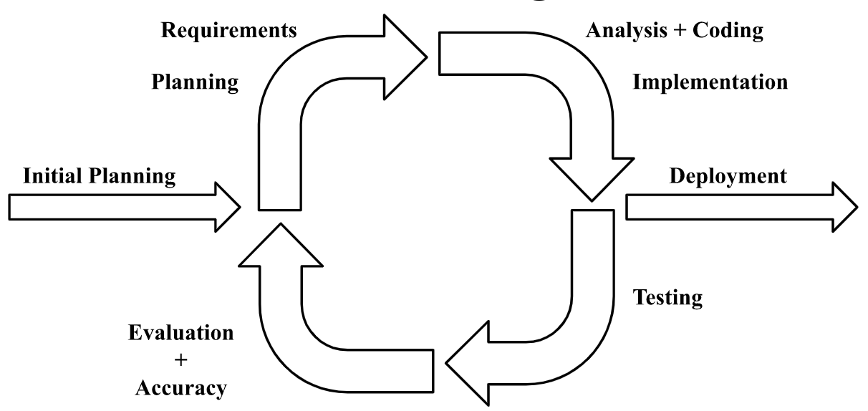
5. PROPOSED STRATEGY
Figure: Iterative Model
5

Slide 8
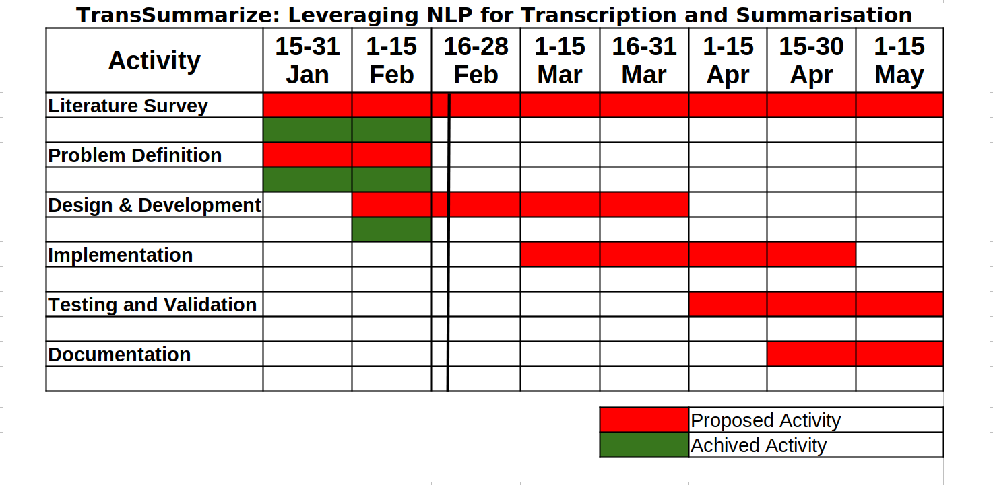
7. GANTT CHART
Notes:
<number>

Slide 9
8. REFERENCES
[1] Shaikh Naziya, S., & Deshmukh, R. R. (2016). Speech recognition system—a review. IOSR J. Comput. Eng, 18(4), 3-8.
[2] Nenkova, A., & McKeown, K. (2012). A survey of text summarization techniques. Mining text data, 43-76.

Slide 10
THANK YOU

