Slide 1
DONATION WEBSITE
BY
HARI PRAKASH. M
22UCA547

Slide 2
ABSTRACT
The platform connects donors with financially disadvantaged students, enabling educational support through transparent and secure transactions.
Key Features
Student Support: Students can apply for financial aid for tuition fees, books, and academic essentials.
Donor Contributions: Donors can contribute to specific cases or a general education fund.
Transparency & Accountability: Ensures clear tracking of donations and fund usage.
User-Friendly Interface: Easy navigation for students and donors.
Secure Transactions: Reliable and safe payment processing.
Efficient Data Handling: Organized student and donor information management.
Technology Stack
Frontend: HTML, CSS, JavaScript, Bootstrap
Backend: Django, MySQL

Slide 3
Existing System
Traditional education donation methods have several issues:
Donors don’t know how their money is used.
No proper tracking of funds.
Little to no interaction between donors and students.

Slide 4
Proposed System
The Education Donation Website solves these problems with:
User Profiles: Students share their achievements and financial needs.
Donation Categories: Donors can choose to support tuition fees, books, or supplies.
Transparency & Tracking: Donors can see how their funds are used.

Slide 5
Problem Definition & Project Description
Many students struggle to continue their education due to financial difficulties. This project creates a platform where donors can support students while ensuring transparency and accountability. By connecting donors and students, the platform helps underprivileged students pursue their education.

Slide 6
modules
Admin: Manages users, donations, and fund allocation.
User: Students apply for aid, and donors contribute to education.
Admin Module
View Fund Allocation
View Donor List
View Student List
User Module
Registration
Upload Documents
Donate Funds
Post Feedback

Slide 7
SYSTEM ANALYSIS
EQUIREMENTS SPECIFICTAION
HARDWARE REQUIREMENTS
Processor : Intel
RAM : 4.00GB
Hard disk : 40GB
Monitor : 15”mVGA monitor
Keyboard : 104 keys keyboard
Mouse : Optical mouse
SOFTWARE REQUIREMENTS
Opersating system : 64-bit
Local host server : XamppServer
Database connectivity : phpMyAdmin
Front end : HTML, CSS, JavaScript andBootstrapBack end : Django and MYSQL

Slide 8
Feasibility Study
The Education Donation Website is a simple platform designed to help college students raise funds for scholarships, events, and educational resources. This study evaluates whether the project is practical and sustainable by analyzing technical, operational, and economic aspects.

Slide 9
Technical Feasibility
Checks if the required technology is available:
Frontend: HTML, CSS, JavaScript (for a simple and user-friendly interface).
Backend: Django (a reliable framework for website functionality).
Database: MySQL (secure storage for user and fundraiser data).
Payment Gateway: Razorpay (for easy and secure donations).

Slide 10
Operational Feasibility
Ensures college students can easily use the platform:
Student-Friendly Features:
Simple and clean design for easy navigation.
Students can create fundraisers for scholarships, projects, and events.
Real-time updates on fundraiser progress.
Secure and quick donations through Razorpay.
Focus on College Students:
Only college students can create fundraisers for educational needs.
Donors (friends, family, alumni) can easily contribute.
Students can track donations and share updates.

Slide 11
Economic Feasibility
Checks if the website can generate enough revenue to cover its costs.
How It Will Earn Money:
Small fee charged on each donation.
Colleges or student groups can pay for extra features (e.g., custom branding).
Partnerships with educational organizations or sponsors.
Costs to Consider:
Website development and maintenance.
Server hosting costs.
Razorpay transaction fees.
Marketing to attract students and donors.

Slide 12
Razorpay Details
Razorpay is a secure and easy-to-use payment gateway widely used for accepting donations, payments, and subscriptions.
Key Features:
Multiple Payment Methods: Supports UPI, credit/debit cards, net banking, and wallets.
Secure Transactions: PCI DSS compliant with fraud prevention measures.
Instant Settlements: Fast processing of payments to the recipient’s account.
Custom Checkout: Easily integrates with websites and apps.
Recurring Payments: Supports automatic donations/subscriptions.

Slide 13
Razorpay Details
Integration with Education Donation Website:
Used to process donations securely.
Allows tracking of donation history.
Sends automated payment confirmations to donors.
Pricing & Fees:
Transaction Fee: ~2% per transaction (varies by payment method).
No Setup Fee: Free to start using Razorpay.

Slide 14
Razorpay Details
Tax Payment Details:
GST (Goods and Services Tax): 18% GST is applied to the transaction fee.
Example Calculation:
If a transaction fee is 2% on a ₹1,000 donation → ₹20 fee.
GST on ₹20 (18%) = ₹3.60.
Total deduction: ₹20 + ₹3.60 = ₹23.60.
Domestic & International Payments:
Domestic Payments (India):
Supports INR payments via UPI, net banking, credit/debit cards, and wallets.
Standard transaction fee: 1.75% – 2% + GST.
International Payments:
Supports payments in multiple currencies via credit/debit cards.
Transaction fee: 3% – 4% + GST.
Requires activation via Razorpay’s dashboard.

Slide 15
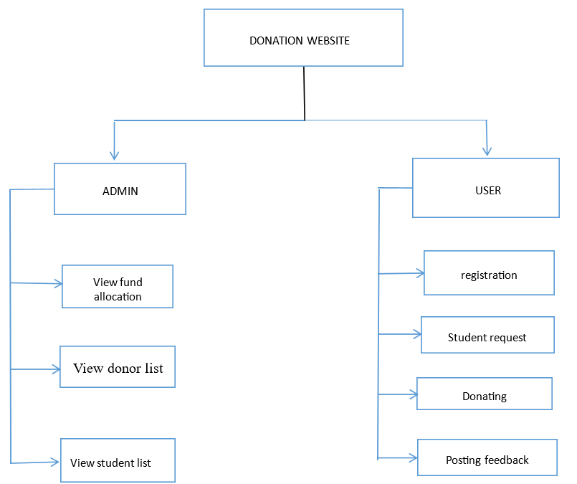
ARCHITECTURE DESIGN

Slide 16
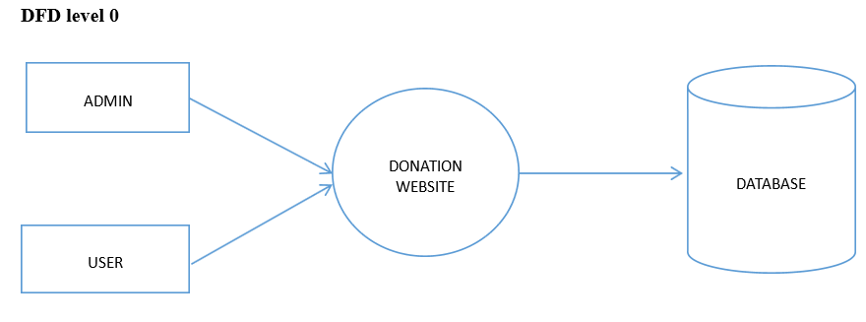
DATA FLOW DIAGRAM

Slide 17
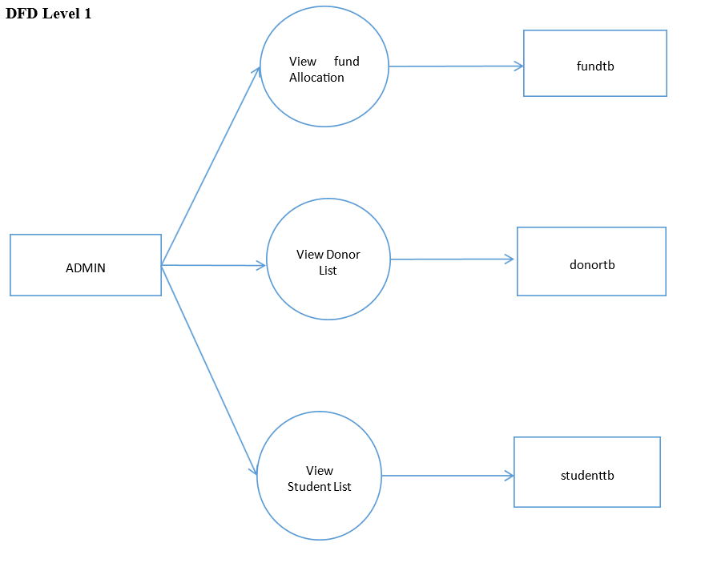
DATA FLOW DIAGRAM

Slide 18
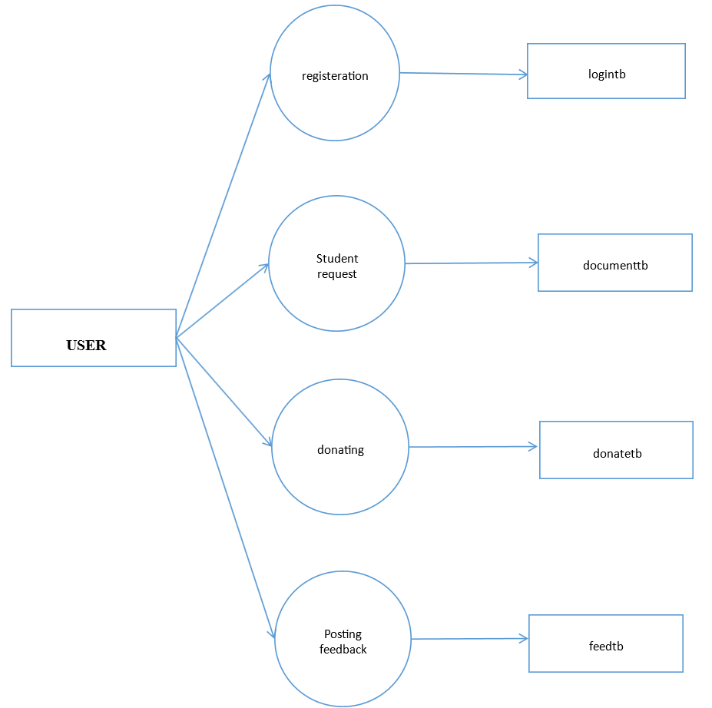
DATA FLOW DIAGRAM

Slide 19
DATA DICTIONARY
Table Name: SignupForm
Purpose: Stores user registration details
S. No. | Field Name | Data Type | Size | Constraint | Description
1 | username | Varchar | 150 | Not Null | Unique username for the user
2 | email | Varchar | 254 | Not Null | User's email address
3 | password | Varchar | 128 | Not Null | Hashed password for authentication

Slide 20
Table Name:DonationForm
Purpose:Stores donor information and donation details
S. No. | Field Name | Data Type | Size | Constraint | Description
1 | first_name | Varchar | 50 | Not Null | Donor's first name
2 | last_name | Varchar | 50 | Not Null | Donor's last name
3 | phone_number | Varchar | 10 | Not Null | Must be exactly 10 digits
4 | email | Varchar | 254 | Not Null | Donor's email address
5 | aadhar | Varchar | 12 | Not Null | Must be exactly 12 digits
6 | pancard | Varchar | 10 | Not Null | Must follow format AAAAA1111A
7 | permanent_address | Varchar | 255 | Not Null | Donor's permanent address
8 | country | Varchar | 50 | Not Null | Country of residence
9 | state | Varchar | 50 | Not Null | State of residence
10 | city | Varchar | 50 | Not Null | City of residence
11 | pincode | Varchar | 6 | Not Null | Postal code
12 | date | Datetime | - | Not Null | Datetime-local input field for donation date

Slide 21
Table Name:ScholarshipForm
Purpose:Stores student scholarship application details
S. No. | Field Name |  | Data Type | Size | Constraint | Description
1 | full_name |  | Varchar | 100 | Not Null | Student's full name
2 | email |  | Varchar | 254 | Not Null | Student's email address
3 | mobile_number |  | Varchar | 15 | Not Null | Must be in format +91XXXXXXXXXX
4 | date_of_birth |  | Date | - | Not Null | Date input field
5 | student_id |  | Varchar | 50 | Not Null | Unique student ID
6 | father_name |  | Varchar | 100 | Not Null | Father's name
7 | mother_name |  | Varchar | 100 | Not Null | Mother's name
8 | siblings |  | Text | - | Nullable | Details of siblings (if any)
9 | address |  | Text | - | Not Null | Student's residential address
10 | district |  | Varchar | 50 | Not Null | Student's district
11 | state |  | Varchar | 50 | Not Null | State of residence
12 | country |  | Varchar | 50 | Not Null | Country of residence

Slide 22
13 | college_name | Varchar | 150 | Not Null | Name of the college
14 | degree | Varchar | 100 | Not Null | Degree being pursued
15 | department_head_contact | Varchar | 15 | Not Null | Contact number of the department head
16 | semester_fee | Decimal | 10,2 | Not Null | Number input field for semester fee
17 | aadhar_card | file | - | Not Null | File input for Aadhar card upload
18 | pan_card | File | - | Not Null | File input for PAN card upload
19 | bank_passbook | File |  | Not Null | File input for bank passbook upload
20 | college_bonafide | File |  | Not Null | File input for college bonafide certificate upload
21 | extracurricular_certificate | File |  | Not Null | File input for extracurricular certificate upload

Slide 23
NORMALIZATION
Normalization is the process of organizing data in a database to reduce duplication and improve efficiency.
This process involves breaking large tables into smaller ones and setting up relationships between them.
Why is Normalization Important?
Reduces duplicate data (Redundancy)
Ensures data consistency
Improves database efficiency
Makes updates and modifications easier

Slide 24
First Normal Form (1NF) – No Duplicate Rows & Atomic Data
Rules:
✔ Each column should have only one value (Atomicity).
✔ Each row should be unique (No duplicate rows).
Second Normal Form (2NF) – No Partial Dependencies
Rules:
✔ Must be in 1NF.
✔ All non-key attributes should depend only on the primary key, not just part of it.
Third Normal Form (3NF) – No Transitive Dependencies
Rules:
✔ Must be in 2NF.
✔ No transitive dependency (Non-key attributes should not depend on another non-key attribute).

Slide 25
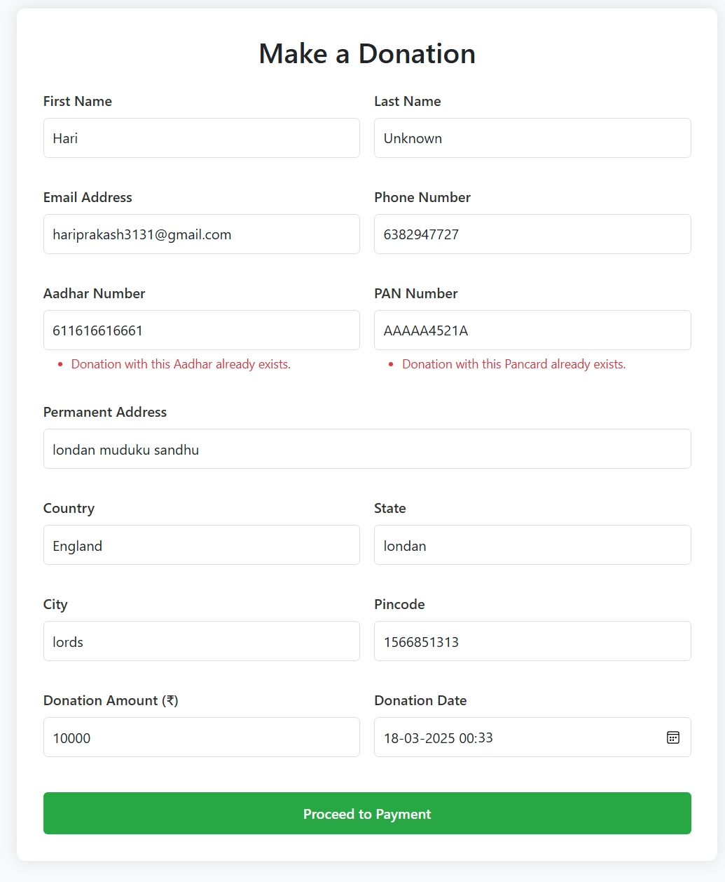
Error message

Slide 26
System Testing
Unit Testing: Individual modules are tested
- Integration Testing: Ensures proper interaction between modules
- Validation Testing: Confirms alignment with requirements
- Output Testing: Verifies correct system outputs
- User Acceptance Testing: Ensures usability and reliability

Slide 27
User Manual
Admin Operations:
- Manage students, donors, and applications
- Approve/reject applications
Student Operations:
- Apply for scholarships
- Upload documents and track status

Slide 28
Technology Stack
Django: Python web framework for backend
- MySQL: Database management
- HTML, CSS, Bootstrap: Frontend design
- JavaScript: Enhances interactivity

Slide 29
Future Enhancements
Razorpay Payment Gateway Integration
- Mobile Application Development
- Automated Donation Receipts
- AI-Based Scholarship Matching
- Multi-Currency and International Payments
- Blockchain for Transparency

Slide 30
Project Objectives
Provide a platform for students to apply for scholarships
- Allow donors to contribute towards student education
- Ensure secure, transparent, and efficient transactions
- Simplify donation and scholarship management for admins

Slide 31
Key Features
- Secure student scholarship application and donation process
- Real-time donation tracking and reporting
- User authentication and authorization
- Admin dashboard with comprehensive management tools

Slide 32
Security Measures
- User authentication with password encryption
- SQL injection prevention using Django ORM
- CSRF protection for secure form submissions
- Regular expression validation for secure data input

Slide 33
References & Bibliography
Website References:
- W3Schools: HTML, CSS, Bootstrap
Tools & Libraries:
- Django, MySQL Workbench, Bootstrap
AI Tools
- ChatGPT, Deepseek, Windsurf, Trae

Slide 34
Installation Process
1. Install Python and Django: `pip install django`
2. Install MySQL Workbench: `pip install mysqlclient`
3. Clone or download the project files
4. Create and activate a virtual environment
5. Configure database settings in `settings.py`
6. Run migrations: `python manage.py makemigrations` and `python manage.py migrate`
7. Start the server: `python manage.py runserver`
8. Access the website at `http://127.0.0.1:8000/`

Slide 35
User Roles and Permissions
Admin:
Manages users, donations, and applications
Approves/rejects applications
Student:
Applies for scholarships
Uploads documents and tracks application status
Donor:
Makes donations towards student scholarships
Tracks donation history

Slide 36
Testing Results and Validation
Unit Testing:
Verified individual modules' functionality
Integration Testing:
Ensured proper interaction between modules
Validation Testing:
Confirmed system aligns with requirements
Output Testing:
Verified accurate and consistent results

Slide 37
Future Scope and Enhancements
AI-Powered Matching: Auto-match donors and students
Blockchain Transparency: Track donations securely
Multi-Currency Support: Accept international donations
Mobile App: Android/iOS app for accessibility
Enhanced Reporting: Real-time data analytics and visual reports

Slide 38
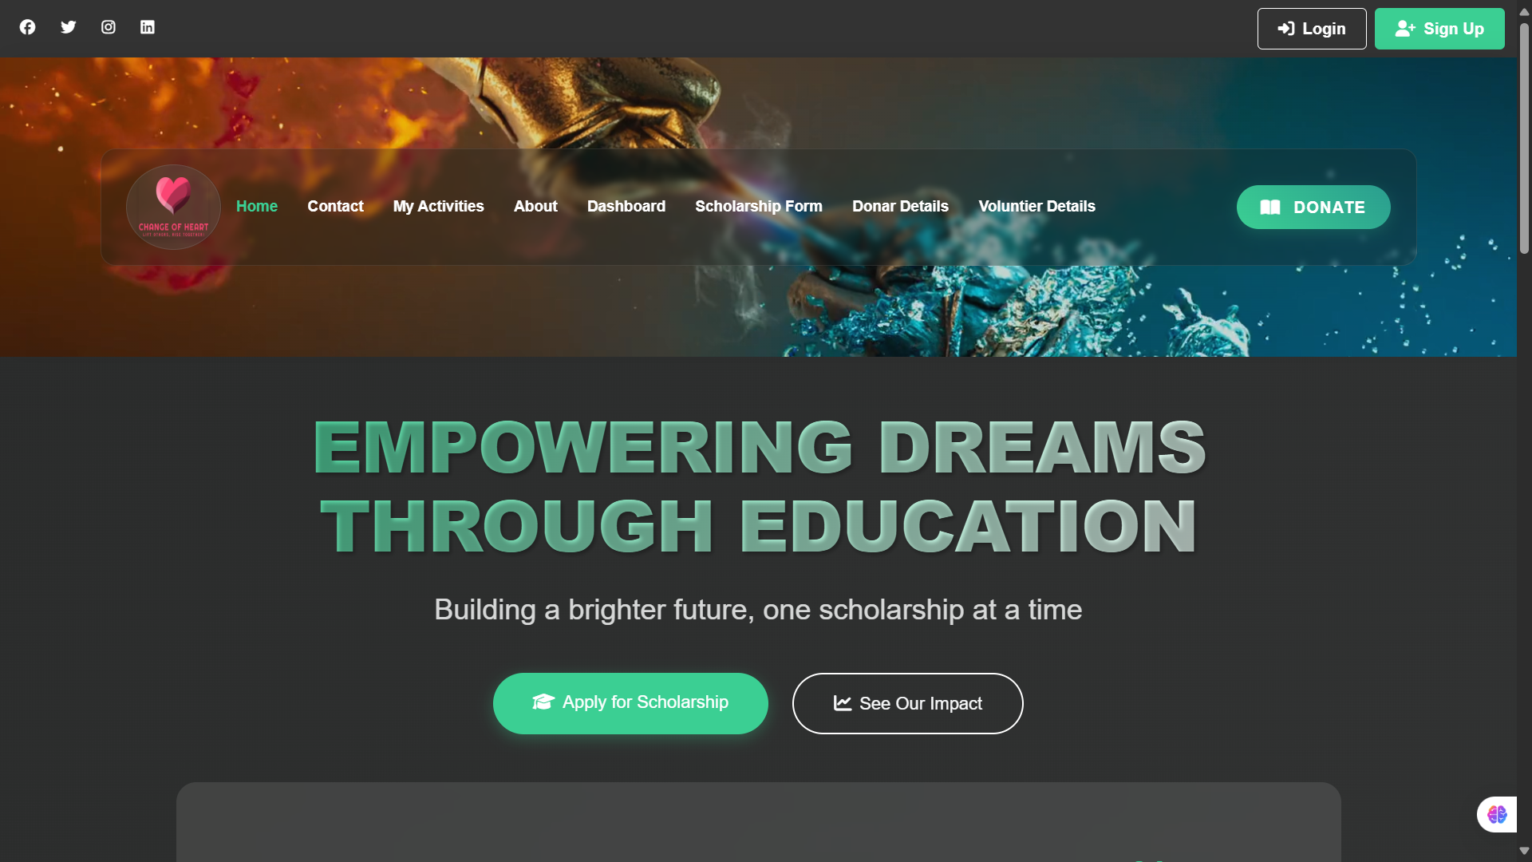
SAMPLE SCREENSHOTS

Slide 39
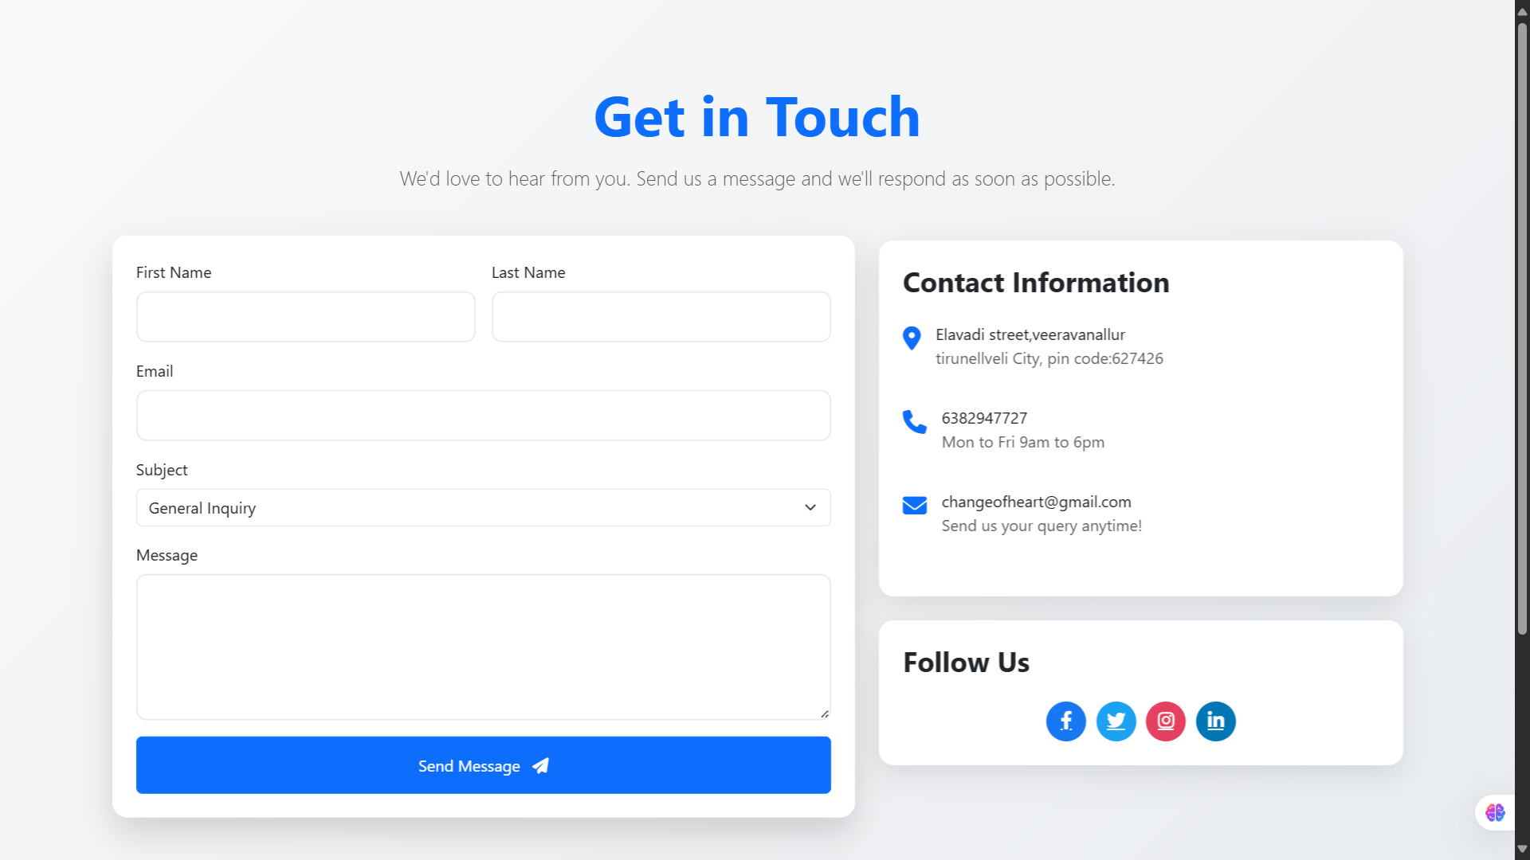

Slide 40
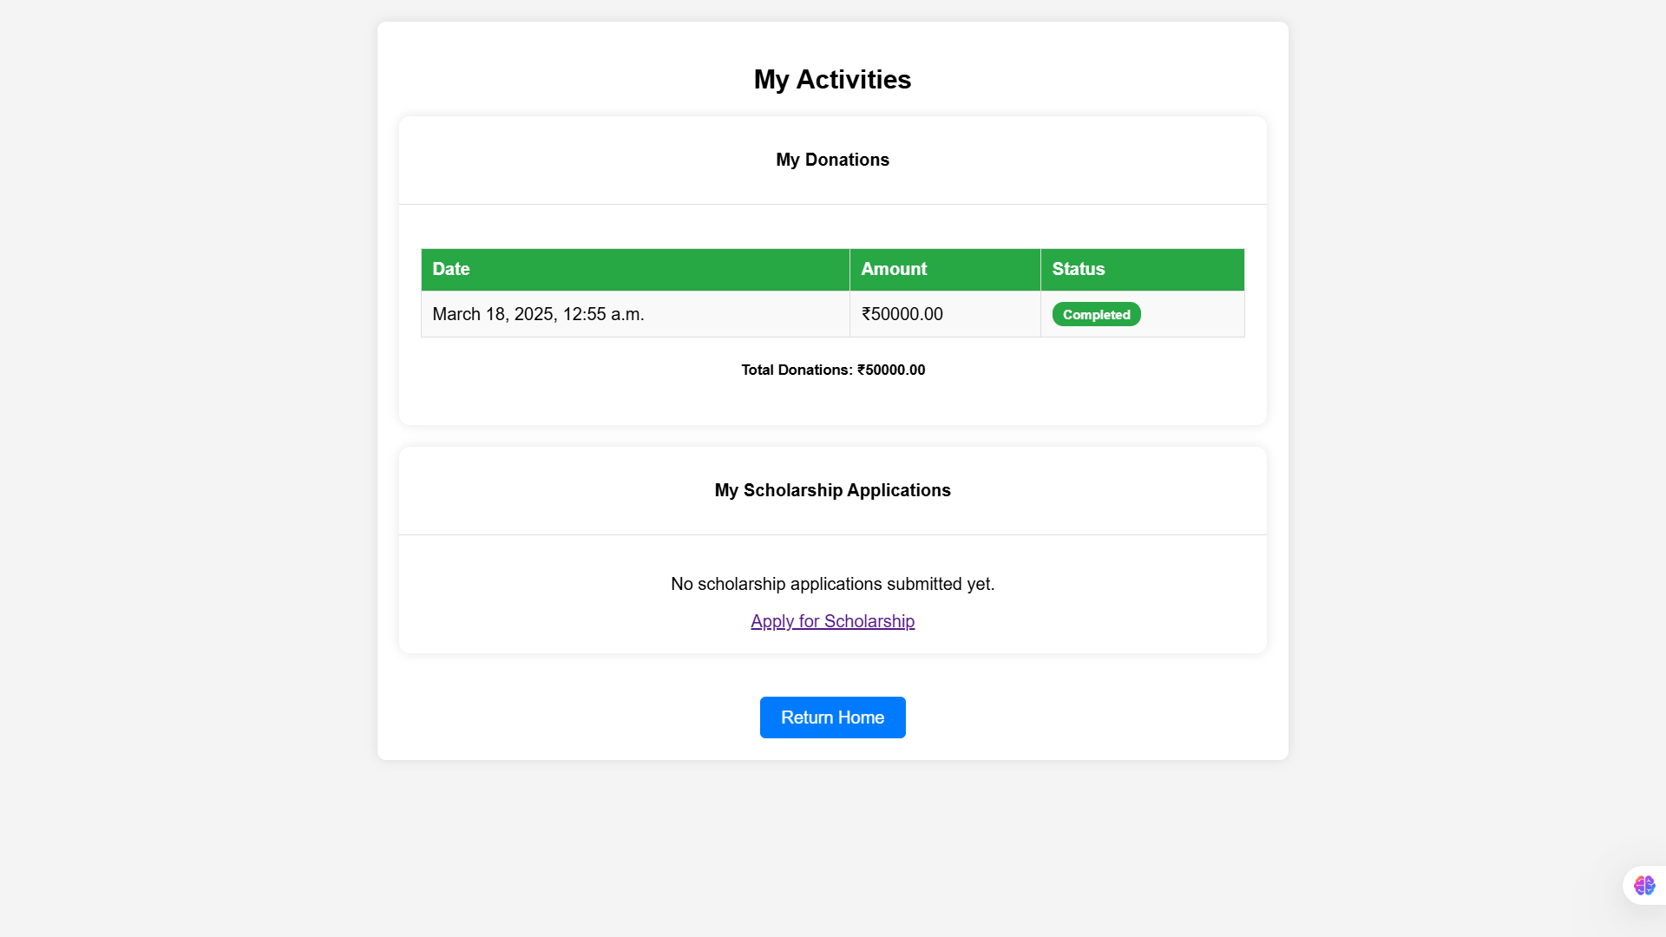

Slide 41
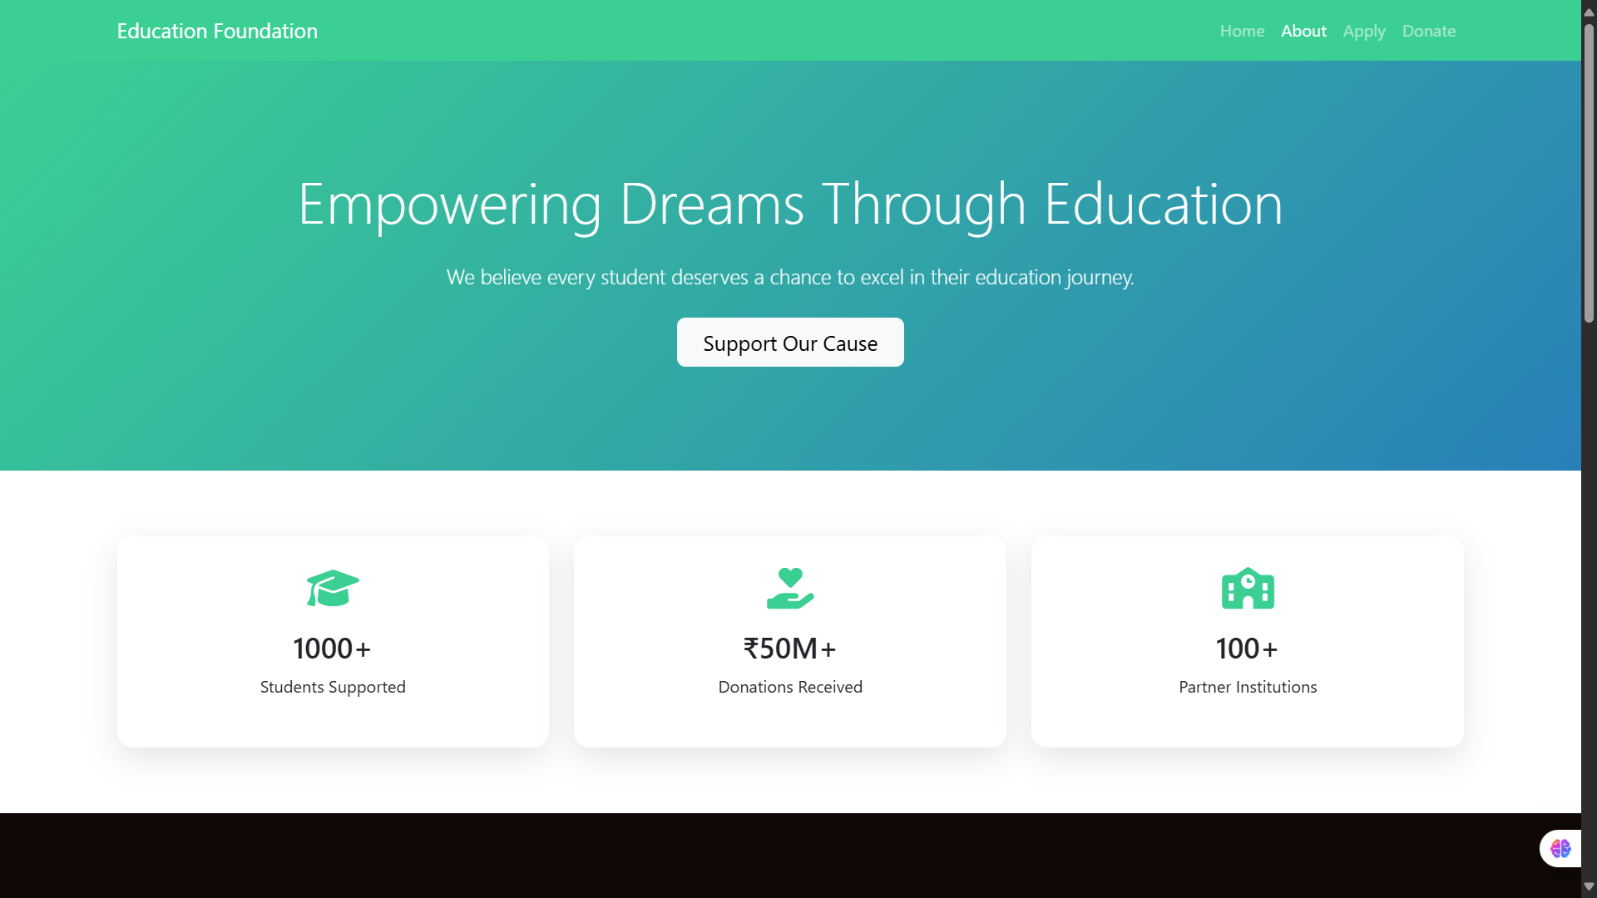

Slide 42
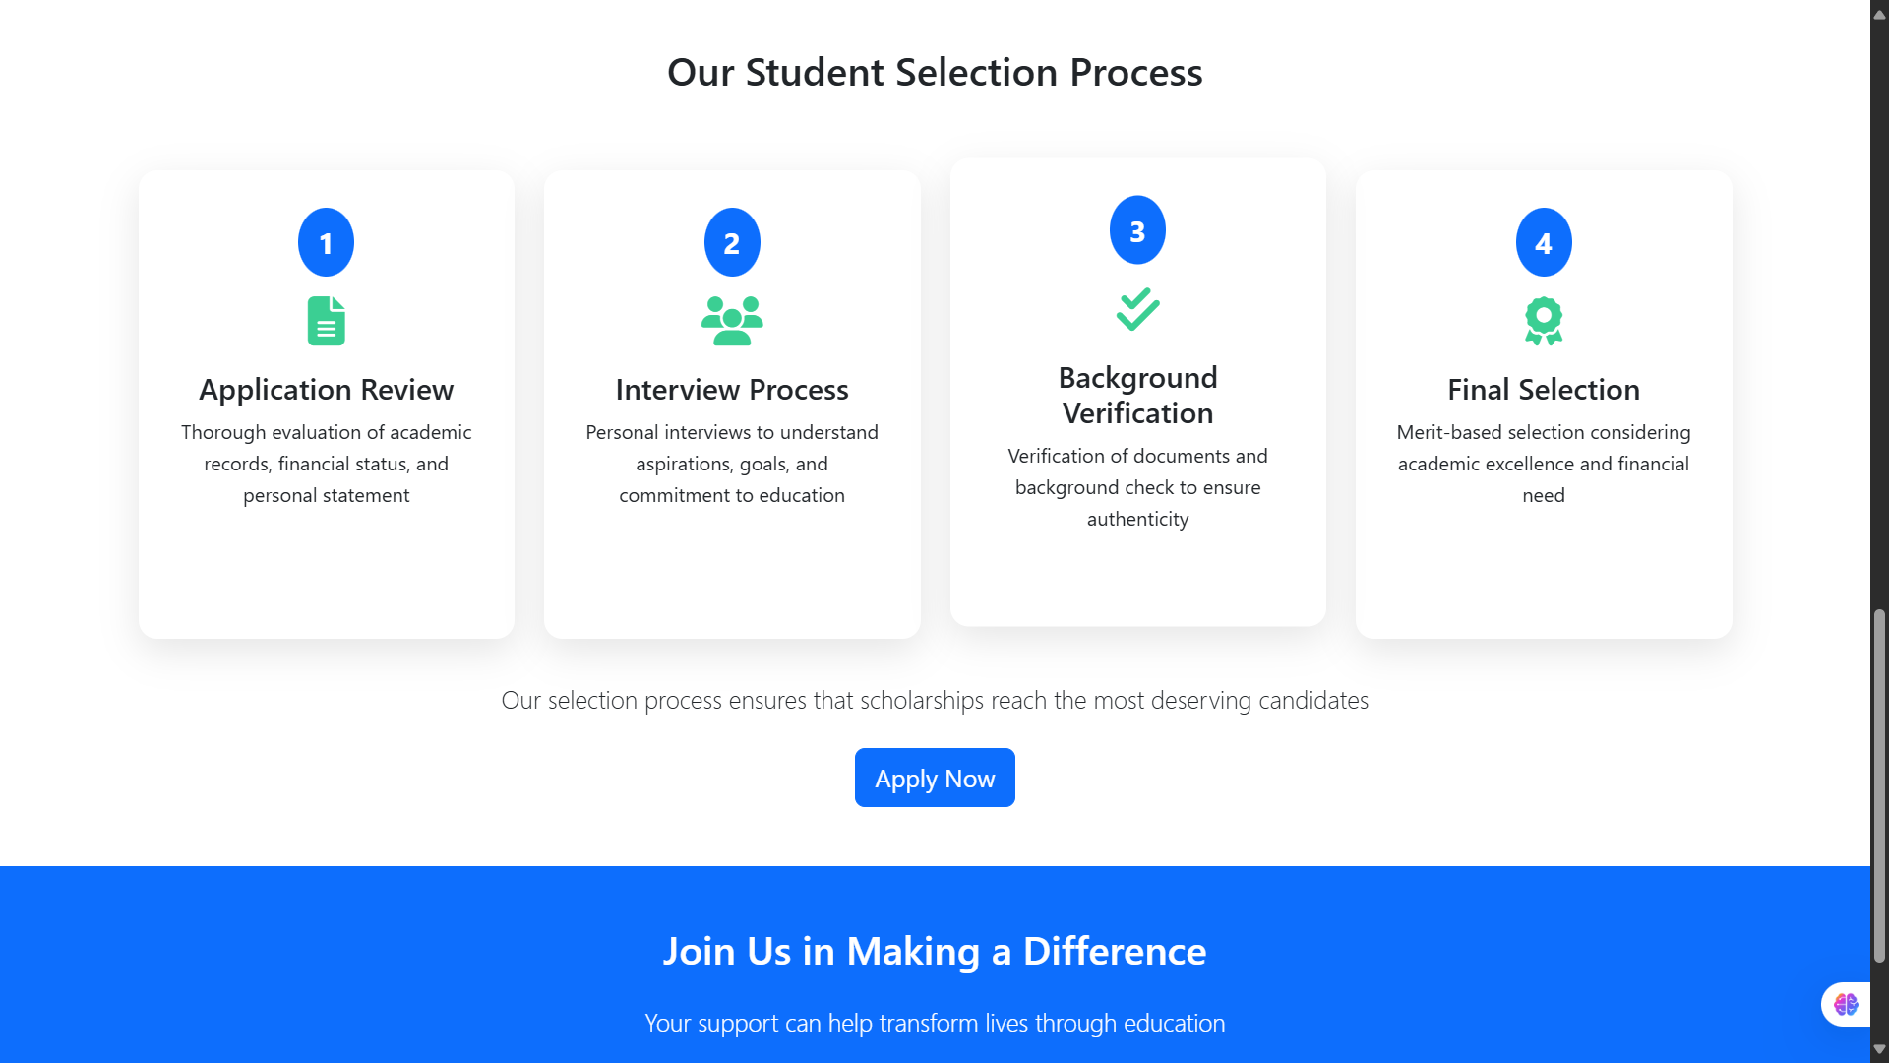

Slide 43


Slide 44
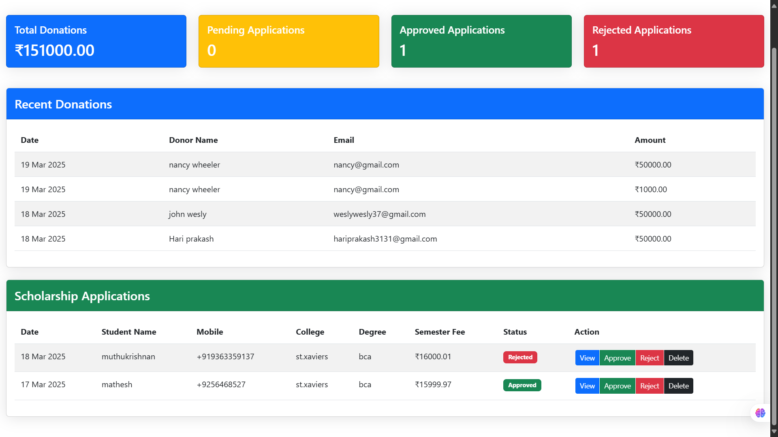

Slide 45
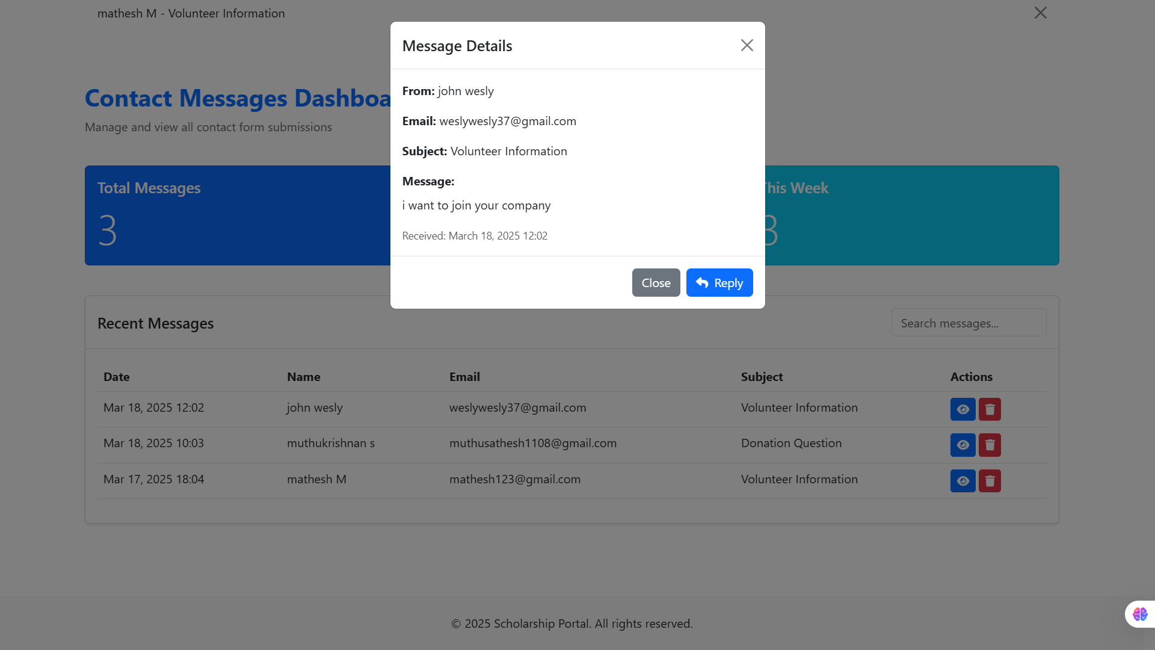

Slide 46
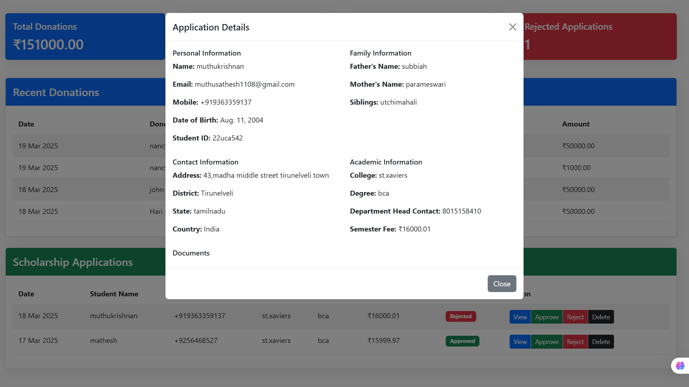

Slide 47
Conclusion
The Donation Website streamlines financial aid distribution with improved transparency and efficiency. Future enhancements like AI matching and blockchain integration will further improve the platform's capabilities.

Slide 48
THANK YOU

