Slide 1


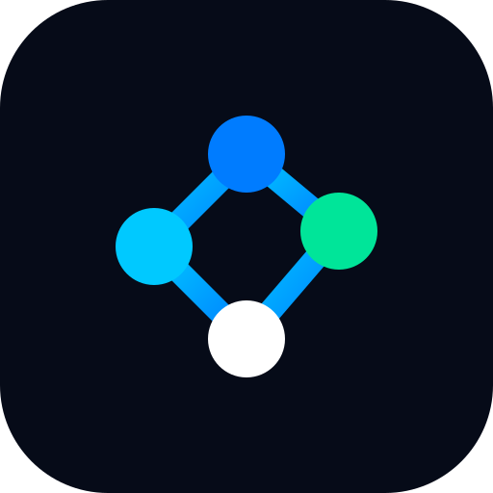











Macrograph AI
Prices
B.TECH CSE (AI & ML) · FINAL YEAR PROJECT
Agriculture
Monetary
Real
Finance
Multi-agent intelligence for the Indian economy, where every number traces back to an official source
Orchestrator
Labour
Fiscal
10 sector agents
A2A + FastMCP
Causal knowledge graph
Hariprasaadh K
Services
External
Reg. No. 23BAI1061 · B.Tech CSE (AI & ML)
Guide: [Guide name], [Designation]
School of Computer Science and Engineering, VIT Chennai · November 2026
Capital Markets
declared A2A peer edge
orchestrator delegation
Notes:
Good morning. I am Hariprasaadh K, and my project is Macrograph AI: a multi-agent platform that answers questions about the Indian economy under one rule, no source, no answer. The graphic on the right is the real topology of the system: a LangGraph orchestrator that delegates to ten sector agents, and, in gold, the seven agent-to-agent peer edges that the protocol allows between sectors. Everything else is refused. In the next fifteen minutes I will cover the problem, the design, the causal model, the product, what we measured, and what is still open.

Slide 2




Scattered sources, invented numbers
THE PROBLEM
Fragmented data
A TYPICAL ANALYST QUESTION
“How will a $20 rise in Brent crude travel through India’s inflation, interest rates and growth?”
MoSPI, RBI, CGA and DGCI&S publish through APIs, spreadsheets and PDF bulletins, each with its own units, base years and release calendar.
Fluent, unsourced numbers
A language model can quote a CPI figure that appears in no official release; because it looks plausible, it is hard to catch.
THE ANSWER NEEDS DATA FROM
MoSPI CPI, GDP, IIP
RBI DBIE repo, credit
Conflicting values
When several agents fetch the same indicator on their own, one report can carry two different vintages of it.
CGA deficit, capex
DGCI&S trade
NSE / BSE markets
IMD monsoon
Hidden transmission
Agmarknet mandi prices
EPFO payroll
Shocks move across sectors with lags and signs; describing each series alone cannot explain how a shock travels.
Different formats, frequencies, base years and release calendars
Notes:
Take one realistic question: how will a twenty-dollar rise in Brent crude travel through Indian inflation, interest rates and growth? To answer it, an analyst reads MoSPI for CPI and GDP, RBI DBIE for the repo rate and credit, CGA for fiscal data, DGCI&S for trade, the exchanges for markets, and IMD and Agmarknet for the monsoon and food prices. Each publishes differently. Language models make this look easy, but they can produce a CPI number that exists in no release. If several agents fetch the same indicator independently they can disagree inside one answer. And the real question is about transmission across sectors, which no single series explains.

Slide 3




What prior work leaves open
LITERATURE SURVEY
Work | Approach | Gap for Indian macro answers
Hao & Xie (2025) | Several LLMs act as heterogeneous households | Stylised tasks, no observed data
Lin et al. (2026) | LLM agents simulate macro expectation surveys | Simulated survey answers only
Xiao et al. (2025) TradingAgents | Analyst, researcher and trader agent roles | One shared data feed, no owners
Yang et al. (2020) | Macro knowledge graph mined from literature | Links not re-tested on data
Zhu et al. (2025) KG2RAG | Graph-guided expansion of retrieved chunks | The model still writes numbers
Dadopoulos et al. (2025) | Metadata-driven RAG over financial filings | No claim-level verification
Kato (2026) AI Economist Agent | Reports grounded in executed model runs | U.S. only; no Indian sources
Gaps this project targets
Data ownership across agents
One owner per indicator,
enforced by the A2A server
Evidence grades for causal edges
Edge audit labels each edge
SEEDED or EMPIRICAL
Machine-checked numbers
Decimal claim verifier against
content-addressed evidence
Coverage of India
MoSPI, RBI DBIE, CGA, DGCI&S
behind sector FastMCP servers
Notes:
The seven reference papers fall into two groups. LLM agents for economics and finance: Hao and Xie simulate heterogeneous households with several language models, Lin and colleagues simulate survey respondents, and TradingAgents models a trading firm with specialised roles. Knowledge graphs and retrieval: Yang and colleagues build a macro graph from literature, KG2RAG expands retrieval with a graph, the metadata RAG paper works on filings, and Kato's AI Economist grounds narratives in model runs, the closest work to ours, but for the U.S. Four gaps remain for our setting: nobody assigns an owner to each indicator, graph edges are not graded by evidence, numbers are not machine-checked, and Indian official sources are not covered.

Slide 4







Seven objectives, one rule
OBJECTIVES
O1
O2
O3
O4
Sector-wise data access
Coordinated multi-agent reasoning
Source-grounded answers
Explicit causal model
One FastMCP server and local store per sector, fed by official sources
Typed A2A protocol with discovery, routing, loop guards and tracing
Provenance enforced in the protocol; missing data reported, not estimated
Knowledge graph of transmission channels with lag, sign and evidence class
O5
O6
O7
Traceable provenance
Research instruments
Usable interface
No source,
no answer
Source, table, period, retrieval time and hash on every observation
Edge audit, anomaly radar, trajectory, twin, MPC and claim verification
Cited dashboard, streaming chat, causal lab and agent registry
Every figure carries agent, table and period; gaps are shown as unavailable
Notes:
These gaps became seven objectives. O1, one data server and store per sector backed by official sources. O2, a typed agent-to-agent protocol with discovery, routing, loop protection and tracing. O3, answers grounded in sources, enforced by the protocol itself. O4, an explicit causal model of how shocks move between indicators. O5, full provenance on every observation. O6, research instruments that let us test the model against data. O7, an interface people can actually use. One rule governs all of them: no source, no answer. If a value cannot be retrieved, the system says it is unavailable instead of estimating it.

Slide 5


Ten sector agents, one owner per number
PROPOSED SYSTEM
Real
Agriculture
Prices
Monetary
Finance
GDP, GVA, IIP, GFCF
Crops, MSP, monsoon,
mandi prices
CPI and WPI inflation,
food, fuel and core
Repo corridor, M3,
liquidity, stance
Bank credit, GNPA,
WALR and MCLR
MoSPI e-Sankhyiki
Agmarknet · IMD
MoSPI e-Sankhyiki
RBI DBIE
RBI DBIE tables
Capital Markets
Fiscal
External
Labour
Services
NIFTY, India VIX,
FII/DII flows, G‑Sec
Fiscal deficit, GST,
capex, public debt
Forex reserves, trade,
BoP, USD/INR
PLFS unemployment,
EPFO payroll
Services GVA, PMI,
IT exports
yfinance · SEBI
CGA · Union Budget
RBI · DGCI&S
MoSPI PLFS · EPFO
MoSPI · PMI releases
A2A for reasoning
MCP for data
No shortcuts
agents talk only through typed requests
each agent reads only its own MCP server
sector packages never import each other
Notes:
The system decomposes the economy into ten sector agents. Each one owns its indicators: Prices owns CPI and WPI, Monetary owns the repo rate and M3, Finance owns bank credit and NPAs, Real owns GDP and IIP, and so on. Ownership means no other agent recomputes that number; if Fiscal needs CPI it must ask Prices. Each agent reads its own sources through its own FastMCP server: MoSPI's e-Sankhyiki server, RBI DBIE tables, CGA, DGCI&S, yfinance and others. Three rules keep this clean: agents talk to each other only over A2A, data arrives only through MCP, and sector packages never import one another.

Slide 6





Reasoning flows apart from data
ARCHITECTURE
Web app
Dashboard
Streaming chat
Causal Lab
A2A registry
Knowledge-graph explorer
Evidence drawer
React 18 · TypeScript · Vite
API gateway
/api/v1/chat/stream
/api/v1/analyze
/api/v1/research/*
/api/v1/brief/*
/a2a/v1/*
FastAPI · Uvicorn · SSE
Orchestrator
decompose
parallel_a2a_execute
kg_causal_enrichment
synthesis
LangGraph StateGraph
Causal intelligence
Knowledge graph (20 × 12)
Scenario engine
Research lab
Daily brief
Claim verifier (library)
NetworkX · statsmodels
A2A protocol
Agent Cards
Capability router
6 server checks
7 declared peer edges
Trace store
agent ↔ agent · reasoning only
Sector agents
Real
Agriculture
Prices
Monetary
Finance
Capital Markets
Fiscal
External
Labour
Services
10 packages · one owner each
Data layer
MoSPI e-Sankhyiki
RBI DBIE
CGA
DGCI&S
yfinance
IMD
Agmarknet
DuckDB stores
agent ↔ data · data only
Notes:
This is the layered architecture, top to bottom. The React web app talks to a FastAPI gateway that streams chat over server-sent events. A LangGraph orchestrator with four nodes decomposes the question, delegates, enriches with the causal graph and synthesises. Beside it sits the causal intelligence layer: the knowledge graph, the scenario engine, the research lab, the daily brief and the claim verification library. The two teal bands are the key design decision. The A2A layer carries only reasoning between agents; the data layer carries only data, through one FastMCP server per sector backed by DuckDB stores. An agent never fetches another agent's data.

Slide 7
From question to cited report in four steps
ORCHESTRATION
1
Route
2
Delegate
3
Enrich
4
Synthesise
decompose
parallel_a2a_execute
kg_causal_enrichment
synthesis
Scores Agent Cards against the query; an LLM chooses only if no card matches
Concurrent sector_analysis requests, plus one bounded follow-up round
Shortest causal paths between observed indicators; optional shock simulation
Indicator matrix with provenance hashes, causal diagram and source table
WORKED RUN · OCTOBER 2026
OBSERVATIONS RETURNED
GRAPH PATHS FOUND
“How does a rise in crude oil prices affect inflation and RBI repo rate policy?”
Indicator | Value | Period | Source
CPI headline (YoY) | 5.54% | Sep 2026 | MoSPI
Repo rate | 5.25% | Feb 2026 | RBI DBIE
M3 growth (YoY) | unavailable | Jun 2026 | RBI DBIE
CPI → repo · 1 hop, 1 month
Brent → CPI · 2 hops, 3 months
Brent → repo · 3 hops, 4 months
≈ 11 s
Shock: Brent +$20 / bbl
Routed to Monetary, Prices and Agriculture
Every value keeps its period, status and SHA-256 hash
end to end with live official data
and no LLM key
Notes:
The orchestrator is a four-node LangGraph state graph. Decompose scores every Agent Card against the question; a language model is consulted only if no card matches, and its choice is intersected with registered agents. Delegate sends one sector_analysis request per agent concurrently, with at most one bounded follow-up round. Enrich finds shortest transmission paths between the observed indicators and can run a shock. Synthesise writes the report: an indicator matrix with provenance hashes, a causal diagram, path and scenario tables and a source table. In the worked run, a crude-oil question returned live CPI of 5.54 percent from MoSPI and a repo rate of 5.25 percent, reported M3 as unavailable instead of guessing, found three graph paths, and finished in about eleven seconds without an LLM key. Single-sector questions skip all of this and go straight to the owning agent.

Slide 8



A protocol that refuses unsourced answers
TRUST LAYER · A2A + MCP
Six checks on every A2A request
7 declared peer edges
1
Loop guards
consumer → provider · A2A task
Depth ≤ 5 · at most 25 requests per conversation · no cycles
Finance
Monetary
repo_rate
2
Declared dependency
Sector-to-sector calls only on the 7 declared edges
Fiscal
Prices
cpi_headline
3
Capability
External
Finance
bank_credit_growth
The task must be listed in the receiver’s Agent Card
4
Schema
Strict Pydantic v2 envelopes; extra fields rejected
MCP data path for every value
5
Timeout and retry
Live official source
Cached snapshot
Structured unavailable
90 s request, 25 s peer; only transient errors are retried
6
Provenance
No Source, No Answer
Never an estimate. Each value keeps source URL, dataset, table, period, retrieval time and a record reference.
A successful reply with no sources is rejected
Notes:
Trust is enforced in code, not left to prompts. Every A2A request passes six checks in the server: loop guards limit depth to five and a conversation to twenty-five requests and reject cycles and duplicates; sector-to-sector calls are allowed only along seven declared edges, shown on the right; the task must appear in the receiver's Agent Card; envelopes are strict Pydantic models; requests time out; and, most importantly, a successful reply that carries no sources is rejected as an invalid response. That is No Source, No Answer at protocol level. Below the A2A layer, every value comes through MCP: live from the official source, else a cached snapshot tagged as cached, else a structured unavailable status, never an estimate.

Slide 9
20 indicators, 12 typed transmission edges
CAUSAL KNOWLEDGE GRAPH
Trade balance
+1m
USD/INR
Bank NIFTY
sign under review
−1m
−1m
Brent crude
+1m
WPI inflation
+2m
CPI headline
+1m
Repo rate
−3m
Bank credit growth
+2m
IIP growth
+1m
GDP growth
Monsoon departure
+3m
Foodgrain output
−2m
CPI food
Central capex
+2m
GFCF investment
No edges yet
NIFTY 50
India VIX
Forex reserves
Debt-to-GDP
EPFO additions
EVIDENCE TIER, AS TYPED IN THE ONTOLOGY (PRIORS)
EDGE ANATOMY
Theory
Statistical association
Lagged relationship
Each edge: stable rel-id, lag, sign, confidence and mechanism
Checked on load: no self-loops, unknown endpoints, duplicates
NetworkX answers path and impact queries; Neo4j mirror optional
Granger predictive
Structural causal model
Notes:
The causal layer is a knowledge graph of twenty canonical indicators and twelve directed edges. The main chain reads left to right: Brent crude to wholesale prices, to CPI, to the repo rate, to bank credit, to industrial production and GDP, with branches to the trade balance, the rupee and Bank NIFTY, and separate chains for the monsoon and for public capex. Each edge carries a stable id, a lag in months, a sign, a confidence, a mechanism and its assumptions, and is typed on a five-tier scale from theory to a structural causal model. These types and confidences are priors typed into the ontology, not measurements; the next slides show how we test them. The red edge has a sign we already know is doubtful. Five indicators have no edges yet.

Slide 10

Tracing a $20 oil shock, hop by hop
SCENARIO ENGINE
PROPAGATION RULE
Δ target = shock × Π (sign × 0.55 × confidence) × 0.15
Lags add up along the path, confidence multiplies, and the band is ±25% of Δ.
Hop 1: 20 × (0.55 × 0.95) × 0.15 = +1.57
so WPI moves from 2.45 to 4.02
SIMULATED
A transparent heuristic, not a VAR: the constants are design choices and deltas stay in each indicator’s own unit.
USD/INR falls after the oil shock, which is implausible: the run exposed a doubtful + sign on trade balance → USD/INR.
Path confidence 0.95 → 0.85 → 0.81 → 0.71 → 0.59 → 0.57 over six hops
Live baselines live CPI 5.54% (MoSPI, Sep 2026) replaces the default; peak 6.32%
Notes:
Scenarios propagate along the graph. For each hop the signal is multiplied by the edge sign, a per-hop attenuation of 0.55 and the edge confidence; a global scale of 0.15 converts it to a change. For the first hop, twenty dollars times 0.55 times 0.95 times 0.15 gives plus 1.57 on WPI. The chart shows the main chain: WPI rises 1.57 points after one month, CPI 0.78 after three, the repo rate 0.41 after four, and then credit, IIP and GDP turn slightly negative, and confidence falls from 0.95 to 0.57 over six hops. I want to be clear that this is a transparent heuristic, labelled simulated, not a VAR. And the run itself exposed a problem: the rupee appreciates after an oil shock, because the trade balance to USD/INR edge has the wrong sign. That fix is first on our roadmap.

Slide 11
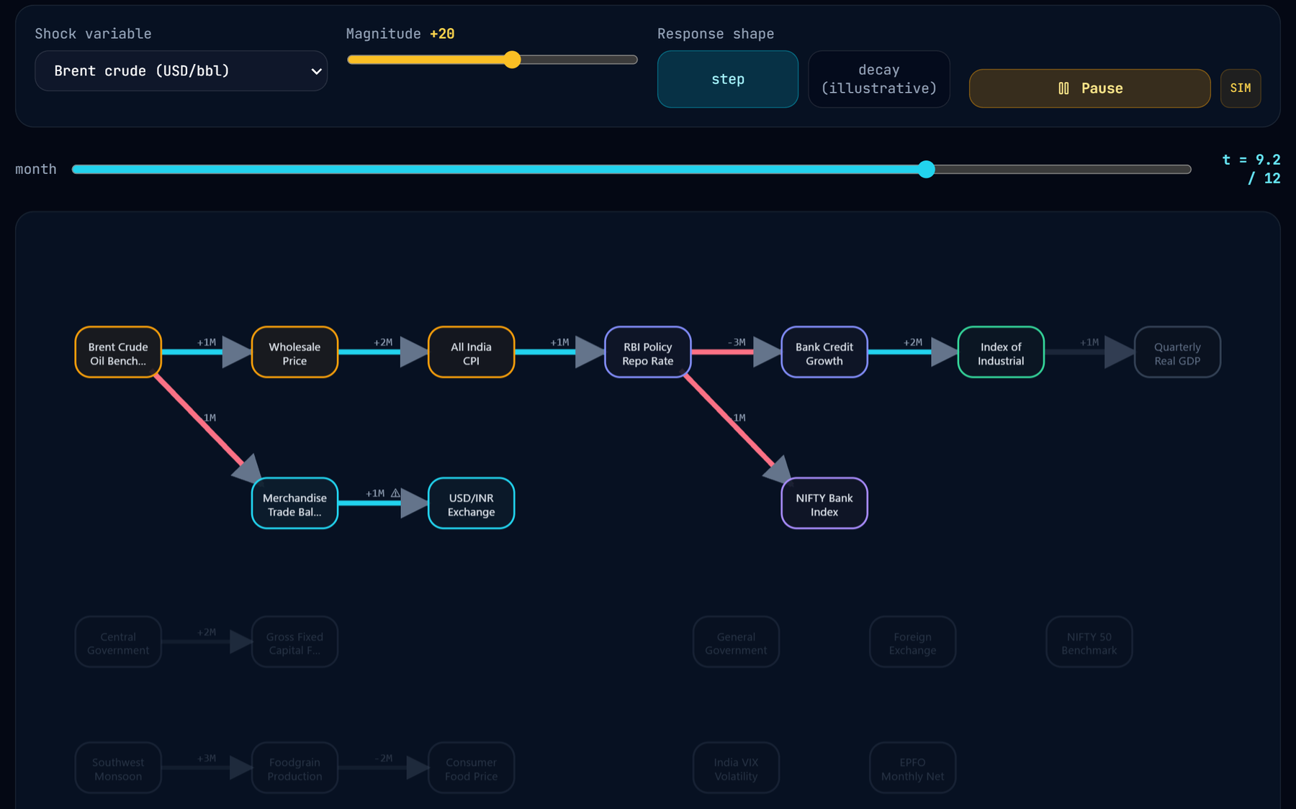
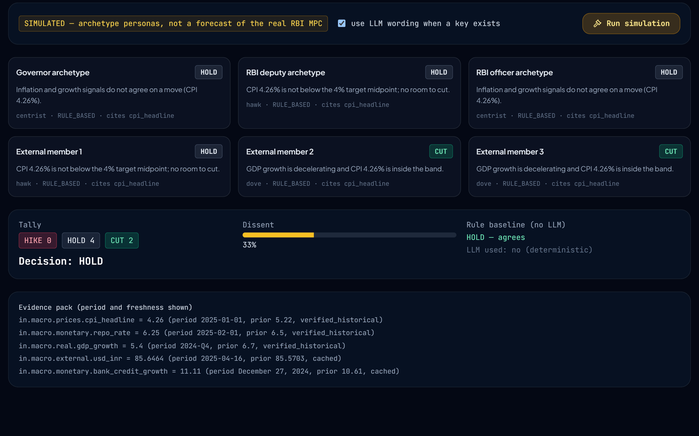
A lab that tests its own assumptions
CAUSAL LAB
Causal Lab · Shockwave · Brent crude +20
Causal Lab · MPC · rule-based mode
Path shortest route and cumulative lag
MPC six simulated seats vs a rule baseline
Shockwave month-by-month propagation, step or decay
Radar z-score anomalies, propagating or isolated
Twin base vs shocked world, weakest hop
Edge audit Granger re-test: SEEDED or EMPIRICAL
Notes:
The Causal Lab is where the platform inspects its own model, and every number in it is labelled simulated, cached or seeded. Path finds the shortest transmission route between any two indicators. Shockwave, on the left, animates a shock month by month; here it is Brent crude plus twenty. Twin compares the base and shocked worlds and attributes the attenuation to each hop. On the right, the MPC tab simulates a six-seat monetary policy committee with a deterministic rule baseline and optional LLM personas; in this run it voted four to two to hold, matching the rule. Radar flags unusual readings and asks whether connected indicators moved too. Edge audit re-tests every edge with Granger causality on live series and labels it seeded or empirical.

Slide 12

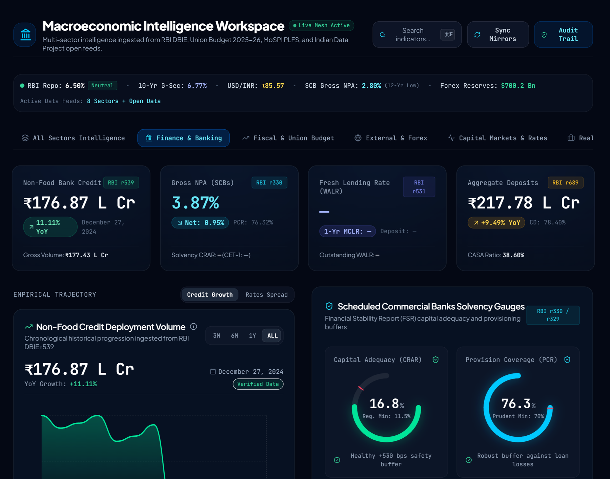
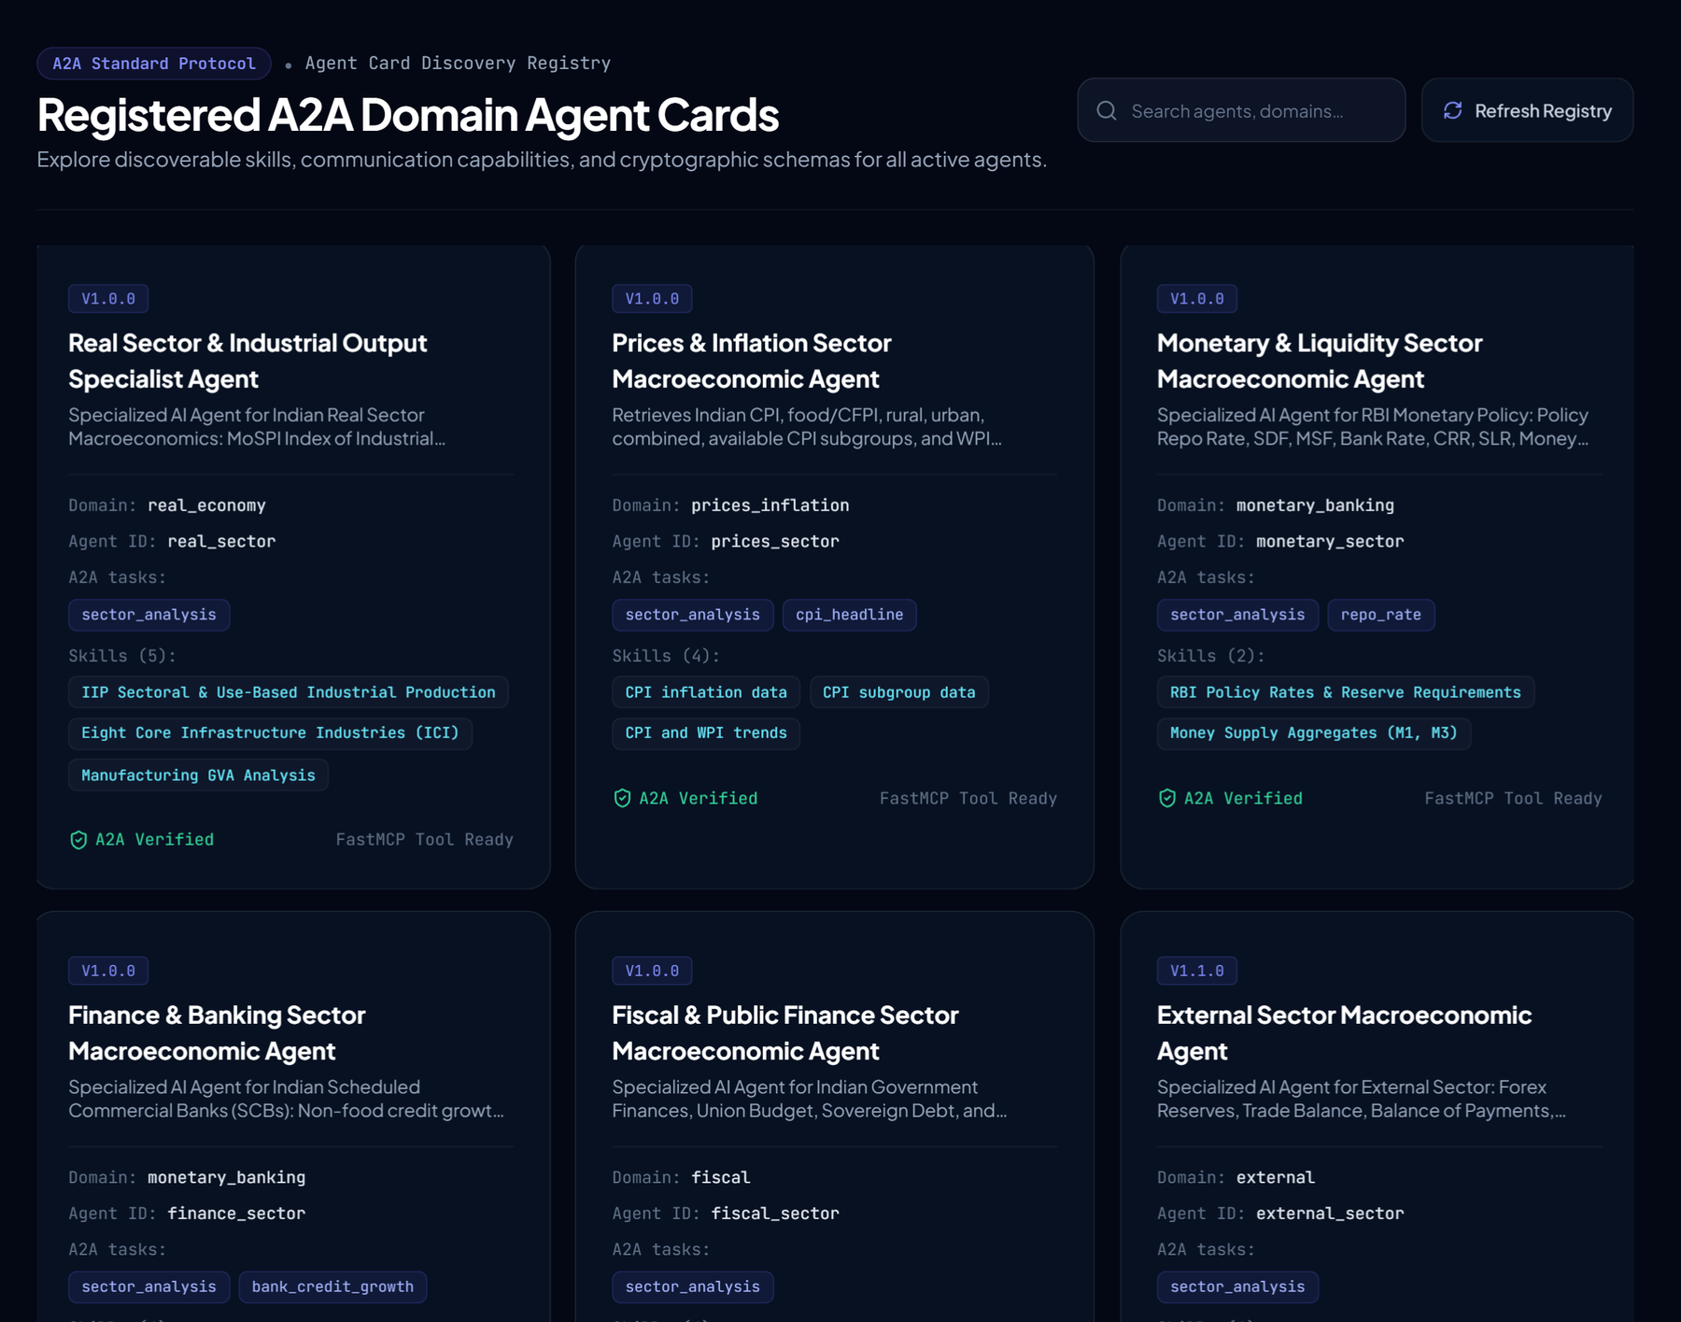
A working product, not a notebook
PRODUCT SHOWCASE
Dashboard · All sectors
Dashboard · Finance & banking
A2A agent registry
Cross-sector dashboard
Finance and banking
A2A agent registry
Live ticker, early-warning brief and sector tabs; KPIs carry their table and period.
Credit, asset quality and capital gauges from RBI DBIE tables r539, r330, r531 and r689.
Agent Cards with skills, A2A tasks and the declared peer edges between sectors.
ALSO IN THE APP Streaming chat with a live A2A trace · Evidence drawer · Knowledge-graph explorer · Google sign-in · Command palette
Notes:
This is the product, not a mock-up; these are screenshots of the running application. The dashboard combines a live ticker, an early-warning brief and sector tabs, and every KPI states the table and period it came from. The finance tab reads RBI DBIE tables directly: non-food credit, gross NPAs, capital adequacy and provision coverage. The A2A registry lists each agent's card with its skills, the tasks it answers and the peer edges it may use. The app also has a streaming chat that shows the live A2A call tree for each answer, an evidence drawer, a knowledge-graph explorer, Google sign-in and a command palette.

Slide 13


What the measurements show
RESULTS
550 / 551
≈ 11 s
test cases passed across all ten
sector suites (455 test functions)
cross-sector answer with live
official data and no LLM key
PYTEST · 12 OCT 2026
END-TO-END RUN
48.9k
0 / 12
lines of code, excluding tests:
37.6k Python and
11.3k TypeScript
causal edges testable today:
series overlap at most 2 of the
10 months required
Anomaly radar
Simulated MPC
REPOSITORY COUNT
EDGE EVIDENCE AUDIT
18 series scanned, 8 long enough
Trade balance, Aug 2024: z = −2.65
classified as isolated
HOLD by 4 to 2, dissent 0.33
matches the rule-only baseline
Notes:
Here is what we measured. The full run of all ten sector test suites passed 550 of 551 cases from 455 test functions; the one failure is a monetary-sector test that drifted from the code's source precedence, and it is logged. A cross-sector question returned a cited report with live official data in about eleven seconds, in deterministic mode with no LLM key. The code base is about 49 thousand lines. And one result is uncomfortable but important: the edge evidence audit could test none of the twelve causal edges, because the series currently available overlap for at most two months against the ten required. So the graph is a documented set of assumptions, and we report it that way. The radar scanned 18 series and found one isolated anomaly; the simulated committee held by four to two.

Slide 14





Honest limits, concrete next steps
LIMITATIONS & ROADMAP
Known limitations
Twelve-week roadmap
Seeded edge statistics
WEEKS 1–2 Credibility fixes
Confidences and p-values are curated priors; none testable yet
Wire claim verification into synthesis, fix the edge sign,
surface silent failures, repair the failing test
Heuristic scenario engine
Fixed 0.55 and 0.15 constants, unit-blind deltas, band is not a CI
WEEKS 3–6 Causal modelling
Verifier not in the answer path
Claim verification is tested, but no live answer calls it yet
Estimate edges from long series (ADF, BH-corrected Granger,
local projections); back-tested LP or BVAR scenarios
Short histories
10 of 18 radar series have fewer than 8 observations
WEEKS 5–8 Evaluation
No documentary retrieval
About 250 questions with gold answers, five baselines and
ablations; point-in-time MPC benchmark
RBI minutes and the Economic Survey are not indexed
Open cost-bearing endpoints
WEEKS 9–12 Consolidation
Chat, brief and MPC routes lack auth and rate limits
Results analysis, endpoint hardening,
documentation and a workshop paper draft
Also logged from the live run: “None%” shown for M3,
permissive agriculture routing, a misleading no-key log line.
Notes:
We are explicit about the limits. The edge statistics are priors, and none can be tested yet. The scenario engine is a heuristic with fixed constants. The claim verification library is implemented and tested but not yet connected to the answers. Many series are too short for the radar and the audit. Policy documents are not indexed, and the cost-bearing endpoints need authentication. The live run also exposed three small defects, which are logged. The roadmap addresses these in order: first credibility, wiring verification into synthesis and fixing the sign; then estimating the edges properly from long series and replacing the heuristic with local projections or a BVAR; then a real evaluation against five baselines with about 250 questions; and finally consolidation into a workshop paper.

Slide 15

Every number has an owner and a source
CONCLUSION
O1
O2
O3
O4
O5
O6
O7
Data access
Coordination
Grounded answers
Causal model
Provenance
Research tools
Interface
DELIVERED
DELIVERED
PARTLY
PARTLY
DELIVERED
PROTOTYPES
DELIVERED
Responsibility for each number lies with one agent, every number travels with its source, and missing evidence is reported openly, while the platform’s own audit shows how much of the causal reasoning still rests on assumptions.
NEXT
1 Verify every claim before it is shown
2 Estimate edges from long series
3 Benchmark against five baselines
Thank you
github.com/Hariprasaadh/macrograph-ai
Hariprasaadh K · 23BAI1061 · VIT Chennai
Questions and discussion welcome
Notes:
To conclude: five of the seven objectives are delivered, and two, grounded answers and the causal model, are partly delivered, for the reasons I have shown. The contribution is a complete, tested platform in which each number has one owner and travels with its source, and missing evidence is reported rather than invented. Its most useful result is an honest one: its own audit shows how much of the causal reasoning still rests on assumptions. The next steps are to verify every claim before it is shown, estimate the edges from long series, and benchmark the system against baselines. Thank you; I am happy to take questions, and I can show the live application.

